Slide 1
Labeling of DNA

Slide 2
Radioactivity and stable isotopes
Rate of Radioactive decay with units
Geiger-Muller Counter

Slide 3
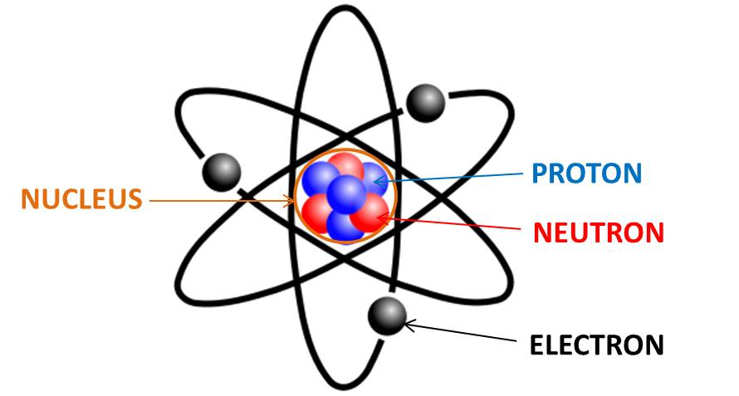
An atom is composed of positively charged nucleus that is surrounded by
negatively charged electrons.
The number of electrons is equal to the number of protons = Atomic Number
Sum of protons and neutrons present in the nucleus = Atomic mass
Strong nuclear forces holds the positive protons and neutral neutrons together
in the nucleus.
In stable nuclei, nuclear force is strong enough to hold the nucleus permanently.
Unstable nuclei (either have too many neutrons or too many protons):
These unstable nuclei balance themselves by giving off the excess protons or
neutrons. This is called radioactive decay. Unstable nuclei are radioactive and
emits radiation.

Slide 4
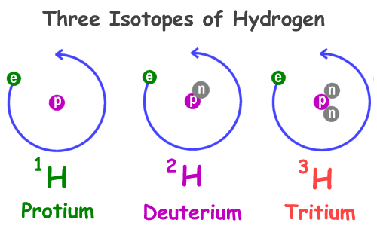
Atoms that have the same amount of protons but differs in neutrons amount are called isotopes.
For example, carbon-12, carbon-13, and carbon-14 are three isotopes of the element carbon with mass numbers 12, 13, and 14, respectively. The atomic number of carbon is 6, which means that every carbon atom has 6 protons so that the neutron numbers of
these isotopes are 6, 7, and 8 respectively.
The spontaneous degradation of nucleus & transmission of one element to
another with consequent emission of rays ( or ) particles is known as
radioactivity.

Slide 5
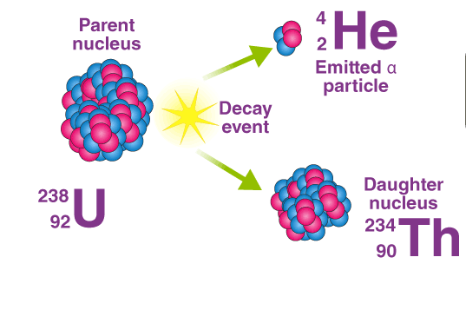
Three types of Decay:
Alpha (α) Decay or alpha radiation : Release of α particle (₂He⁴)
Parent nucleus
An alpha particle is identical to the nucleus of a normal Helium atom i.e., doubly ionized helium atom (He²⁺)
Daughter nucleus + alpha particle
When an atom emits an alpha particle in alpha decay, the atom's mass number decreases
by four .
The atomic number of the atom goes down by two, as a result of the loss of two protons
– the atom becomes a new element.

Slide 6
Beta (β⁻) Decay or beta radiation
(too many neutrons)
+
+
e ⁻
+
+
Lost high energy electron is called β particle.
Atomic mass will be same, however, atomic number will be enhanced by one.
New element is formed; one place higher in the periodic table.

Slide 7
3. Beta (β⁺) Decay or positron radiation
(too many protons)
+
+
e ⁺
+
+
+
+
+
+
Beta-plus decay (also called positron emission) occurs when a proton is converted to a neutron, and in the process, emits a positively charged electron (a positron).
A positron is a particle identical to an electron except that it has a positive charge
Atomic number decreases by one and mass number remains the same . One place lower in the periodic table.

Slide 8
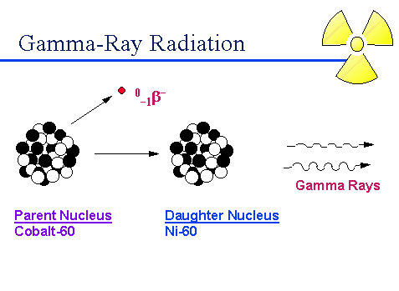
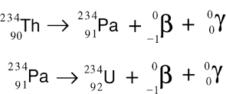
Gamma Radiation
A gamma ray is a high-energy photon emitted by a radioisotope.
Often are emitted along with alpha and beta particles.
Gamma radiation doesn’t have a positive or negative charge.
Gamma rays are similar to X-rays, but they have even greater energy.
Gamma radiation can only be stopped by a thick layer of lead or concrete.
Other examples:

Slide 9
Separating Alpha, Beta, and Gamma Particles
>Alpha and beta particles are deflected in opposite directions- alpha particles toward the negative plate and beta particles toward the positive plate.
>Gamma rays are un-deflected.
Path of the beta particle is curved more than the alpha. This is due to the mass.

Slide 10
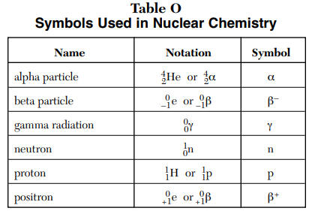

Slide 11
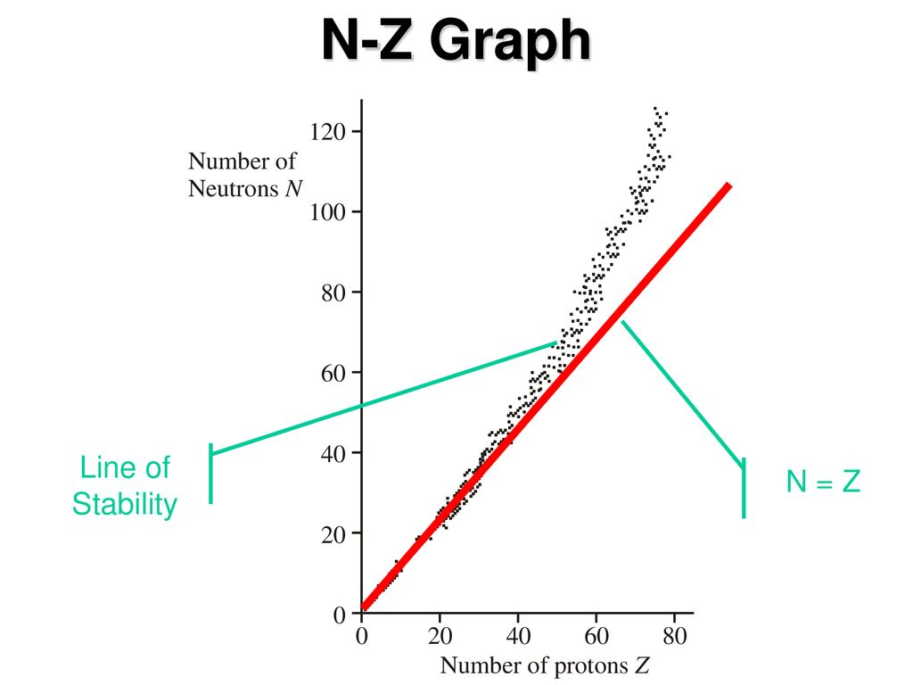
Unstable or Stable nuclei:
What type of decay likely to occur?
If a radioisotope lies left or right of
stability line, it is unstable and likely
to decay to become stable
Radioisotopes left to stability line have
too many neutrons and they are likely
to undergo beta- decay.
Radioisotopes right to stability line have
Too many protons and they are likely
To undergo beta+ decay.
High number of protons (> 82): alpha decay

Slide 12
Stable & Unstable isotopes
Unstable isotopes: Spontaneously fall apart, emitting particles and energy (radioactivity) : Radioisotopes
Stable isotopes: Remain as they are indefinitely
Hydrogen =¹H, ²H stable, ³H unstable
Carbon: ¹² C, ¹³ C stable, ¹⁴ C unstable
Oxygen: ¹⁶ O, ¹⁸ O stable, ¹⁷ O unstable
Deuterium H-2, an isotope twice as heavy as hydrogen, is predominantly used in nutrition research, Nitrogen-15 is the most common stable isotope used in agriculture.
¹³ N, ¹² N: β⁺ Release
¹⁶ N, ¹⁷ N, ¹⁸ N, ¹⁹ N, ²⁰ N, ²¹ N…..: β⁻ Release

Slide 13
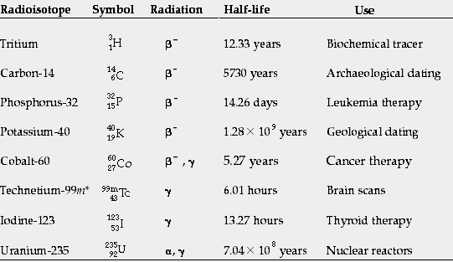
Use of Radioisotopes

Slide 14
APPLICATION OF RADIOISOTOPES IN BIOLOGICAL SCIENCES
Radioisotopes are frequently used for tracing metabolic path ways
Labeling of nucleic acids
Study of the mechanism & rate of absorption , accumulation & translocation of inorganic & organic compounds in the animal and plants.
Radiolabeled drugs are useful in pharmacokinetic studies (site of accumulation, rate of accumulation, rate of metabolism & metabolic products ).
Virtually any enzyme reaction can be assayed using radioactive tracer methods.
Radioisotopes have been used in study of the mechanism of enzyme action and also in studies of ligand binding to membrane receptors.
Radioimmuno assays are useful in analysis of hormones, growth factors, tumour markers, cytokines, bacterial antigens, vitamin D & various biological molecules.
Radioisotopes have role in management of malignancies. Tumour tissues are attacked by beam of radiation. ¹³¹I is used for treatment of thyroid cancer. ⁶⁰Co is the source of radiation.

Slide 15
The SI unit of radioactive activity is the becquerel (Bq), in honor of the scientist Henri Becquerel. One Bq is defined as one transformation, decay, or disintegration per second. Since sensible sizes of radioactive material contain many atoms, a Bq is a tiny measure of activity; amounts giving activities on the order of GBq (gigabecquerel, 1 x 10⁹ decays per second) or TBq (terabecquerel, 1 x 10¹² decays per second) are commonly used.
Another unit of radioactivity is the curie, Ci, it is equal, by definition, to the activity of any radionuclide decaying with a disintegration rate of 3.7 × 10¹⁰ Bq, so that 1 curie (Ci) = 3.7 × 10¹⁰ Bq.
Counts per minute (cpm) is a measure of radioactivity. It is the number of atoms in a given quantity of radioactive material that are detected to have decayed in one minute. Disintegrations per minute (dpm) is also a measure of radioactivity.

Slide 16
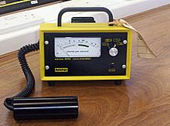
Radioactivity measurement:
Geiger-Muller counter (G-M Counter)
The Geiger Muller counter (Gas based counter) is an instrument used for measuring ionizing radiation.
It detects ionizing radiation such as alpha particles, beta particles and gamma rays using the ionization effect produced in a Geiger–Müller tube.
It is one of the best-known radiation detection instruments
Readout: Count per second
Absorbed dose

Slide 17
Radioisotopes which are commonly used in the biological research
³²P, ³³P, ¹³¹I, ³⁵S, ¹⁴C, ⁴⁵Ca, ³H

Slide 18
ATP, [γ-³²P]- 1 mCi Perkin Elmer
ATP, [γ-³²P]- 3000Ci/mmol 10mCi/ml EasyTide Lead, 250 µCi

Slide 19
Labeling and Detection
of Nucleic acid
In molecular biology, hybridization (is a phenomenon in which single-stranded deoxyribonucleic acid (DNA) or ribonucleic acid (RNA) molecules anneal to complementary DNA or RNA.
Though a double-stranded DNA sequence is generally stable under physiological conditions, changing these conditions in the laboratory (generally by raising the surrounding temperature) will cause the molecules to separate into single strands.
These strands are complementary to each other but may also be complementary to other sequences present in their surroundings. Lowering the surrounding temperature allows the single-stranded molecules to anneal or “hybridize” to each other.
Nucleic acid hybrids can be formed between two strands of DNA, two strands of RNA
or one strand of DNA and one of RNA.

Slide 20
Nucleic acid hybridization with a labeled probe is the only way to detect a complementary target sequence in a complex nucleic acid mixture.
Nucleic acid probes are oligonucleotides or polynucleotides that can bind with high specificity to complementary sequences.
Probes can be complementary to either DNA or RNA and can be from as few as 20 nt to hundreds of nt long.
DNA probes
RNA probes
Oligonucleotide probes

Slide 21
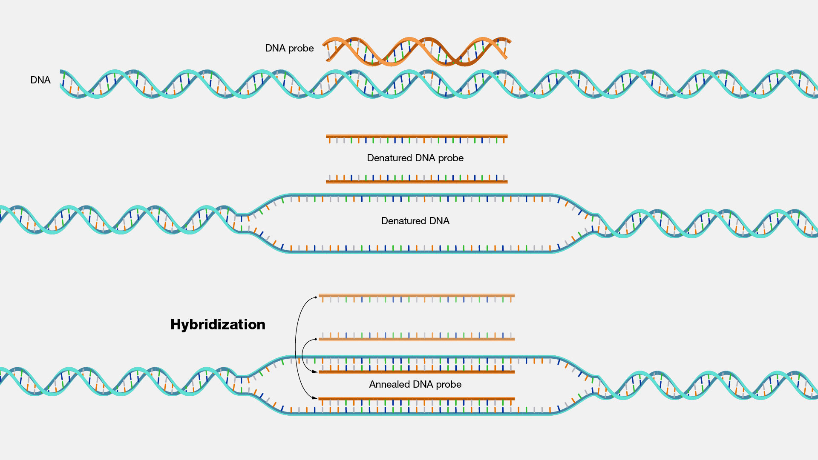

Slide 23
Oligonucleotide probes are short stretches of single-stranded DNA or RNA used to detect the presence of complementary nucleic acid sequences (target sequences) by hybridization.
In molecular biology, a nucleic acid probe is a fragment of DNA or RNA which can be radioactively or fluorescently labeled. These probes can be used to detect the presence of nucleotide sequences in analyzed RNA or DNA that are complementary to the sequence in the probe.
The labeled probe is first denatured (by heating or under alkaline conditions such as exposure to sodium hydroxide) into single stranded DNA (ssDNA) and then hybridized to the target ssDNA (Southern blotting) or RNA (northern blotting) immobilized on a membrane or in situ.

Slide 24
DNA probes
DS OR SS
RNA probes
SS
Oligonucleotide probes
SS
Heterologous Probe: Probe that is similar, but not exactly the
same
Mouse probe can be used to search a human genomic library.
2. Homologous: Probe that is exactly complementary to the nucleic acid sequence of interest

Slide 25
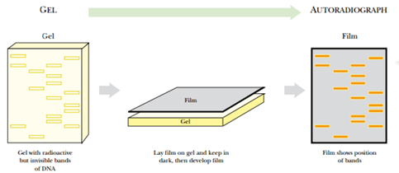
The labeling with radioisotopes or radioactive isotopes is called radiolabelling.
Autoradiography

Slide 26
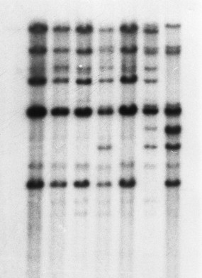
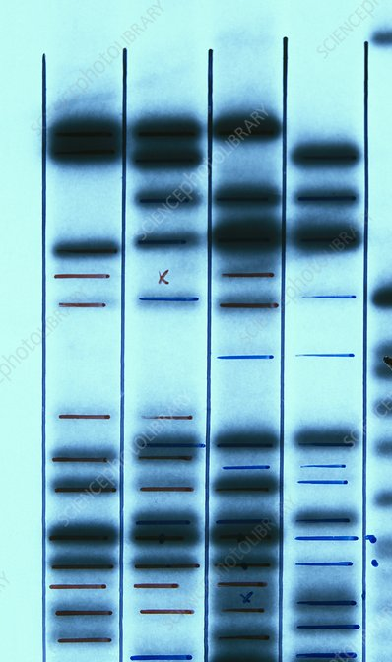
Autoradiography

Slide 27
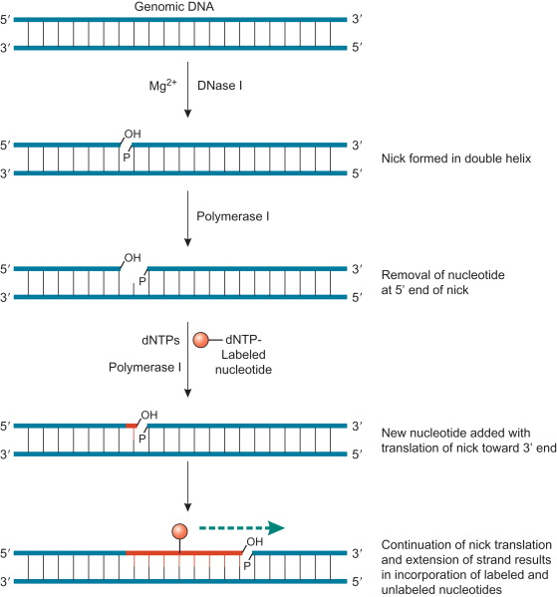
Label Location
There are two ways to label a DNA molecule –
by the ends (end labeling) OR all along the molecule (uniform labeling)
Uniform labeling:
A. Nick translation
The endonuclease DNase I is used to
create nicks at random sites in the strand
of double stranded target DNA
DNA polymerase I is used to add nucleotide residues to the free 3’-hydroxyl ends created during the DNase I nicking process.
As the DNA polymerase I extends the 3’-end, the 5’- to 3’ exonulecase activity of the enzyme simultaneously removes bases from the 5’-end of the nick.
Sequential addition of bases on to 3’-end with the simultaneous removal of bases from the 5’-end results in translation of the nick
Along the DNA molecule.
DNA ligase

Slide 28
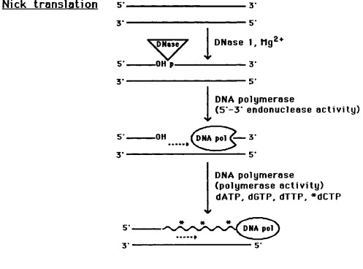
exo

Slide 29
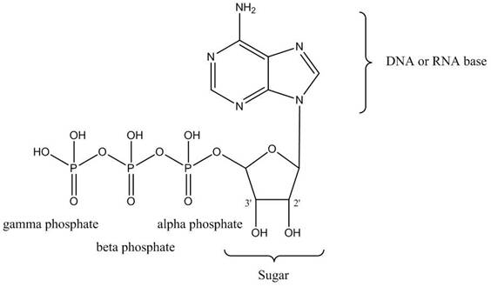
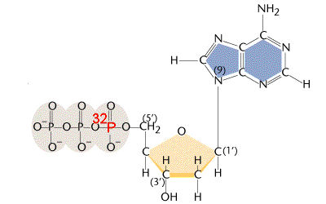
Pancreatic DNase I
E. coli DNA polymerase I
DNA ligase
When performed in the presence of a radioactive ([α-³²P]dNTP the newly synthesized
strand becomes radioactivity labeled.

Slide 30
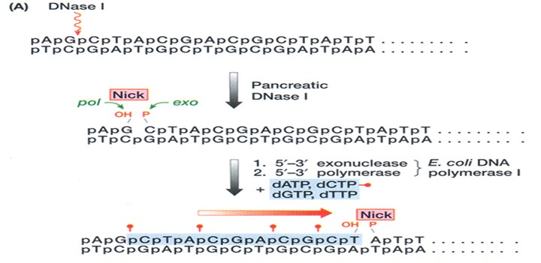
Nick Translation: Radioactive Phosphate Position

Slide 31
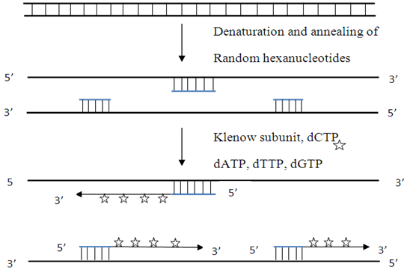
B. Random priming:
This is an alternative method for
preparing uniformly labeled DNA is by oligo-nucleotide –primed
DNA synthesis with hexanucleotide (or longer oligomers) of
random sequences
The klenow fragment is used as this
enzyme lacks the 5’-3’ exonuclease
activity of DNA Polymerase I.
It fills gaps between adjacent primers.
Labeled nucleotides are incorporated
Into new DNA that is synthesized.

Slide 33
Catalyzed by

Slide 35
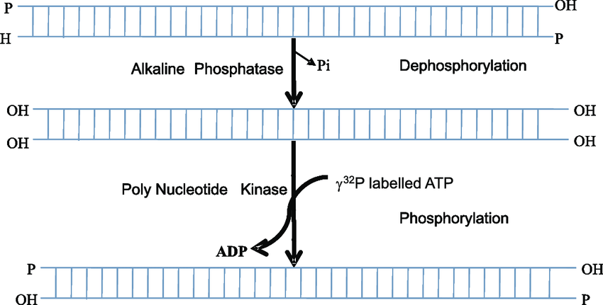
B. 5’-end labeling
Alkaline Phosphatase
T4 polynucleotide Kinase
O

Slide 36
5'-end labeling for DNA we use gamma P, but it is alpha that is used at the 3' end?

Slide 37
MCQ
Nucleic acids are readily labeled with tags that facilitate detection or purification. Which of the following components are required for the 3’- end labeling of DNA with radioactive phosphorous?
(A) Terminal deoxynucleotidyl transferase and (gamma) γ – ³²P dNTP
(B) Polynucleotide kinase and (gamma) γ – ³²P dNTP
(C) Terminal deoxynucleotidyl transferase and (alpha) α – ³²P dNTP
(D) Polynucleotide kinase and (alpha) α – ³²P dNTP

