Slide 1
Unit V
DNA sequencing
DNA sequencing is the process of determining the nucleic acid sequence – the order of nucleotides in DNA. It includes any method or technology that is used to determine the order of the four bases: adenine, guanine, cytosine, and thymine.
The rapid speed of sequencing attained with modern DNA sequencing technology has been instrumental in the sequencing of complete DNA sequences, or genomes, of numerous types and species of life, including the human genome and other complete DNA sequences of many animal, plant, and microbial species.

Slide 2
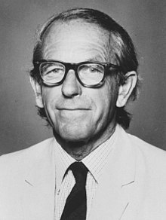
Frederick Sanger, a pioneer of sequencing. Sanger is one of the few scientists who was awarded two Nobel prizes, one for the sequencing of proteins, and the other for the sequencing of DNA.

Slide 3
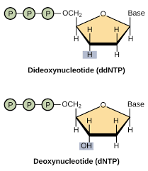
Enzymatic Chain Termination Method
(Sanger sequencing or dideoxy method)
Developed by Sanger and coworkers in 1977.
This method is based on the DNA polymerase dependent synthesis of a complementary
DNA strand in the presence of dNTPs and dideoxynucleotides (ddNTPs) that serve
as terminators.
The DNA synthesis reaction is randomly terminated whenever a ddNTP is added in the
Growing oligonucleotide chain, resulting a truncated products of varying lengths with
an appropriate ddNTP at their 3’-terminus.
The products are separated by using capillary gel electrophoresis and its terminal ddNTPs
are used to reveal the DNA sequence of the strand.

Slide 4
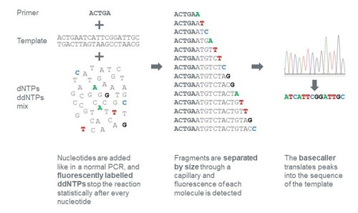

Slide 6
Nowadays, Sanger sequencing is usually automated. Automated sequencing instruments combine sequencing with fluorescently labeled primers or dideoxy chain terminators with polyacrylamide gel electrophoresis and computer data capture.

Slide 7
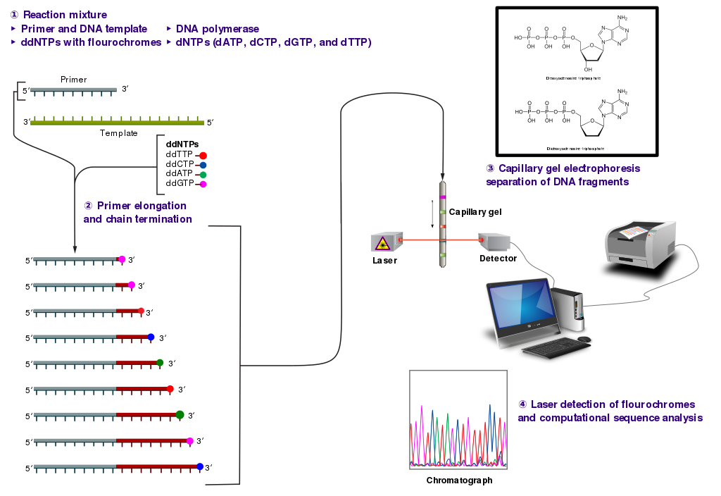

Slide 8
Sanger DNA sequencing is widely used for research purposes like:
Targeting smaller genomic regions in a larger number of samples
Sequencing of variable regions
Validating results from next-generation sequencing (NGS) studies
Verifying plasmid sequences, inserts, mutations
HLA typing
Genotyping of microsatellite markers
Identifying single disease-causing genetic variants

Slide 9
Maxam–Gilbert sequencing
Maxam–Gilbert sequencing is a method of DNA sequencing developed by Allan Maxam and Walter Gilbert in 1976–1977. This method is based on nucleobase-specific partial chemical modification of DNA and subsequent cleavage of the DNA backbone at sites adjacent to the modified nucleotides.
Maxam-Gilbert sequencing requires radioactive labeling at one 5' end of the DNA and purification of the DNA fragment to be sequenced. Chemical treatment then generates breaks at a small proportion of one or two of the four nucleotide bases in each of four reactions (G, A+G, C, C+T). The concentration of the modifying chemicals is controlled to introduce on average one modification per DNA molecule. Thus a series of labeled fragments is generated, from the radiolabeled end to the first "cut" site in each molecule. The fragments in the four reactions are electrophoresed side by side in denaturing acrylamide gels for size separation. To visualize the fragments, the gel is exposed to X-ray film for autoradiography, yielding a series of dark bands each corresponding to a radiolabeled DNA fragment, from which the sequence may be inferred.

Slide 10
4 different chemicals cleave DNA at four different positions; hydrazine and hydrazine NaCl selectively attack pyrimidine nucleotides while dimethyl sulfate and piperidine attack purine nucleotides. Take a look at the chemistry here.
Hydrazine: T + C
Hydrazine NaCl: C
Dimethyl sulfate: A + G
Piperidine: G
Denatured DNA of equal volume is added to 4 separate tubes containing these 4 different chemicals. Afterward, sample incubation is performed followed by gel electrophoresis using PAGE- polyacrylamide gel electrophoresis.
The results of chemical cleavage are shown in the illustration given below. To enable visualization autoradiography analysis is carried out. The presence of 32P on the DNA allows us to determine fragments generated by the cleavage.

Slide 11
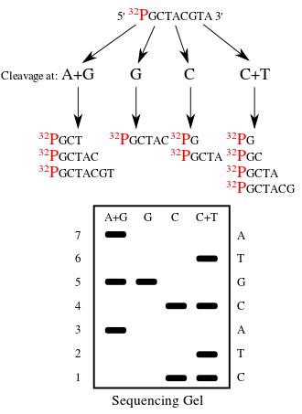

Slide 12
The first full DNA genome to be sequenced was that of bacteriophage φX174 in 1977.
In 1995, Venter, Hamilton Smith, and colleagues at The Institute for Genomic Research (TIGR) published the first complete genome of a free-living organism, the bacterium Haemophilus influenzae.

