Slide 1
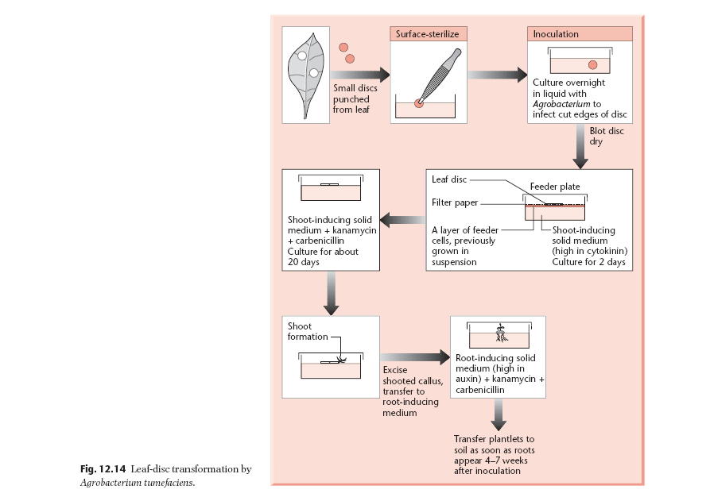
A simple experimental procedure for Agrobacterium-mediated transformation

Slide 2
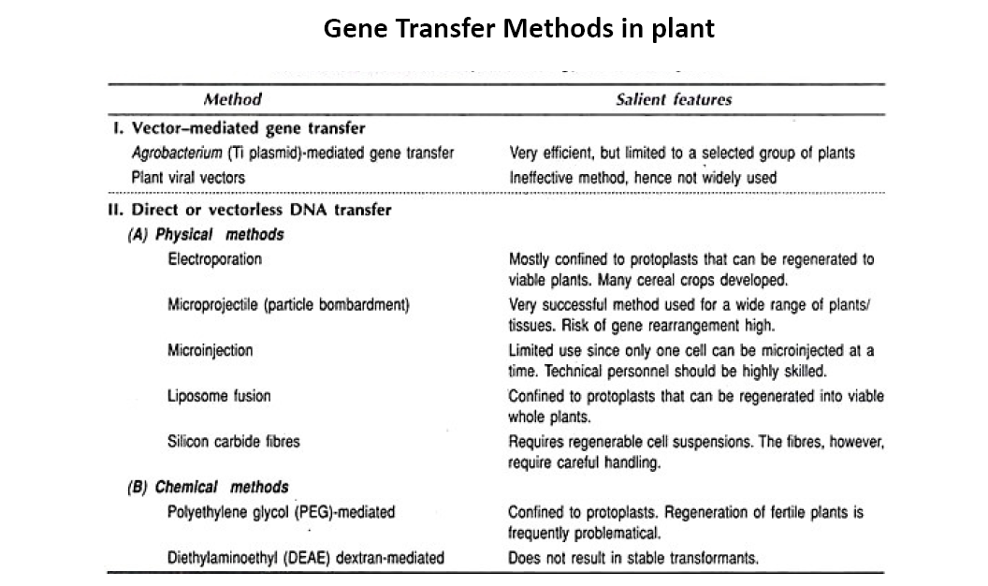

Slide 3
Transgenic Plants
Transgenic plants are those plants, which carry additional, stably integrated and expressed foreign gene from trans species.
A genetically modified organism (GMO) is an animal, plant, or microbe whose DNA has been altered using genetic engineering techniques.
The key difference between GMO and transgenic organism is that GMO is an organism that has an artificially altered genome, while the transgenic organism is a GMO that has an altered genome containing a DNA sequence or gene from a different species.
The combined use of RDT, GENE TRANSFER METHODS AND TISSUE CULTURE TECHNIQUES LED to the production of Transgenic Plants.

Slide 4
Transgenic Plants: Applications
In 1982, the first transgenic plants were produced in tobacco plants (Nicotiana tabacum)
Bt Cotton – India's First Transgenic Crop.

Slide 5
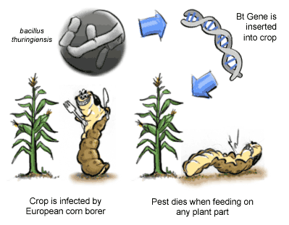
Transgenic Plants: Applications
In 1982, the first transgenic plants were produced in tobacco plants (Nicotiana tabacum)
Bt Cotton – India's First Transgenic Crop.
1. Development of Insect, virus and herbicide resistant plants
a. Insect resistant plants:
Bacillus thuringiensis (or Bt)
Delta endotoxin (Cry I, II, III, ETC.)

Slide 6
b. Virus resistant plants:
Coat Protein mediated Resistance
Movement Protein mediated resistance
Tobacco, Potato, Tomato, etc.
c. Herbicidal Resistance:
Glyphosate kills plants by interfering with the synthesis of the essential amino acids phenylalanine, tyrosine and tryptophan. These amino acids are called "essential" because animals cannot make them; only plants and micro-organisms can make them and animals obtain them by eating plants.
It inhibits EPSP synthase 5-enolpyruvylshikimate-3-phosphate (EPSP) synthase: Aromatic Amino Acids biosynthesis in plants

Slide 7
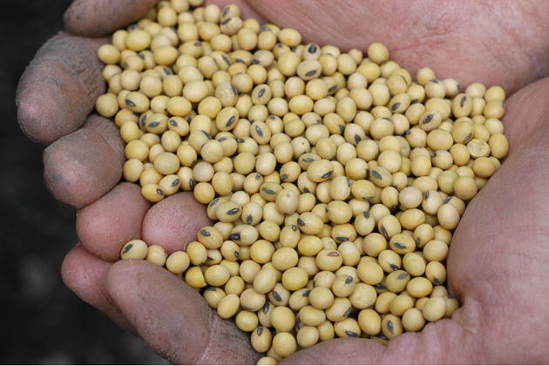
Resistance towards Glyphosate (Roundup)
Two Approaches:
Overproduction of EPSP Synthase
Expression of Mutant version of EPSP Synthase
Example:
Roundup Ready soybean
Roundup Ready Soybeans (RR soybeans) are genetically engineered soybeans that have had their DNA altered to allow them to withstand the herbicide glyphosate (the active ingredient in Monsanto's herbicide Roundup). They are also known as "glyphosate tolerant" soybeans.

Slide 8
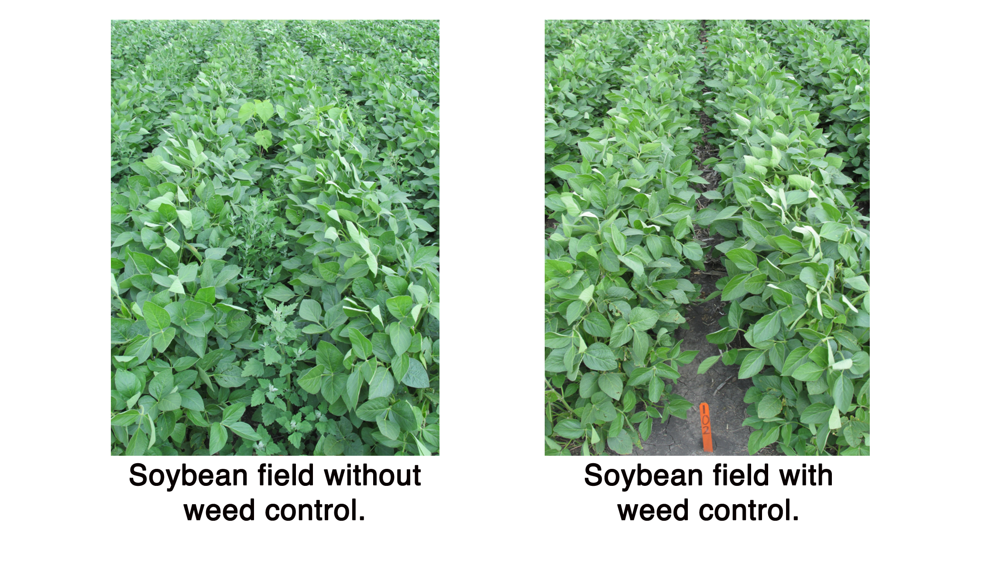

Slide 9
2. Development of Stress tolerant plants
Stress-tolerant plants establish a new metabolic homeostasis in response to stress and thereby can continue to grow without suffering stress-induced injury.
Transgenic plants with improved salt and drought stress tolerance have been developed with a large number of abiotic stress-related genes.
Among these, the most extensively used genes are the glycine betaine biosynthetic codA, the DREB (dehydration-responsive element-binding protein) transcription factors, and vacuolar membrane Na⁺/H⁺ antiporters.

Slide 10
Glycine Betaine and the codA Gene
Glycine betaine (GB) is one of the most important osmoprotectants that provides protection to vital cellular organelles during plant adaptation to abiotic stress.
The protective role of GB has been demonstrated in a number of transgenic plants engineered with genes involved in various biosynthetic pathways of GB
B. DREB-Transgenic Plants
DREB genes encode transcription factors which act as master switches to regulate the expression of many down-stream abiotic stress tolerance-responsive genes
C. Na⁺/H⁺ Antiporter Genes in GM Plants / NHX1
In the wake of increasing soil and water salinization, the role of Na⁺/H⁺ antiporters is of tremendous importance. Over the last several years, transgenic plants with expression of antiporter genes demonstrated improved salt tolerance

Slide 11
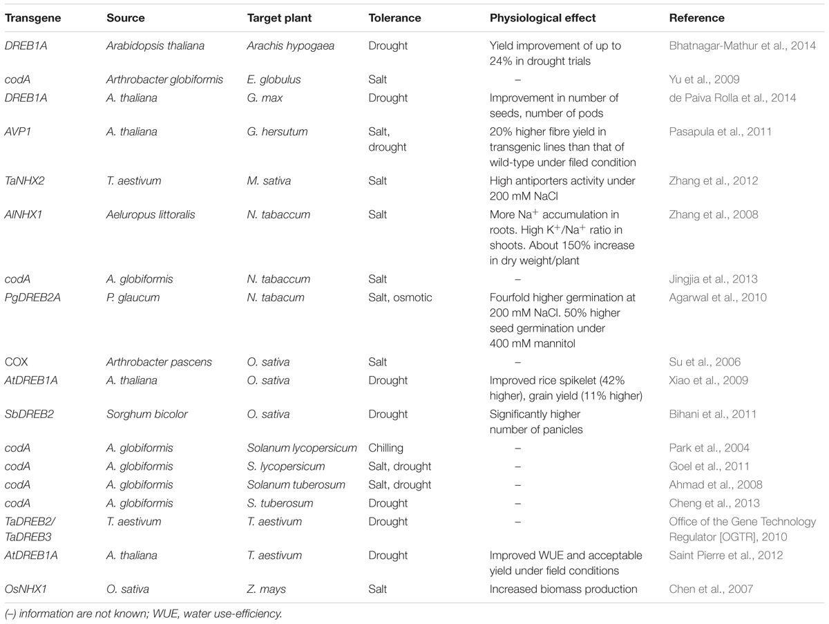

Slide 12
High temperature tolerance in transgenic plants has largely been achieved either by over-expressing heat shock protein genes or by altering levels of heat shock factors that regulate expression of heat shock and non-heat shock genes
Submergence resistance
While rice grows in water, it cannot survive floods which in 2010 led to loss of 4 millions of tons of rice in India and Bangladesh alone.
Addition of a single gene Sub1A was sufficient to allow rice to survive underwater for up to two weeks. The gene is in the public domain.
Sub1A is an ethylene-response-factor-like gene that confers submergence tolerance to rice.
Submergence tolerance is defined as the ability of a rice plant to survive and continue growing after being completely submerged in water for several days.

Slide 13
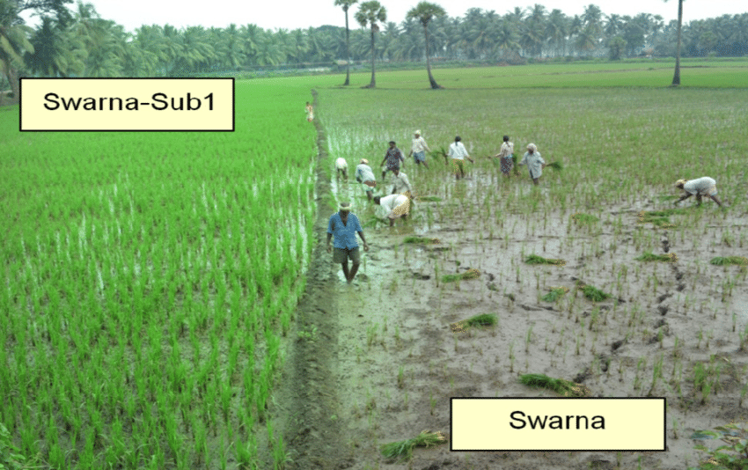

Slide 14
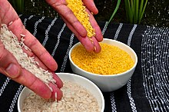
3. Modification of plant nutritional content like amino acid, lipid, vitamin and iron.
a. Golden Rice is a variety of rice (Oryza sativa) produced through genetic engineering to biosynthesize beta-carotene, a precursor of vitamin A, in the edible parts of the rice.

Slide 15
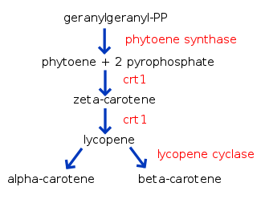
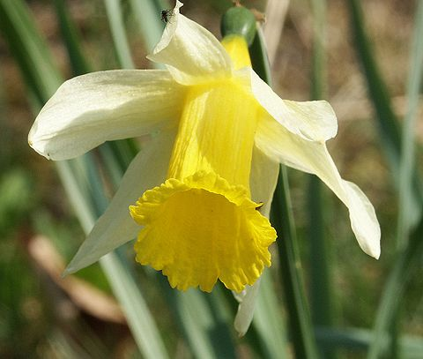
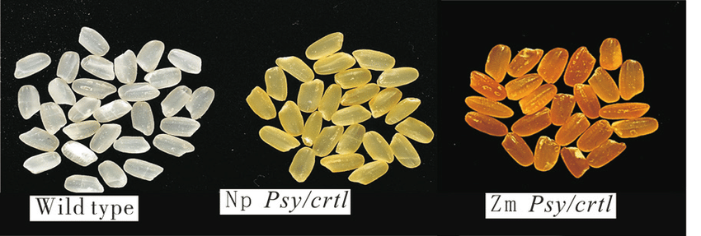
carotenoid biosynthesis pathway in golden rice. The enzymes expressed in the endosperm of golden rice, shown in red, catalyse the biosyntheis of beta-carotene from geranylgeranyl diphosphate. Beta-carotene is assumed to be converted to retinal and subsequently retinol (vitamin A) in the animal gut
Golden rice was created by transforming rice with two beta-carotene biosynthesis genes:
1. psy (phytoene synthase) from daffodil (Narcissus pseudonarcissus)
2. crtI (phytoene desaturase) from the soil bacterium Erwinia uredovora
(The insertion of a lcy (lycopene cyclase) gene was thought to be needed, but further research showed it is already produced in wild-type rice endosperm.)
Golden Rice 2

Slide 16
> The first transgenic approach to increase Fe concentration in rice seeds is the enhancement of Fe accumulation in rice seeds by ferritin gene expression under the control of endosperm-specific promoters.
> Among the essential amino acids, Lys, Trp, and Met have received the most attention because they are most limiting in cereals (particularly Lys and Trp) and legumes crops (particularly Met), which represent the major sources of human food and animal feed worldwide.
> Soybean GmMYB73 promotes lipid accumulation in transgenic plants
Jatropha Seed lipid enhancement
Biofuel development in India centers mainly around the cultivation and processing of Jatropha plant seeds which are very rich in oil (40%).

Slide 17
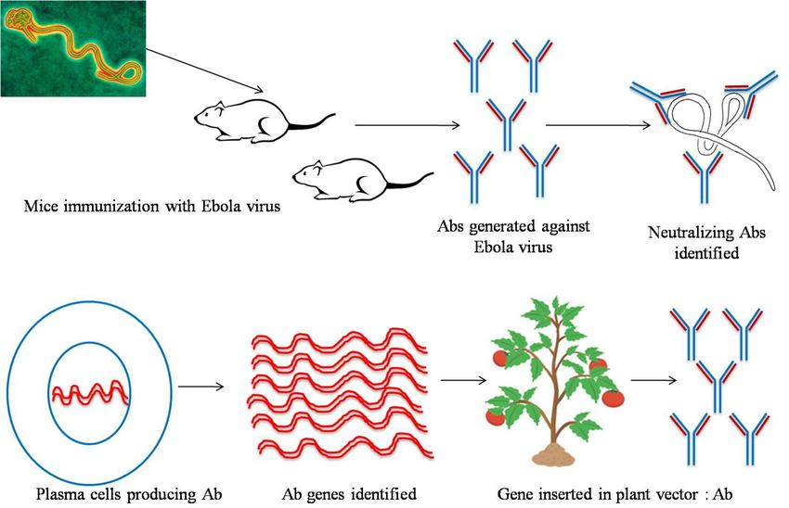
4. Plants as bioreactor for production of antibodies
A plantibody is an antibody that is produced by plants that have been genetically engineered with animal DNA encoding a specific human antibody known to neutralize a particular pathogen or toxin.
Plants are easy to grow and can generate considerable biomass.
Plantibodies: to immunosupressed person.

Slide 18
5. Synthesis of edible vaccines
Edible vaccines are nothing but transgenic plant and animal-based production of or those contain agents that trigger an animal's immune response. In simple, plant or animal-made pharmaceuticals are edible vaccines.
>As a part of fruit and vegetables
>Not required production facilities, purification, sterilization, packaging or
Specialized delivery system
The gene encoding for the orally active antigenic protein is isolated from the
Pathogen, and a suitable construct for constitutive or tissue-specific expression
of the gene is prepared.
Edible vaccines for measles, cholera, foot and mouth disease, and hepatitis B, C, & E
are available.
Plantibodies can be given to immunosupressed person.
Difference between plantiobodies and edible vaccine???

Slide 19
Concerns:
Dosage
Degradation of protein components in the stomach

Slide 20
6. Plants as bioreactor for production of other therapeutic agents
Therapeutic protein production in plants is an area of great potential for increasing and improving the production of proteins for the treatment or prevention of disease in humans and other animals.
Human protein C (ANTICOAGULANT)
Human hirudin variant 2 (ANTICOAGULANT)
Hunan erythropoietin (Anemia)
Human alpha interferon (hepatitis C and B)
Human growth hormone (Dwarfism)

Slide 21
6. Delayed ripening
Genetic engineering is used to delay ripening in fruits.
Polygalacturonase: Slow breakdown of the polygalacturonic acid, a component
of cell walls in the fruit peri-carp.
Longer the enzyme: over-ripe of the fruit
Tomatoes have been engineered so that express less of the polygalcturonase
Enzyme.
This was achieved by antisense technology.
Expression of the antisense copy of the gene led to the less amount of the
enzyme

Slide 22
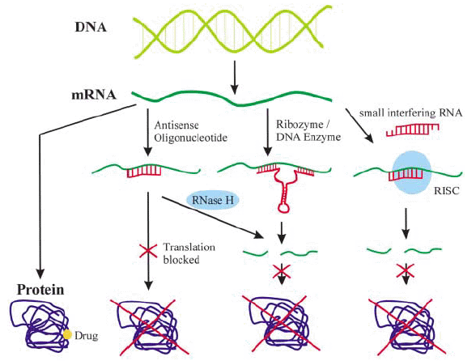
Antisense Technology
Antisense technology is a new and promising tool for controlling gene expression in a cell. Using synthetic antisense oligonucleotides, it targets genes at the level of mRNA, rather than DNA, and prevents them from producing proteins.
RISC:
RNA-induced silencing complex

Slide 23
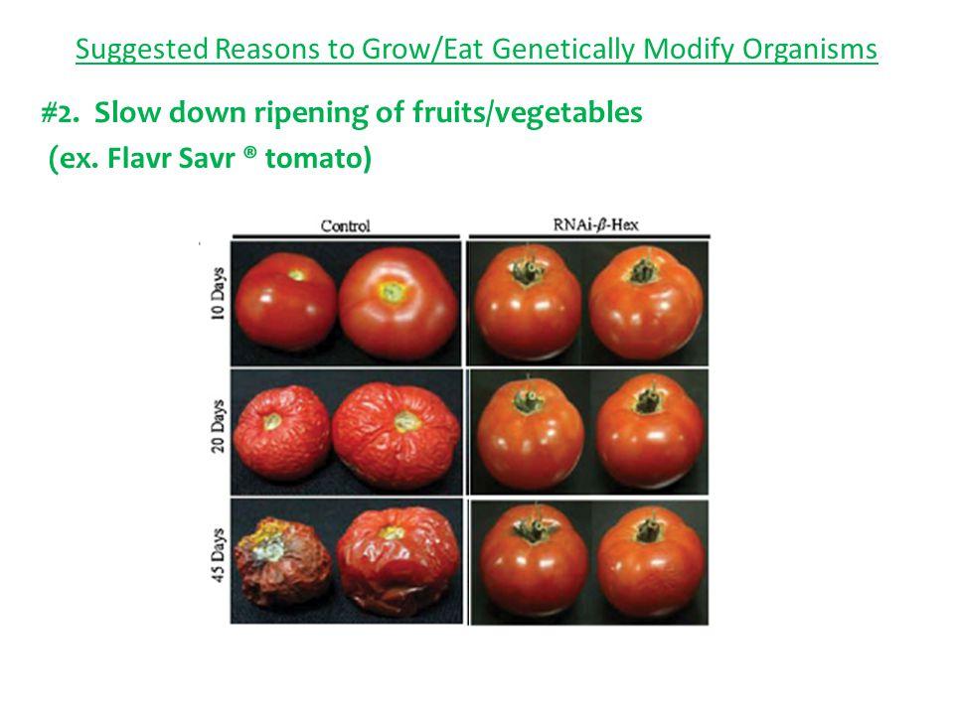
Tomato Name: Flavr Savr
Longer shelf life
Enhanced flavor
Delayed ripening

Slide 24
7. Production of bio-plastics
Alcaligenes eutrophus produce polyhydroxybutyrate (PHB), a biodegradable and renewable biopolymer
A gene from this bacterium that are responsible for the biosynthesis of PHB
Is being transferred to plant for production of biodegradable plastic.

Slide 25
Molecular Farming
Molecular farming is the production of pharmaceutically important and commercially valuable proteins in plants. Its purpose is to provide a safe and inexpensive means for the mass production of recombinant pharmaceutical proteins.
Antibodies
Blood Products
Cytokines
Growth factors
Hormones
Recombinant enzymes
Human/Veterinary Vaccines
Therapeutic compounds so produced are also known as biopharmaceuticals
(pharmaceuticals from biological organisms)

