Slide 1
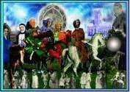
The Canterbury Tales
by Geoffrey Chaucer Source: Taken from open sources

Slide 2
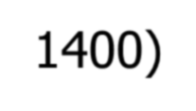
Geoffrey Chaucer (1340-1400)
Dominant literary figure in the 14th century
“Father of English Literature”
Life experiences
--child of wealthy wine merchant
--page in a royal household
--spoke French, Latin, & Italian
--Soldier & diplomat
--member of Parliament Chaucer

Slide 3
Division of Chaucer’s Work
Chaucer’s work are divided into three periods:
French Period: Romaunt of the Rose, The Book of the Duchess, The Parliament of Fowls.
Italian Period: Troilus and Criseyde, The House of Fame, Legend of Good Women.
English Period: The Canturbury Tales
“Chaucer found his native tongue a dialect and left it a language”- Lowell
Chaucer first introduced Rhyme royal and Heroic Couplet in Troilus and Criseyde and The Canturbury Tales respectively.

Slide 4
Geoffrey Chaucer and The Canterbury Tales (cont.)
Went against tradition when he wrote in Middle English (East Mid Dialect) rather than French.
Considered “Father of the English Language” because he went against the norm and chose to write in the language of the people
planned many more tales, but did not complete the proposed 120 tales before his death
wrote about all classes in The Canterbury Tales to give us a glimpse of English society at the time
Old English: form of German spoken by Saxons before
Norman Conquest in 1066.
Early Modern English: Latin and French spoken

Slide 5
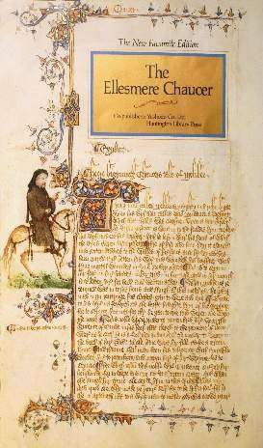
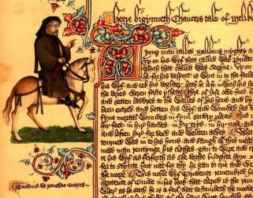
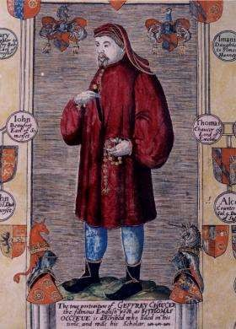
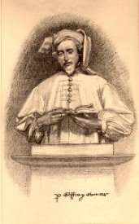
Chaucer Images

Slide 6
The Middle Ages
Background
Hierarchy – Class Structure During Chaucer’s Time
Nobility/Ruling Class -
Knight and Squire
Clergy - Monk, Friar, Prioress, Parson, Summoner, Pardoner
Middle Class – Merchant, Doctor, Student, Wife of Bath
Peasants – Miller,
Plowman, Skipper

Slide 7
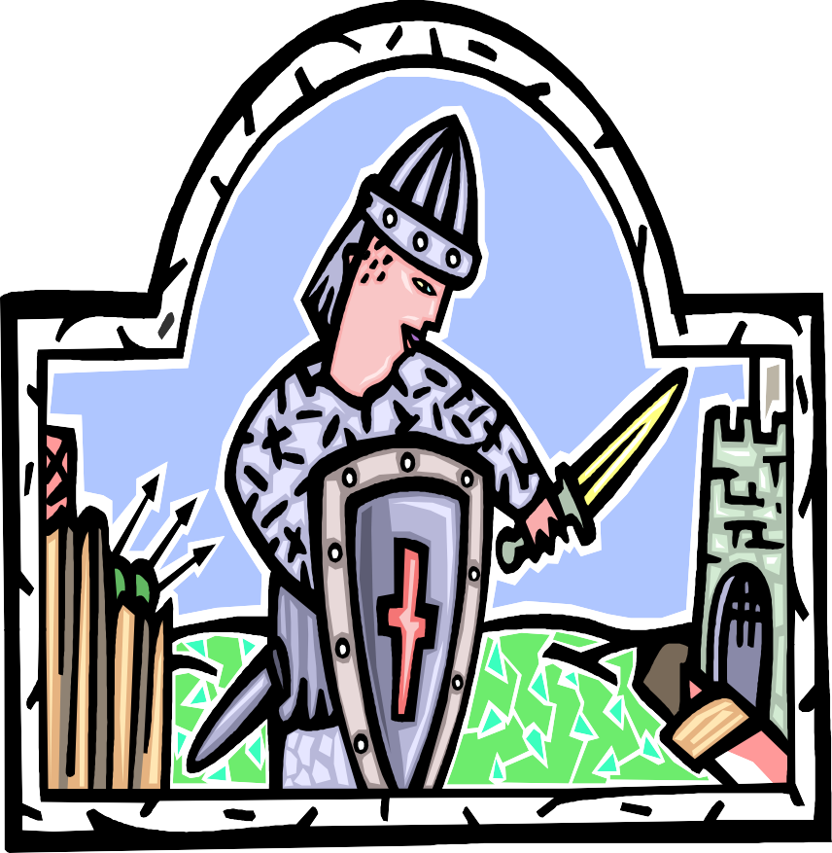
Code of Chivalry
A knight must be:
True to his God and a defender of the faith.
True and loyal to his lord and king.
True to his lady.
Humble and modest in daily actions.
Brave and fierce in war and adversity.

Slide 8
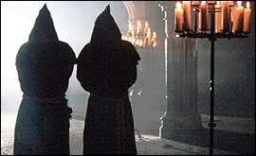
Code of the Clergy
A member of the clergy must:
Be chaste and pure.
Be devoted to God.
Obey God and Biblical law.
Take vows of poverty.
Achieve heavenly reward through earthly denial.

Slide 9
Seven Deadly Sins
Gluttony
Avarice / Greed
Sloth
Lust
Vanity
Pride
Anger

Slide 10
Moral Virtues (opposite of sins)
Moderation
Generosity
Diligence
Love
Modesty
Humility
Forgiveness

Slide 11
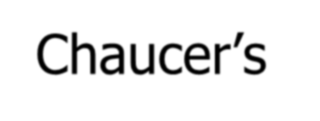
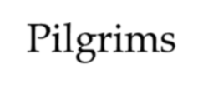
Chaucer’s Canterbury Tales
Takes representatives of English society on a pilgrimage to Canterbury Cathedral (Shrine of Archbishop Thomas Becket)
Pilgrims—each has speech and tale that matches a real person during his (Chaucer’s) time

Slide 12
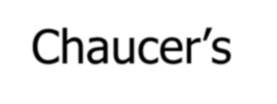
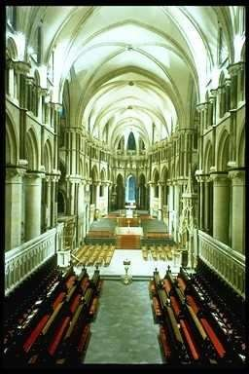
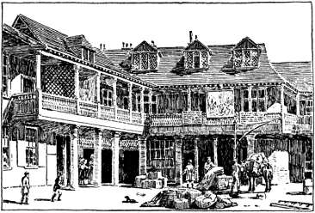
Chaucer’s Canterbury Tales (cont.)
30 characters representing all social classes
--Although fictional, does have realistic settings and occupations
*Tabard Inn
*Canterbury & Canterbury Cathedral
*Shrine of Thomas Becket

Slide 13
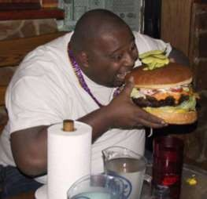
The Prologue
Thirty pilgrims are on their way to
Canterbury to pay homage at Becket’s tomb.
Each agrees to tell two tales on the way to the shrine and two tales back.
The winner will receive a supper paid for by all.

Slide 14
List of 30 Pilgrims
Narrator – line 20
Knight – line 43
Squire – line 81
Yeoman – line 103
Prioress (+ 3) – line 122
Monk – line 169
Friar – line 212
Merchant – line 280
Oxford Cleric – line 295
Serjeant at Law – line 319
Franklin – line 341
Guildsmen – (Haberdasher, Dyer, Carpenter, Weaver, Carpet-Maker) - line 371
Cook – line 390
Skipper – line 398
Doctor – line 421
Wife of Bath – line 455
Parson – line 488
Plowman – line 539
Miller – line 561
Manciple – line 585
Reeve – line 605
Summoner - line 641
Pardoner – line 689

Slide 15
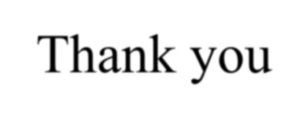
Thank you

