Slide 1
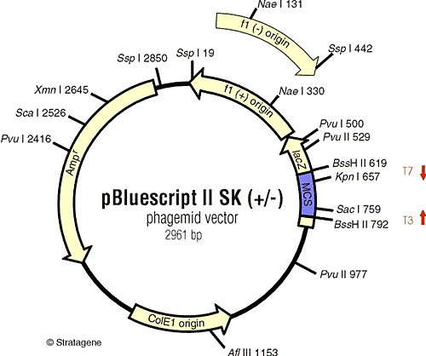
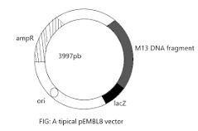
Many vectors combine elements from both plasmids and phages and are known as phasmids or, if they contain an M13 ori region, phagemids.
1. Phagemid vectors are plasmids having a small segment of a filamentous phage M-13, fd, or F1 phage capable to carry up to 10 kb passenger DNA. Examples: pEMBL series of plasmids and pBluescript family plasmids.

Slide 2
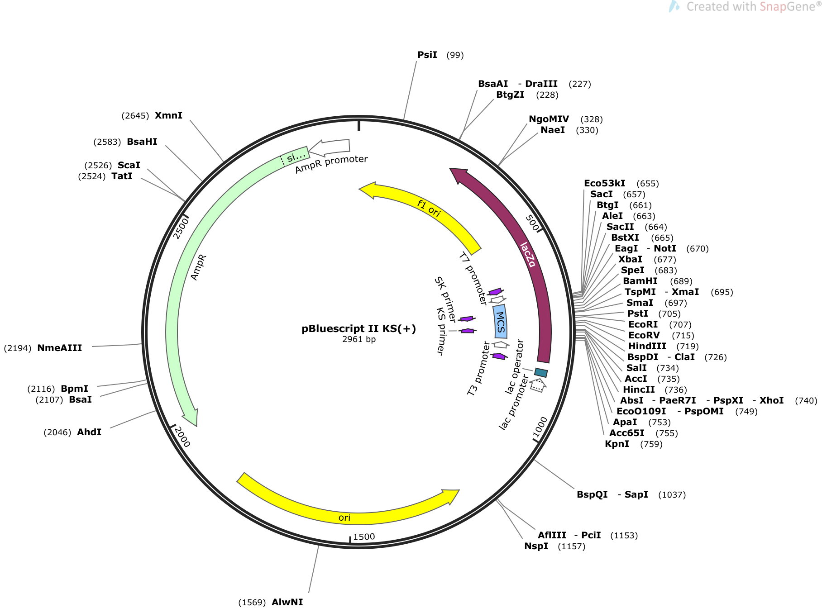

Slide 3
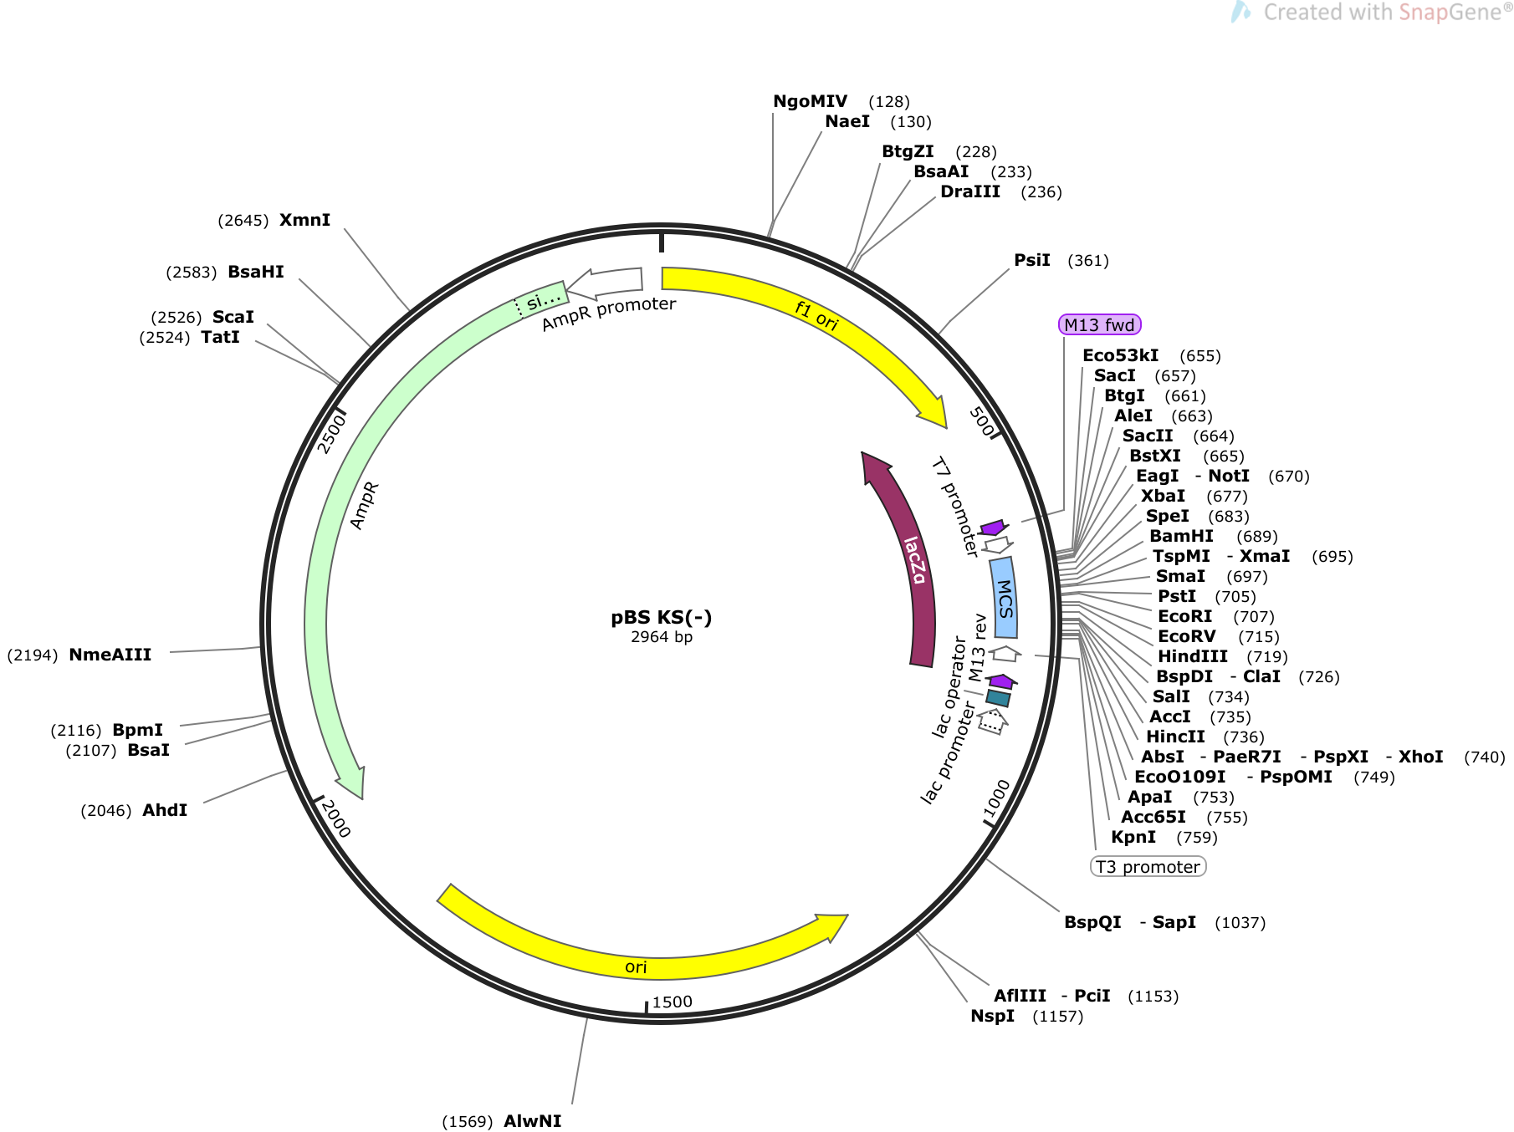

Slide 4
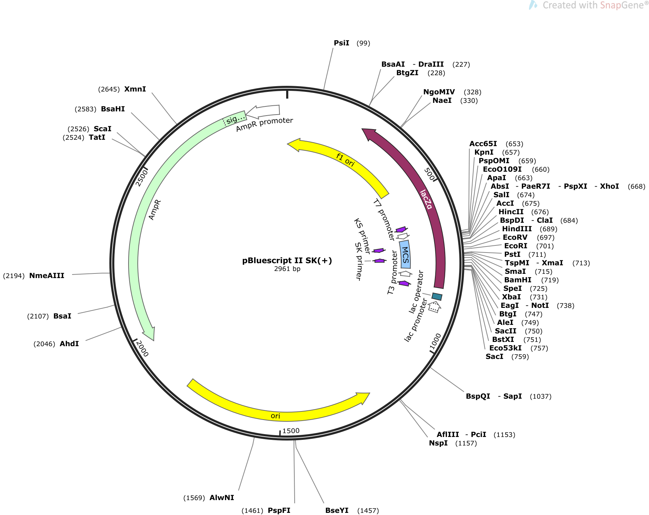

Slide 5
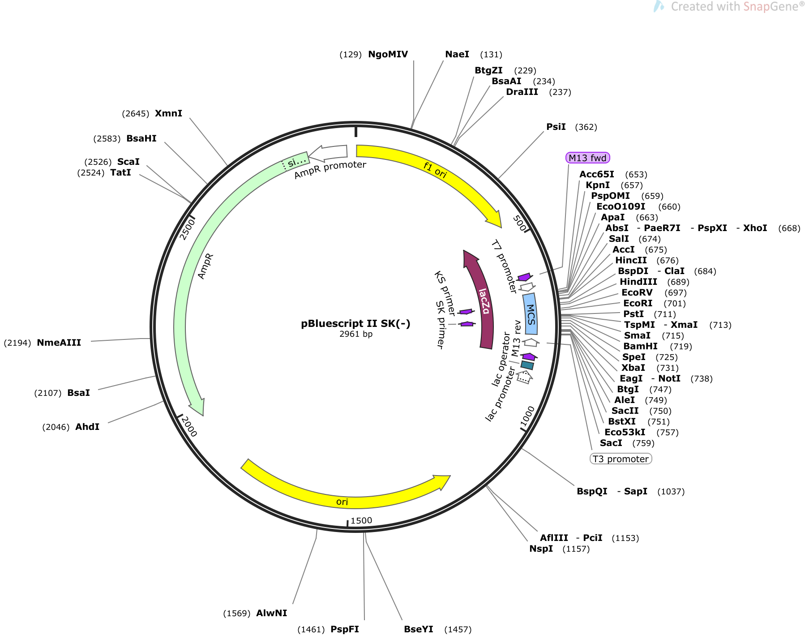

Slide 6
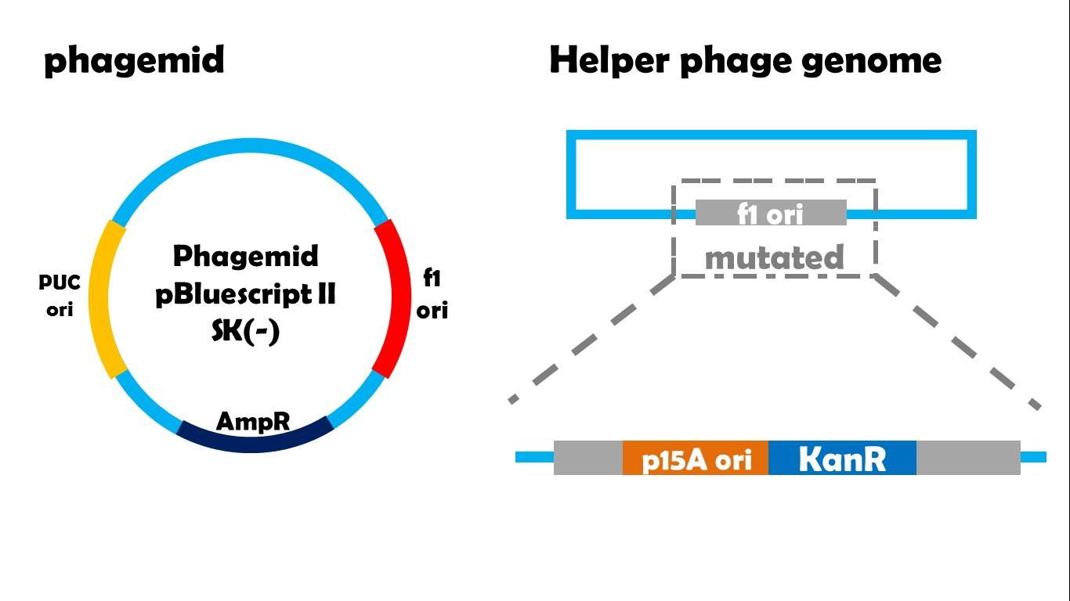
This type of Vectors can be used to make single-stranded DNA for sequencing
Take M13KO7 helper phage and phagemid pBluescript II SK(-) as example, as we use them in our experiment. M13KO7 helper phage has complete coat proteins and a complete genome just like normal M13 phage. But its f1 ori has been inserted by a p15A ori and a kanamycin resistance gene. While in pBluescript, its structure is like a normal plasmid but carries two replication origin: a high efficient PUC ori for itself, and an additional normal f1 ori. In other phagemid and helper phage pairs, situations are same: helper phage’s replication origin is mutated while phagemid contains an additional replication origin for this helper phage.

Slide 7
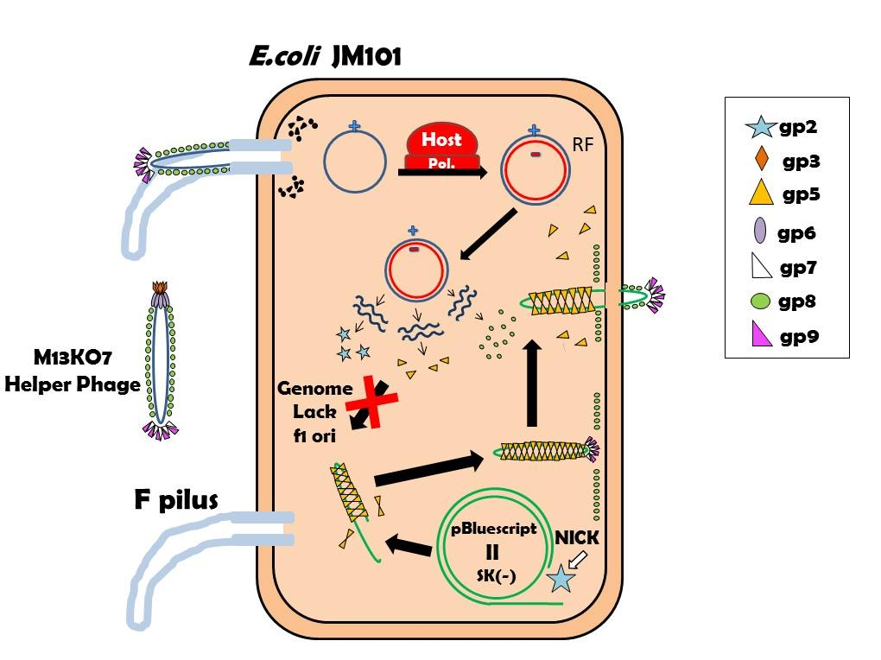

Slide 8
When it comes to M13KO7 helper phage, it still can successfully infect E.coli with F plasmid and make its genome stable in cytosol by host’s polymerase. But because its f1 ori has been mutated, so gp2 cannot make a nick on M13KO7's genome. This means, helper phage cannot produce progeny phage itself. However, if this E.coli has been transformed with a pBluescript II SK(-), gp2 will recognize intergenic region and make a nick on this plasmid. And then gp5 dimers will package the single strand of pBluescript because they believe this is their “genome”! In this situation, host cell will release phages but these phages do not contains their genome, they will carry phagemid instead. So they will not be able to make next generation after infection, so we call them “phagemid-carrying phage”.
DNA purified from the phagemids can
be used directly for sequencing.

Slide 9
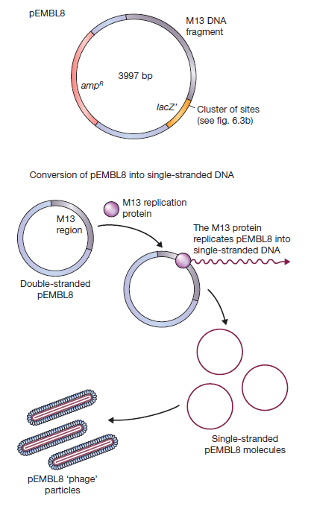
Example: pEMBL8

Slide 10
2. Cosmids
Cosmids are vectors that are hybrids of lambda phages and
plasmids, and this vector can replicate in the cell like a plasmid
or can be packaged like that of a phage.
A cosmid is a basically a plasmid that carries a cos site.
It is small (5-7 kb) circular DNA containing an origin for DNA replication (ori), selectable markers and restriction sites from plasmid plus a sequence from lambda needed for packaging the DNA (cos site). Cosmids may be used to clone large DNA molecules of up to 45 kb. They also have high transformation efficiency. Some examples of cosmid vectors include pJB, PWE and SuperCos series.
Insert Capacity: 35-45 Kb

Slide 11
With a cosmid vector of 7 kb, insertion of 31–45 kb of foreign DNA, much more than a phage-λ vector can accommodate.
Note that, after packaging in vitro, the particle is used to infect a suitable host. The recombinant cosmid DNA is injected and circularizes like phage DNA but replicates as a normal plasmid without the expression of any phage functions. Transformed
cells are selected on the basis of a vector drug resistance
marker.
Cosmids provide an efficient means of cloning large pieces of foreign DNA. Because of their capacity for large fragments of DNA, cosmids are particularly attractive vectors for constructing libraries of eukaryotic genome fragments.

Slide 12
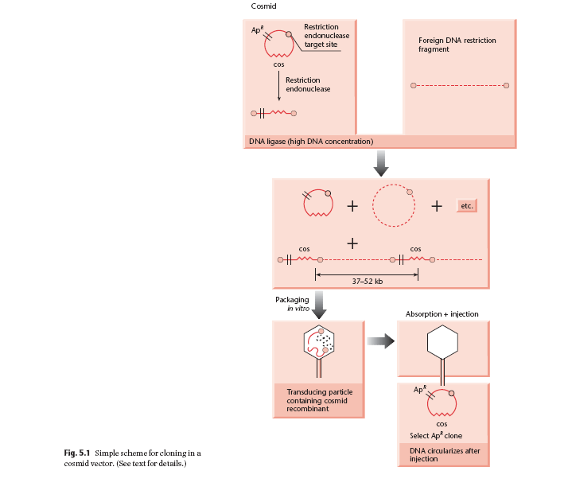
Cloning in a
cosmid vector

Slide 13
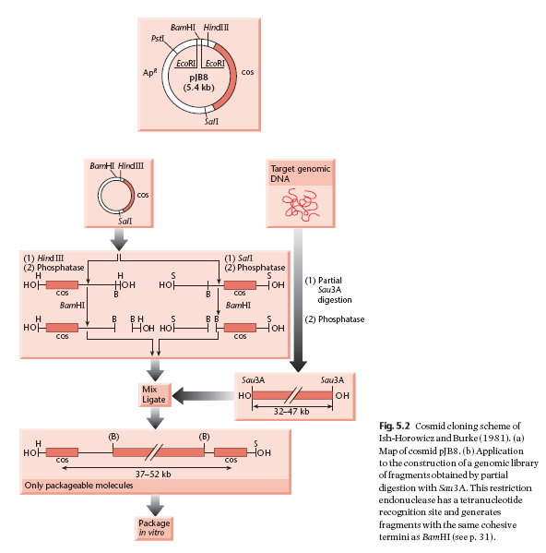
Strategy I

Slide 14
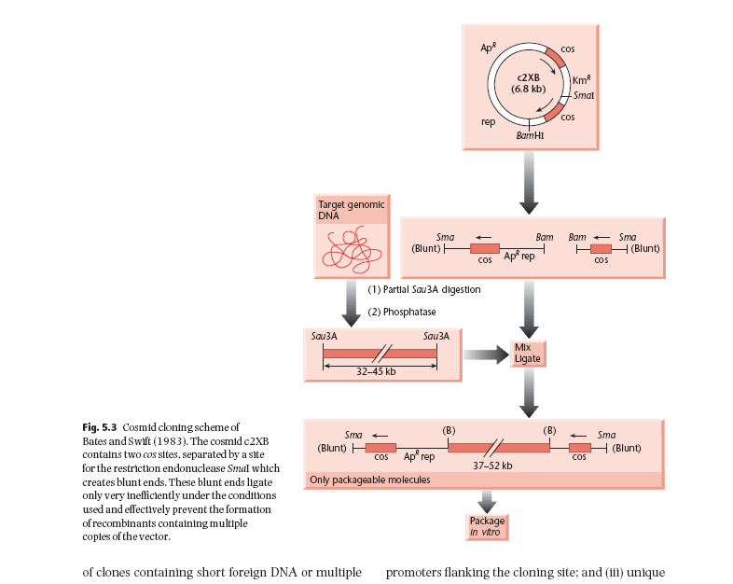
Strategy II

Slide 15
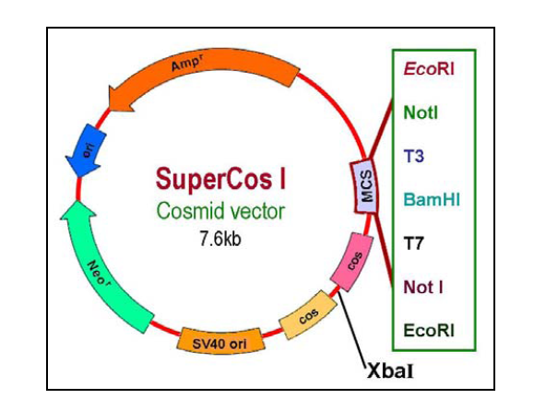
Modern Cosmid Vector with MCS

Slide 16
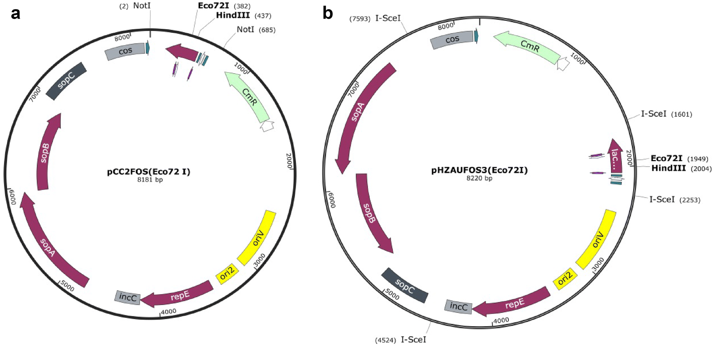
3. Fosmid
It contains the F-plasmid origin of replication and a
lambda phage cos site.
This vector can hold up to 40 Kb.

Slide 17
A bacterial artificial chromosome (BAC) is a DNA construct, based on a functional fertility plasmid (or F-plasmid), used for transforming and cloning in bacteria, usually E. coli.
F-plasmids play a crucial role because they contain partition genes that promote the even distribution of plasmids after bacterial cell division.
The bacterial artificial chromosome's usual insert size is 50–300 kb.
A similar cloning vector called a PAC has also been produced from the DNA of P1 bacteriophage.
BACs are capable of maintaining human and plant genomic fragments of little greater than 300 kb for over 100 generations with a high degree of stability (Woo et al. 1994) and have been used to construct genome libraries with an average insert size of 125 kb (Wang et al. 1995a).

Slide 18
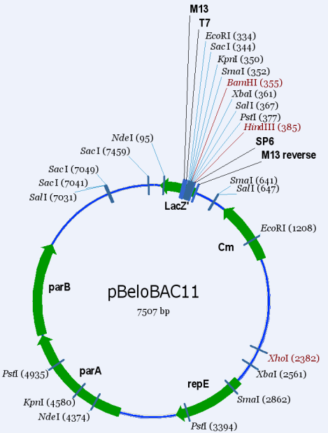
A BAC Vector

Slide 19
Cloning vectors and their insert capacities
Vector system | Host cell | Insert capacity (kb)
Plasmid | E. coli | 0.1-10
Bacteriophage λ | E. coli | 5-25
Cosmid | E. coli | 35-45
Bacteriophage P1 | E. coli | 70 -100
BAC (bacterial artificial chromosome) | E. coli | 50-300
P1 bacteriophage-derived AC (PAC) | E. coli | 100-300

