Slide 1
Recombinant DNA Technology

Slide 2
Genetic Engineering:
The deliberate modification of an organism’s genetic information by changing its nucleic acid genome.
Genome:
The full set of genes present in the cell or virus; all genetic material in an organism
Genetic engineering is the process of using recombinant DNA (rDNA) technology to alter the genetic makeup of an organism.
Genetic engineering involves the direct manipulation of one or more genes. Most often, a gene from another species is added to an organism's genome to give it a desired phenotype.

Slide 3
*Genetic engineering is broad term that refers to the process that is used to manipulate the genetic structure of an organism.
*Recombinant DNA technology is the technique used to create a recombinant DNA molecule bearing DNA of two different species.
Molecular cloning is a set of experimental methods in molecular biology that are used to assemble recombinant DNA molecules and to direct their replication within host organisms.
The cloning method involves the replication of one molecule to produce a population of cells with identical DNA molecules. Molecular cloning generally uses DNA sequences from two different organisms: the species that is the source of the DNA to be cloned, and the species that will serve as the living host for replication of the recombinant DNA.

Slide 4
Recombinant DNA Technology is defined as “the joining together of DNA molecules from different organisms and inserting it into a host organism to produce new genetic combinations that are of value to science, medicine, agriculture and industry.”
Recombinant DNA (rDNA) is an artificially made DNA strand that is formed by the combination of two or more gene sequences. This new combination may or may not occur naturally.
Recombinant DNA is the general name for a piece of DNA that has been created by combining at least two fragments from two different sources.
Genetic scientists achieve rDNA representing unique DNA strand using several types of techniques. Like naturally occurring DNA, recombinant DNA has the ability to produce recombinant proteins. It is often these proteins that play the key role in the application of recombinant DNA.

Slide 5
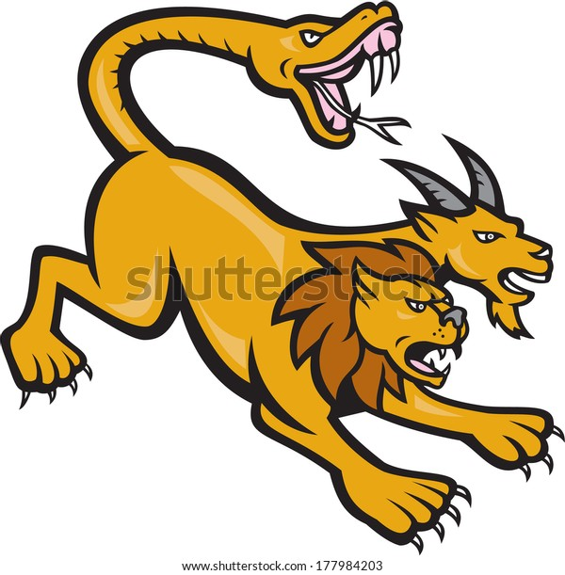
Recombinant DNA molecules are sometimes called chimeric DNA, because they can be made of DNA sources from two different species, like the mythical chimera.
Insert of Interest
Vector
rDNA

Slide 6
Recombinant DNA (rDNA) is a technology that uses enzymes to cut and paste together DNA sequences of interest.
The recombined DNA sequences can be placed into vehicles called vectors that ferry the DNA into a suitable host cell where it can be copied or expressed.

Slide 7
Pieces of DNA, such as human DNA, can be engineered in a fashion that allows them to be copied, or replicated, in bacteria or yeast.
This involves attaching appropriate elements to a piece of DNA and then transferring into a bacterial or yeast cell, with those elements then instructing the bacterial or yeast cell to copy this DNA along with its own.
This process is known as DNA cloning, with the resulting cloned DNA often referred to as recombinant DNA.

Slide 8
Formation of rDNA
In most cases, rDNA is created in a laboratory setting using a process of molecular cloning. This method allows in vivo DNA replication, in the living cells.
A cloning vector is a DNA molecule that replicates inside a living cell and is used to form rDNA.
The cloning vector is usually a small part of a DNA strand that holds the genetic information that is needed for the replication of cells.
Polymerase chain reaction (PCR) is another method that can be used to replicate a specific DNA sequence and create rDNA, which is used to replicate DNA in a laboratory test tube.

Slide 9
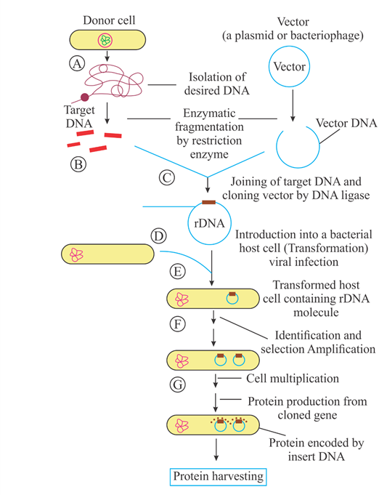
The standard method of recombinant DNA technology involves:
1. Choosing the appropriate host organism and cloning vector.
2. Preparation of vector DNA. 3. Preparation of DNA to be cloned.
4. Creation of recombinant DNA with DNA ligase.
5. Introduction of rDNA to host organism.
6. Selection of organisms containing vector sequences
7. Screening for clones with desired DNA inserts and biological properties

Slide 10
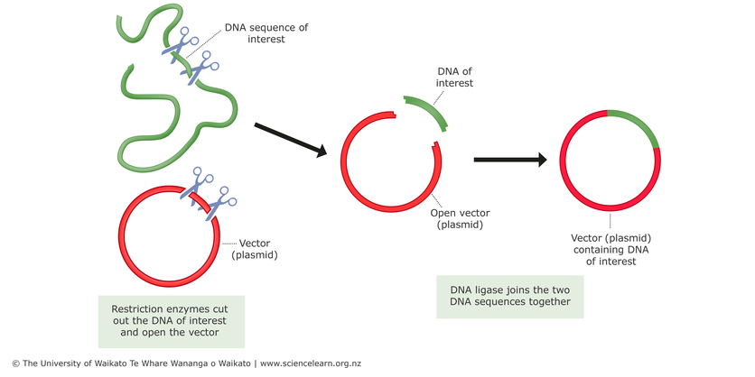
Steps:1 - 4
Creation of rDNA

Slide 11
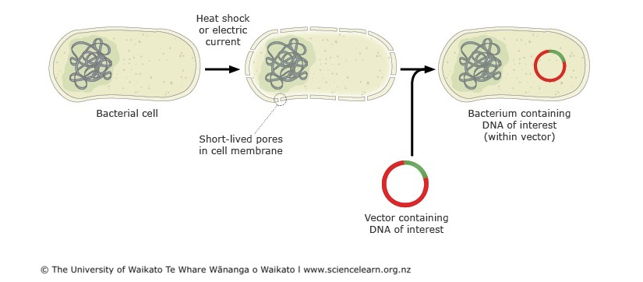
Steps:5 - 7
Getting rDNA in to host organism

Slide 12
A vector is a DNA molecule used as a vehicle to artificially carry foreign genetic material into another cell, where it can be replicated and/or expressed (e.g., plasmid, cosmid, Lambda phages).
A vector containing foreign DNA is termed recombinant DNA.
The four major types of vectors are plasmids, viral vectors, cosmids, and artificial chromosomes.
Of these, the most commonly used vectors are plasmids.
Common to all engineered vectors have an origin of replication, a multicloning site, and a selectable marker.

Slide 13
1. Host organisms
Escherichia coli
Yeast
Plant cells
Mammalian cells

Slide 14
2. Vector
The purpose of a vector is to transfer the genetic information and to isolate, multiply, or express the insert in the target cell.
All vectors may be used for cloning and are therefore cloning vectors, but there are also vectors designed specially for cloning, while others may be designed specifically for other purposes, such as transcription and protein expression.
Vectors designed specifically for the expression of the insert in the target cell are called expression vectors, and generally have a promoter sequence that drives expression of the transgene.

Slide 15
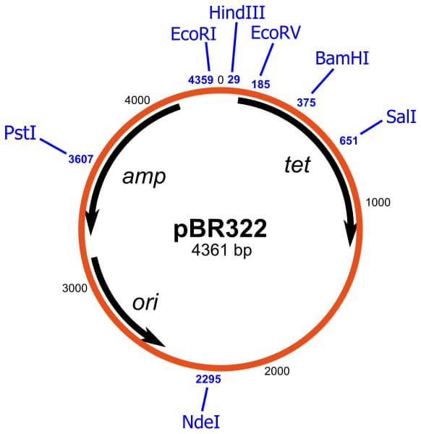
The pBR322 plasmid is one of the first plasmids widely used as a cloning vector.

Slide 16
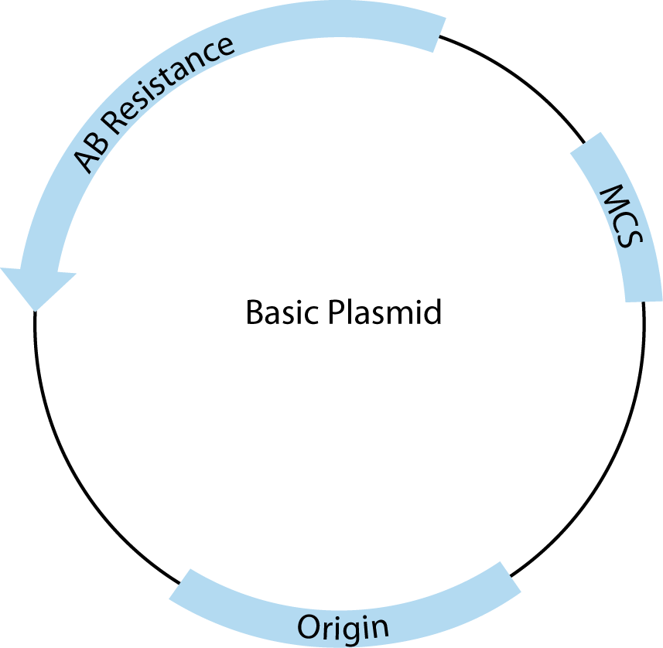

Slide 17
Cloning vector and expression vector are two types of vectors, used in recombinant DNA technology to carry foreign DNA segments into a target cell.
Both cloning and expression vectors comprise of the origin of replication, unique restriction sites, and selectable marker gene in their vector sequences. Both cloning and expression vectors are self - replicative due to the presence of an origin of replication.
The main difference between cloning vector and expression vector is that cloning vector is used to carry foreign DNA segments into a host cell, whereas expression vector is a type of a cloning vector, which contains suitable expression signals with maximal gene expression.

Slide 18
3. Restriction enzymes, DNA ligase, etc.
(DNA modifying enzymes): These enzymes are involved in the degradation, synthesis and alteration of the nucleic acids.
4. Preparation of DNA insert of interest
5. rDNA transfer methods ------Bacterial, Yeast, Plant and Animals
6. Screening

