Slide 1
What is light?
Light is electromagnetic radiation. What we usually describe as light is only the visible spectrum of this radiation with wavelengths between 400nm and 700nm.
The elementary particle that defines light is the photon.
b)
a)
There are 3 basic dimensions of light
Intensity (amplitude) which is related to the perception of brightness
Frequency (wavelength), perceived as colour
Polarization (angle of vibration) which is not or weakly perceptible to humans

Slide 2
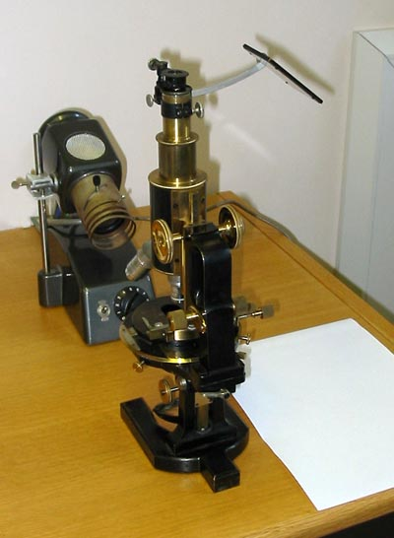
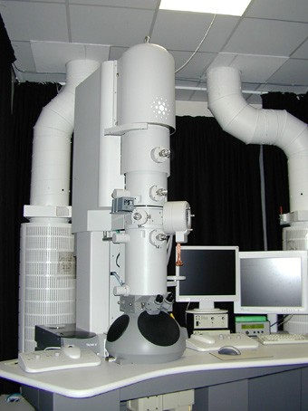
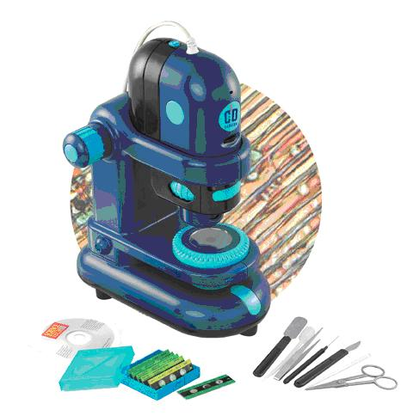
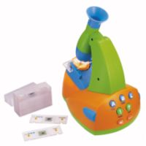
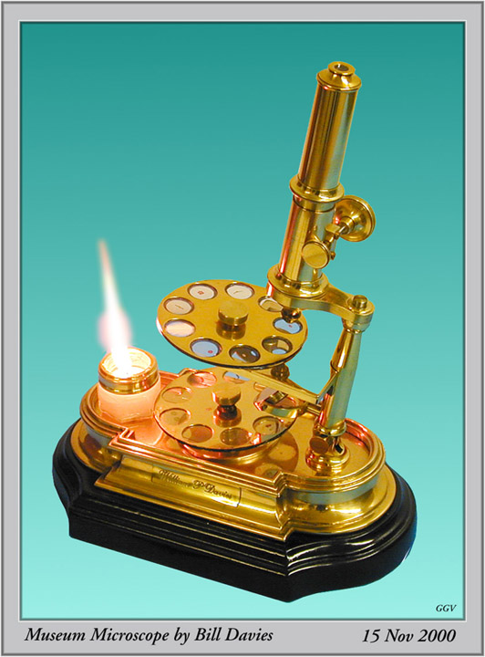
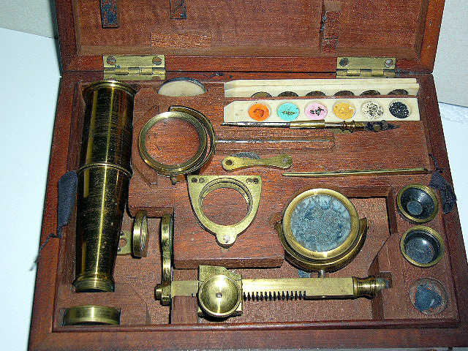
What is a microscope?

Slide 3
The microscope has become one of the most recognizable symbols of science.
Starting with use of a simple lens in ancient times, to the first compound microscope around 1590, and up to the microscopes you are using in 7th grade life science, the microscope has allowed scientists to make discoveries about the “invisible world.”

Slide 4
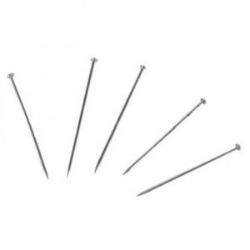
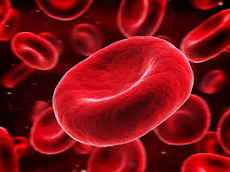
Micro- = “small”; -scope = “to look at”
Photographs of cells are taken using a microscope, and these pictures are called micrographs.

Slide 5
What is a microscope?
Theoretically a microscope is an array of two lenses.
Focal plane
Image plane
Image plane
Objective lens
Tube lens
Eyepiece lens
Classic compound microscope

Slide 6
Your friend - the objective

Slide 7
What is magnification?
Magnification is a measure of how much larger a microscope (or set of lenses within a microscope) causes an object to appear.
Magnification is defined by the
magnification by the objective
x
the magnification by eyepiece
BUT maximum magnification does not mean maximum resolution!

Slide 8
What is resolution?
Resolution describes the minimal distance of two points that can be distinguished.
The resolution of a microscope or lens is the smallest distance by which two points can be separated and still be distinguished as separate objects.
The smaller this value, the higher the resolving power of the microscope and the better the clarity and detail of the image.
Picture taken from http://microscopy.fsu.edu/primer/anatomy/numaperture.html

Slide 9
What is the numerical aperture?
NA is an estimate of how much light from the sample is collected by the objective
α2
α1
Objective lens
Oil (n = 1.5)
Air (n = 1.0)
Coverslip (n = 1.5)
Glass slide (n = 1.5)
NA = n sin α
n = refractive index
α = angle of incident illumination

Slide 10
The higher the numerical aperture of a lens, the better the resolution of a specimen will be which can be obtained with that lens.
d=0.5 λ/n sin Ɵ
Where d= resolution
Λ = wavelength of light used

Slide 11
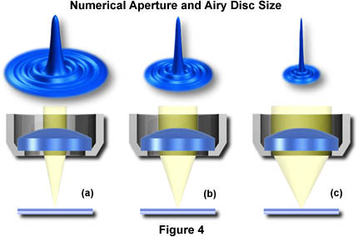
Numerical aperture, NOT magnification determines resolution!
Increasing NA
A lens with a larger NA will be able to visualize finer details and will also collect more light and give a brighter image than a lens with lower NA.

Slide 12
Microscopy
Light
Electron

Slide 13
Light (Optical) Microscopy
Visible light is uses.
Glass lens are used
Advantage: It can often be performed on living cells, so it’s possible to watch cells carrying out their normal behaviors (e.g., migrating or dividing) under the microscope.

Slide 14
Principle
When a ray of light passes from one medium to another it bends by phenomena called refraction.
Bending of light slows the speed.
The bending of light is determined by refractive index of the medium.

Slide 15
Types of Light Microscopes
Bright field Light Microscope
Phase Contrast Light Microscope
Dark-Field Light Microscope
Fluorescence Light Microscope

Slide 16
Contrasting techniques
Fibroblast grown in culture
Brightfield
Phase contrast
DIC
Darkfield
Taken from: http://fig.cox.miami.edu/~cmallery/150/Fallsyll.htm

Slide 17
Brightfield
Principle: Light is transmitted through the sample and absorbed by it.
Application: Only useful for specimens that can be contrasted via dyes.
Very little contrast in unstained specimens.
With a bright background, the human eye requires local intensity fluctuations
of at least 10 to 20% to be able to recognize objects.
Cross section of sunflower root
(http://www.zum.de/Faecher/Materialien/beck/12/bs12-5.htm)
Piece of artificially grown skin
(www.igb.fhg.de/.../dt/PI_BioTechnica2001.dt.html )

Slide 18
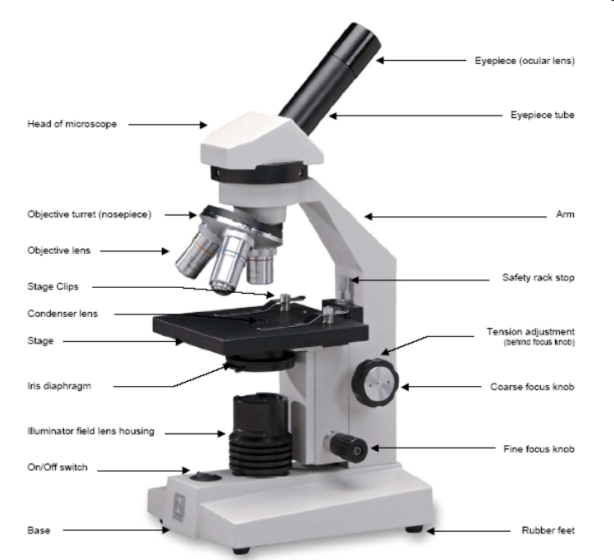
Typical Classroom Microscope

Slide 19
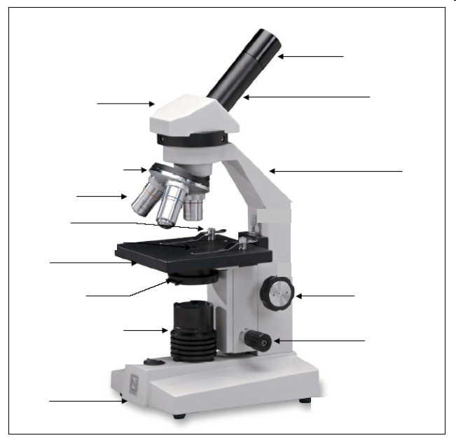
Eyepiece

Slide 20
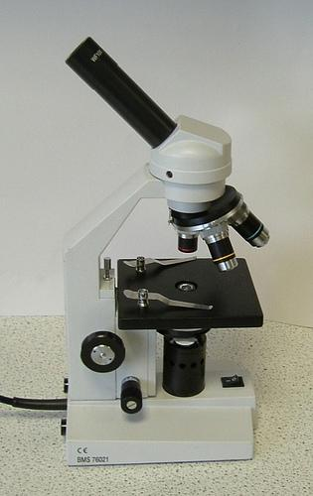
Eyepiece
Also known as the ocular
Contains the first lens you look through - usually a magnification of 10x
Located on the top of the body tube

Slide 21
Objective Lenses

Slide 22
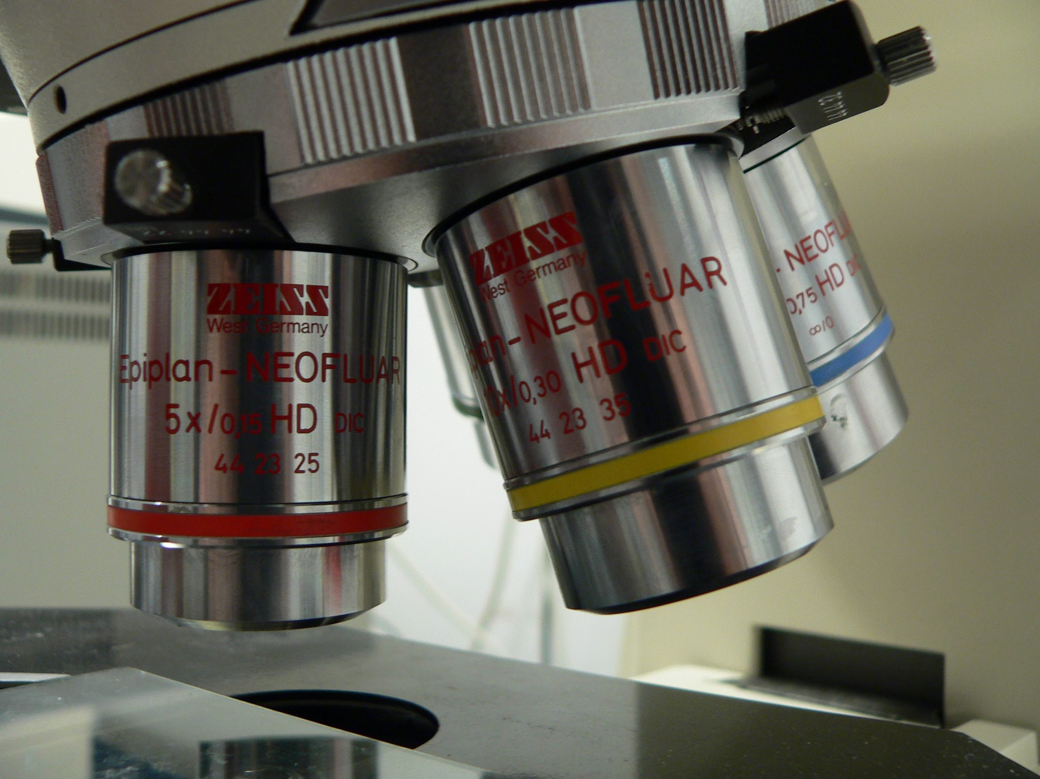
Objective Lenses
Used in combination with the eyepiece to provide a range of magnification
Magnification ranges from 40x to 400x
Located on the nose-piece at the bottom of the body tube

Slide 23
Nosepiece

Slide 24
Nosepiece
Holds the objective lenses
Rotates to enable magnification
Located at the bottom of the body tube

Slide 25
Arm

Slide 26
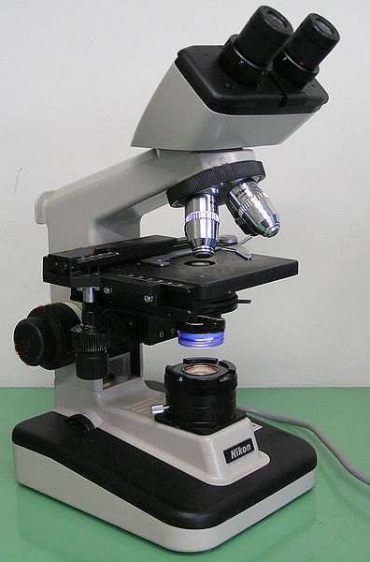
Arm
Supports the upper parts of the microscope
Used to carry the microscope
When carrying a microscope, always have one hand on the arm and one hand on the base. Use two hands!!

Slide 27
Base

Slide 28
Base
Supports the whole microscope
Used to carry the microscope
When carrying a microscope, always have one hand on the arm and one hand on the base. Use two hands!!

Slide 29
Stage

Slide 30
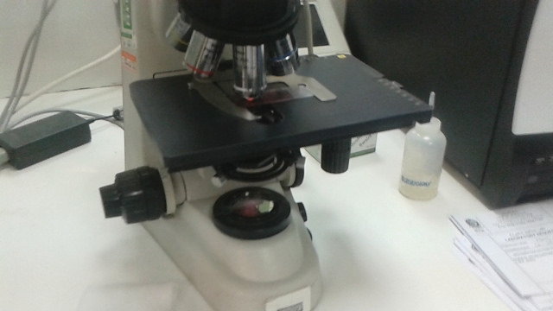
Stage
Supports the slide
The slide contains the specimen or object that you are viewing with the microscope.

Slide 31
Stage Clip

Slide 32
Stage Clip
Helps to hold the slide in place
Usually one on each side of the hole (stage opening) = 2 stage clips
The stage opening allows light to pass from the light source to the lenses.

Slide 33
Light Source

Slide 34
Light Source
Provides light necessary for viewing the specimen
Usually either a mirror or illuminator
Sends light through the stage opening to the diaphragm

Slide 35
Diaphragm

Slide 36
Diaphragm
Wheel or lever located below the stage opening
Regulates the amount of light that can enter the lenses
May need to be adjusted based on the thickness of the specimen being studied

Slide 37
Coarse Adjustment Knob

Slide 38
Coarse Adjustment Knob
Raises and lowers the stage or objective lenses
Used only when focusing the low power (4x) objective lens

Slide 39
Fine Adjustment Knob

Slide 40
Fine Adjustment Knob
Raises and lowers the stage or objective lenses a small distance for exact focusing
Used when focusing the medium power (10x) and high power (40x) objective lenses

Slide 41
Let’s Review...

Slide 42
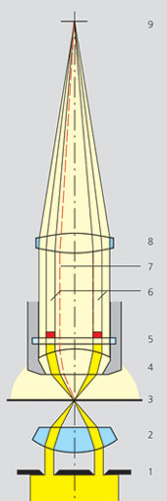
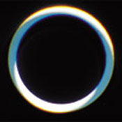
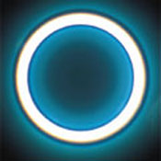
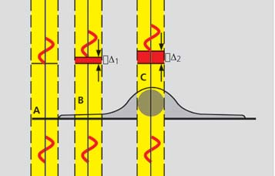
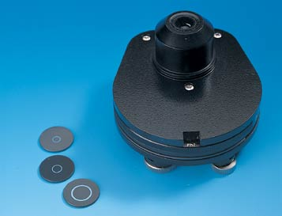
Phase contrast
Principle: Incident light [Io] is out of phase with transmitted light [I] as it was slowed down while passing through different parts of the sample and when the phases of the light are synchronized by an interference lens, a new image with greater contrast is seen.
Phase ring
I0
not aligned
aligned
Phase stops
I
https://www.youtube.com/watch?v=fCZw4X7V5Pw

Slide 43
Phase contrast
Application: Phase contrast is the most commonly used contrasting technique All tissue culture microscopes and the time-lapse microscopes are set up for phase.
brightfield
wrong phase stop
right phase stop

Slide 44
Applications
Determine morphologies of living cells such as plant and animal cells
Studying microbial motility and structures of locomotion
To detect certain microbial elements such as the bacterial endospores

Slide 45
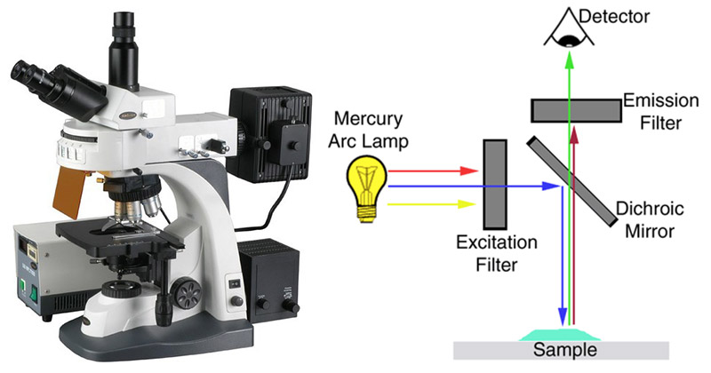
Fluorescence
https://www.youtube.com/watch?v=SfzmW7EMdLE

Slide 46
Applications
Used in the visualization of bacterial agents such as Mycobacterium tuberculosis.
Used to identify specific antibodies produced against bacterial antigens/pathogens in immunofluorescence techniques by labeling the antibodies with fluorochromes.
Used in ecological studies to identify and observe microorganisms labeled by the fluorochromes
It can also be used to differentiate between dead and live bacteria by the color they emit when treated with special stains

Slide 47
Confocal Microscope
https://www.youtube.com/watch?v=QFtZFbug1SA

Slide 48
Darkfield
Principle: The illuminating rays of light are directed through the sample from the side by putting a dark disk into the condenser that hinders the main light beam to enter the objective. Only light that is scattered by structures in the sample enters the objective.
Application: People use it a lot to look at Diatoms and other unstained/colourless specimens
Darkfield
Symbiotic Diatom colony
(www1.tip.nl/~t936927/making.html)
Brightfield

Slide 49
Applications
It is used to visualize the internal organs of larger cells such as the eukaryotic cells
Identification of bacterial cells with distinctive shapes such as Treponema pallidum, a causative agent of syphilis.
https://www.youtube.com/watch?v=W9MhkmyfMLQ

