Slide 1
introduction
Adverse Drug Reaction:
Adverse drug reactions (ADRs) are unintended and harmful effects of medications that occur in a patient.
ADRs can range from mild symptoms such as nausea and dizziness to severe reactions such as anaphylaxis and death
According to WHO(1972) “ADR is a response to a drug which is noxious and unintended and which occurs at doses normally used in man for prophylaxis, diagnosis, or therapy of disease or for the modification of physiologic function”.

Slide 2
Difference b/w Adverse Drug Reaction (ADR) & Adverse Drug Event (ADE)
The difference b/w ADR & ADE is that ADRs can occur even after appropriate prescription and correct dosing and ADE are generally associated with inappropriate use of the drug that occurs during the therapy

Slide 3
History about ADRs
In 1922: JAUNDICE associated with the use of SALVARSAN, an organic arsenical used in the treatment of Syphilis.
In 1937: In USA, 107 people died from taking an ELIXIR OF SULFANILAMIDE that contained the SOLVENT DIETHYLENE GLYCOL
Establishment of the FOOD AND DRUG ADMINISTRATION (FDA), which was given the task of enquiring into the safety of new drugs before allowing them to be marketed.
In 1958: Thalidomide marketed in West Germany as a non barbiturate hypnotic & for morning sickness during pregnancy based on animal toxicity report. 1959-61 (4000-100000 case) thalidomide disaster.
In 1959-1961, it was reported in that there was an outbreak of PHOCOMELIA (hypoplastic and aplastic limb deformities) in the new born babies.
The THALIDOMIDE INCIDENT led to a public outcry, to the institution all round the world of DRUG REGULATORY AUTHORITIES, to the development of a much more sophisticated approach to the preclinical testing and clinical evaluation of drugs before marketing, and to a greatly increased awareness of adverse effect of drugs and methods of detecting them...
Adverse Drug Reaction(ADR)

Slide 4
Importance of ADR Monitoring and Reporting
Detecting and reporting ADRs is crucial for several reasons:
ADRs can have a significant impact on patient health and healthcare costs. In the United States, for example, it is estimated that ADRs are responsible for over 2 million hospitalizations and 100,000 deaths each year.
The economic impact of ADRs is also significant, with one study estimating that the cost of ADR-related hospitalizations in the US is over $4 billion annually.
First, it helps healthcare professionals and regulatory agencies identify safety issues with medications and take appropriate action to mitigate harm.
Second, it can lead to improvements in medication safety and the development of safer medications.
Finally, it can help patients make informed decisions about their health and the medications they take

Slide 5
Types of ADR
Traditional Classification
As proposed by Rawlins and Thompson (1977):
Type A (Augmented)
Type B (Bizarre)
Newer Classification
As proposed by Rene J Royer (1997):
Type A (Augmented)
Type B (Bizarre)
Type C (Continuous)
Type D (Delayed effects)

Slide 6
Types of ADR
Wills and Brown classification:
To overcome the limitations of Rawlins and Thompson classification, adverse reactions are classified into nine categories based on their mechanism:
1.Type A (Augmented) Dose related
2.Type B (Bugs) Non- dose related
3.Type C (Chemical/Chronic) Dose related & time related
4.Type D (Delivery/Delayed) Time related
5.Type E (Exit/End of use) Withdrawal
6.Type F (Familial/Failure) Failure of therapy
7.Type G (Genotoxicity)
8.Type H (Hypersensitivity)
9.Type U (Unclassified)

Slide 7
Types of ADR
1.Type A (Augmented) Dose related:
2.Type B (Bizarre) reactions Non- dose related
3.Type C (Chemical/Chronic) Dose related & time related
Reactions which can be predicted from the known pharmacology of the drug
• Dose dependent,
• Can be alleviated by a dose reduction
E.g.
• Anticoagulants → Bleeding
• Beta blockers → Bradycardia
Cannot be predicted from the pharmacology of the drug
Not dose dependent, Host dependent factors important in predisposition
E.q.
Penicillin Anaphylaxis,
Anticonvulsant → Hypersensitivity
Type C reactions are irritant reaction that is related to drug concentration.
Eg: contact dermatitis.
Biological characteristics can be predicted from the chemical structure of the drug/metabolite
E.g.
Paracetamol- Hepatotoxicity

Slide 8
Types of ADR
4.Type D (Delivery/Delayed) Time related
5.Type E (Exit/End of use) Withdrawal
6.Type F (Familial/Failure) Failure of therapy
Occur after many years of treatment.
Can be due to accumulation.
E.g.
Chemotherapy →Secondary tumors
Phenytoin during pregnancy → Teratogenic effects
Antipsychotics → Tardive dyskinesia
Occur on withdrawal especially when drug is stopped abruptly
E.g.
Phenytoin withdrawal→ Seizures
Steroid withdrawal → Adrenocortical insufficiency.
They only occur in genetically predisposed patient.
It can be improved if medicine withdrawn.
e.g.: Hemolytic anemia with primaquine in G6PD deficient individuals.

Slide 9
Types of ADR
7.Type G (Genotoxicity)
8.Type H (Hypersensitivity)
9.Type U (Unclassified)
Irreversible genetic damage is caused by this Type G adverse reaction.
e.g.: teratogenic agent like Thalidomide causes genetic damage to the developing fetus.
They are also known as drug allergy and is often immune mediated response.
This includes those reactions in which the mechanism is unclear.
e.g.: Taste disturbances associated with Simvastatin.

Slide 10
ADR DETECTION METHOD
There are several methods for detecting ADRs:
Pre marketing Studies
Post marketing surveillance
Electronic health records (EHRs)
Active Surveillance
Prescription Event Monitoring (PEM)
Intensive Monitoring

Slide 11
Pre marketing Studies
1. Animal Studies:
Acute/Chronic Toxicity study
Mutagenicity & Carcinogenicity
Teratogenicity
2. Human Studies:
Clinical trails study

Slide 12
Post marketing surveillance
A. Spontaneous Reports
B. Epidemiological methods:
i)Case Control Studies
ii)Cohort Studies
C. Meta Analysis of Clinical Study
D. Published Case Report

Slide 13
Post marketing surveillance
Spontaneous reporting
This method involves healthcare professionals, patients, or caregivers reporting ADRs to regulatory agencies or pharmaceutical companies voluntarily. This is the most common method for detecting ADRs. The strengths of this method include its simplicity, low cost, and ability to detect rare and unexpected ADRs. However, it is subject to underreporting due to lack of awareness, reluctance to report, and variability in reporting criteria

Slide 14
Post marketing surveillance
Cohort Studies
CEM involves monitoring patients who have been prescribed a specific medication over a prolonged period, usually several months or years.
Healthcare professionals collect data on adverse events that occur during the monitoring period.
This method can detect ADRs that occur after long-term medication use and can detect previously unknown ADRs. However, it is time-consuming and expensive.

Slide 15
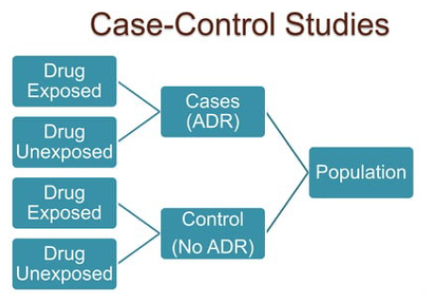
Post marketing surveillance
Case Control Studies
Individuals affected by the adverse event being studied are identified.
Each case is matched with several disease free control patients, randomly recruited from the study base.
Drug histories of both the groups are traced backwards for the comparison.
The suspicion is strengthened if high association is found. Advantage: Can be analyzed quickly as number of patients analyzed is small.

Slide 16
Electronic Health Records (EHRs):
EHRs are computerized patient records that contain information about medications, medical history, laboratory results, and other relevant information. EHRs can be used to detect ADRs by analyzing patterns of medication use and associated adverse events. EHRs also have the potential to provide real-time ADR detection and automated reporting. However, limitations include incomplete or inaccurate data, privacy concerns, and lack of standardization.

Slide 17
Active Surveillance:
This method involves healthcare professionals systematically searching for ADRs in patients using specific tools, such as questionnaires or interviews. Active surveillance can be used to detect ADRs that are difficult to identify through spontaneous reporting. This method is particularly useful for detecting ADRs that have a delayed onset or are not recognized by patients or healthcare professionals.

Slide 18
Prescription Event Monitoring (PEM):
PEM involves monitoring patients who have recently started taking a new medication. Healthcare professionals collect data on adverse events that occur within a specified time frame after the patient starts taking the medication. This method is useful for detecting ADRs that occur shortly after medication initiation and can detect previously unknown ADRs. However, it is limited by its narrow focus on specific medications.

Slide 19
Intensive Monitoring:
Intensive monitoring involves monitoring a select group of patients who are at high risk of developing ADRs. This method can be used to detect rare or severe ADRs that may not be detected through other methods. However, it is resource-intensive and may not be feasible for large populations.

Slide 20
Collection of data for Detection of ADR
PATIENT Related
Details of suspected ADr
Details of suspected DRUG
Patients demographic data
Presenting complaints
Past medication history
Current drug therapy details including OTC medications
Treatment with any other system of medicine
Risk factors
Nature and severity of suspected reaction
Time of onset of suspected reaction
Duration of suspected reaction
Previous report on reported reaction
Name of the suspected drug
Time of administration
Complete dosing regimen
Previous report on suspected drug

Slide 21
Role of Healthcare Professionals in Detecting ADRs
Possibility of an ADR should always be considered during differential diagnosis.
ADR may be detected during ward round with the medical team.
Patient counselling, medication history interview and communicating with other healthcare professional may provide additional clues.
Patients who are at higher risk should be monitored closely
Patients with renal or hepatic impairment.
Patients who had history of allergic reactions. Patients taking multiple drugs.
Pregnant and breastfeeding women

Slide 22
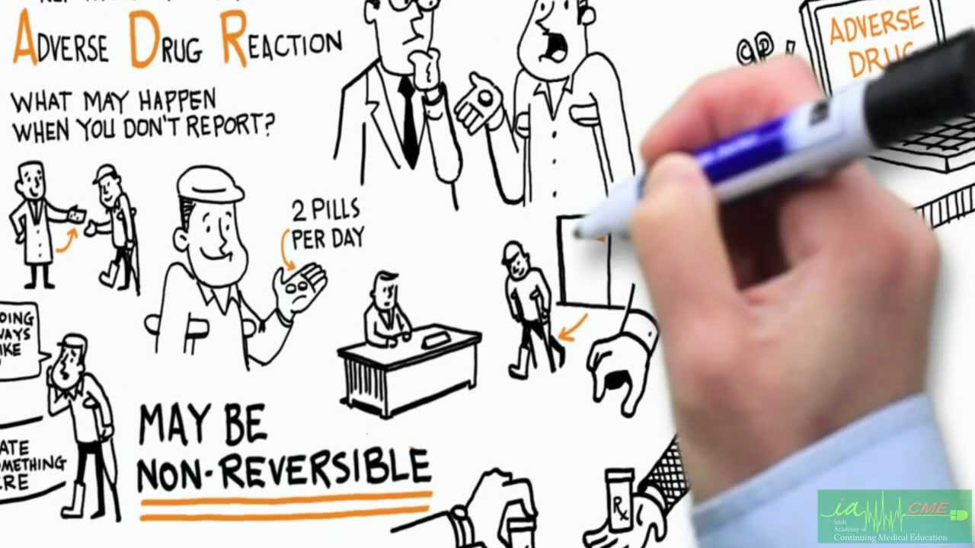
ADR REPORTING METHOD
Who can Report?
All healthcare professionals (clinicians, dentists, pharmacists, nurses etc) and Non-healthcare professionals including consumers can report suspected adverse drug reaction.

Slide 23
Where to report ?
Duly filled Suspected Adverse Drug Reaction Reporting Form can be send to the nearest Adverse Drug Reaction Monitoring Centre (AMC) or directly to the National Coordination Centre(NCC).
Call on Helpline (Toll Free) 1800 180 3024 to report ADRs.
Or can directly mail this filled form to pvpi@ipcindia.net orpvpi.ipcindia@gmail.com
A list of nationwide AMCs is available at:
http://www.ipc.gov.in,
http://www.ipc.gov.in/PvPI/pv_home.html

Slide 24
What to report ?
Report serious adverse drug reactions. A reaction is serious when the patient outcome is:
•Life-threatening
• Hospitalization (initial or prolonged)
•Disability (significant, persistent or permanent)
• Congenital anomaly
• Required intervention to prevent permanent impairment or damage
Report non-serious, known or unknown, frequent or rare adverse drug reactions due to Medicines, Vaccines and Herbal products

Slide 25
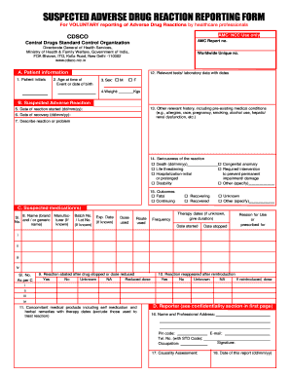
Mandatory field for suspected ADR reporting form
Patient initials
Age at onset of reaction
Reaction terms
Date of onset of reaction
Suspected medications reporter information.

Slide 26
What happens to the submitted information?
ADR reported by HCP, Patient or Others
Causality assessment at AMCS
Reports are periodically reviewed by the NCC-PVPI
Forwarded to NCC-PVPI through ADR database
Suggests required interventions Information is submitted to the Steering committee of PvPI
Global Pharmacovigilance Database (Managed by WHO- UMC)
Suggests required interventions
Data is Analyzed & forwarded

