Slide 1
International Nonproprietary Names

Slide 2
Contents
General Introduction
Elements in the INN system
Principle for selection
Protection of INNs
How to apply for INNs

Slide 3
Introduction
An International Nonproprietary Name (INN) identifies a pharmaceutical substance or active pharmaceutical ingredient by a unique name that is globally recognized and is public property. A nonproprietary name is also known as a generic name.
The INN system as it exists today was initiated in 1950 by a World Health Assembly resolution and began operating in 1953 when the first list of International Nonproprietary Names for pharmaceutical substances was published. The cumulative list of INNs now stands at some 9300 names designated since that time, and this number is growing every year by some 140-160 new INNs
The WHO administers an international generic nomenclature system called INNs also known as rINN, for recommended International Nonproprietary Names or pINN for proposed International Nonproprietary Name).
International Nonproprietary Names (INN) facilitate the identification of pharmaceutical substances or active pharmaceutical ingredients. Each INN is a unique name that is globally recognized and is public property.

Slide 4
THE INN SYSTEM
The INN system was established in 1950 by the World Health Assembly and the first list of International Nonproprietary Names for pharmaceutical substances was published in 1953.
The cumulative list of INN now stands at some 7000 names designated since that time, and this number is growing every year by some 120-150 new INN.

Slide 5
Aim of this INN system
To provide health professionals with a unique and universally available designated name to identify each pharmaceutical substance.
For the clear identification, safe prescription dispensing of medicines to patients, and
For communication and exchange of information among health professionals and scientists worldwide.
Nonproprietary names are intended for use in pharma, labeling, product information, advertising and other promotional material, drug regulation, and scientific literature, and as a basis for product names, e.g., for generics.

Slide 6
TRADE NAME AND NONPROPRIETARY NAMES
Nowadays, most products available on the market are advertised, promoted, and identified by a trading name. In the pharmaceutical field, trade names are used when prescribing, dispensing, selling, promoting, or buying a medicament. Trade names are usually selected by the owner of the product registered in national trademarks or patent offices. They are private property and can be used only with the consent of the owner of the trademark.
In most cases, brand names are chosen for a finished pharmaceutical product. Therefore, pharmaceutical preparations containing the same active drug substance are frequently sold under different brand/trade names in different countries and even within the same country.

Slide 7
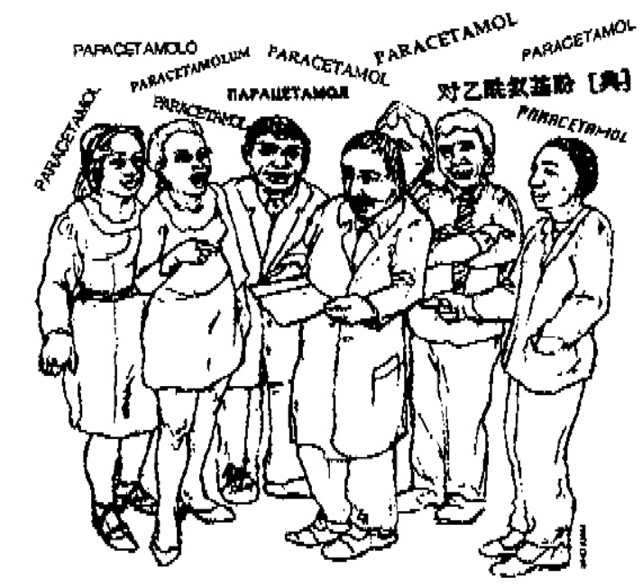
Conti…
Various Trade names for one substance. For example, paracetamol.
Nonproprietary names are intended to be used as public property without restraint. These names are usually designed by the national or international nomenclature commissions.
Nonproprietary names are designations to identify the active pharmaceutical drug substance rather than the final product.
The selection of a nonproprietary name follows established rules so that the name itself communicates to the medical and pharmaceutical health professional to whom the active drug substance belongs.

Slide 8
Selection of INN/ Principle
The names which are given the status of an INN are selected by the World Health Organization on the advice of experts from the WHO Expert Advisory Panel on the International Pharmacopoeia and Pharmaceutical Preparations.
The process of INN selection follows three main steps:
A request/application is made by the manufacturer or inventor
After a review of the request a proposed INN is selected and published for comments
After a time period for objections has lapsed, the name will obtain the status of a recommended INN and will be published as such if no objection has been raised. Since the name is available in the public domain it may be used freely. However, it should not be registered as a trademark since this would prevent its use by other parties.

Slide 9
How its work
INN is designated for the active part of the molecule only, to avoid the multiplication of entries in cases where several salts esters, etc. are used. In such cases, the user of the INN must create a modified INN (INNM)
Ex: Mepyramine maleate (a salt of mepyramine with maleic)
The primary principles for selection:
Distinctive in sound and spelling; Not too long; and Not liable to confusion with other names in common use. Ex: ac: anti-inflammatory agents, Ibufenac derivatives -coxib for COX-2 inhibitors, a type of anti-inflammatory drugs (e.g., celecoxib)

Slide 10
Counti..
Do not select
Do not select names for mixtures of substances.
Do not select
Do not select herbal substances (vegetable drugs) or homeopathic products.
Do not select
Do not select names for those substances that have a long history of use for medical purposes under well-established names such as those of alkaloids (e.g., morphine, codeine) or trivial chemical names (e.g., acetic acid).

Slide 11
Trademark Owner
In the process of INN selection, the rights of existing trademark owners are fully protected. If in the period of four months following the publication of a proposed INN, a formal objection is filed by an interested person who considers that the proposed INN is in conflict with an existing trade-mark, WHO will actively pursue an arrangement to obtain a withdrawal of such an objection or will reconsider the proposed name. As long as the objection exists, WHO will not publish it as a recommended INN.

Slide 12
Protection of INN
The World Health Organization collaborates closely with INN experts and national nomenclature committees to select a single name of worldwide acceptability for each active substance that is to be marketed as a pharmaceutical. To avoid confusion, which could jeopardize the safety of patients, trademarks should neither be derived from INNs nor contain common stems used in INNs.
During the past few years, INN common stems have been increasingly introduced in trademarks. This hampers the selection of new nonproprietary names within the established system. Given the fact that all INNs should be distinct from existing INNs and trademarks, this practice causes difficulties when selecting a new name.

Slide 13
Conti..
There are a large number of brands for a single pharmaceutical substance generic name No. of brands INN Amoxycillin 86 Vinleurosine.
Based on recommendations made by the WHO Expert Committee on the Use of Essential Drugs, a resolution was adopted during the 46th World Health Assembly requested Member States to
"Enact rules or regulations, as necessary, to ensure that international nonproprietary names… are always displayed prominently”.
Encourage manufacturers to rely on their corporate name and the international nonproprietary names, rather than trademarks, to promote and market multisource products introduced after patent expiration.
Develop policy guidelines on the use and protection of international nonproprietary names and discourage the use of names derived from INNs, and particularly names including INN stems in trademarks.

Slide 14
USE OF INNS IN INDIA
In India, Section 13 (b) of the Trade Marks Act, 1999 prohibits the registration of names of chemical elements or INNs which have been declared by the World Health Organization (WHO) and notified by the Registrar of Trade Marks. Nevertheless, there are names that are similar to INNs.
The WHO has brought the same to the attention of the Drug Controller General of India. The basic requirement of Section 13 (b) of the Trade Marks Act, 1999 is that INNs must be notified by the Registrar.
The use of INNs as trademarks constitutes a problem in two ways: use of parts of INNs in trademarks can dilute the INN system by creating confusion in drug nomenclature. Secondly, since trademarks enjoy legal protection unlike INNs, the use of INN stems in trademarks may hinder the coining of new INNs in the future using the common stem, where a trademark owner opposes the INN. This is because the selection of INNs ensures that the rights of trademark owners are not affected by INNs.

Slide 15
Prevention of registration of certain trademarks by some Indian companies
The WHO demanded that the applications for registration of brand names, like Tiotrop, Guapride, Dipride, and Pride by companies Sun Pharma, Ajanta Pharma, Divus Lab, and First Care Pharma respectively should not be entertained.
Also, WHO asked the DCGI to prevent approval of the brand name Riluzole by Rajvi Vipul Bhagat, Mumbai as Riluzole is an INNs

Slide 16
Conclusion
While selecting INNs it is ensured that these are not similar to trademarks. WHA Resolution in 1993 exhorts Member States to develop legal and policy regimes to address this need. Though WHA Resolution is non-binding in nature, India has substantially implemented its requirements under Section 13 (b) of the Trade Marks Act, 1999. Nevertheless, no INN has been notified by the Trade Marks Registry in the Trade Marks Journal.
The Controller General of Patents, Designs, and Trade Marks has finally published a list of International Non-Proprietary Names as declared by the World Health Organization which can be viewed at this link http://ipindia.nic.in/list_INN_08February2012.pdf. Hopefully, this publication will be followed up by an official notification, following which Trade Mark Examiners will be mandated to examine pharmaceutical trademarks for any similarities to the INNs published in the list. Any names which are identical, to those on the INN list will not be registered as a pharmaceutical trademark.

Slide 17
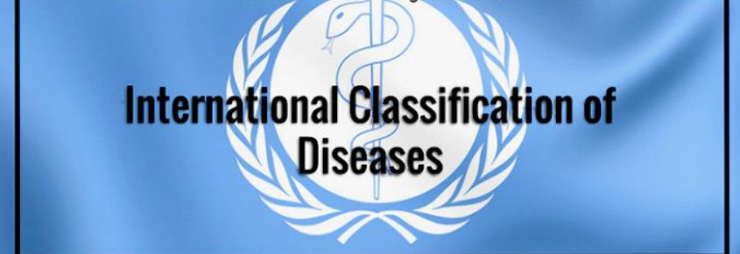
Presented By:
Anmol Kumar
M.Pharm 1st Year
Pharmacology
Under The Guidance:
Dr. Mamta Tiwari
Assistant Professor
CSJMU KANPUR

Slide 18
Contents
Introduction
Development & Evaluation
Principle
Purpose &Uses

Slide 19
Introduction
ICD serves a broad range of uses globally and provides critical knowledge on the extent, causes and consequences of human disease and death worldwide via data that is reported and coded with the ICD. Clinical terms coded with ICD are the main basis for health recording and statistics on disease in primary, secondary and tertiary care, as well as on cause of death certificates.
These data and statistics support payment systems, service planning, administration of quality and safety, and health services research. Diagnostic guidance linked to categories of ICD also standardizes data collection and enables large scale research.

Slide 20
ICD Purpose & Uses
The ICD is important because it provides a common language for recording, reporting, and monitoring diseases. This allows the world to compare and share data in a consistent and standard way – between hospitals, regions and countries and over periods of time. It facilitates the collection and storage of data for analysis and evidence-based decision-making.
Users include physicians, nurses, other providers, researchers, health information managers and coders, health information technology workers, policy-makers, insurers, and patient organizations.
ICD has been translated into 43 languages and it is being used by all member States. Most countries (117) use the system to report mortality data, a primary indicator of health status.
All Member States are expected to use the most current version of the ICD for reporting death and disease statistics (according to the WHO Nomenclature Regulations adopted by the World Health Assembly in 1967)

Slide 21
Principles of classification of ICD:
The ICD is a variable-axis classification. The structure of ICD structure was developed of that proposed by William Farr during early days of international discussions. According to him, for all practical, epidemiological purposes, statistical data on diseases should be grouped in the following way:
epidemic diseases
constitutional or general diseases
local diseases arranged by site
developmental diseases
injuries

Slide 22
WHO Family of International Classifications
The WHO Family of International Classifications (WHO-FIC) is comprised of classifications to describe various aspects of the health and the health system in a consistent manner.
The purpose of FIC is to assist the development of reliable statistical systems at local, national and international levels, with the aim of improving health status and health care.

Slide 23
Family of International Classification (FIC)

Slide 24
Development &Evaluation
The International Classification of Diseases (ICD) is a system, developed collaboratively between the World Health Organization (WHO) and 10 international centers so that the medical terms reported by physicians, medical examiners, and coroners on death certificates can be grouped together for statistical purposes. Development of ICD

Slide 25
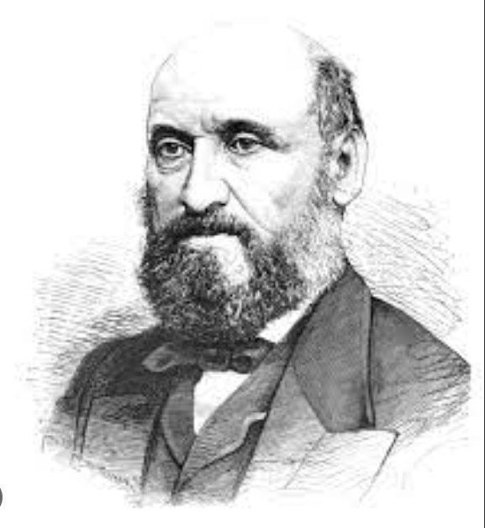
Evolution of ICD
William Farr
First attempts to systematically classify diseases were made in 17th & 18th century by Francois Bossier de Lacroix Published under Nossologia methodia
William Farr first medical statistical of the general resister office of England and submitted his report on Nomenclature and Statistical Classification of Diseases.
The utility of uniform classification of cause of death. Was recognized at the first international statistical Congress. He was held in Brussels in 1853.
At the next Congress in Paris in 1955, Far and d’Espine Submitted two separate lists with different principles. The Congress adopted both.
In 1893, French physician Jacques Bertillon introduced Bertillon’s classification of cause of death at the Congress of the international statistical Institute of Chicago.

Slide 26
ICD History Conti..
1893
ISI adopted 1st edition of international classification system: The International List of Causes of Death
1899
“Causes of Death” adopted by some American and European countries New ICD edition approximately every 10 years
1910–1920
ICD-2 (1910-1920) renamed: International Classification of Causes of Sickness and Death ICD-4 (1930-1938), transfer to categories based on etiology.
1939–1948
ICD-5 (1939-1948), comparability between successive ICD versions ICD-6 (1949-1957), WHO entrusted ICD as its criterion: International Classification of Diseases, Injuries, and Causes of Death.

Slide 27
ICD History Conti..
ICD-6 (1949-1957), WHO entrusted ICD as its criterion: International Classification of Diseases, Injuries, and Causes of Death: • For the first time included morbidity • New main category: Mental, Psychoneurotic, and Personality Disorders
ICD-7 Seventh Revision Conference was held in Paris in 1955 and, the revision was limited to essential changes.
ICD-8 (1968-1978) Expanded cross-indexing hospital clinical records
ICD-9 (1979-1994) Included narrative MBD descriptions similar to DSM-II language. • 1978 refined classification and diagnosis of mental disorders • 1982 diagnostic instruments and algorithms shaped and refined
ICD-10 was endorsed by the Forty-third World Health Assembly in May 1990 and came into use in the WHO Member States in 1994. India adopted this classification in 2000.
ICD-11 launched on 2019 and released 1st Jan 2022 .

Slide 28
ICD- 11
The ICD-11 is the eleventh revision of the International Classification of Diseases. It replaces the ICD-10 as the global standard for recording health information and causes of death. The ICD is developed and annually updated by the World Health Organization.
Originating in the 19th century, the latest version of the ICD, ICD-11, was adopted by the 72nd World Health Assembly in 2019 and came into effect on 1st January 2022.

Slide 29
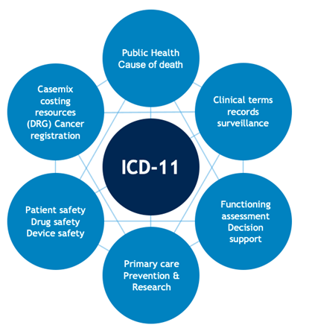
ICD- 11
As a classification and terminology ICD-11:
allows the systematic recording, analysis, interpretation, and comparison of mortality and morbidity data collected in different countries or regions and at different times;
Ensures semantic interoperability and reusability of recorded data for the different use cases beyond mere health statistics, including decision support, resource allocation, reimbursement, guidelines, and more.

Slide 30
Pharmacovigilance safety databases
ARIS G Pharmacovigilance
Oracle Argus
Presented By Under the supervision
Anmol Kumar Dr. Mamta Tiwari
M.Pharm Assistant Professor
Pharmacology CSJMU Kanpur

Slide 31
Pharmacovigilance Safety Database
A drug safety database is a repository for ICSRs about one or multiple medicinal products, coming from various sources from multiple geographical regions.
Pharmacovigilance safety databases collect information about drug side effects from various sources like healthcare providers, patients, scientific literature, social media, and safety studies.
They combine all the data into one place and use standards like the ICH Medical Dictionary and the WHO Drug Global to categorize the side effects. The databases also have features to detect errors, missing data, and duplicate report

Slide 32
Conti..
COTS pharmacovigilance is the use of commercially available software for managing pharmacovigilance activities.
This approach avoids developing custom software in-house.
COTS software can provide features and functionalities for adverse event reporting, case management, signal detection, risk management, and compliance with regulatory requirements.
Examples of COTS pharmacovigilance software include ArisGlobal, Oracle Argus, and Veeva Vault Safety.

Slide 33
ARIS g Pharmacovigilance
Aris G Pharmacovigilance is a software solution designed to support the end-to-end pharmacovigilance process. It is offered by ArisGlobal, a leading provider of life sciences software solutions
The software assists pharmaceutical firms, biotechs, medical device makers, and contract research organizations (CROs) in managing the complete drug safety process, including adverse events.
Aris G Pharmacovigilance is designed to comply with global regulatory requirements such as ICH E2B(R3) and E2B(R2) guidelines, the FDA’s 21 CFR Part 11, and the European Medicines Agency (EMA) regulations.

Slide 34
Key Features
Global cloud-based access with a real-time review of cases
Automated coding
Automated duplicate checks
Automated validity and triage of cases
Configuration of client-based SOPs, workflows, review, and reporting procedures
Integration with other PV systems, such as safety signal management
Automated case tracking and follow-up
Real-time benefit-risk analysis
Global automated submission options

Slide 35
Oracle Argus
Oracle Argus is a pharmacovigilance software application designed to help pharmaceutical companies, contract research organizations (CROs), and regulatory agencies manage adverse event reporting and analysis for drugs, biologics, and medical devices.
The software offers a comprehensive solution for safety case management, from case processing and medical review to signal detection and management, aggregate reporting, and risk management planning.

Slide 36
Key features
Case management
Medical review
Signal detection
Risk management
Aggregate reporting
Configurable workflow

Slide 37
References
https://www.biomapas.com/selecting-a-pharmacovigilance-drug-safety-database/
https://www.quanticate.com/pharmacovigilancesafetydatabase#:~:text=A%20pharmacovigilance%20safety%20database%20is,s)%20from%20all%20sources%20globally.
https://www.oracle.com/life-sciences/pharmacovigilance/argus-safety-case-management/
https://www.arisglobal.com/

