Slide 1
Topic- Industry and National Programmes Related to pharmacovigilance
Sub. Code – 204 T

Slide 2
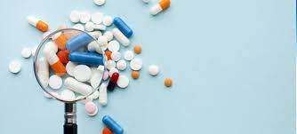
CONTENT : -
Introduction
Pharmacovigilance in India
Scope and Objectives
National Related programmers (NRP)
Why Pharmacovigilance
Methods in Pharmacovigilance
Spontaneous reporting
Mission
Vision

Slide 3
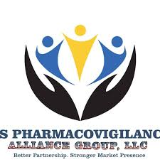
Introduction :-
Pharmaco - Vigilance
Pharmakon = Medicine
Vigilance = To keep watch
Alter of watchfulness
In respect of danger ; care ; caution

Slide 4
Detection
Introduction :-
Pharmacovigilance is a system to monitor the safety and effective of medicines and other pharmaceutical products.
Assessment
Understanding
Reporting
As per WHO :-
Pharmacovigilance as “science and activities relating to the detection assessment, understanding and prevention of adverse effects or any other possible drug-related problems”.
Prevention

Slide 5
Why Pharmacovigilance
Incomplete information collected during the pre- marketing phase of drug.
ADRs are leading cause of morbidity and mortality in both developing and developed world.
4th leading cause of death in USA.
30 – 70 % of all ADRs are Preventable .
They increase cost of patient care and loss of patient confidence in health care system.

Slide 6
Methods in Pharmacovigilance ….
Passive surveillance
Spontaneous reporting
Case series Study
Stimulated reporting
Active surveillance
Comparative observational studies
Cross sectional , case control and cohort studies
Targeted clinical investigations
Descriptive studies.

Slide 7
Spontaneous reporting
Health care professional describes his/ her own observation of a suspected ADR with marketed drug.
USA Med watch program
UK yellow card system

Slide 8
Impact of yellow card scheme :-
Year
Medicine
Adverse reaction
2014
2014
2013
2012
2011
2009
2003
Voriconazole
TNF alpha inhibitor
Risperidone and paliperidone
Statins
Citalopram and escitilopram
Finasteride
Aspirin
Liver and photo toxicity, squamous cell carcinoma
Risk of TB
Intraoperative floppy iris syndrome during cataract surgery
Hyperglycemia and diabetes
QT interval prolongation
Potential risk male breast cancer
Reyes syndrome in children’s under 16 years

Slide 9
Why do need Pharmacovigilance In India ?
India is a vast country with a population of over 1 – 2 billion with
Vast ethnic variability
Different disease prevalence patterns
Practice of different system of medicines
Different socioeconomic status .

Slide 10
Pharmacovigilance in India
Background :-
1989 – ADR monitoring system for India proposed ( 12 regional centers) .
19987 – India joined WHO- ADR monitoring programmed ( 3 centre's : AIIMS, KEM (King Edward Memorial ), , AMU ( Aligarh Muslim University )
2004 – 2008 – National Pharmacovigilance Programmed .
( * 2 Zonal , * 5 Regional , * 24 Peripheral , * Overseen by CDSCO )
2010 – Pharmacovigilance Programmed of India .

Slide 12
National Pharmacovigilance program (NPP)
The National Pharmacovigilance Program (NNP) officially inaugurated by the Central Health Minister at New Delhi
Established in 1968, the WHO Programme for International Drug Monitoring (PIDM) provides a global platform for Member States to exchange safety and regulatory information on all medicines and vaccines.

Slide 13
National Pharmacovigilance program (NPP)
Pharmacovigilance is the science of monitoring and assessing the safety, efficacy, and quality of drugs through pre-marketing clinical trials and post-marketing surveillance. Its main objective is to detect adverse effects that may arise from using various pharmaceutical products.
The Uppsala Monitoring Centre (UMC, WHO), Sweden is maintaining the international database of adverse drug reaction (ADR) reports received from several National Centre's. In September 2005, the database had 3.5 million adverse drug reaction reports and 78 countries were participating in this programme. Vigibase online (web based) system is used for submission of ADR reports.

Slide 14
Who to Report
Use the ‘Suspected Adverse Drug Reaction Reporting from’ which is available on the official website of IPC ( www.ipc.gov.in ) as well as CDSCO ( www.cdsco.nic.in ) to report any ADR. A reporter who is not a part of AMC can submit the ICSR to the nearest AMC or directly to the NCC.

Slide 16
National Coordinating Center
Preparation of SOPs, guidance documents & training manuals
Cross check completeness, causality assessment as per SOPs.
Reporting to CDSCO headquarters
Conduct training workshop of all enrolled centers.
Publications of medicine safety neswletters.

Slide 17
Personnel at zonal/ sub – zonal CDSCO
Provide procurement , financial and administrative support to ADR monitoring centers.
Report to CDSCO HQ
Personnel at CDSCO HQ : -
Take appropriate regulatory decision & action on the basis of recommendation of PvPI NCC at IPC Ghaziabad.
Propagation of medicine safety related decision to stakeholders.
Collaboration with WHO- Uppsala Monitoring Centre – Sweden.
Provide for budgetary provisions & administrative support to run PvPI

Slide 18
Which is the National Pharmacovigilance Centre?
All India Institute of Ayurveda, New Delhi is the National Pharmacovigilance Co-ordination Centre (NPvCC) for implementation of the Pharmacovigilance program for ASU & H Drugs.

Slide 19
Regional Centers Under PvPI
These regional centers are recognized as regional Resource Center.
Eastern Region : IPGMER , Kolkata
Western Region : KEM Hospital , Mumbai
Northern Region : PGIMER- Chandigarh
Southern Region : JSS Hospital , Mysore.

Slide 20
What is the importance of Pharmacovigilance for industry?
The Pharmacovigilance team in WHO aims to assure the safety of medicines and vaccines by ensuring reliable and timely exchange of information on safety issues, promoting Pharmacovigilance activities throughout the Organization and encouraging participation in the WHO Programme for International Drug Monitoring.

Slide 21
What is the scope of Pharmacovigilance in pharmaceutical industry
Pharmacovigilance involves activities related to understanding assessment, detection and prevention of adverse effects or any other drug-related problems
The aims of Pharmacovigilance within the industry are essentially the same as those of regulatory agencies; that is to protect patients from unnecessary harm by identifying previously unrecognized drug hazards, elucidating pre-disposing factors, refuting false safety signals and quantifying risk in relation to benefit.
Although the perspectives of companies and the regulatory agencies may be different they now work more and more closely together and share information.

Slide 22
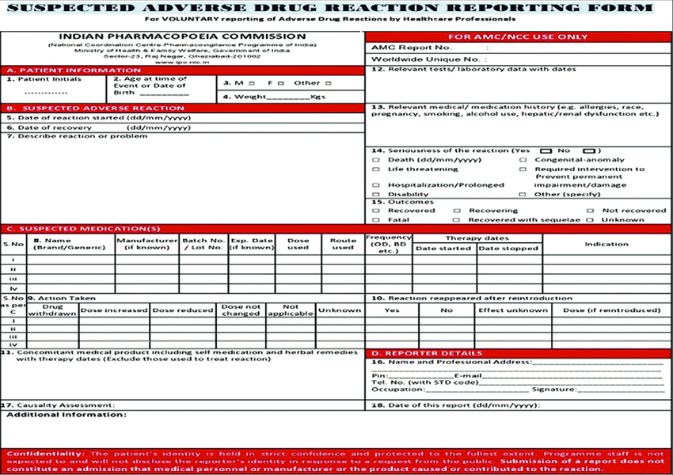

Slide 23
T
H
A
N
K
YOU

