Slide 1
Topic- PHARMACOVIGILANCE IN INDIA AND INTERNATIONAL ASPECTS

Slide 2
CONTENT : -
Introduction
Pharmacovigilance in India
Scope and Objectives
Mission
Vision
Short Term Goals

Slide 3
Pharmacovigilance in India
Introduction :-
Pharmacovigilance is a system to monitor the safety and effective of medicines and other pharmaceutical products.
As per WHO :-
Pharmacovigilance as “science and activities relating to the detection assessment, understanding and prevention of adverse effects or any other possible drug-related problems”.

Slide 4
Pharmacovigilance in India
Background :-
1989 – ADR monitoring system for India proposed ( 12 regional centers) .
19987 – India joined WHO- ADR monitoring programmed ( 3 centre's : AIIMS, KEM (King Edward Memorial ), , AMU ( Aligarh Muslim University )
2004 – 2008 – National Pharmacovigilance Programmed .
( * 2 Zonal , * 5 Regional , * 24 Peripheral , * Overseen by CDSCO )
2010 – Pharmacovigilance Programmed of India .

Slide 5
mission of Pharmacovigilance program in India
Initiated with AIIMS, New Delhi as National Coordination Centre (NCC) for monitoring ADRs in the country July 2010, shifted to India Pharmacopoeia Commission (IPC) , Ghaziabad on 15th April 2011 .
Vision :-
To improve patient safety and welfare of India population by monitoring the drug safety reducing the risk associated with use of medicines.
Mission :-
Safeguard the health of the Indian population by ensuring that the benefits of use medicine outweigh the risk associate with its use .
Notes:
MADE BY SATENDRA CAHAUHAN

Slide 7
National pharmacovigilance program (NPP)
The National Pharmacovigilance Program (NNP) officially inaugurated by the Central Health Minister at New Delhi.

Slide 8
Objective of Pharmacovigilance Programmed of India
To create a nation system for patient safety reporting.
To identify and analyse the new signal ADR from the reported cases.
To generate the evidence- based information on safety of medicines.
To support regulatory agencies in the decision- making process on use of medicines.
To communicate the safety information on use of medicine to various stakeholders to minimize to the risk.
To provide training and consultancy to other national Pharmacovigilance centers locates across globe.
To collaborate with other national centre's for the exchange of information and data management.
To promote rational use of medicine.

Slide 9
Short term goals
To develop and implement pharmaco-vigilance system in India.
To enroll , initially , all MCI approved medical colleges in the program covering north, south , east and west of India.
To encourage healthcare professionals in reporting of adverse reaction to drugs, vaccines, medical devices and biological products.
Collection of case report and data.

Slide 10
Long term goal
To expand the Pharmacovigilance programme to all hospitals ( govt. & private ) and centers of public health programs located across India.
To develop and implement electronic reporting system ( e- reporting ).
To develop reporting culture amongst healthcare professionals.
To make ADR reporting mandatory for healthcare professionals.

Slide 11
Performance & effectiveness of the Pharmacovigilance system
Who can Report
What to Report
Whom to Report
Healthcare professionals (clinical, dentist , pharmacist, nurses and other) can report suspected adverse drug reaction. Pharmaceutical companies can also send ICSRs specific for their product to NCC.
All type of suspected ADRs- irrespective of whether they are know or unknown, serious and non-serious, frequently or rare. Although Pharmacovigilance is primarily concerned with pharmaceutical medicines, adverse reactions associated with drugs used in traditional medicine ( e. g. herbal remedies ) should also be considered.
Use the ‘Suspected Adverse Drug Reaction Reporting from’ which is available on the official website of IPC ( www.ipc.gov.in ) as well as CDSCO ( www.cdsco.nic.in ) to report any ADR. A reporter who is not a part of AMC can submit the ICSR to the nearest AMC or directly to the NCC.

Slide 12
Organization committees under NCC
This :-
Steering Committee
Working Group
Quality Review Panel
Core Training Panel
Signal Review Panel

Slide 13
NCC working module
Letter of intent AMCs Coordinator
NCC - PvPI
Examine the Suitability
Approved by NCC
Vigi- Flow login provided by NCC to AMCs
AMCs- To perform the causality of the ADRs and furnish the mandatory field in the suspected ADRs form
AMCs- upload the ADR in Vigi- Flow send to
NCC – PvPI

Slide 15
Responsibilities of stakeholder
Personnel at AMC :-
Collection of ADR reports.
Perform follow up the complainant to check completeness as per SOPs.
Reporting to PvPI National Coordinating Centre.
Training/ sensitization / feedback / to physicians through newsletters circulated by the PvPI NCC.

Slide 16
Personnel at NCC
Preparation of SOPs, guidance documents & training manuals.
Data collation, Cross- cheek completeness , Causality Assessment etc as per SOPs.
Conduct Training workshops of all enrolled centers
Publication of Medicines Safety Newsletter.
Reporting to CDSCO Headquarters.
Analysis of the PMS, PSUR, AEFI data received from CDSCO HQ.

Slide 17
Personnel at zonal/ sub – zonal CDSCO
Provide procurement , financial and administrative support to ADR monitoring centers.
Report to CDSCO HQ
Personnel at CDSCO HQ : -
Take appropriate regulatory decision & action on the basis of recommendation of PvPI NCC at IPC Ghaziabad.
Propagation of medicine safety related decision to stakeholders.
Collaboration with WHO- Uppsala Monitoring Centre – Sweden.
Provide for budgetary provisions & administrative support to run PvPI.

Slide 18
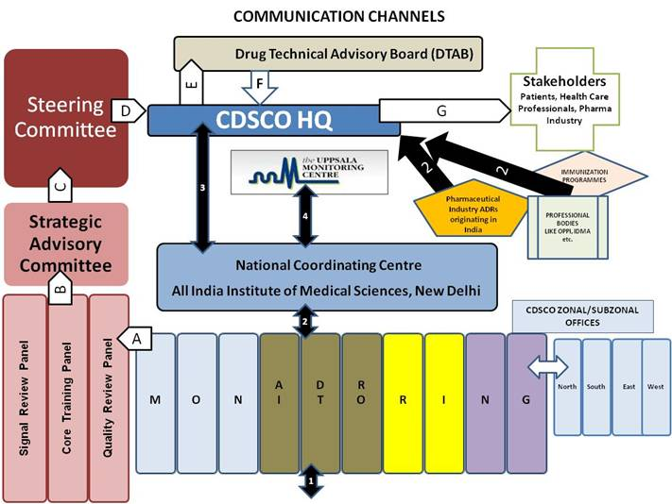

Slide 19
Phase or road map of pvip
Initiation phase (2010 – 2011 )
Expansion and consolidation phase ( 2011-2012)
Expansion and maintenance phase (2012- 2013).
Expansion and optimization ( 2013 – 2014 )
Excellence phase ( 2014 – 2015 ).

Slide 20
Vigiflow
Vigiflow is an Individual Case Safety Report ( ICSR) management system developed and hosted by Uppsala monitoring centre(UMC) .
How to access Vigiflow
Web address : https://adr.who-umc.org
Log in is done with a personal user name and password
From the secure web – page.

Slide 21
Vigiflow
The minimum information you have to enter on a spontaneous report for it to be considered ‘complete’ by Vigiflow is the following six mandatory fields :-
1. 2). 3).
4). Onset date 5). Reaction term 6). Drug name
Patient age (either DOB, age at time of onset or age group)
Report tile
Patient initial

Slide 22
Vigiflow demo chart
Login with Id and password
Quick start
1 2 3 4
REPORT INFO PAGE PATIENT PAGE TEST and Procedures RELEVANT MEDICAL
a) Patient Characteristics Page HISTORY PAGE
b) Death related information a) Result from test and
a) Report information procedure
section Free text Structured
b) Information on sender b) test information information
c) Information on Primary source
Free information Structured information

Slide 23
5
7
6
RELEVANT PAST DRUG THERAPY
REACTION PAGE
Reaction / Events- free text
Relatedness of Drugs to reaction
DRUG PAGE
Suspected Drugs
Concomitant Drugs
1
2
3
4
5
6
7
The CAUSALITY ASSESSMENT
Save Report
Save to NCC
Quality Review at NCC
Submit Report to UMC

Slide 24
T
H
A
N
K
YOU

