Slide 1
Safety Pharmacology
Safety pharmacology is a branch of pharmacology specialising in detecting and investigating potential undesirable pharmacodynamic effects of new chemical entities (NCEs) on physiological functions in relation to exposure in the therapeutic range and above.
Safety pharmacology studies are required to be completed prior to human exposure (i.e., Phase I clinical trials), and regulatory guidance is provided in ICH S7A and other documents.
These test are conducted at doses not too much in excess of the intended clinical dose.

Slide 2
SAFETY PHARMACOLOGY ICH S7(A+B) & E14 Guidelines Step 4, May12, 2005
1
S7A Guideline Safety pharmacology Studies for Human Pharmaceuticals.
2
S7B Guideline The Non-clinical Evaluation of the Potential for Delayed Ventricular Repolarization (QT Interval Prolongation) by Human Pharmaceuticals.
3
E14 Guideline The Clinical Evaluation of QT/QTc Interval Prolongation and Proarrhythmic Potential for Non-Antiarrhythmic drugs.

Slide 3
ORIGIN
The origins of safety pharmacology are grounded upon observations that organ functions (like organ structures) can be toxicological targets in humans exposed to novel therapeutic agents and that drug effects on organ functions (unlike organ structures) are not readily detected by standard toxicological testing.

Slide 4
The history of safety pharmacology
Safety pharmacology only came into effect in the 1990s as a result of the ICH (International Conference of Harmonization), which led to an ongoing project between scientists and regulatory bodies to set guidelines for safety and the potentially fatal effects of drugs on humans. The current guideline is known as the ICH S7A/S7B regulation.
For example, in the past, pharmaceutical companies sometimes used compounds containing lead in their drug testing procedures. At the time, the lethal effects of lead on the human body were not clear and there were no regulations to set standards for this form of drug development.
Today a drug must meet the regulations set by the EMA (European Medicines Agency) or the FDA (Food and Drug Administration) in the United States.

Slide 5
CONTENTS
1
objective of safety pharmacology
2
general considerations in selection/design
3
use of in vivo and in vitro studies

Slide 6
Conti……..
5
dose levels or concentrations of test substance
6
in vitro studies
4
sample size and use of controls

Slide 7
aim
To characterize pharmacodynamic /pharmacokinetic (PK/PD) relationship of a drug’s adverse effects using continuously evolving methodology.
To protect Phase I clinical trial volunteers from acute adverse effects of drugs.
To protect patients (including patients participating in Phase II and III clinical trials)
To minimize risks of failure during drug development and post- marketing phases due to undesirable pharmacodynamic effects.
OBJECTIVE OF SAFETY PHARMACOLOGY
SP studies are described in the international conference on harmonization (ICH) S7a and S7b guidelines.
According to ICH S7A

Slide 8
To identify undesirable pharmacodynamic properties of a substances.
To investigate the mechanism of action of a adverse pharmacodynamic effect .
To evaluate adverse pharmacodynamic and pathophysiological effect of a substance .
To help protect clinical trial participants and patients receiving marketed products from potential adverse effects of pharmaceuticals

Slide 9
GENERAL CONSIDERATIONS IN SELECTION/DESIGN
1) Effects related to the therapeutic class of the test substance, since the mechanism of action may suggest specific adverse effects.
2) Adverse effects associated with members of the chemical or therapeutic class
3) ligand binding or enzyme assay data suggesting a potential for adverse effects
4) Results from previous safety pharmacology studies, from secondary pharmacodynamic studies, from toxicology studies, or from human.

Slide 10
Importance of Safety Pharmacology
Determination of dosage regime, subject selection of novel compounds.
Helps in risk evaluation and hazard identification.
Critical step in design of clinical trials.

Slide 11
Safety Pharmacology Studies
The core battery SP studies, performed according to GLP standards as per ICH guidelines, involves the investigation of major vital organisms.
TIER- 1
CORE BATTERY
CVS
CNS
Respiratory
TIER-2
SUPPLEMENTARY STUDIES
Renal
GI system
Others

Slide 12
Continue……..
1. Safety Pharmacology Core Battery
2. Supplemental Safety Pharmacology Studies
Safety pharmacology core battery is to investigate the effects of the test substance on vital functions.
a) Follow-up Studies For Safety Pharmacology Core Battery These are meant to provide a greater depth of understanding than, or additional knowledge to, that provided by the core battery on vital functions for potential adverse pharmacodynamic
To evaluate potential adverse pharmacodynamic effects on organ system functions not addressed by the core battery or repeated dose toxicity studies

Slide 13
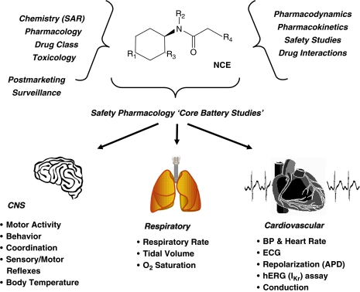

Slide 14
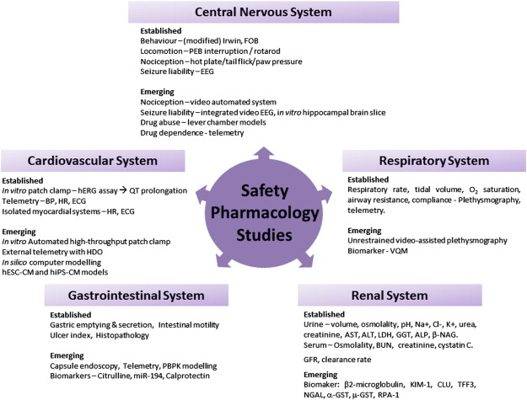

Slide 15
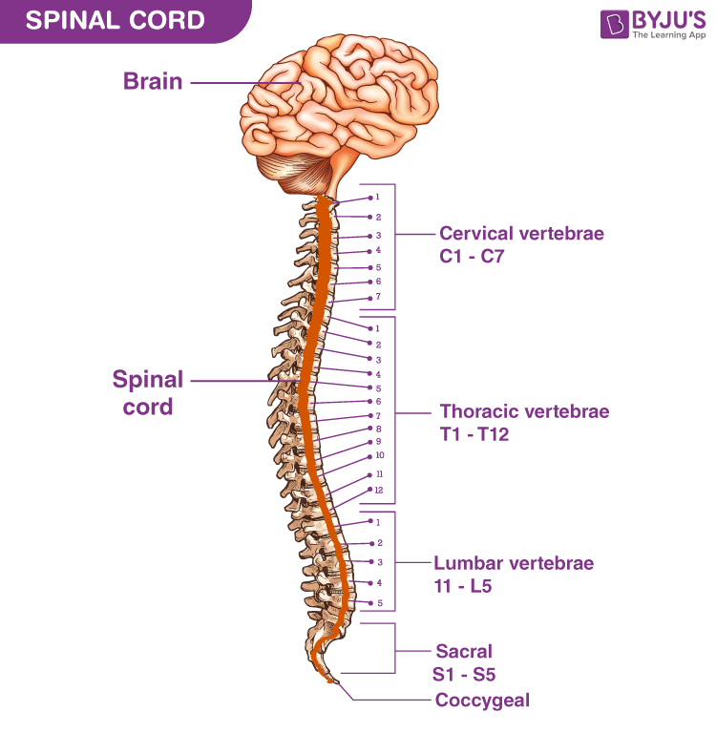
Central Nervous System
TIER- 1
In Core battery
Motor activity
In Follow-up studies
Learning and memory
Behavioral changes
Coordination
Sensory/motor reflex response
Body
Temperature
Ligand-specific binding
Neurochemistry
Visual & auditory examination

Slide 16
Evaluation Methods
1. Functional Observation Battery (FOB)
2. Irwin’s test
FOB method of evaluation involves Neurological and Neuropathological investigations
This method is to evaluate the qualitative effect of test substance on behavioural and physiological functions and also duration of action •

Slide 17
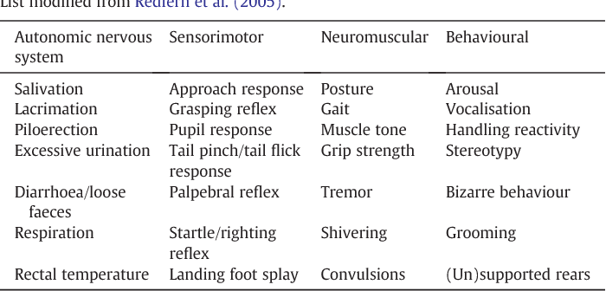
The parameters observed are…

Slide 18
Other evaluation techniques
Emerging Techniques
Rotarod
Hot plate test, Tail flick, paw pressure
Photoelectric beam interruption techniques.
Passive avoidance tests
Pentylenetetrazol (PTZ) seizure tests .
Electroencephalography (EEG)
Automated video systems .
Integrated video and EEG systems.

Slide 19
2. Cardiovascular Systems(CVS)
Core Battery
Blood Pressure
Heart rate
Follow up Studies
Cardiac output
Ventricular contractility
Vascular resistance
Endogenous & exogenous substances on the Cardiovascular response

Slide 20
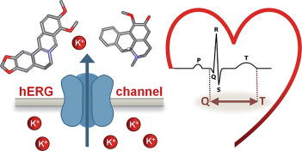
Evaluation methods
Electrocardiogram(ECG) Established techniques
In vitro hERG assay
The effects of an NCE on the hERG channel can be detected using screening methodologies such as
· Manual patch clamp
· Automated high-throughput patch clamp
· Isolated organ preparation
· Whole heart preparation
· Isolated purkinje fibre

Slide 21
3.Respiratory system
Core battery
Respiratory rate Airway resistance
Tidal volume compliance
Haemoglobin oxygen saturation pulmonary arterial pressure.
Follow up studies
blood gases
blood pH
Airway resistant compliance
Pulmonary artery pressure.
Notes:
core

Slide 22
Evaluation methods
Plethysmography
Head out Plethysmography
whole body plethysmography
Respiratory parameters:
Inspiratory Time (Ti, ms)
Expiratory Time (Te, ms)
Peak Inspiratory Flow (PIF, ml/s)
Peak Expiratory Flow (PEF, ml/s)
Tidal Volume (TV, ml)
Respiratory Rate (ResR, breaths/min)
Relaxation Time (Tr, ms)

Slide 23
HERG ASSAY
human ether –a-go-go related gene was first identified in late 1980’s in a mutant fruit fly.
hERG encodes the inward rectifying voltage gated potassium channel in the heart (IKr) which is involved in cardiac repolarization.
Inhibition of the hERG current causes QT interval prolongation resulting in potentially fatal ventricular tachyarrhythmia.
In humans it is expressed widely, including in the brain, adrenal gland, thymus, retina and in cardiac and smooth muscle tissues.

Slide 24
STRUCTURE OF HERG
A detailed atomic structure for hERG based on X-ray crystallography is not yet available, but structures have recently been solved by electron microscopy.
In the laboratory the heterologously expressed hERG potassium channel comprises 4 identical alpha subunits, which form the channel's pore through the plasma membrane.
Each hERG subunit consists of 6 transmembrane alpha helices, numbered S1-S6, a pore helix situated between S5 and S6, and cytoplasmically located N- and C-termini.

Slide 25
Conti….
The S4 helix contains a positively charged arginine or lysine amino acid residue at every 3rd position and is thought to act as a voltage- sensitive sensor, which allows the channel to respond to voltage changes by changing conformations between conducting and non- conducting states (called 'gating').
Between the S5 and S6 helices, there is an extracellular loop (known as 'the turret') and 'the pore loop', which begins and ends extracellularly but loops into the plasma membrane.
The pore loop for each of the hERG subunits in one channel face into the ion- conducting pore and are adjacent to the corresponding loops of the 3 other subunits, and together they form the selectivity filter region of the channel pore.

Slide 26
Supplemental Safety Pharmacology Studies
TIER-2
Renal/Urinary System Renal parameters should be assessed are -
· Urinary volume,
· specific gravity,
· Osmolality,
· pH, fluid/electrolyte balance,
· proteins, cytology, and
· blood chemistry determinations such as blood urea nitrogen, Na+, Cl-, K+, creatinine and plasma proteins

Slide 27
KIDNEY INJURY MARKER
FUNCTIONAL MARKER
LEAKAGE MARKER
Urinary
Protein
Albumin
Calcium
Glucose aspartate aminotransferase (AST),
Alanine amino- transferase (ALT),
lactate dehydrogenase (LDH),
α-glutamyl transferase (GGT),
alkaline phosphatase (ALP) 
N-acetyl-α-D-glucosaminidase (α-NAG)
New kidney injury molecule-1 (KIM-1) and
Markers Clusterin (CLU)
These kidney injuries are assessed primarily using histology

Slide 28
2. Gastrointestinal System
Gastric secretion
Gastrointestinal injury potential
Bile secretion
Transit time in vivo
Ileal contraction in vitro
Gastric pH measurement
Gastric emptying
Intestinal motility
Emesis induction

Slide 29
Evaluation methods
Barium sulphate (BaSO4) or a charcoal test meal
Pylorus ligation test
Emerging techniques
Endoscopy
Biomarkers
EMG Citrulline
miR-194
Calprotectin

Slide 30
Alternate models
Zebrafish model: anticonvulsant activity, locomotor activity, behavioural paradigms such as addiction, memory and anxiety.
human embryonic stem cell derived cardiomyocytes (hESC-CM) and
human inducible pluripotent stemcell derived cardiomyocytes (hiPS-CM) as models of in vitro high throughput drug screening and CVS safety assessment

Slide 31
Conditions under which Studies are not Necessary
Safety pharmacology studies may not be needed for locally applied agents. e.g., dermal or ocular .
cytotoxic agents with novel mechanisms of action, there may be value in conducting safety pharmacology studies.
For biotechnology-derived products that achieve highly specific receptor targeting, it is often sufficient to evaluate safety pharmacology endpoints as a part of toxicology and/or pharmacodynamic studies, and therefore safety pharmacology studies can be reduced or eliminated for these products.
For biotechnology-derived products that represent a novel therapeutic class and/or those products that do not achieve highly specific receptor targeting, a more extensive evaluation by safety pharmacology studies should be considered
A new salt having similar pharmacokinetics and pharmacodynamics properties- safety pharmacology studies are not necessary

