Slide 1
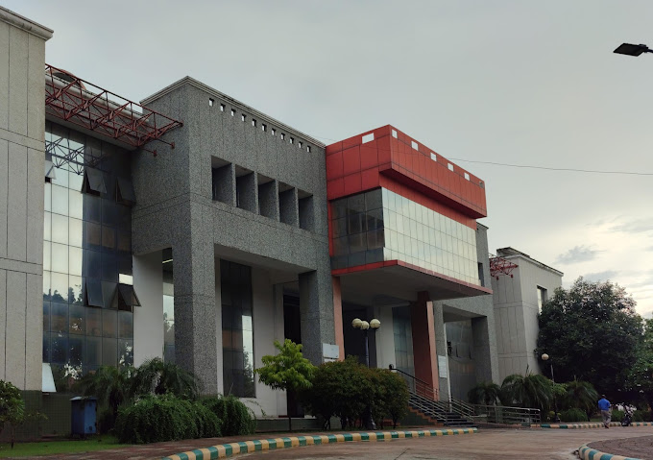
Presentation on- Targeted Clinical Investigation

Slide 2
Contents
Targeted clinical investigation
Pharmacokinetic & PD studies
Genetic testing
Interaction studies
Large simplified trial

Slide 3
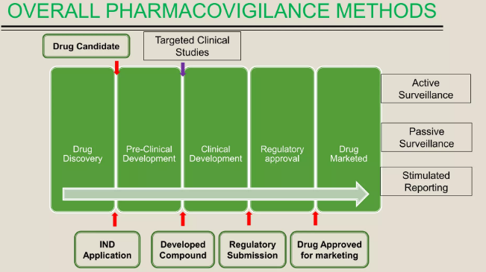
Targeted clinical investigation
Targeted clinical investigation is the pharmacovigilance methods.
OVER-ALL PHARMACOVIGILANCE METHOD

Slide 4
Targeted clinical investigation
When significant risks are identified from pre-approval clinical trials, further clinical studies might be called for to evaluate the mechanism of action for ADRs.
This investigation includes-
> PK and PD studies
> Genetic testing
> Interaction studies
> Large simplified trial

Slide 5
PK and PD studies
Pharmacodynamics is the study of how a drug affects an organism, whereas pharmacokinetics is the study of how the organism affect the drug.
Pharmacodynamic and pharmacokinetic studies are conducted to determine whether a particular dosing instruction can put patients at an increased risk of adverse events.

Slide 6
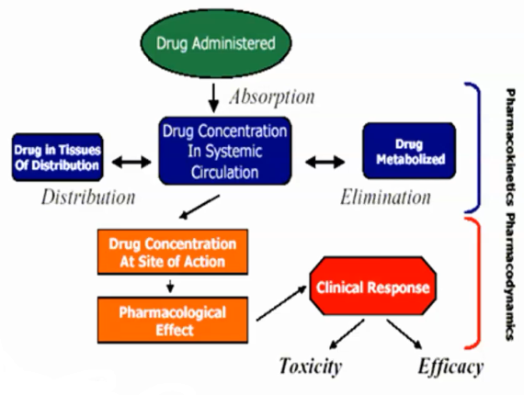

Slide 7
Genetic Testing
It is the study of a person’s DNA in order to identify genetic differences or susceptibility to particular diseases or abnormalities.
Several methods can be used for genetic testing:
Molecular genetic tests
Chromosomal genetic tests
Biochemical genetic tests

Slide 9
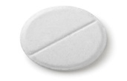
Interaction studies
Based on the pharmacological properties and the expected use of the drug in general practice, conducting specific studies to investigate potential drug-drug interaction and food-drug interaction might be called for
Possible effects Possible effects
Drug
Drug
Drug
F Food
Decrease action of drugs
Increase action of drugs
Cause Adverse Effects
Decrease Action of drugs
Increase action of drugs
Cause Adverse Effects

Slide 10
Drug- Drug interactions
Drug- drug interactions occur when a drug interacts , or interferes, with another drug. This can alter the way one or both of the drugs act in the body, or cause unexpected side effects.
Aspirin + Warfarin Synergism (excessive bleeding)
Antibiotic + Blood thinner Antagonism (less effect)
Codeine + Paracetamol Addition (increased analgesic effect)
Clavulanic acid + Amoxicillin Synergism (increased antibiotic effect)
NSAID+ Cox2 inhibitors Synergism (increased bleeding)
SSRI,S + VITAMIN K Synergism (increased bleeding)
Anti emetics + Tranquilizers Unknown effect (Breathing problems)
H2 Blockers +PPI’s Alteration (increased ph of stomach)
Phenobarbitol + Warfarin Antagonism (less effect)
Erythromycin + Warfarin Synergism ( increased bleeding)

Slide 11
Drug-food interactions
A drug-food interaction happens when the food you eat affects the ingredients in a medicine you are taking so the medicine cannot work the way it should.
Bisphosphonates+ Any drug Reduced effectiveness of drug’
Benzodiazepines + grapefruit Inhibit enzyme involved in drug metabolism
Digoxin + Oatmeal Decreased adsorption of drug
Aspirin + Milk Upset stomach
Acetaminophen + Alcohol Liver damage
MOA Inhibitors + Food (tyramine) Severe headache
Tetracycline + calcium food Reduced absorption of drug
Warfarin + Vitamin K Reduced effect of drug
Celecoxib + milk Upset stomach
Naproxen + Fatty food Upset stomach
Oxycodon + Alcohol Coma, asthma
Caffeine + Food Rapid heart beat

Slide 12
Large simplified trial
It is a type of randomized clinical trial ideally suited to answer many important clinical questions and because it typically answers only one or two questions in a broader patient population, is generally more efficient and less expensive than other large randomised clinical trials.
It has a large sample size and statistical power to detect clinically relevant treatment effects, Providing unambiguous result and minimizing the effects of random errors.

