Slide 1
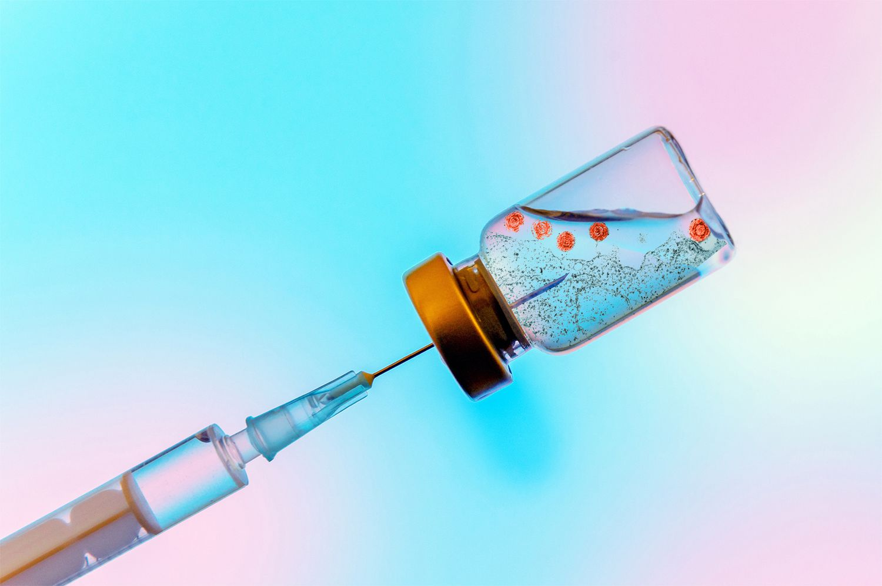
Vaccine Pharmacovigilance
Vaccine Pharmacovigilance
Definition- According to the CIOMS/WHO working group on vaccine pharmacovigilance,
Vaccine pharmacovigilance is defined as “the science and activities relating to the”
o Detection,
o Assessment,
o Understanding and
o Communication
of adverse events following immunization and other vaccine or immunization-related issues, and to the prevention of untoward effect of the vaccine or immunization.

Slide 2
Importance of vaccine safety
Decreases in disease risk and increased attention on vaccine risks
Public confidence in vaccine safety is critical
Low tolerance for vaccine risks
– Higher standard of safety is expected
– Vaccinees generally healthy
– Lower risk tolerance = need to search for rare reaction

Slide 3
Steps of vaccine pharmacovigilance
Detect signal suggesting AEFI is related to vaccine.
Develop hypothesis about causal association between an AEFI and vaccination
Test hypothesis through appropriate epidemiological method

Slide 4
Vaccine provide by Govt. of India
Govt. of India is providing vaccination to prevent 7-vaccine preventable disease (VPDs) namely,
>Diphtheria,
>Pertussis,
>Tetanus,
>Polio,
>Measles,
>Hepatitis B,
>BCG
>JE vaccination,
>Hib (given as pentavalent containing Hib+DPT+Hep B

Slide 5
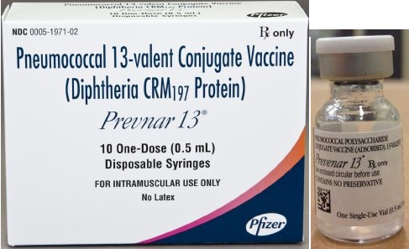
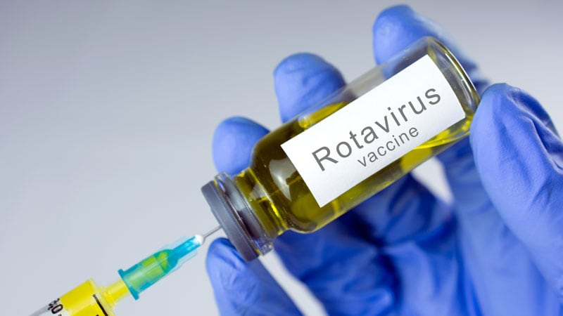
Other vaccines......
1- Pneumococcal vaccine
2-Rotavirus vaccine
3-Hepatitis A
4-MMR
5-Influenza
6-Meningococcal
7- Cholera
8- JE
9- HPV
10-Varicella
11- Typhoid

Slide 6
Source for vaccine safety
> Local health workers
> Health education campaigns
> Visiting experts
> Online resources and communication network
> Religious and/or community leader
> Parents, guardians and vaccine
> Radio and telivision
> printed material
> Video or DVD

Slide 7
Which AEFIs should be reported?
• Serious AEFI
• Signal and events associated with newly introduced vaccine
• AEFI that may have been caused by an immunization error
• Significant events of unexplained cause occurring within 30 days after a vaccination
• Event causing significant parental or community concern
• Swelling, redness, soreness at the injection site IF it lasts for more than 3 days or swelling extended beyond nearest joint

Slide 8
Adverse event following immunization (AEFI)
Definition-
An AEFI is any untoward medical occurrence which follows immunization and which does not necessarily have a causal relationship with the usage of the vaccine.
The adverse event may be
any unfavourable or unintended sign, abnormal laboratory finding, symptoms or disease.

Slide 9
Classification
Vaccine product-related reaction
An AEFI that is caused or precipitated by
vaccine due to one or more of the inherent
properties of the vaccine product.
Extensive limb
e.g. swelling following DTP vaccination.

Slide 10
Vaccine quality defect-related reaction
An AEFI that is caused or precipitated by a vaccine
that is due to one or more quality defects of the
vaccine product inducing its administration device as
provide by the manufacturer.
Ex. Failure by the manufacturer to completely
inactivate a lot of inactivated polio vaccine leads to
cases of paralytic polio.

Slide 11
Immunization error-related reaction
An AEFI that is caused by inappropriate vaccine handling, prescribing or administration.
Ex. Transmission of infection by contaminated multidose vial.

Slide 12
Immunization anxiety-related reaction
An AEFI from anxiety about the immunization.
e.g. Vasovagal syncope in an adolescent following vaccination.

Slide 13
Coincidental event-
An AEFI that is caused by something other than the vaccine product, immunization error or immunization anxiety.
e.g. A fever after vaccination (temporal association) and malarial parasite isolated from blood

Slide 14
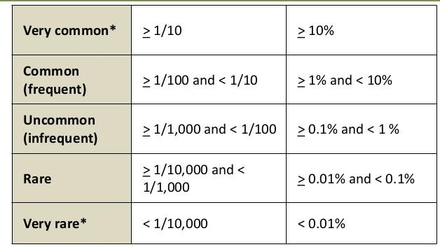
AEFI Frequency Terminology

Slide 15
Two type of vaccine reaction-
Minor
Severe

Slide 16
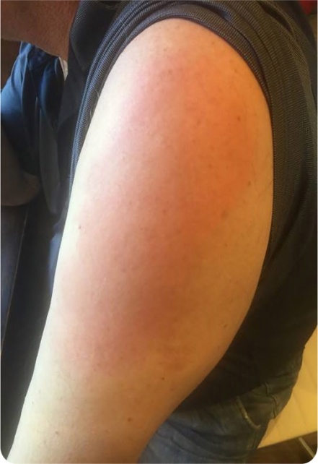
Minor reaction
Usually occur within a few hours of injection.
Resolve after short period of time and pose little danger.
Local (includes pain, swelling or redness at the site of injection).
Systemic (includes fever, malaise, muscle pain, headache or loss of appetite).

Slide 17
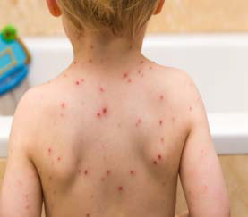
Severe reaction
Usually do not result in long-term problems.
Can be disabling.
Are rarely lives threatening?
Include seizures and allergic reactions caused by the body’s reaction to a particular component in a vaccine.

Slide 18
Serious AEFI cases (formats and timelines)

Slide 19
Vaccine Evaluation
Pre-licensing
Randomised, Blinded, Controlled Clinical Trials Vaccine efficacy:
Protective Effect under Idealised Conditions RTC: controlled experiments, simple interpretation
Post-licensing
Observational Studies
Vaccine effectiveness
Protective Effect under Ordinary Conditions of a public health programme
Prone to bias, more complex interpretation

Slide 20
Basic Calculation of Vaccine Evaluation
VE(%) = (ARU-ARV/ARU).100

Slide 21
Precaution-
A condition in a recipient which may increase the chance or severity of an adverse event, or
May compromise the ability of the vaccine to produce immunity.

