Slide 1
UNIT 3
REHABILITATION

Slide 2
Passive Exercises
Passive exercises are also called “passive ROM (Range of Motion)” movements and allow you to move through the full range of your joints without any effort on your body part. your range of motion includes how far you can move your joints in different directions. Passive exercises help prevent stiffness in your joints. Someone else will help you move / stretch your muscles because you may have an underlying injury or weaknesses in certain areas of your muscle that need to be released to have a better training.

Slide 3
Passive exercises for knee
Range of Motion
Wall Slides - Lie on your back and bend your affected knee 90° with your foot flat against the wall. Slowly slide your foot down the wall by bending your knee as far as possible. Hold for 5-10 seconds and then slowly help raise the affected knee back using the healthy leg.
Passive Knee Flexion - Insert your foot through the loop of an exercise strap and lie on your stomach. Gently pull the strap handle until your knee is flexed to the point of tightness. Hold for 5-10 seconds and then relax.
Passive Knee Extension - Sit on the floor and fully extend your affected knee. Place a pillow under your ankle and a weight over your knee. Allow your knee to reach full extension by relaxing your muscles.
Prone Leg Hang - Lie on your stomach with a pillow under your affected knee. Allow your leg to hang freely. To assist in gaining full knee extension, a weight may be placed over your heel.
Calf Stretch - Face a wall and stand with your rear leg straight and your front leg slightly bent. With you heels on the floor, lean towards the wall until the calf muscle in your rear leg is tight. Be sure not to bounce and hold the position for 10 seconds and then relax.

Slide 4
Groin Stretch - Sit on the floor and put your feet together. Ask your partner to firmly push your knees outward. Hold for 10 seconds and then relax.
Hamstring Stretch - Insert your foot through the loop of an exercise strap and lie on your back. While keeping your affected knee straight, pull the strap handle until your leg is tight. Hold for 5-10 seconds and relax. Resistive Knee Extension
STRENGHT
Straight Leg Raises
Toe Raises
Resistive Knee Extension
Hamstring Strengthening
Hip Flexion
Hip Extension
Hip Adduction
Hip Abduction

Slide 5
ACTIVE EXERCISE
Active exercise is any exercise in which a person must exert force to complete a move. One can use active exercise to improve one’s strength, flexibility, conditioning, and overall functional capacity.
Active exercises involve your physical effort exerted into muscular activity.
When you’re doing the exercises yourself, it’s active exercise.
Active exercises can be range-of-motion exercises or general exercises to move the body and help strengthen the neural signals that communicate with your body to perform movements.

Slide 6
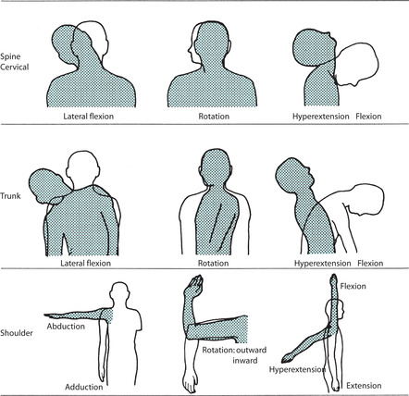

Slide 7
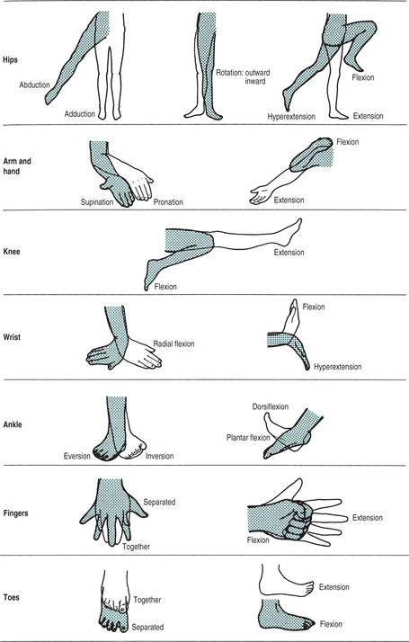

Slide 8
There are three main categories of actives exercises - Free exercise, Assisted exercise and Resisted exercise. Assisted exercises are utilized for very weak muscles whose force of contraction is not sufficient to complete the movement and therefore, assistance of external force is needed to complete the movement. The external force of assistance is usually provided by YOUESELF
Sometimes mechanical devices are also used to assist the completion of the movement. Assistive exercise is used in the early stage of strengthening of very weak muscles.
When the voluntary contraction of the muscle is insufficient to produce movement, An external force may be added to the complete range.
This external force must be applied in the direction of the muscle action.
As the muscular power is increasing, the assistance given must be decreased proportionally.

Slide 9
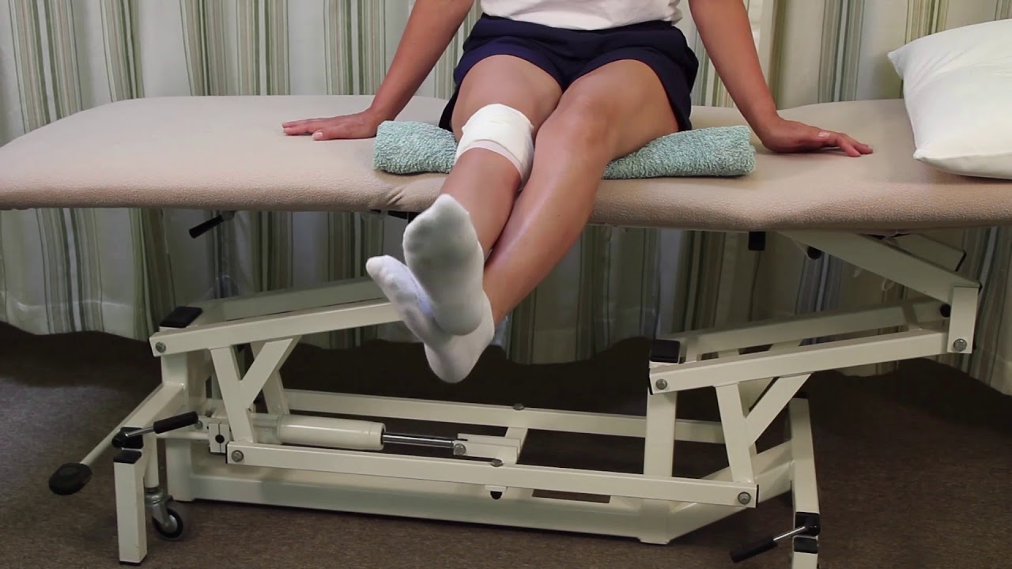
ACTIVE ASSISTED KNEE EXTENSION WITH HEALTHY KNEE SUPPORT ACTIVE ASSISTED KNEE FLEXTION WITH HEALTHY KNEE SUPPORT

Slide 10
Resisted exercise is performed against a force that tends to oppose the force of muscle contraction. In this type of exercise a force is applied to resist the active movement in order to make it difficult. Resisted exercises are used to increase the strength and the size of a muscle. Resisted exercise is also known as strength training.
Exercise with weight

Slide 11
STRETCHING
Stretching is a form of physical exercise in which a specific muscle or tendon is flexed or stretched in order to improve the muscle's elasticity and improve range of motion.
Stretching can be dangerous when performed incorrectly. There are many techniques for stretching in general

Slide 12
Static stretching
The simplest static stretches are static stretches. This brings the joint to its end range of motion and hold it there using external forces.

Slide 13
Dynamic stretching
Dynamic stretching is a movement-based stretch aimed at increasing blood flow throughout the body while also loosening up the muscle fibers. Standard dynamic stretches typically involve slow and controlled active contraction of muscles. An example of such a dynamic stretch is lunges. Another form of dynamic stretching is ballistic stretching, which is an active stretch that involves bouncing or swinging back and forth at a high speed in order to take a muscle beyond its typical range of motion using momentum.

Slide 14
PNF
There are more advanced forms of static stretching, such as proprioceptive neuromuscular facilitation (PNF), which involves both active muscle contractions and passive external forces. PNF stretching may involve contracting either the antagonist muscles, agonist muscles, or both
Contract-relax method (CR)
target muscle (TM) being lengthened (“stretched”)
hold in stretch position while the person contracts (activates) the TM to 50-60% of maximum isometric contraction for 4-6 seconds
follow this with a shorter relaxation of the muscle for 2-3 seconds “let go”
during this time a passive stretch by another person assisting the technique, stretches the muscle even further than the initial passive stretch ( take further into range)
the final passive stretch is held for 10-15 seconds
the muscle is then relaxed for 20 seconds before performing another PNF repetition

Slide 15
Basic Principles of PNF:
Manual Pressure – Placement of hands in direction of the desired movement.
Visual Stimulation – Show the patient how to do the desired movement. Give starting and end points to the patient.
Quick Stretch – Trigger the stretch reflex of the muscle spindles. Not necessary in orthopedic problems. (Not used with pain).
Maximum Resistance – Amount of resistance, which allows the patient to move rhythmically and pain free through the entire range of motion.
Build up tension to maximum and maintain until strength starts to decline, then gradually release.
Timing – Distal to proximal or proximal to distal. Use the stronger components to irradiate to the weaker. (P to D means strong P to irradiate D). (D to P means strong elbow to irradiate weak shoulder).

