Slide 1
ORGANIZATIONAL BEHAVIOR
UNIT – 1ST : ORGANIZATION

Slide 2
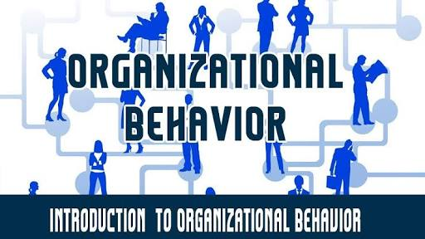
INTRODUCTION : ORGANIZATION BEHAVIOR
Organizational behavior (OB) can be defined as the understanding , prediction and management of human behavior both individually or in a group that occur within an organization .
‘Organization +Behavior =Organization Behavior’
Organization: An org. is a collection of 2 or more people who work together to achieve pre –determined and agreed goals.
Behavior : It is verbal or physical response shown by a person as a consequence of the impact of his/her surroundings .

Slide 3
Meaning and Definitions of OB
Organizational Behavior is the study of individuals , group and organizational systems.
OB is considered as an Art of applied science which deals with the emotions , feelings , believes , perceptions, intellectually and mentality of people working in an organization.
Acc to Robbin “OB is field of study that investigates the impact that individual , group and structure have on behavior within org.

Slide 4
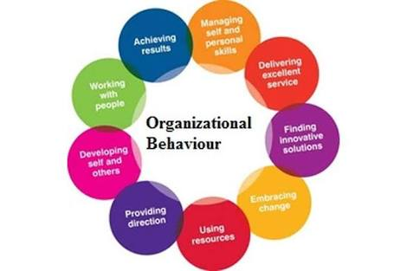

Slide 5
Why to study OB ?
To understanding level of motivation and satisfaction of employees.
Skill development (To enhance abilities & knowledge )
To helps in increasing effectiveness & efficiency of the org.
-Effectiveness (doing the things right )/ Ability to perform a task.
- Efficiency (Performing or functioning in the best possible manner with the least waste of time and effort)
To create healthy & ethical environment in the org.
OB helps in utilising the resources to the optimum level.
Overall , it improves the goodwill of the org.

Slide 6
What is Organization
Organization means “People that work together”
In simple words, Org. refers to a group of two or more persons who work together for achieving goals .
Acc to R.C Davis “Org. is a group of people who are co-operating under the direction of leadership for the accomplishment of a common end.”

Slide 7
Contd….
Org. has basically been defined in three ways :
1- As a group of people
2- As a process
3- As a structure …..

Slide 8
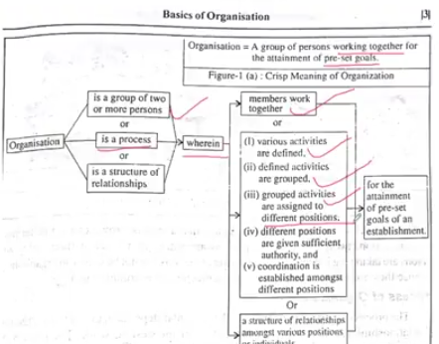
Contd….

Slide 9
Key elements and components of organization
People
Structure
Technology
Environment
These are major factors that affect organization behavior …..

Slide 10
Contd….

Slide 11
Contd....

Slide 12
Nature of Org. Behavior
A Separate field of study and not a single discipline
An interdisciplinary approach (information comes from various discipline )
An applied science
A normative science
It is a science as well as art
A humanistic and optimistic approach
A total system approach

Slide 13
1-A Separate field of study and not a single discipline : Discipline is an accepted science that is based on theoratical foundation .But OB has multi-disciplinary and not based on a specific theoratical background
2- An interdisciplinary approach : To study human behaviour at work , Tries to integrate the relevant knowledge drawn from related disciplines like – psychology ,sociology and anthropology.
3-An applied science : Involves both applied research and its application in organizational analysis.
4-A normative science : with the positive science discuss only cause effect relationship . OB deals with what is accepted by individuals and society engaged in an organization.

Slide 14
5- A humanistic and optimistic approach : Treats people as thinking and feeling human being . Based on the belief that people have an innate desire to be independent, creative and productive.
6- A total system approach : The system approach is one that integrates all the variables, affecting organizational functioning.

