Slide 1
UNIT -2
POSTURE

Slide 2
Curves of the Spine
The normal spine has an S-shaped curve when viewed from the side. This shape allows for an evenly distribution of weight and flexibility of movement. The spine curves in the following ways:
The cervical spine curves slightly inward, sometimes described as a backward C-shape. The normal curvature of this part of the spine is 20 to 40 degrees.
The thoracic spine curves outward, forming a regular C-shape with the opening at the front. This part of the spine is important for standing up straight and achieving balance. A normal curvature for this part of the spine is 20 to 40 degrees.
The lumbar spine curves inward and, like the cervical spine, backward C-shape. and curvature of 40 to 60 degrees is normal here.
These curves balance each other, so your head should be aligned with your hips when standing up straight. This position works to minimize the effect of gravity and shock absorbers to distribute mechanical stress during movement and allows you to have good posture .
While most people have a slight sideways curve, the spine should not curve more than 10 degrees to the left or right.

Slide 3
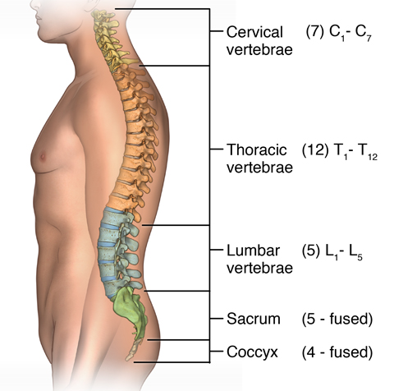
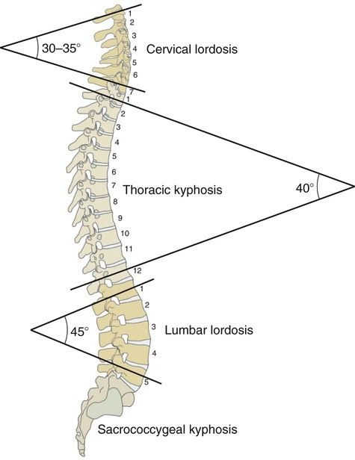

Slide 4
Lordosis
Your cervical spine and lumbar spine are naturally curved a little forward, toward the front of your body. This naturally occurring lordosis helps you maintain your posture and absorb shock when you move.
Lordosis develops if your spine curves too much and pushes your posture out of its usual alignment. You might see lordosis that affects your lumbar spine called swayback. In the lumbar spine, a 40- to 60-degree curve is typical.

Slide 5
Causes of Lordosis(Swayback)
Some common causes are:
Fractures.
Discitis is inflammation of intervertebral disc space.
Kyphosis may force the low back to compensate for the imbalance created by a curve occurring at a higher level of the spine.
Obesity may cause some overweight people to lean backward to improve balance. This has a negative impact on posture.
Osteoporosis is a bone density disease that may cause vertebrae to loose strength, compromising the spine's structural integrity.
Spondylolisthesis occurs when one vertebra slips forward in relation an adjacent one, usually in the lumbar spin

Slide 6
8 of the best lordosis exercises
Plank
Side plank
Pelvic tilt with exercise ball
Superman
Crunches
Quadruped arm opposite leg raises
Dead bug
Hip bridge

Slide 7
Kyphosis
Kyphosis is an exaggerated, forward rounding of the upper back.
In older people, kyphosis is often due to weakness in the spinal bones that causes them to compress or crack. Other types of kyphosis can appear in infants or teens due to malformation of the spine or wedging of the spinal bones over time.
Mild kyphosis causes few problems. Severe kyphosis can cause pain. Treatment for kyphosis depends on your age.

Slide 8
Causes
The shape of vertebrae can be changed by
Fractures. Broken vertebrae can result in curvature of the spine. Compression fractures, which can occur in weakened bone, are the most common. Mild compression fractures often don't produce noticeable signs or symptoms.
Osteoporosis. Weak bones can cause spinal curvature, especially if weakened vertebrae develop compression fractures. Osteoporosis is most common in older women and people who have taken corticosteroids for long periods of time.
Disk degeneration. Soft, circular disks act as cushions between spinal vertebrae. With age, these disks flatten and shrink.
Other problems. Spinal bones that don't develop properly before birth can cause kyphosis.

Slide 9
Exercises for kyphosis
Knee rolls
Lie on the floor with the knees bent and feet flat on the floor.
Move the knees slowly to one side until the back feels tense.
Repeat at least five times on each side.
Pelvic tilting
Lie on the floor with the knees bent and feet flat on the floor.
Slowly arch the back, keeping the buttocks and upper back flat on the ground.
Hold the arch for a few seconds before returning to a fully flat position.
Repeat at least five times.
Knees to chest
Laying in the same position as the previous two exercises, bring one knee up towards the chest.
Clasp the hands around the knee and gently pull the knee closer to the chest.
Hold this position for a few seconds, then release.
Repeat at least five times on each leg.

Slide 10
Flat Back Syndrome
Flat Back Syndrome is a disorder in which the lower part of the vertebral column loses some of its normal anatomical curve and becomes straight. In people suffering from this condition, front to back imbalance in the vertebral column takes place. This front to back imbalance is also known as a sagittal imbalance.

Slide 11
Causes of Flat Back Syndrome
There may be many causes of this condition, some of which are:
Degenerative Disc Disease. When disc degeneration occurs, the vertebral column starts leaning forward and the lumbar curve decreases. The patient thus suffers from pain and stiffness because of degenerative disc disease.
Compression fractures. Osteoporosis is an age-related bone degenerative process which leads to weakness of spinal bones and compression fractures.
Ankylosing Spondylitis (FUSION OF THE BONES). This results in pain, swelling, and stiffness in the entire length of the vertebral column. In some patients of ankylosing spondylitis, a decrease in the lumbar region lordosis and an increase in the thoracic region kyphosis takes place. This causes the patient to have an increased forward posture.
After Scoliosis Treatment. Flat back syndrome sometimes takes place after the correction of scoliosis. This is due to rods being used to correct the abnormal curvature in the patients of scoliosis. These rods also have a tendency to cause the side effect of straightening the normal anatomical curvatures of the back.

Slide 12
EXERCISES FOR FLAT BACK SYNDROME
Serpent Pose (Bhujangasana)
Standing Forward Bneding
Foam Rolling
Chair March
Superman
Quadruped arm opposite leg raises

Slide 13
Scoliosis
Scoliosis is a sideways curvature of the spine that most often is diagnosed in adolescents.
Most cases of scoliosis are mild and don’t need treatment. In adults, the degree of the spinal curve may or may not determine. Scoliosis only becomes a factor when surgery is being considered. Changes in the appearance of the body are also possible depending on the degree of the spinal curve.
Some children will need to wear a brace to stop the curve from worsening. Others may need surgery to straighten severe curves

Slide 14
Causes
Causes
Doctors don't know what causes the most common type of scoliosis — although it appears to involve hereditary factors, because the disorder sometimes runs in families.
Below are some of the possible causes of scoliosis:
Neuromuscular conditions: These conditions affect the nerves and muscles. They include cerebral palsy, and muscular dystrophy.
Congenital scoliosis: Congenital means that the condition was present at birth. Scoliosis is rare at birth, but it can occur if the bones in the spine develop abnormally when the fetus is growing.
Specific genes: Researchers believe that at least one gene plays a role in the development of scoliosis.
Leg length: If one leg is longer than the other, an individual may develop scoliosis.
Other causes: Poor posture, carrying backpacks, connective tissue disorders, and some injuries can cause spinal curvature.

Slide 15
Exercises
In severe cases, scoliosis can progress over time. In these cases, a doctor may recommend spinal fusion. This surgery reduces the curvature of the spine and prevents scoliosis from getting worse.
Therapeutic exercise for scoliosis can:
Pelvic Tilts
Cat-Camel
Double-Leg Abdominal Press
Single Leg Balance
Plank Exercise
Bird Dog

Slide 16
Rounded shoulders,
Its sometimes known as “mom posture,” are part of overall bad posture, and they can get worse if left untreated.
It describes the common postural problem when the shoulders, sit forward of the midline of the body (when looking at the body side-on). If you find that you feel slouched or hunched, you probably have rounded shoulders to some degree.

Slide 17
cause
Daily tasks that may contribute to rounded shoulders include:
using a smartphone or tablet
using a computer or laptop
sitting for long periods
driving a vehicle
bending over repeatedly
carrying heavy objects all day
Increased stress on the shoulder joints can cause pain around the neck and upper back.

Slide 18
Exercise
It may take time to notice the adjustment to the shoulders, but it is better not to rush or force the body into a position that is not comfortable.
Handclasp
The handclasp stretch is simple and can be done every day. Standing up straight with the hands by their sides, a person reaches their hands behind them to clasp them together.
Gently, they then pull the shoulders back, while taking care not to allow the neck to push forward.
The shoulders should be pulled back until the chest opens and a deep stretch is felt. The position should be held for 30 seconds.
Door chest stretches
Standing straight in front of a doorframe, a person should place one hand on either side of the frame, just above head height.
Moving one foot forward and gently lunging past the frame will stretch the chest and shoulders. Hold this position for 30 seconds.

Slide 19
Shoulder blade squeeze
This basic exercise reminds the body what good posture feels like, and helps build strength throughout the day.
Sitting up tall, a person should move both shoulder blades together, as if trying to hold a tennis ball between them. As they flex, the shoulders should move down and away from the ears.
A person begins by standing with their tailbone, lower back, upper back, and head against a wall. The feet are positioned slightly away from the wall. The arms are pressed flat against the wall, keeping the elbows at a 90 degree angle.
This position is held for 30 seconds to a minute to provide a gentle stretch and workout for the shoulders and upper back.
Wall angels
To do a wall angel, a person stands with their back to a wall, feet positioned slightly forward, keeping the arms pulled back to remain in contact with the wall at all times.
The arms start in a ‘W’ position, which resembles a person flexing both of their biceps. Both arms are against the wall.
The hands are then extended upwards towards the ceiling while keeping the shoulders down and flexed. Then the arms are returned to the starting ‘W’ position. This move is one repetition. Ideally, 10 such repetitions should be done during each training session.

Slide 20
Knock knees (Genu valgum)
Knock knees is when there's a gap between your ankles when you stand with your knees together. It's common in children aged 3 to 6 and usually gets better on its own as they grow without causing any problems.
Knock knee is a condition in which the knees bend inward and touch or "knock" against one another..

Slide 21
Causes of knock knees
Knock knees in children is a normal part of growth and development, and it usually gets better as they get older.
an injury to the knees or legs
osteomyelitis (a bone infection)
arthritis
vitamin D deficiency
some genetic conditions which affect the joints
physical trauma (injury)
rickets
growth plate injury
benign bone tumors
fractures that heal with a deformity (malunion)

Slide 22
Exersices
Side lunges
Lying abduction
Wall squat
Orthotics
Surgery

Slide 23
Bow Legs (Genu Varum)
Bow legs (or genu varum) is when the legs curve outward at the knees while the feet and ankles touch. Infants and toddlers often have bow legs. Sometimes.

Slide 24
What causes bowed legs in babies?
Blount’s disease. Blount’s disease (tibia vara) is a growth disorder caused by an issue in the growth plate of your child’s shin bone. Blount’s disease is more common in African American children, children who are overweight and children who walked early.
Rickets. Rickets is caused by a calcium or vitamin D deficiency. Deficiencies in these important nutrients make your child’s bones softer and weaker, causing his or her legs to bow. Rickets is very rare in the United States but still occurs often in developing countries.
Other bone issues. Fractures that haven’t healed correctly and abnormally developed bones (bone dysplasia) can cause bow legs.
Blount’s disease: This condition causes abnormal development of the shins and shin curves below the knees. Once the child starts walking, the disease worsens the bow legs. Over time, the condition may lead to knee joint problems as well.
Bone dysplasia: This is a general term for many conditions that affect bone and cartilage growth, leading to abnormalities in bone size or shape.
Dwarfism: The most common form of dwarfism is caused by a condition known as achondroplasia, which is a bone growth disorder that can lead to bow legs.
Infection or injury: Prior infection, injury or a poorly healed bone fracture may prevent normal growth and development of the leg bones.
Paget’s disease: Paget’s disease is a metabolic disease common in older people. It affects the way bones break down and rebuild. This causes the rebuilt bones to be weaker than usual, which can cause the legs to become bowed.
Rickets: This is a disease caused by prolonged deficiency of vitamin D, which is essential for the healthy growth and development of bones. This condition causes the bones to become soft and weak, causing the legs to bow.

Slide 25
Exercises
Lift a dumbbell with your feet to strengthen your legs.
Adductor stretching with feet together
Hamstring stretching
Side-Lying Hip Internal Rotation
Strengthen your adductor muscles to better support your bow legs.

Slide 26
Flatfeet
Flatfeet is a common condition, also known as flatfoot, in which the arches on the inside of the feet flatten when pressure is put on them.

Slide 27
causes
Achille’s tendon injuries.
Broken bones.
Cerebral palsy.
Diabetes.
Down syndrome.
High blood pressure.
Obesity.
Pregnancy.
Rheumatoid arthritis.
obesity
pregnancy
diabetes

Slide 28
Exercises
The golf ball roll
Calf raises
Towel curls
Calf stretch
Heel Raises

