Slide 1
Basic transducer Principle
By:
Somesh Kumar Malhotra
Assistant Professor,
ECE Deptt.,UIET,CSJM University

Slide 2
Introduction
  A major function of the medical instrumentation is the measurement of physiological variables.
  A variable is any quantity whose value changes with time.
  Examples of physiological variables
    Body temperature
    The electrical activity of the heart (ECG)
    Arteial blood pressure
    Respiratory flow

Slide 3
Introduction
  Physiological variables occur in many form:
    Ionic potentials and currents
    Mechanical movements
    Hydraulic pressures and flows
    Temperature variation
    Chemical reactions and many more……..
    A transducer is required to convert each variable into an electrical signal which can be amplified or otherwise process and converted into some form of display.

Slide 4
INTRODUCTION OF TRANSDUCERS
A transducer is a device that convert one form of energy to other form. It converts the measurand to a usable electrical signal.
In other word it is a device that is capable of converting the physical quantity into a proportional electrical quantity such as voltage or current.
Pressure
Voltage

Slide 5
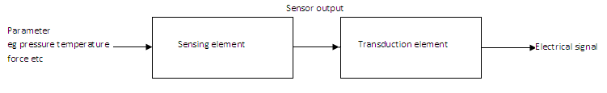
BLOCK DIAGRAM OF TRANSDUCERS
Transducer contains two parts that are closely related to each other i.e. the sensing element and transduction element.
The sensing element is called as the sensor. It is device producing measurable response to change in physical conditions.
The transduction element convert the sensor output to suitable electrical form.

Slide 6
CHARACTERISTICS OF TRANSDUCERS
Ruggedness
Linearity
Repeatability
Accuracy
High stability and reliability
Speed of response
Sensitivity
Small size

Slide 7
CLASSIFICATION OF TRANSDUCERS
The transducers can be classified as:
Active and passive transducers.
Analog and digital transducers.
On the basis of transduction principle used.
Primary and secondary transducer
Transducers and inverse transducers.

Slide 8
ACTIVE AND PASSIVE TRANSDUCERS
Active transducers :
These transducers do not need any external source of power for their operation. Therefore they are also called as self generating type transducers.
The active transducer are self generating devices which operate under the energy conversion principle.
As the output of active transducers we get an equivalent electrical output signal e.g. temperature or strain to electric potential, without any external source of energy being used.

Slide 9
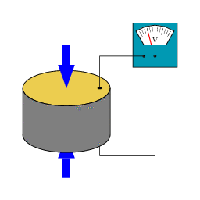
Piezoelectric Transducer

Slide 10
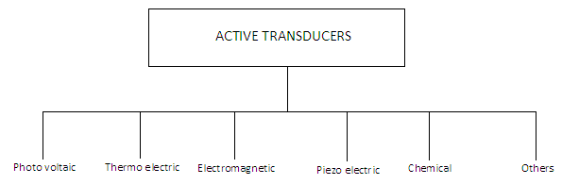
CLASSIFICATION OF ACTIVE TRANSDUCERS

Slide 11
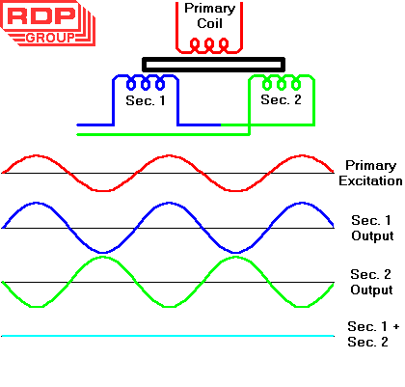
ACTIVE AND PASSIVE TRANSDUCERS
Passive Transducers :
These transducers need external source of power for their operation. So they are not self generating type transducers.
A DC power supply or an audio frequency generator is used as an external power source.
These transducers produce the output signal in the form of variation in resistance, capacitance, inductance or some other electrical parameter in response to the quantity to be measured.

Slide 12
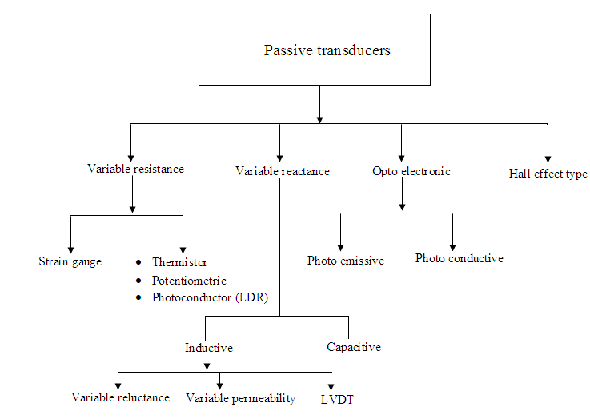
CLASSIFICATION OF PASSIVE TRANSDUCERS

Slide 13
PRIMARY AND SECONDARY TRANSDUCERS
Some transducers contain the mechanical as well as electrical device. The mechanical device converts the physical quantity to be measured into a mechanical signal. Such mechanical device are called as the primary transducers, because they deal with the physical quantity to be measured.
The electrical device then convert this mechanical signal into a corresponding electrical signal. Such electrical device are known as secondary transducers.

Slide 14
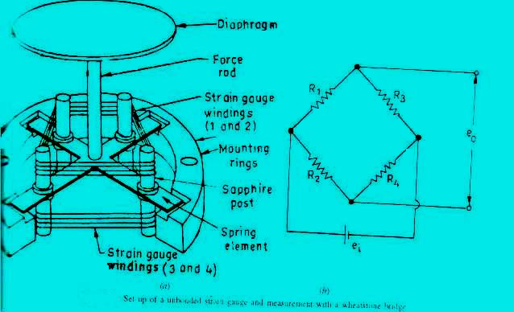
CONTD
Ref fig in which the diaphragm act as primary transducer. It convert pressure (the quantity to be measured) into displacement(the mechanical signal).
The displacement is then converted into change in resistance using strain gauge. Hence strain gauge acts as the secondary transducer.

Slide 15
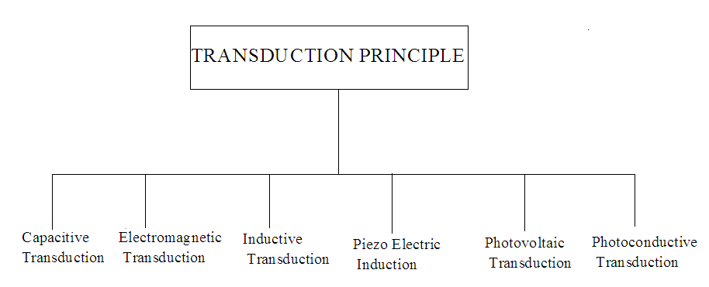
CLASSIFICATION OF TRANSDUCERS
According to Transduction Principle

Slide 16
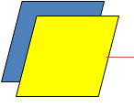
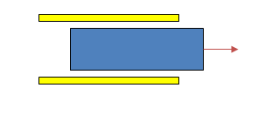
CLASSIFICATION OF TRANSDUCERS
According to Transduction Principle
CAPACITIVE TRANSDUCER:
In capacitive transduction transducers the measurand is converted to a change in the capacitance.
• A typical capacitor is comprised of two parallel plates of conducting material separated by an electrical insulating material called a dielectric. The plates and the dielectric may be either flattened or rolled.
• The purpose of the dielectric is to help the two parallel plates maintain their stored electrical charges.
• The relationship between the capacitance and the size of capacitor plate, amount of plate separation, and the dielectric is given by
C = ε0 εr A / d
d is the separation distance of plates (m)
C is the capacitance (F, Farad)
ε0 : absolute permittivity of vacuum
εr : relative permittivity
A is the effective (overlapping) area of capacitor plates (m2)
d
Area=A
Either A, d or ε can be varied.

Slide 17
According to the above relationship the capacitance increases:
  Due to increase in the effective surface area of the plates
  Due to the increase in the permittivity of the material
  Due to the decreasing of the distance between the plates
  Capacitance plethysmograph is an example of capacitance transducer which is used for the measurement of the blood flow.

Slide 18
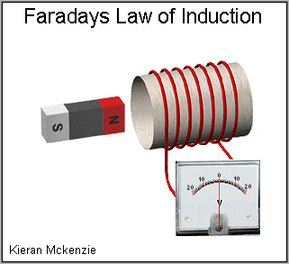
CLASSIFICATION OF TRANSDUCERS
According to Transduction Principle
ELECTROMAGNETIC TRANSDUCTION:
In electromagnetic transduction, the measurand is converted to voltage induced in conductor by change in the magnetic flux, in absence of excitation.
The electromagnetic transducer are self generating active transducers
The motion between a piece of magnet and an electromagnet is responsible for the change in flux

Slide 19
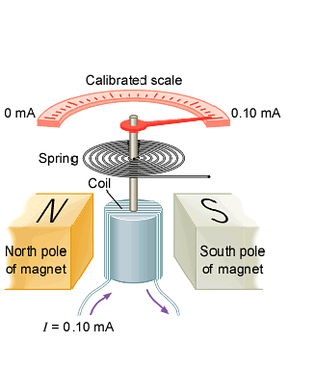
Galvanometeric Movement

Slide 20
The above galvanometeric movement can be used as:
  Analog meters
  Light beam galvanometers in photographic recorders
  Pen motor in ink recorder
  Thermal recorders
  The most important biomedical applications are:
  (a) Heart Sound Microphones
  (b) Pulse Transducers
  (c) Electromagnetic Blood Flow Meters.
  Magnetic induction has an electrostatic equivalent called electric induction. condenser microphone based on this principle is not widely
  used due to its wide frequency response and high sensitivit

Slide 21
Thermoelectric Transducer
The junction of two dissimilar metals forms a thermocouple.
When the two junctions are at different temperatures, a voltage is developed across the junction.
By measuring the voltage difference, the difference in temperature between the two junctions can be calculated.
If the temperature of one junction is known and the voltage difference is measured, then the temperature of the second junction can be calculated.

Slide 22
Thermocouples
Thermocouples provide:
A wide useful temperature range,
Are inherently differential,
Are rugged
Reliable and inexpensive
And usually have a fast response.
The main disadvantage of thermocouples:
is the very low output, on the order of 40 μV/ °C.
Slight nonlinearity
And need for calibration.

Slide 23
Thermocouples
There are some observed laws of thermocouple behavior used as a rule-of-thumb guide to thermocouple circuit design and construction.

Slide 24
Thermocouples
The thermoelectric effect: when one junction has a different temperature than the other, an electromotive force is produced in the circuit and current flows.
The magnitude of the force or potential depends on the temperature difference between the two junctions.
There are three components of the thermoelectric: The Seebeck effect, Peltier effect, and Thompson effect.

Slide 25
Thermocouples: Seebeck effect
The Seebeck effect is the conversion of thermal energy to electrical energy.
This effect measures the ease at which excess electrons will circulate in an electrical circuit under the influence of thermal difference.
The change in the voltage is proportional to the temperature difference between the junctions when the ends are connected to form a loop.

Slide 26
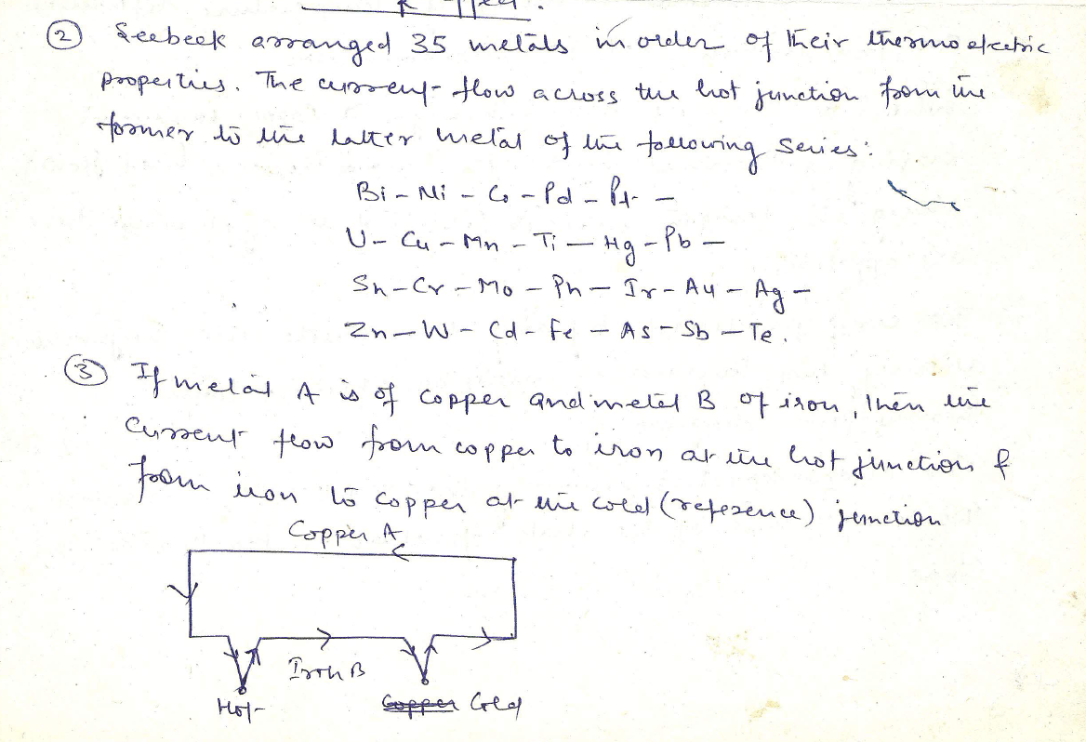

Slide 27
Thermocouples: Peltier effect
The Peltier effect is closely related to the Seebeck effect. It represents the thermal effect due to a reversible current through dissimilar materials or through similar metals due to an external source of current.
A current flow in one direction might warm the junction of the two dissimilar materials (and release heat to the surroundings of that junction), whereas if the current was reversed, the junction would cool (and absorb heat from its surroundings).

Slide 28
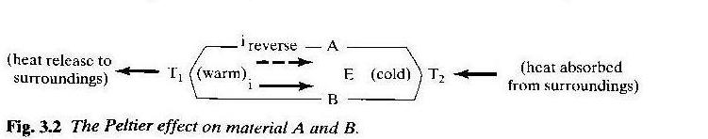
Thermocouples: Peltier effect

Slide 29
Thermocouples: Thompson effect
The Thompson effect is the absorption or liberation of heat by a homogeneous conductor due to a current flowing through it.
It is primarily evident in currents introduced form external sources and those generated by the thermocouple itself. The ability of a given material to generate heat with respect to both a unit temperature gradient and a unit current, is gauged by the Thompson coefficient.
The importance of the Peltier and Thompson effects is essentially infinitesimal because the heat evolved is negligible compared to the amount of thermal energy available from the environment to the junctions of T1 and T2.

Slide 30
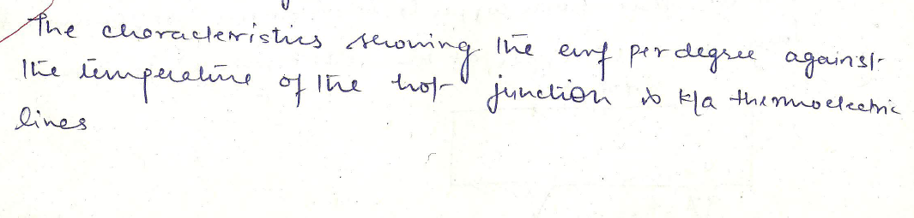
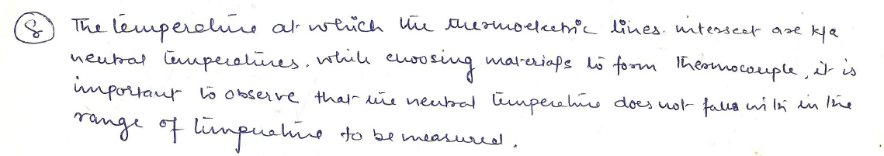

Slide 31
The (Thermocouple) Thermoelectric Laws
The three fundamental empirical laws behind the accurate measurement of temperature by thermoelectric means are the:
Law of homogeneous materials
Law of intermediate materials
Law of intermediate temperatures.
Law #1: the voltage across a thermocouple is unaffected by temperatures elsewhere in the circuit, provided the two metals used are each homogeneous.
Thus one can use lead wires made of thermocouple metals.

Slide 32
The (Thermocouple) Thermoelectric Laws
2. Law of intermediate materials
Law #2: If a third metal is inserted in either A or B and if the two new junctions are at the same temperature, no effective voltage is generated by the third metal. This means that a real voltmeter (or amplifier) can be used.
The terminals of a voltmeter are usually made of a third metal and can be close together. It is important to make sure the terminals of the voltmeter are at the same temperature.

Slide 33
The (Thermocouple) Thermoelectric Laws
3. Law of intermediate materials
Law #3: If a metal C with different temperature is inserted in one of the AB junctions, then no net voltage is generated so long as junction AC and BC are at the same temperature.
This means that the two wires or a junction can be soldered together and the presence of the third metal, solder, will not affect the voltage if there is no temperature gradient across the solder junction.

Slide 34
The (Thermocouple) Thermoelectric Laws
T1
A
V1
+
V3
G
-
B
A
V2
Ref.
T2
Fig. 4-5 (a)

Slide 35
Piezoelectric Transducer
When pressure is applied to certain non-conductive materials so that deformation takes place as shown in Fig, a charge separation occurs in the material and an electrical voltage , Vp , can be measured across the material.
The natural piezoelectric materials are
  Quartz
  Rochelle salt (sodium potassium tartarate)
The piezoelectric process is reversible. If an electric field is applied to a slab of material that has piezoelectric properties, it changes its dimensions.

Slide 36
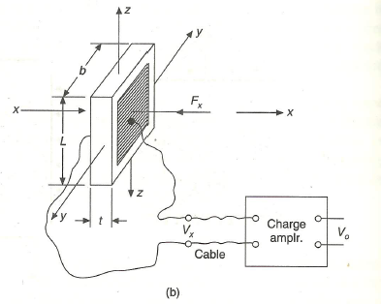
Piezoelectric Transducer

Slide 37

Piezoelectric Transducer
Frequently, two slices, with proper orientation of the polarity of the piezoelectric voltages, are sandwiched between layer of conductive metal foil, thus forming the bimorph configuration shown in Fig. below.

Slide 38
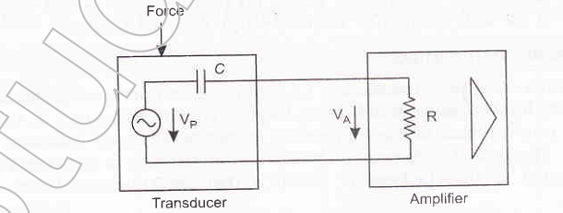
Piezoelectric Transducer
The electric equivalent of a piezoelectric transducer shown in figure below is that of voltage source , Vp, proportional to the applied mechanical force connected in series with a capacitor, which represents the conductive plates separating by the insulating piezoelectric material.

Slide 39

Resistive Transducers
The dc resistance of a conductor of length lx, having a uniform area of cross section a and with specific resistivity p of its material is given by

Slide 40
Resistance Thermometer
Resistance thermometers are primary electrical transducer enabling measurement of temperature changes in terms of resistance change.
The resistive element usually made of a solid material
  A metal
  A metal alloy
  A semiconductor material

Slide 41
Resistance Thermometer
Resistivity
  Metal : increases with temperature.
  Semiconductor and Insulator: decreases with temperature
  Wire wound elements employs considerable length of wire and if free to expand , the length also increase with increase in temperature.
  Hence as temperature changes , the change in resistance will be due to change in both length and resistivity

Slide 42
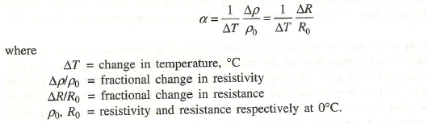
Resistance Thermometer
The temperature coefficient of resistance is given by

Slide 43
Resistance Thermometer
The resistance at any temperature T degree C is given by
Each metal or metallic alloy obey the relationship over a range of temperature and each resistance transducer is generally limited to measure temperature within this range.

Slide 44
Resistance Thermometer
The wire wound resistance thermometer as shown in fig usually consist of a coil wound on a mica or ceramic former , which also serve as supporting mount for the coil. The coil is wound in bifilar form so as to make it non-inductive .
The element are normally enclosed in a protective tube pyrex glass ,porcelain , quartz or nickle , depending on the range of temperature and the nature of the fluid.

Slide 45
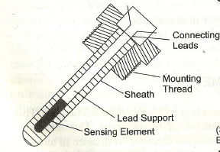
Resistance Thermometer

Slide 46
Thermistors
Thermistor is a contraction of a term “thermal resistor”.
Thermistor are temperature dependent resistors. They are made of semiconductor material which have negative temperature coefficient of resistivity i.e. their resistance decreases with increase of temperature.
Thermistor are widely used in application which involve measurement in the range of 0-60º Thermistor are composed of sintered mixture of sulphides,silicates, oxides and selenides of metals such as mangnese, nickle, cobalt, copper,zinc, iron, aluminium and uranium.

Slide 47
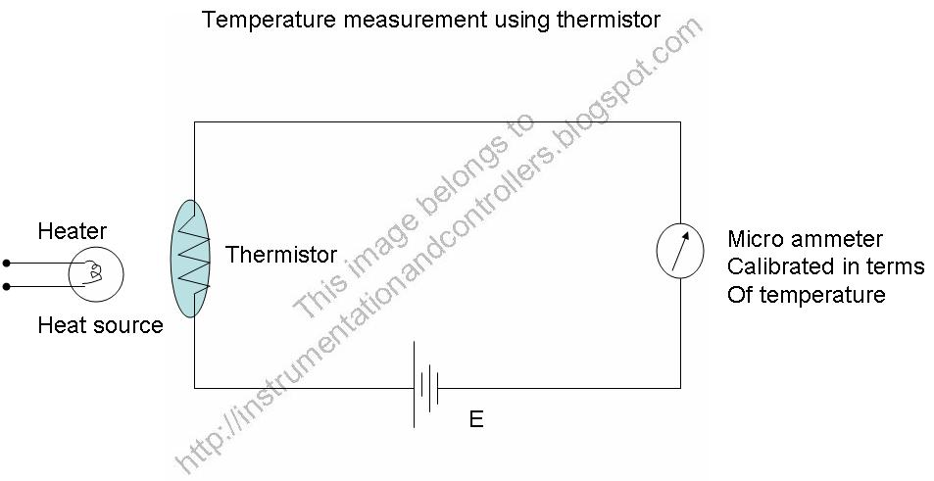
Thermistors

Slide 48
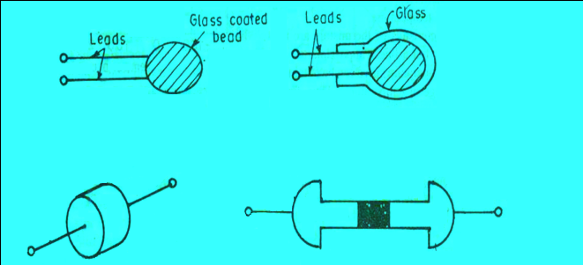
Thermistors
The thermistor may be in the form of beads, rods and discs.
The thermistor provide a large change in resistance for small change in temperature. In some cases the resistance of themistor at room temperature may decreases as much as 6% for each 1ºC rise in temperature.

Slide 49
Thermistors
The resistance temperature relation is generally of the form:
R = R₀ exp[β(1/T – 1/T₀)]
R = Resistance at temp. T, Ω
R₀= Resistance at temp. T₀, Ω
β = Constant, Characterstics of material
T, T₀ Absolute tempratures, K

Slide 50
Resistive Displacement Transducers
(Potentiometer)
Basically a resistance potentiometer , or simply POT consist of resistive elements provided with a sliding contact k/a wiper.
The motion of the sliding contact may be translatory or rotational as shown in fig .
Some pots are combination of the two motion i.e. translational as well as rotational. These pots have their resitive elemets in the form of a helix and therefore, they are called helipots

Slide 51
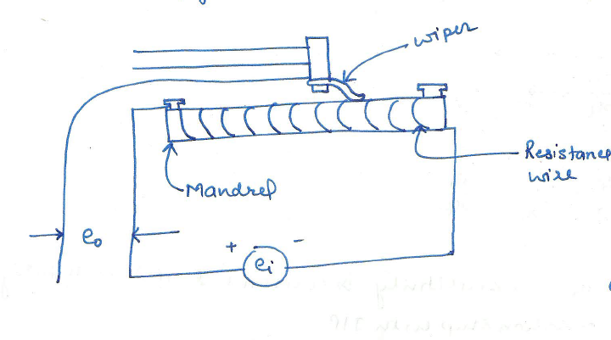
Resistive Displacement Transducers
(Potentiometer)

Slide 52
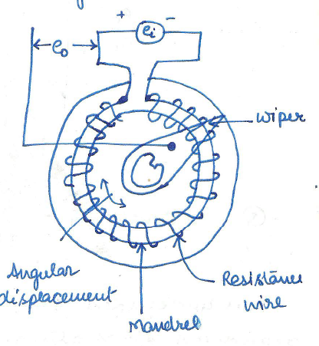
Resistive Displacement Transducers
(Potentiometer)

Slide 53
Resistive Displacement Transducers
(Potentiometer)
The resistive body of pot may be wire wound. A very thin 0.01 mm diameter of Pt or nickle alloy is carefully wound on an insulated former. The resistance are made up of cerment, hot moulded carbon, carbon films and thin films.
Consider a translational pot as shown in fig :

Slide 54
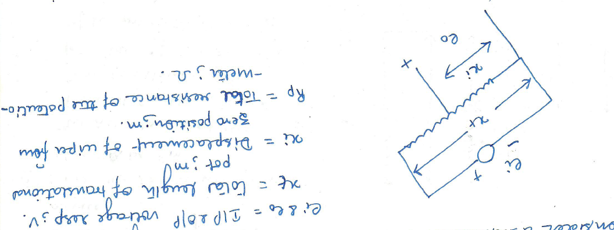
Resistive Displacement Transducers
(Potentiometer)

Slide 55
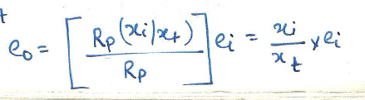
Resistive Displacement Transducers
(Potentiometer)
If the distribution of reistance w.r.t. translational movement is linear, the reistance per unit length is Rp/xt.
The o/p voltage under ideal condition is

Slide 56
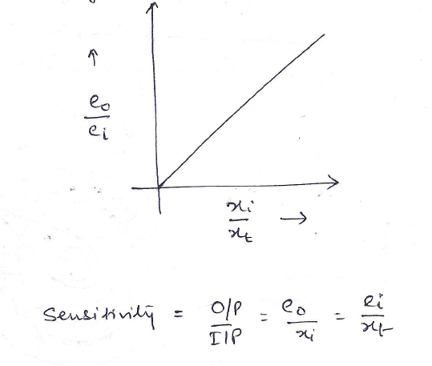
Resistive Displacement Transducers
(Potentiometer)
Under ideal circumstances , the o/p voltage varies linearly with displacement as shown in Fig.

Slide 57
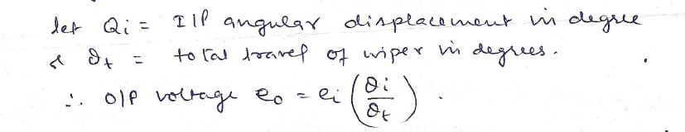
Resistive Displacement Transducers
(Potentiometer)
Similarly for the rotational motion
When an electrical instrument , which from load for pot and is connected across the o/p terminals, the indicated voltage is less than the given above eqn. the error which is referred to as loading error is caused by the i/p resistance of the o/p device

Slide 58
Theory of Strain Gauge
When a wire of length l and cross sectional area a is subjected to longitudinal stress σ, its length increases l to l+Δl due to tensile strain along its axis and its cross sectional area decreases from a to a- Δa due to compessive strain at right angle to its axis and along its circumference.
The ratio Δl/l k/a axial unit strain occuring along the direction of the applied stress and the ratio Δd/d, in this case , is the lateral or transverse unit strain.

Slide 59
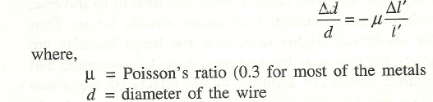

Theory of Strain Gauge
They are related to each other
Resistance of the wire of unifrom cross section a is given by

Slide 60
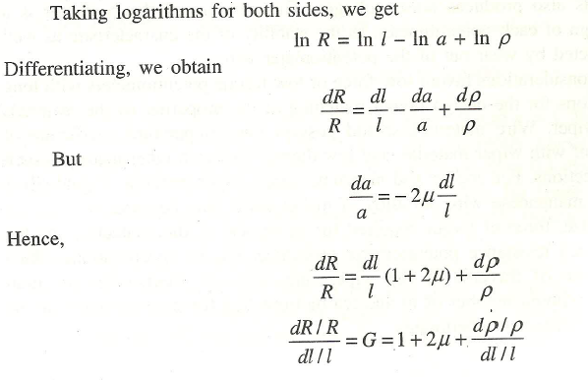
Theory of Strain Gauge

Slide 61
Theory of Strain Gauge
G is called gauge factor, G for some of the materials are given below
  Nickle- -12.1
  Manganin- 0.47
  Nichrome- 2.0
  Constantan- 2.1
  Soft iron- 4.2
  Pt – 4.8
  Carbon- 20
  Doped crystals – 100- 5000

Slide 62
Types of strain gauge
The following are the major type of strain gauges:
  Unbonded metal strain gauge
  Bonded metal strain gauge
  Bonded metal foil strain gauge
  Vaccum deposited thin metal film strain gauge
  Sputter deposited thin metal strain gauge
  Bonded semiconductor strain gauge
  Diffused metal strain gauge
  Strain gauge are broadly used for two major type of application and they are
  experimental stress analysis of machine and structures
  Construction of force , torque , pressure, flow and acceleration transducers.

Slide 63
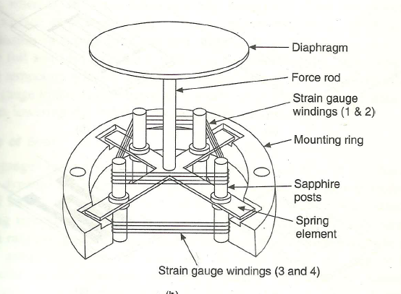
Unbonded metal strain gauge

Slide 64
Unbonded strain gauge
In actual transducer system employing four saphire posts and holding four equal lengths of tungsten-platinum wire of 5 micron diameter, are common as the four wire can form a wheatstone bridge circuit providing temperature compensation.
The four post, as shown in Fig are mounted on a star spring structure.
When the centre of the star spring is subjected to the force under measurement, the star spring flexes with each pair of the strain gauge element on opposite sides going into strain of opposite polarity.

Slide 65
Unbonded strain gauge
The resulting unbalanced voltage of the bridge circuit is proportional to the force and hence the pressure on the diaphragm.
The whole assembly is encased in a housing with provisions for admissions of pressure and for electrical connections
They are available for pressure ranges from as low as 0-0.15 to 0-660 bars.

Slide 66
Bonded metal strain gauge
In the case of bonded filament strain gauge, the resistance wire is made into a form of a grid and cemented between two pieces of thin paper. The factor to be considered are as follows:
  Filament construction
  Material of the filament wire
  Base carrier material
  Cement used to bond the filament to the carrier
  Lead wire connection.

Slide 67
Filament construction
The filament wire is of bonded type, which is made in the form of a flat grid or flattened helix or a thin foil to give a flat grid pattern as shown in fig.

Slide 68
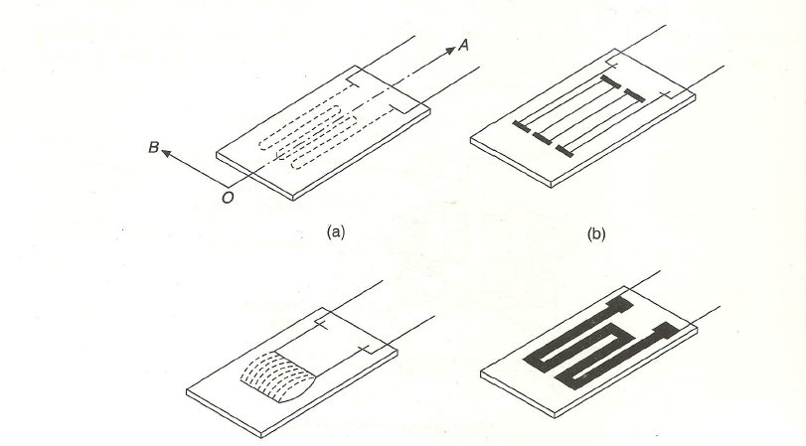
Filament Construction

Slide 69
Material of the filament wire
Common material used are isoelastic and nichrome V.
Following factors should be considered for selection of material of the filament wire:
  High gauge factor
  High resistivity
  Low temperature senstivity
  High electrical stability
  Good solderibilty
  Low hysteresis
  Low thermal emf
  Good corrosion resistance.

Slide 70
Base carrier Material
The carrier material or the support material should have the following properties:
  Good adherence to cement
  High dielectric strength
  High mechanical strength
  Minimum thickness consistence with other factors
  Minimum temperature restriction
For room temperature application, the carrier material used for the filament wire is nitrocellulose impregnated paper and for higher temperature, phenolic-plastic –impregnated paper is used.

Slide 71
Strain gauge cement
The cement to be used for joining the strain gauge to the straining membraneshould have the following properties:
  High mechanical strength
  High creep resistance
  High dielectric resistance
  Good adherence
  Minimum moisture attraction
  Minimum temperature restriction
  Ease of application
  The capacity to dry fast

Slide 72
Lead wire connections
A soldered junction between the fine filament and heavier lead wire or ribbon may be alright for static or slowly varying loads.
However, for dynamic strain measurement, the joint is welded.
Lead wire should have a low stable resistivity and a minimum temperature coefficient of resistance.
These lead wire are to be insulated properly with material of same thermal classification as the gauge carrier and bonding elements.The recommended lead wire insulating material for temperature range is given below:
  Below 75 ⁰C- Nylon
  Between 75⁰C and 65⁰C –Vinyl
  Between 75⁰C and 95⁰C – Polyethene
  Between 75⁰C and 260⁰C – Teflon
  Above 260 ⁰C – glass sleeving or glass impregnated silicon.

Slide 73
VARIABLE-INDUCTANCE TRANSDUCERS
An inductive electromechanical transducer is a transducer which converts the physical motion into the change in inductance.
Inductive transducers are mainly used for displacement measurement.

Slide 74
The inductive transducers are of the self generating or the passive type. The self generating inductive transducers use the basic generator principle i.e. the motion between a conductor and magnetic field induces a voltage in the conductor.
The variable inductance transducers work on the following principles.
  Variation in self inductance
  Variation in mutual inductance

Slide 75
PRINCIPLE OF VARIATION OF SELF INDUCTANCE
Let us consider an inductive transducer having N turns and reluctance R. when current I is passed through the transducer, the flux produced is
  Φ = Ni / R
Differentiating w.r.t. to t,
  dΦ/dt = N/R * di/dt
The e.m.f. induced in a coil is given by
  e = N * dΦ/dt

Slide 76
  e = N * N/R * di/dt
  e = N² / R * di/dt
Self inductance is given by
  L = e/di/dt = N² / R
The reluctance of the magnetic circuit is R = Ɩ/μA
Therefore L = N² / Ɩ/μA = N² μA / Ɩ
From eqn we can see that the self inductance may vary due to
  Change in number of turns N
  Change in geometric configuration
  Change in permeability of magnetic circuit

Slide 77
CHANGE IN SELF INDUCTANCE WITH CHANGE IN NUMBER OF TURNS N
From eqn we can see the output may vary with the variation in the number of turns. As inductive transducers are mainly used for displacement measurement, with change in number of turns the self inductance of the coil changes in-turn changing the displacement
Fig shows transducers used for linear and angular displacement fig a shows an air cored transducer for the measurement of linear displacement and fig b shows an iron cored transducer used for angular displacement measurement.

Slide 78
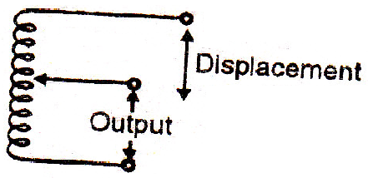

Slide 79
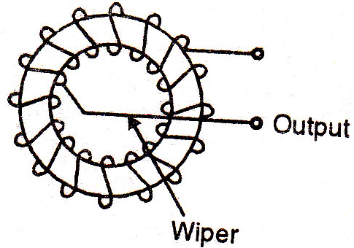

Slide 80
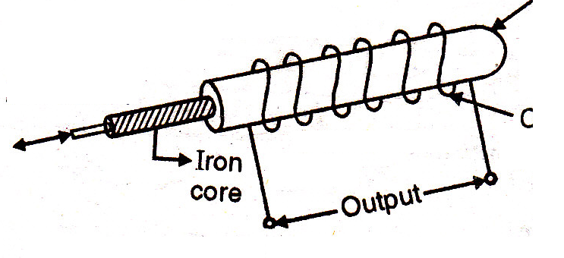
CHANGE IN SELF INDUCTANCE WITH CHANGE IN PERMEABILITY
An inductive transducer that works on the principle of change in self inductance of coil due to change in the permeability is shown in fig
As shown in fig the iron core is surrounded by a winding. If the iron core is inside the winding then the permeability increases otherwise permeability decreases. This cause the self inductance of the coil to increase or decrease depending on the permeability.
The displacement can be measured using this transducer
Ferromagnetic former
displacement
coil

Slide 81
PRINCIPLE OF CHANGE IN MUTUAL INDUCTANCE
Multiple coils are required for inductive transducers that operate on the principle of change in mutual inductance.
The mutual inductance between two coils is given by
  M = KsqrtL1L2
    Where M : mutual inductance
    K : coefficient of coupling
    L1:self inductance of coil 1
    L2 : self inductance of coil 2
By varying the self inductance or the coefficient of coupling the mutual inductance can be varied

Slide 82
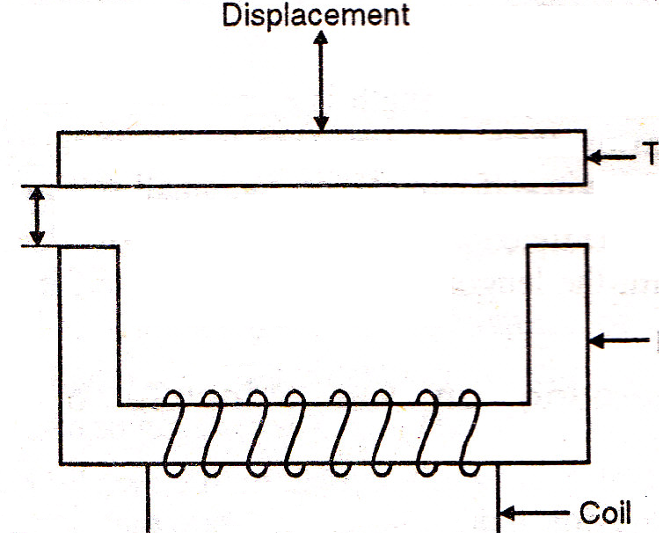
VARIABLE RELUCTANCE INDUCTIVE TRANSDUCER
Fig shows a variable reluctance inductive transducer.
As shown in fig the coil is wound on the ferromagnetic iron. The target and core are not in direct contact with each other. They are separated by an air gap.
The displacement has to be measured is applied to the ferromagnetic core
The reluctance of the magnetic path is found by the size of the air gap.
The self inductance of coil is given by
  L = N² / R = N² / Ri + Ra
    N : number of turns
    R : reluctance of coil
    Ri : reluctance of iron path
    Ra : reluctance of air gap

Slide 83
CONTD.
The reluctance of iron path is negligible
  L = N² / Ra
  Ra = la / μoA
Therefore L œ 1 / la i.e. self inductance of the coil is inversely proportional to the air gap la.
When the target is near the core, the length is small. Hence the self inductance is large. But when the target is away from the core, the length is large. So reluctance is also large. This result in decrease in self inductance i.e. small self inductance.
Thus inductance is function of the distance of the target from the core. Displacement changes with the length of the air gap, the self inductance is a function of the displacement.

Slide 84
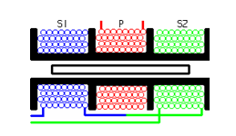
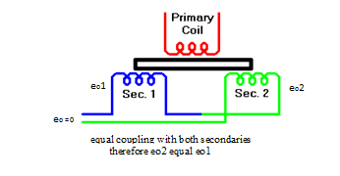
LINEAR VARIABLE DIFFERENTIAL TRANSFORMER(LVDT)
AN LVDT transducer comprises a coil former on to which three coils are wound.
The primary coil is excited with an AC current, the secondary coils are wound such that when a ferrite core is in the central linear position, an equal voltage is induced in to each coil.
The secondary are connected in opposite so that in the central position the outputs of the secondary cancels each other out.

Slide 85
LVDT contd…
The excitation is applied to the primary winding and the armature assists the induction of current in to secondary coils.
When the core is exactly at the center of the coil then the flux linked to both the secondary winding will be equal. Due to equal flux linkage the secondary induced voltages (eo1 & eo2) are equal but they have opposite polarities. Output voltage eo is therefore zero. This position is called “null position”

Slide 87
Now if the core is displaced from its null position toward sec1 then flux linked to sec1 increases and flux linked to sec2 decreases. Therefore eo1 > eo2 and the output voltage of LVDT eo will be positive
Similarly if the core is displaced toward sec2 then the eo2 > eo1 and the output voltage of LVDT eo will be negative.

Slide 88
Underlying Principle Of LVDT

Slide 89
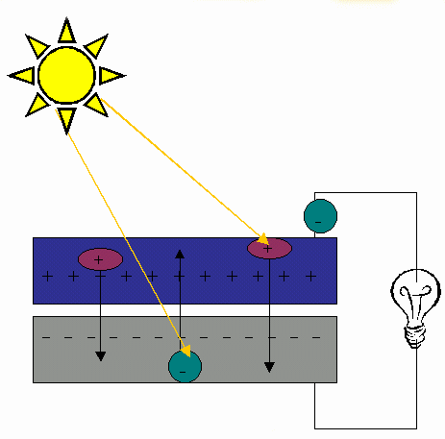
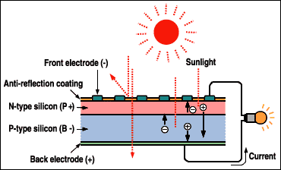
CLASSIFICATION OF TRANSDUCERS
According to Transduction Principle
PHOTOVOLTAIC TRANSDUCTION :
In photovoltaic transduction the measurand is converted to voltage generated when the junction between dissimilar material is illuminated as shown in fig.

Slide 90
Physics of Photovoltaic Generation
n-type semiconductor
+ + + + + + + + + + + + + + +
Depletion Zone
- - - - - - - - - - - - - - - - - -
p-type semiconductor

Slide 91

CLASSIFICATION OF TRANSDUCERS
According to Transduction Principle
PHOTO CONDUCTIVE TRANSDUCTION :
In photoconductive transduction the measurand is converted to change in resistance of semiconductor material by the change in light incident on the material.

Slide 92
CLASSIFICATION OF TRANSDUCERS
Transducer and Inverse Transducer
TRANSDUCER:
Transducers convert non electrical quantity to electrical quantity.
INVERSE TRANSDUCER:
Inverse transducers convert electrical quantity to a non electrical quantity

