Slide 1
Defibrillators
By:
Somesh Kumar Malhotra
Assistant Professor,
ECE Deptt.,UIET,CSJM University

Slide 2
Introduction
As discussed earlier in this chapter, the heart is able to perform its important pumping function only through precisely synchronised action of the heart muscle fibers.
A condition in which this necessary synchronism is lost is known as fibrillation.
During fibrillation the normal rhythmic contraction of either the artria or the ventricles are replaced by rapid irregular twitching of the muscular wall.

Slide 3
Introduction
Fibrillation of artrial muscle is called artrial fibrillation of the ventricles is known as ventricular fibrillation.

Slide 4
Defibrillators
Although mechanical method (heart massage) for defibrillating patient have been tried over the year, the most successful method of defibrillation is the application of an electric shocks to the area of the heart
If sufficient current to stimulate all musculature of the heart simultaneously is applied for a brief period and then released , all the heart muscles fiber enter their refractory periods together, after which normal heart action may resume.

Slide 5
Defibrillators
The discovery of this phenomena led to rather widespread use of defibrillation by applying a brief (0.25 to 1 sec) burst of 60 Hz ac at an intensity of around 6A to the chest of patient through appropriate electrode.
This application of an electrical shock to resynchronize the heart is sometime called countershock.

Slide 6
Defibrillators
If the patient does not respond, the burst is repeated until defibrillation occurs. This method of countershock was known as ac defibrillation.
Attempt to correct atrial fibrillation by this method often result in more serious ventricular fibrillation.
Thus ac defbrillation is no longer used.

Slide 7
Defibrillators
Later dc defibrillation was discovered in which a capacitor is charged to a high dc voltage and then rapidly discharged through electrode across the chest of the patient.
It was found that dc defibrillation is not only more successful than the ac method in correcting ventricular fibrillation, but it can also be used successfully for correcting atrial fibrillation and other type of arrhythmias.

Slide 8
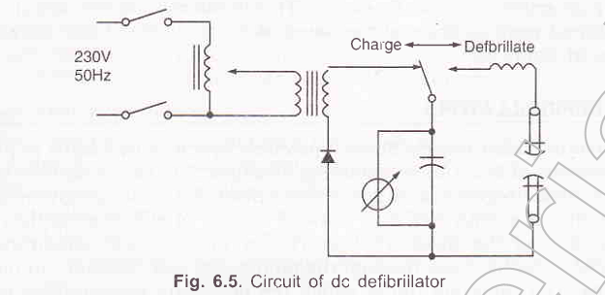
Defibrillators

Slide 9
Defibrillators
An inductor in the defibrillator is used to shape the wave in order to eliminate a sharp and undesirable spike.

Slide 10
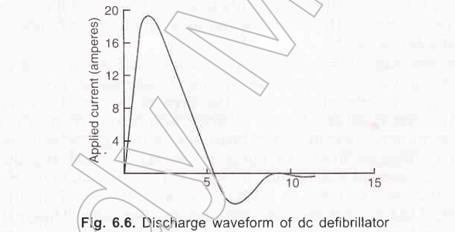
Defibrillators

Slide 11
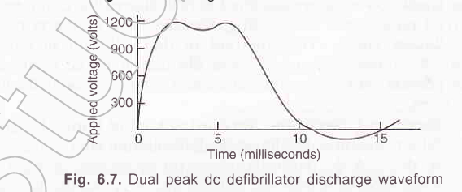
Defibrillators

Slide 12
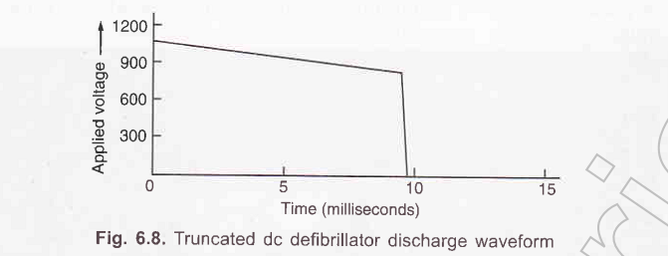
Defibrillators

Slide 13
Defibrillators

Slide 14
Defibrillators
However, if conductive jelly is applied to the paddle prior to electrode placement, care must be taken when the paddle are applied, the jelly does not accidently form a conductive bridge between the paddles. If it does , the defibrillation attempt may not be successful.
With either of the preceding conductive materials, care must be taken that they will not dry out with repeated discharge

Slide 15
Defibrillators

Slide 16
Defibrillators
The two defibrillator electrodes applied to the thoracic walls are called either anterior-anterior or anterior-posterior paddles.
With anterior-anterior paddles, both paddles are applied to the chest.
anterior-posterior paddles are applied to both the patient’s chest wall and back so that energy is delivered through the heart.

