Slide 1
Electrocardioagraphy
Er. Somesh Kr Malhotra
Assistant Professor
ECE Department,UIET

Slide 2
Electrocardiogram
The electrocaerdiogram (ECG or EKG) is a graphic recording or display of the time variant voltage produced by the mycardium dring cardiac cycle.
Fig below show the basic waveform of the normal electrocardiography

Slide 3
Electrocardiogram
The P,QRS and T waves reflect the rhythmic electrical depolarization and repolarization of the myocardium assicated with the contraction of the artia and ventricle.
Electrocardiagram is used clinically in diagnose various diseases and condition assocated with the heart.

Slide 4
Electrocardiogram
Some normal values for amplitude and duration of important ECG parameters are as follows.
Amplitude
P Wave 0.25 mV
R Wave 1.60 mV
Q wave 25% of Rwave
T wave 0.1 to 0.5 mV
Duration
P-R interval 0.12 to 0.20 sec
Q-T interval 0.35 to 0.44 sec
S-T segment 0.05 to 0.15 sec
P wave interval 0.11 Sec
QRS interval 0.09 sec

Slide 5
Electrocardiogram
For his diagnosis , a cardiologist would typically look first at the heart rate.
The normal value lies in the range of 60 -100 BPM.
A slow rate - bradycardia
higher rate - tachycardia.
He would then see if the cycles are evenly spaced.
if not -Arrhythmia
If the PR interval is greater than 0.2 second , it can suggest blockage of AV node.

Slide 6
Electrocardiogram
If one or more of the basic features of the ECG should be missing , a heart block of some sort migth be indicated.
In healthy individuals the electrocardiography remain resaonably constant, even though the heart rate changes with the demnd of the body.
It should be noted that the position of the heart within the thoracic region of the body, as well as the position of the body itself, influences the ‘electrical axis’ of the heart.

Slide 7
Electrocardiogram
The electrical axis (which is parallel to the anatomical axis) is defined as the line along which the greates electromotive forces is developed at a given instant during the cardiac cycle.
the electrical axis shifts continually through the repeatble pattern during every cardiac cycle.

Slide 8
Electrocardiogram
Under pathological conditions , severl changes may occur in the ECg. These includes
altered path of excitation in the heart
changed origin of waves (ectopic beats)
altered relationship (sequences) of features
Change magnitudes of one or more features.
differing duration of waves or intervals.

Slide 9
ECG Amplifier
Normal electronic amplifier are normally reference to ground through their power supplies. This create an interference problem when measuring small values of bioelectric potential.
To overcome this problem differential amplifier are used in measurement of electrocardiogram.
Two amplifiers with separate inputs but common output which delivers the sum of two amplifiers output voltages is a differential amplifier

Slide 10
ECG Amplifier
Both the amplifiers have the same voltage gain, but one amplifier ls inverting (output voltage is 180" out of phase with respect to input) while the other is non-inverting (input and output voltage are in phase).
If the two amplifier inputs are connected to the same input source, the resulting common mode gain should be zero because the signals from the inverting and non-inverting amplifiers cancel each other at the common output.
However, the gain of the two amplifiers is not exactly equal, this cancellation is not complete. A small residual common mode output remains.

Slide 11
ECG Amplifier
When one of the amplifier inputs is grounded and a ,voltage is applied only to the other amplifier input, input voltage appears at the output amplified by the gain of amplifier.
The ratio of the differential gain to the common mode gain is called the common mode rejection ratio-of the differential amplifier which in modern amplifiers can be as high as 10,00,000:1.
Measurement of bioelectric signals that occur as a potential difference between two electrodes is an input to a differential amplifier .The bioelectric signals are between the inverting and non-inverting inputs of the amplifier.

Slide 12
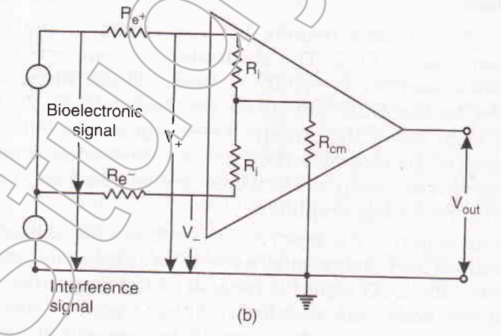
ECG Amplifier
For the interference signal, however, both inputs appear as though they were connected together to common input source. Much smaller common mode gain amplifiers the common mode interference signal.
The electrode impedances Re+ and Re- each form a voltage divider with the input impedance of the differential amplifier as illustrated in Fig.

Slide 13
ECG Amplifier
If the electrode impedance is not identical, the interference signal at the inverting and non-inverting inputs of the differential amplifier may be different and desired degree of cancellation does’nt take place.
Because the electrode impedance cannot be made equal, therefore high CMMR of differential amplifier which can only be realized when input impedance of differential amplifier is very much greater than the electrode impedance.

Slide 14
ECG Electrodes
A number of electrodes usually 5 are affixed to the body of the patient for recording an ECG.
The same number of wires which are known as leads are connected to the ECG Machine.
The pumping action of heart which generate voltage is actually a vector quantity which vary its magnitude as well as the spatial orientation with time, because ECG is measured from the electrode applied to surface of the body, the waveform of the signal is very much dependent on the placement of the electrode.

Slide 15
ECG Electrodes
some of the segment of trace may, however , almost disappear for certain electrodes placements, whereas other may show up clearly on the recording .
For this reason , in a normal electrocardiographic examination , the electrocardiogram is recorded from a number of different leads , usually 12, to ensure that no important details of the waveform is missed.

Slide 16
ECG Electrodes
the placement of the electrodes ,as well as the color codes used to identify each electrode , is shown in Fig.
four electrode is used to record the ECG;the electrode on the right leg is only for ground reference.

Slide 17
ECG Electrodes
Because the input of the ECg recorder has only two terminals, a selection must be made among the available active electrodes.
The 12 standard leads used most frequently sre shown in Fig.
the three bipolar limb leads selection first introduced by Eithenoven, shown in the top row of the figure, are as follows:
LeadI: Left Arm (LA) and Right Arm (RA)
Lead II : Left Leg (LL) and Right Leg (RL)
Lead III : Left Leg(LL) and Left Arm (LA)

Slide 18
ECG Electrodes

Slide 19
ECG Electrodes
working with this three electrode Einthen postulated that at any given instant of the cardiac cycle, the frontal plane representation of the electrical axis of the heart is a two dimensional vector.
Further , the ECG measured from any one of the three basic limb leads is a time variant single dimensional component of the vector.
Einthoven also made the assumption that the heart is near the center of an equilateral triangle, the apexes of which are the right and left shoulder and the crotch.

Slide 20
ECG Electrodes
By assumming that the ECg potential at the shoulder are essentially the same as the wrist and that of the potential at the crotch differ little from those at either ankle, and he let the three points of this triangle represent the electrode position for three limb leads.
This triangle known as ‘Einthoven triangle’.

Slide 21
ECG Recorder Principle
The principal Parts or building blocks of an ECG recorder are shown in Fig.
The connecting wires for the patient electrodes originates at the end of a patient cable, the other end of which plugs into the ECG recorder.The wires from the electrodes connect to the lead selector switch, which also incorporates the resistors necessary for the unipolar leads.

Slide 22
ECG Recorder Principle
A standarization voltage of 1 mV to standardize or calibrate the recorder is used.
From the lead selector switch the ECG signal goes to a pre-amplifier, a differential amplifier with high common mode rejection. It is coupled to avoid problems with small dc voltages that may originate from polarization of the electrodes.
A variable sensitivity adjustment, sometimes marked as standardization adjustment is provided.

Slide 23
ECG Recorder Principle
By means of this adjustment the sensitivity of the ECG recorder can be set so that the standardization voltage of 1 mV causes a pen deflection of 10 mm.
In modern amplifiers the gain usually remains stable once adjusted, so that continuously variable gain control is now frequently a screwdriver adjustment at the side or rear of the ECG recorder.

Slide 24
ECG Recorder Principle
The preamplifier is followed by a power amplifier, which provide power to drive the pen motor that records the actual ECG trace.
A position control on the pen amplifier makes it possible to center the pen on the recording paper.
Heat sensitive paper may be used ald the pen is actually an electrically heated stylus, the temperature of which can be adjusted with a stylus heat control for optimal recording trace.

Slide 25
ECG Recorder Principle
Normally, electrocardiograms are recorded at a paper speed of 25 mm/s, but a faster speed of 50 mm/s is provided to allow better resolution of the QRS complex at very high heart rates or when a particular wave form details are required.
The protection of the electrocardiograph from damage during defibrillation is a severe problem. The voltages that may be encountered in this case may be several thousand volts. Thus special protection must be provided into the electrocardiograph to prevent burnout of components and its damage.

Slide 26
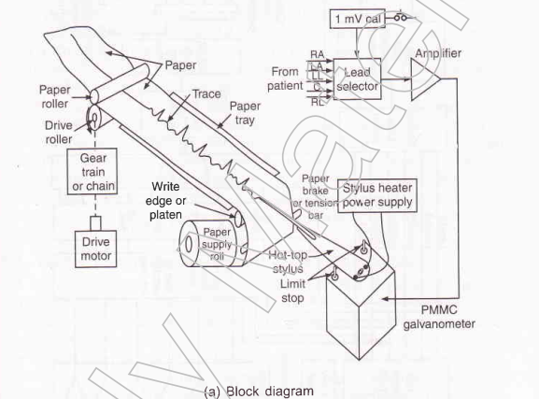
ECG Recorder Principle

Slide 27
Types of ECG recorder
Single channel recorder
single channel ECG recorder is the portable single channel unit.This ECG recorder is mounted on a cart so that it can be wheeled to the bedside of a patient conveniently.
In case, the ECG'of a patient is recorded in the 12 standard lead configuration, the resulting paper strip is from 3 to 6 feet long. It is very inconvenient for the physicial to analyze the ECG.

Slide 28
Types of ECG recorder
Three channel recorder
The three channel recorder record the output of three leads at a time and there is automatic switching to record output of next three channels.
An electrocardiogram with the 12 standard, leads therefore, can be recorded automatically as a sequence of four groups of three traces. The time required for actual recording is only 10 seconds.
The groups of leads recorded and the time at which the switching occurs are automatically identified by code markings at the margin of the recording paper.

Slide 29
Types of ECG recorder
At the end of the recording standardizatron pulses are inserted in all three channels.
Although the actual recording time is reduced substantially compared to single channel recorders, more time is required to apply the electrodes to the patient because separate electrodes must be used for each chest position.
It is much easier to read the output of the three channel ECG recorder as compared to single channel ECG recorder.

Slide 30
Vector Electrocardiographs
The voltage generated by the heart is described as a vector where magnitude and spatial change with time may be of importance. In the type of ECG recorders described above only magnitude is recorded.
Vector Cardiography on the other hand presents an image of both the magnitude, and the spatial orientation of the heart vector.
The heart vector, however,a three dimensional variable and three "views" or projections on orthogonal planes are necessary to describe the variable fully in two dimensional figure.

Slide 31
Vector Electrocardiographs
Special lead placement systems must be used to pick up the ECG signals for vector electrocardiograms, the Frank system being the one most frequently employed.
The vectorcardiogram is usually dispayed on a cathode-ray tube similar to those used for patient monitors.
Such QRS complex is displayed as a sequence of loops on this screen,which is then photographed with a polaroid camera.

Slide 32
Vector Electrocardiographs
Vector-cardiograms are also available that use computer techniques to slow down the ECG signals and to allow the recording of the vectorcardiogram with a mechanical X-Y to recorder.

Slide 33
Electrocardiograph Systems for Stress Testing
If the electrocardiogram is taken at rest the coronary insufficiency is reflected.
In the masters test or two step exercise test, a physiological test is imposed on the cardiovascular system by letting the patient repeatedly walk up and down a special pair of a inch high steps prior recording his ECG.
Based on the same principle is the exercise stress test in which the patient walks at a specified speed on a tread mill whose inclination can be changed.

Slide 34
Electrocardiograph Systems for Stress Testing
Stress test system based on exercises consists of the following parts:
A treadmill with automatic capability to change the speed and inclination in order to apply a specific physiological stress'
An ECG radiometry system to allow recording of the ECG without artifacts while the patient is on treadmill.
An ECG monitor with a cathode ray display and heart rate meter.
An ECG recorder.
An automatic or semiautomatic sphygmomanometer for the indirect
measurement of blood Pressure.
A dc defibriller is usually kept available while the test is being performed. As the exercise stress test involves risk for patients with known or suspected cardiac disorders

Slide 35
Continuous ECG Recording(Holter recording)
A normal electrocardiogram represent only a brief sample of cardiac activity, arrhythmias which occurs intermittently only under certain condition such as emotional which stress occur are intermittently frequently missed.
The technique of continuous ECG recording makes it possible to capture these kinds of arrhythmias.
This was introduced by Norman Holter to obtain a continuous ECG the electrocardiogram of subject is recorded during his normal daily by means of a special magnetic tape recorder.

Slide 36
Continuous ECG Recording(Holter recording)
The smallest device of this type can actually be worn in a shirt pocket and allows recordings of the ECG for four hours.
Other recorders about the size of a camera case are worn over the shoulder and can record ECG for upto 24 hours.
The recorded tape is analyzed using a special scaning device which plays back the tape at a higher speed than that for recording.

Slide 37
Continuous ECG Recording(Holter recording)
In this way a 24 hour record can be reviewed in just 12 minutes.
During the play back the beat to beat interval of Electrocardiogram is displayed on a cathode ray tube as a picket fence pattern in which arrhythmic episodes are clearly visible.
Once such episode has been discovered the tape is backed up and slowed down version of the time interval of arrhythmias is observed.

