Slide 1
GENE CLONING

Slide 2
CONTENTS
Introduction
Process of gene cloning
Successful gene cloning experiments
Future of gene cloning
Application of gene cloning

Slide 3
INTRODUCTION
Gene cloning, also known as DNA cloning, is the process of making identical copies of a specific gene or a segment of DNA.
This involves the isolation and replication of a DNA fragment, which can be a single gene or a piece of genetic material with specific functions in order to study it or use it for various applications.
Gene cloning is a fundamental technique in genetic research, biotechnology, genetic engineering allowing scientists to explore gene functions, produce re-combinant proteins, and modify organisms for a beneficial purposes.

Slide 4
PROCESS OF GENE CLONING
ISOLATION OF DNA
The first step is to isolate the DNA containing the gene of interest.
This DNA can be obtained from a variety of sources, such as the genome of an organism or a specific DNA segment.
2) DIGESTION WITH RESTRICTION ENZYMES
DNA is then cut at specific sequences using enzymes called restriction enzymes.
These enzymes recognize and cleave DNA at particular sites.

Slide 5
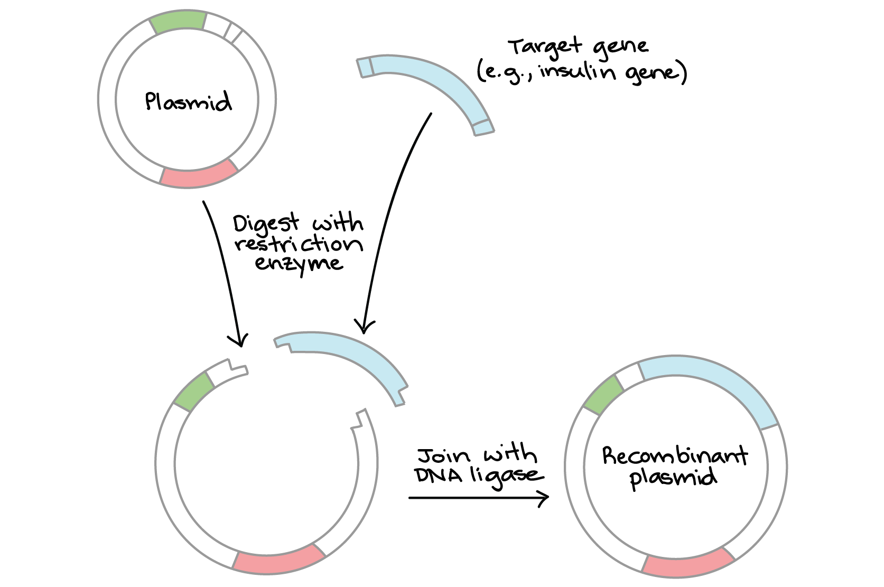
CONT…
3) PLASMID OR VECTOR SELECTION
A small, circular DNA molecule, typically a plasmid or another vector is chosen to carry the gene of interest.
This vector will be used to insert and replicate the gene.
4) LIGATION
DNA ligase, an enzyme is used to join the cut DNA fragments together.
This process results in the gene of interest being inserted into the plasmid and creating a recombinant DNA molecule.

Slide 6
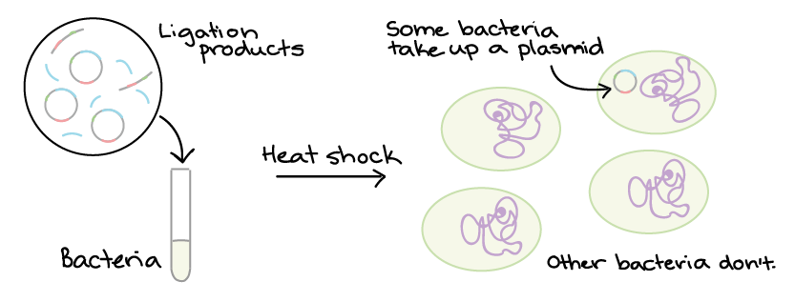
CONT…
5) TRANSFORMATION
The recombinant plasmid is introduced into a host organism, often bacteria.
This is achieved by process of heat shock which decrease the permeability of membrane and the host organism will replicate the plasmid along with its inserted gene.

Slide 7
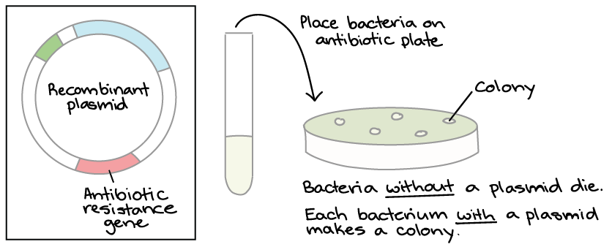
CONT…
6) SELECTION
Selective markers, such as antibiotic resistance genes are commonly included in the plasmid.
Host organism containing the recombinant plasmid can be identified and selected by growing them in a medium containing the corresponding antibiotic.

Slide 8
CONT…
7) REPLICATION AND CLONING
As the host organism multiplies, it replicates the recombinant plasmid.
This results in the cloning of the gene of interest, with multiple identical copies being produced.

Slide 9
CONT…
8) HARVESTING AND VERIFICATION
Once a sufficient number of cloned gene copies have been produced, they can be harvested.
The cloned gene´s identity and sequence can be verified through techniques like DNA sequencing.
The cloned gene can then be used for various purposes.

Slide 10
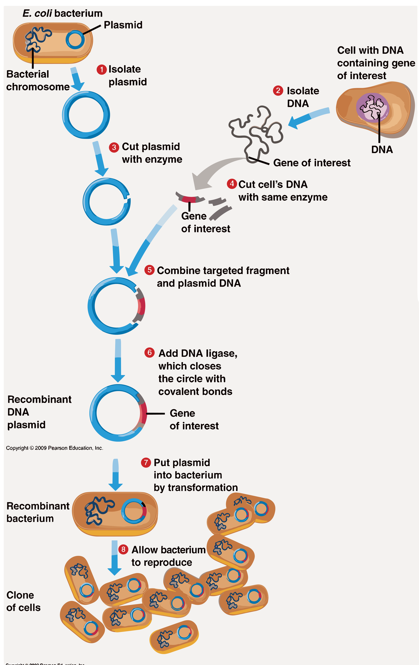

Slide 11
SUCCESSFUL GENE CLONING EXPERIMENTS
Cloning the Insulin Gene (1978): This was one of the early successes in gene cloning. Scientists cloned the human insulin gene into bacteria, allowing for the mass production of human insulin, which revolutionized the treatment of diabetes.
Cloning the Green Fluorescent Protein (GFP) Gene (1994): Roger Y. Tsien and Martin Chalfie, among others, cloned the GFP gene from a jellyfish, leading to its widespread use as a molecular marker in cell and molecular biology. GFP can be used to tag and visualize proteins and other cellular components.
Cloning the Human Genome (2003): The Human Genome Project successfully cloned and sequenced the entire human genome, providing a comprehensive map of human genes and their functions.

Slide 12
CONT…
Cloning of Antibody Genes (1980s-1990s): Scientists have cloned genes encoding antibodies to produce monoclonal antibodies. This technique has been invaluable in research, diagnostics, and the development of therapeutic antibodies.
Recombinant DNA Technology (1973): The foundational experiment by Herbert Boyer and Stanley Cohen marked the beginning of gene cloning. They successfully cloned the first recombinant DNA molecule, which contained genes from two different organisms (E. coli and a plasmid).

Slide 13
FUTURE OF GENE CLONING
Advanced Genome Editing Technologies
Customized Therapies
Gene Therapy
Vaccine Development
Agriculture and Biotechnology
Functional Genomics

Slide 14
APPLICATION OF GENE CLONING
Production of Recombinant Proteins
Gene Therapy
Vaccine Development
Functional Genomics
Genetic Modification
Creation of Transgenic Animals
Pharmaceutical Production
Research in Molecular Biology
Environmental Applications
Forensic Science
Drug Discovery

