Slide 1
Heart Sound Measurement
Somesh Kr Malhotra
Assistant Professor
ECE Department

Slide 2
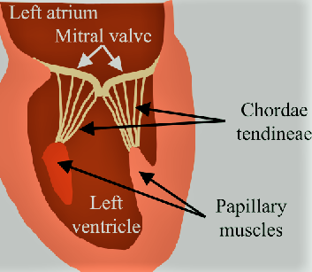
Introduction
When a stethoscope is placed on the chest over different regions of the heart, there are four basic heart sounds that can be heard (listening to heart sounds is called cardiac auscultation).
The sounds waves responsible for heart sounds (including abnormal sounds such as murmurs) are generated by vibrations induced by
valve closure,
abnormal valve opening,
vibrations in the ventricular chambers,
tensing of the chordae tendineae, and
by turbulent or abnormal blood flow across valves or between cardiac chambers

Slide 3
Introduction
The common mechanisms by which heart sounds are generated include
(1) opening or closure of the heart valves
(2) flow of blood through the valve orifice
(3) flow of blood into the ventricular chambers
(4) rubbing of cardiac surfaces.

Slide 4
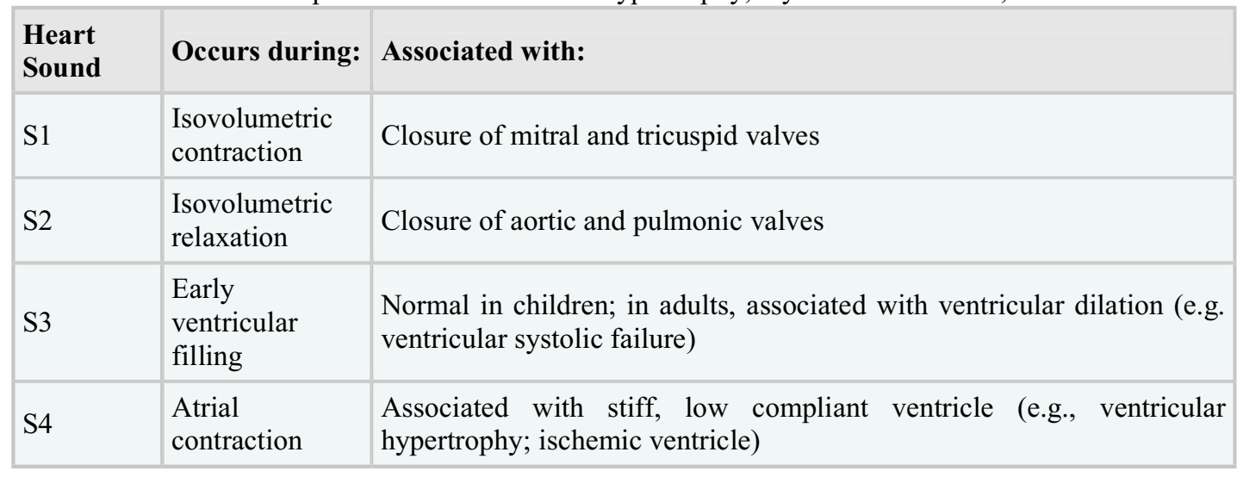
Heart Sound

Slide 5
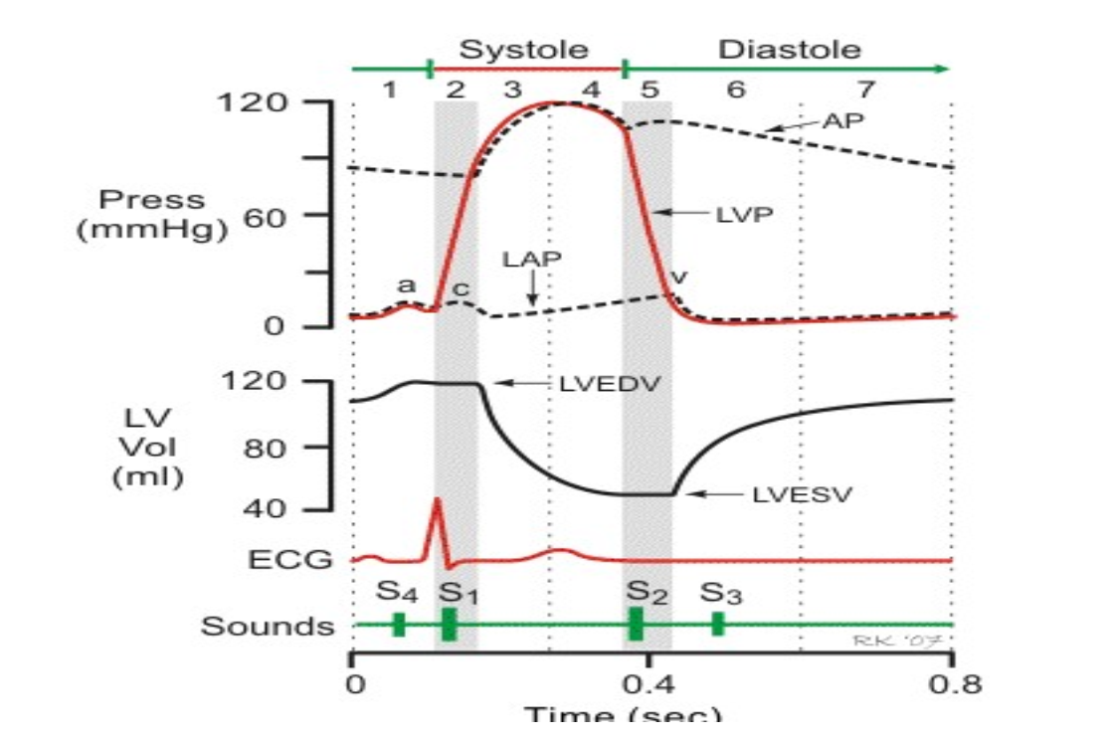
Heart Sound

