Slide 1
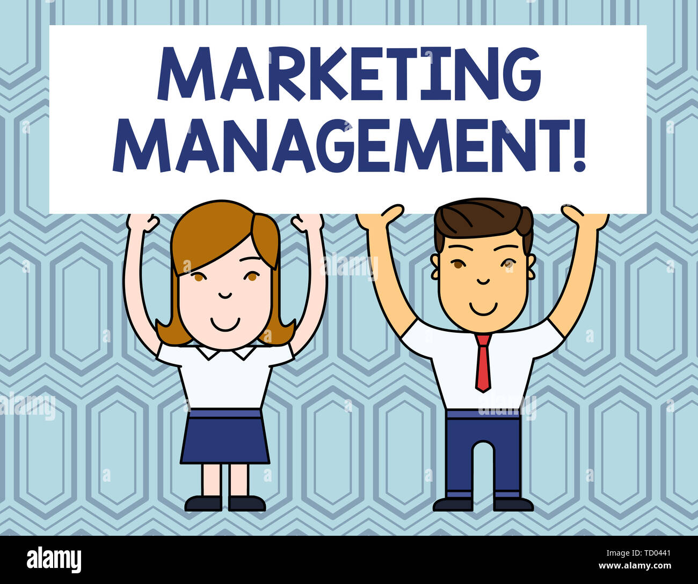
INTRODUCTION TO MARKETING MANAGEMENT

Slide 2
Meaning of Marketing Management
In its simplest form marketing management is made up of 2 words :
Marketing & Management
Management as we all know is the art of getting things done through others , to achieve group goals.
The term marketing comes from market derived from “ marcatus: - which means merchandise”.
Marketing is the belt that connects two important wheels of the economy i.e
PRODUCERS and CONSUMERS.
It refers to all the activities involved in the creation of TIME , PLACE , POSESSION & AWARENESS utilities.
It directs the flow of goods & services from producers to consumers.

Slide 3
Definition of Marketing Management:
“ It is the art and science of choosing target markets and getting , keeping and growing customers through creating , delivering and communicating superior customer values of management”
- Philip Kotler
“ Marketing management is the process of setting marketing goals for an organization, planning and execution of activities to meet these goals , and measuring progress towards their achievement.”
- American Marketing Association

Slide 4
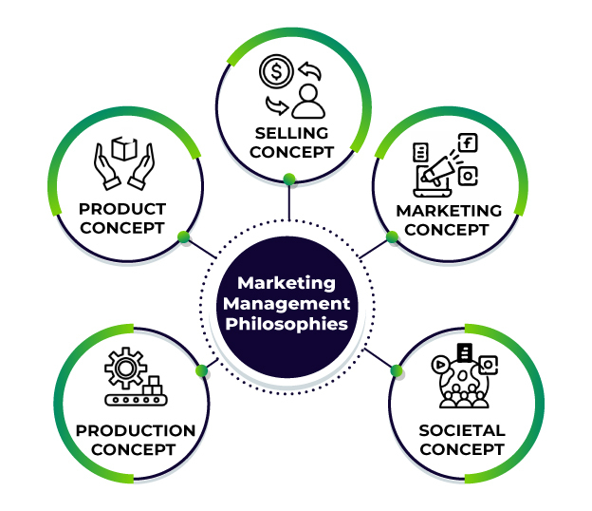
Marketing Management Philosophies

Slide 5
PRODUCTION CONCEPT: It centred on the fact that a seller will only sell a product which has been manufactured irrespective of the needs of the consumers.
PRODUCT CONCEPT: It focuses on a single product manufactured for the consumers without much attention being paid on the requirements of individual customers.
SALES CONCEPT: It focuses on the needs and wishes of the seller , which means the seller would decide what actually does the customer needs.
These approaches were much against the needs of customers , and against the consumer interest. So very soon these lost their relevance and a new approach came into existence , popularly known as the CUSTOMER ORIENTATION PHILOSOPHY.
4. CUSTOMER CONCEPT: The focus of this approach is to ensure customer satisfaction through ensuring the delivery of most adequate product which well conforms to the customer needs.
5. SOCIETAL CONCEPT: The concept which focuses on ensuring present consumer satisfaction alongwith long term social welfare.

Slide 6
SOCIETAL / HOLISTIC / INTEGRATED MARKETING CONCEPT
We are currently functioning according to the SOCIETAL marketing approach
Which tells us about the relevance of ensuring customer satisfaction along with long term social welfare of the consumer and society.
This approach is more socio centric and focuses on the fact that a marketer needs to be socially accountable and ensure that customer satisfaction should not lead to social compromise .
For example:
The idea of CNG CARS is becoming popular because it can satisfy a customer and at the same time do justice with the environment.
Nicotene has become popular to allow people in getting rid of their drug addiction.
Such marketing ideas are both consumer as well as socio oriented.

Slide 7
NATURE OF MARKETING MANAGEMENT

Slide 8
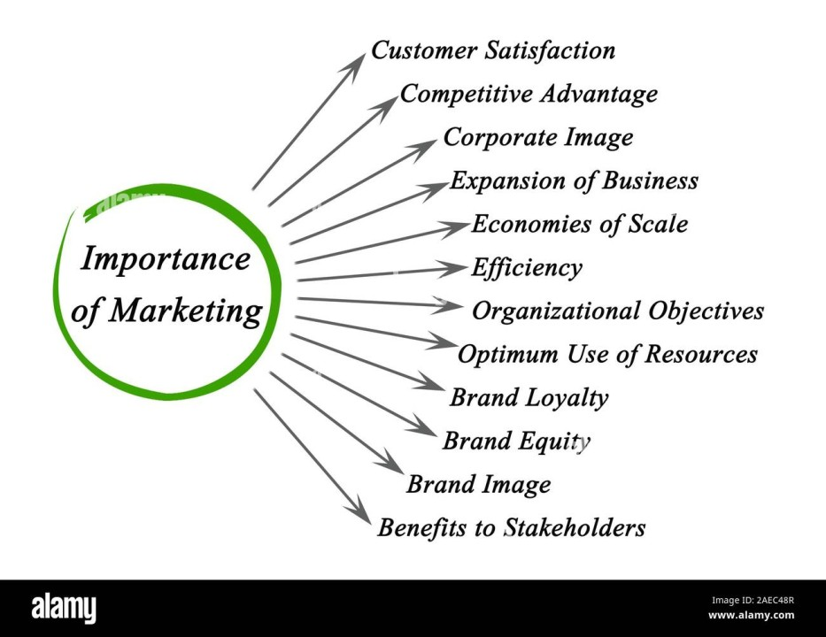
IMPORTANCE OF MARKETING MANAGEMENT

Slide 9
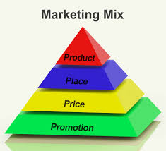
MARKETING ENVIRONMENT
1. INTERNAL ENVIRONMENT

Slide 10
MARKETING MIX: It is the set of internal variables of marketing environment related to a single marketing firm.
These are relatively micro in approach and controllable in nature.
Popularly called the 4 P’s of marketing :
PRODUCT
PRICE
PLACE
PROMOTION
Which are also understood as the following from the perspective of the consumer:
CUSTOMER NEED
COST
CONVENIENCE
COMMUNICATION

Slide 11
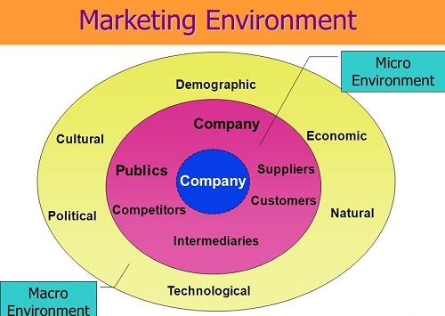
2. EXTERNAL ENVIRONMENT

Slide 12
THANK YOU

