Slide 1
Man Instrumentation System
By:
Somesh Kumar Malhotra
Assistant Professor,
ECE Deptt.,UIET,CSJM University

Slide 2
Man Instrumentation System
Biomedical instrumentation is a set of instruments and equipment utilized in the measurement of one or more characteristics or phenomena, and the presentation of information obtained from those measurements in a form that can be read and interpreted by man.
This is the definition of instrument from the complete man-instrument system which must also include the human or subject on whom the measurement are being made.

Slide 3
Man Instrumentation System
Due to special problems faced in getting data from living organism, specially human beings, and because of the large amount of interaction between the instrumentation system and the subject being measured, it is necessary that the person on whom the measurements are being made be considered an integral part of the instrumentation system.
In order to make sense out of the data obtained from the black box
(the humans organism) the internal characteristic of the black box must be considered in the design and application of any instruments. The overall system, which includes both the organism and the instrumentation required for measurement of the human is called the man-instrument system.

Slide 4
Man Instrumentation System
There are problems associated with such measurements. The process of measuring must not in any way endanger the life of the person on whom the measurements are being made.
It should not cause undue pain or discomfort.
This means that many of the measurement techniques normally employed in the instrumentation of nonliving systems cannot be applied in the instrumentation of humans.

Slide 5
Man Instrumentation System
Man instrumentation system involves the measurement of outputs from an unknown system as they are affected by various combinations of inputs.
The requirement is to understand the nature and characteristics of the system. The unknown system is referred as a black box.
It has a variety of configurations for a given combination of inputs and outputs. The end product of such an exercise is a set of input-output equations for the internal functions of the black box.
These functions may be simple or extremely complex .

Slide 6
Man Instrumentation System
The living human being is one of the most complex black boxes. This black box consists of electrical, mechanical, acoustical, thermal, chemical, optical,hydraulic, pneumatic and many other types of systems. These systems may interact with each other. The human being here referred to as black box may also contain a powerful computer, several types of communication systems, and a great variety of control systems.
However, living black box gives rise to other problems.
Many of the important variables to be measured are not readily accessible to measuring devices.
The measuring device itself introduces some error.

Slide 7
Man Instrumentation System
Some other some problems in obtaining correct measurements are
Safety considerations,
the environment of the hospital in which these measurements are performed .
the medical personnel usually involved in the measurements and
sometimes even ethical and legal considerations.

Slide 8
Man Instrumentation System
Basic principle of biomedical is shown in Fig. below.
Here any physiological event become input to the transducer.
Transducer gives transduced signal which is subjected to signal conditioning .
Subsequently, the output signal is displayed and or saved

Slide 9
Man Instrumentation System
A human being as a whole communicate with his environment in many ways which can be termed as input and output as shown in Fig below.
These input and output can be measured and analyzed in many ways.

Slide 10
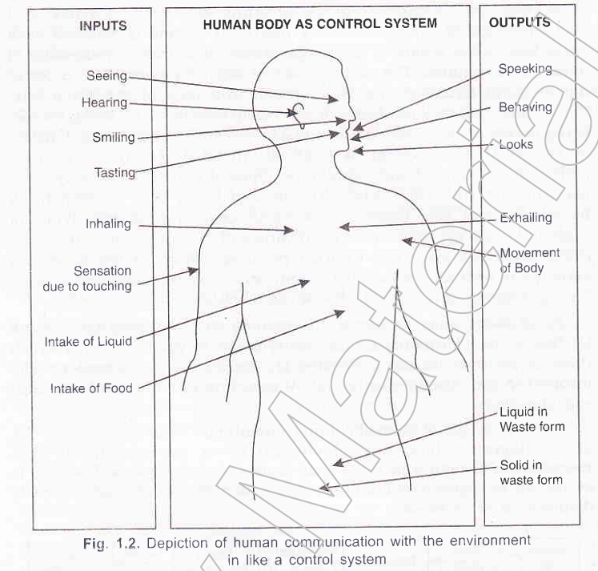

Slide 11
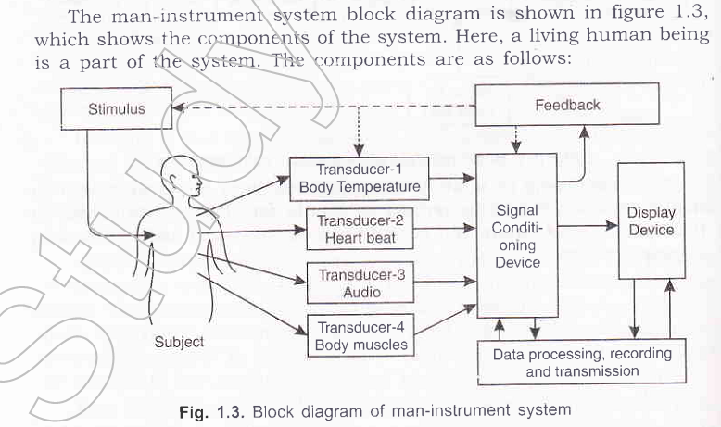
Man Instrumentation System

Slide 12
Man Instrumentation System
Subject:The human being on whom the measurement are made is known as subject.
Stimulus:The response from some external stimulus is required.
Transducer:To transform one form of energy to another we required transducer, especially non-electrical signal to electrical signal.
Signal conditioning Equipment: The devices which are used for amplifying, modifying, filtering or in any way changing the electrical signals are known as signal conditioning equipment.
Display Equipments: Output of the signal conditioning devices must be converted to some form of visual, audible or some tactile information.
Recording, Data processing and transmission Equipment: Recording of measured information is done for possible later use or to transmit it from one location to the another location.
Control Device: It is necessary to have automatic control of stimulus, transducer or any part of instrumentation system, control is incorporated. Such systems consist of feedback loop in which part of the output from signal conditioning devices or display devices to incorporate the required control .

Slide 13
Problem encountered in measuring a living system
Inaccessibility of variables to measurement.
Variability of data
Lack of knowledge of about interrelationship
Effect of transducer on the measurement.
Artifacts
Energy limitation.
Safety Consideration.

