Slide 1
Necrosis
Necrosis is death of cell and tissues in the living animal
Necrosis is defined as a localised area of death of tissue followed later by degradation of tissue by hydrolytic enzymes librated from dead cells
It is invariably accompanied by Inflammatory reaction

Slide 2
Necrosis usually affects a group of contigous cells (in contrast to apoptosis which involves a single cell)
There are inflammatory changes in the surrounding tissue (in contrast to apoptosis where there is no inflammatory changes) .

Slide 3
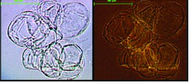
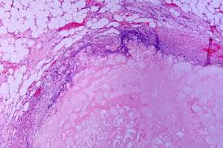
CAUSES
Hypoxia
Ischemia
Physical agents
Chemical agents
Biological agents
Hypersensitivity

Slide 4
Types
Coagulative Necrosis (most common)
Colliquative / Liquefactive necrosis
Caseous Necrosis
Fat Necrosis
Fibrinoid Necrosis

Slide 5
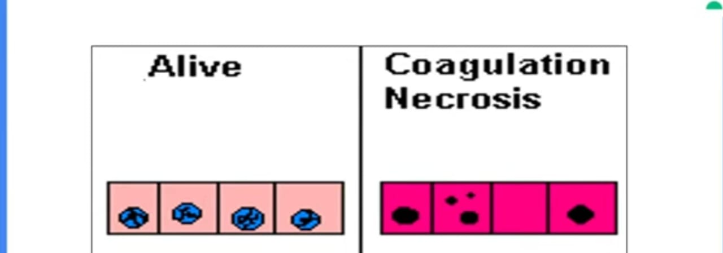
COAGULATIVE NECROSIS
Most common type of Necrosis
Architectural outlines persist but cellular and nuclear details are lost (Ghost cells)

Slide 6
CAUSES
Ischemia due to thrombosis / embolism in all organs expect brain (Amongst solid organs brain is the only exception i.e., it is the only solid organ in which ischemia leads to liquefactive necrosis and not coagulative necrosis )
Mild burns (Thermal injury)
Zenker’s degeneration necrosis

Slide 7
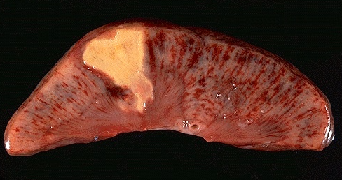
GROSS apperance
Focus in the early stage is pale , firm, and slightly swollen
With progression , the affected area becomes more yellowish , softer and shrunken .

Slide 9
Microscopic apperance
Tomb stones i.e., outlines of the cells are retained and the cell type can still be recognized but their cytoplasmic and nuclear details are lost
The necrosed cells are swollen and have more eosinophillic cytoplasm than the normal
These cell show nuclear changes of pyknosis ,
Karyorrhexis and karyolysis
Eventually , the necrosed focus is infiltrated by inflammatory cells

Slide 10
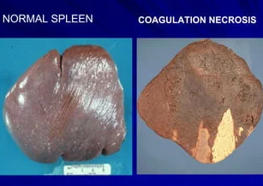

Slide 11
LIQUEFACTION OR COLLIQUATIVE NECROSIS
Liquefaction or colliquative necrosis
Hydrolytic enzmyes in tissue degradation have
a dominant role in causing semi-fluid material
Their architectural details as well as cytoplasmic and nuclear details are lost

Slide 13
CAUSES
Pyrogenic bacterial infections attract nutrophills. Bacterial and leukocytic enzymes liquefy dead cells and tissue .
Ischemic necrosis of brain

Slide 14
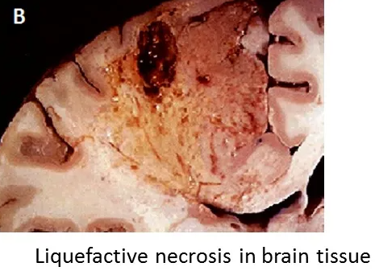
GROSS APPEARANCE
Affected area is soft with liquefied centre containing necrotic debris
Later , a cyst wall is formed .

Slide 15
Microscopic apperance
No architectural or cellular details are visible in the area of necrosis .
The necrotic area usually appears as a cavity containing a mass of necrotic neutrophills , bacteria and tissue debris
The entire necrotic mass is surrounded by a fibrous connective capsule/cyst wall
The cyst wall is formed by proliferating capillaries , inflammatory cells and gliosis

Slide 17
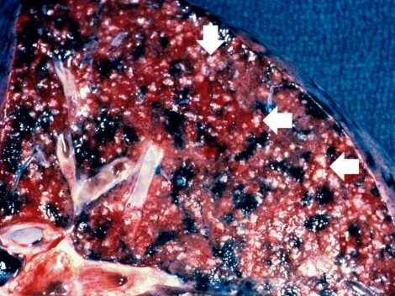
Caseous necrosis
Dead tissue is converted into a homogenous , granular mass resembling cottage cheese .
Their architectural details as wall as cytoplasmic and nuclear details are lost
Accumulation of amorphous (no structure) debris with in an area of necrosis .

Slide 18
CauseS
Associated with lesions of
Mycobacterium tuberculosis
syphilis
Fungi (Histoplasma , coccidiodomycosis )

Slide 19
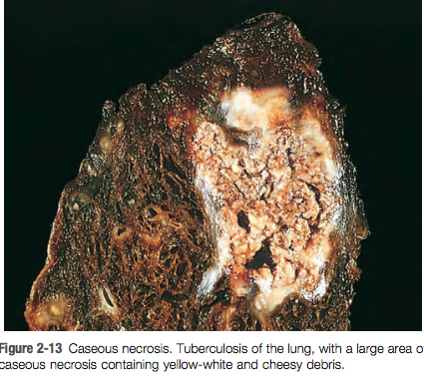
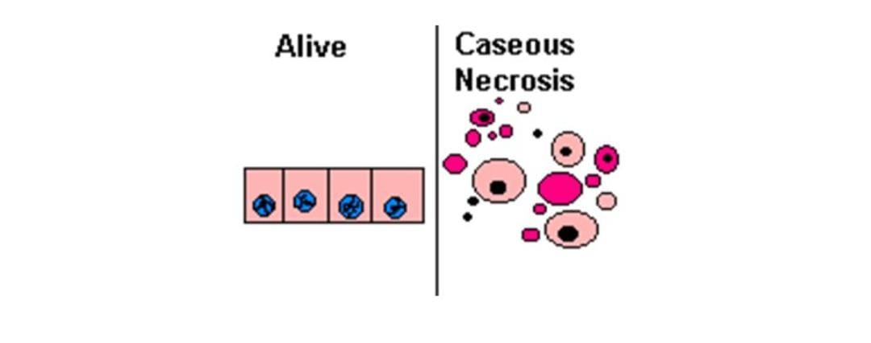
GROSS APPEARANCE
Foci of caseous necrosis resemble dry cheese and are soft , granular and yellowish .

Slide 20
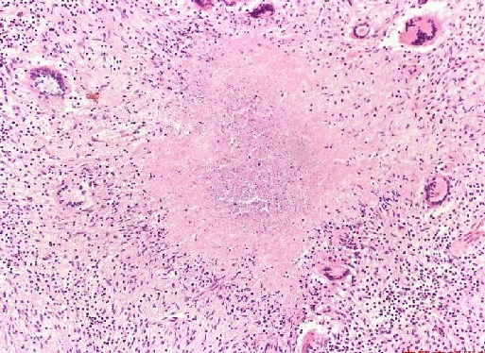
Microscopic appearance

Slide 21
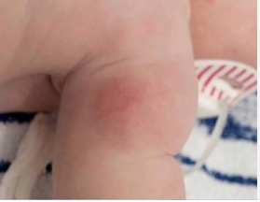
Fat necrosis
Fat necrosis is a special form of cell death occuring at mainly Fat-rich anatomic locations in the body
Death of adipose tissue in a living animal

Slide 22
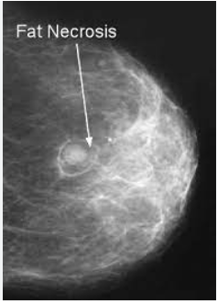
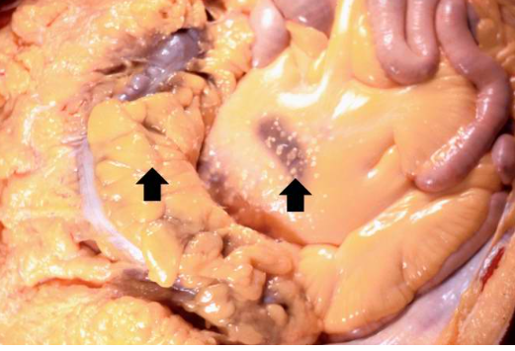
CAUSES
Pancreatic (acute pancreatitis)
Traumatic (breast)

Slide 23
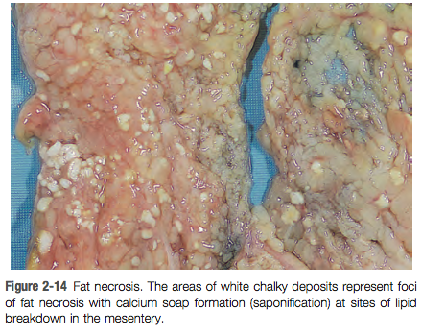
GROSS APPEARANCE
Fat necrosis appears as yellowish-white and firm deposits .
Formation of calcium soaps imparts the necrosed foci firmer and chalky white appearance

Slide 24
Microscopic APPEARANCE

Slide 25
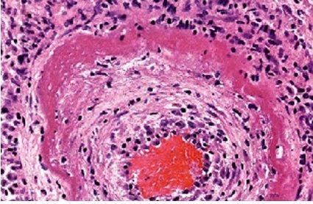
FIBRINOID NECROSIS
Fibrinoid necrosis is characterized by deposition of fibrin –like material which has the staining properties of fibrin
The fibrin like material is deposited in wall of blood vessels

Slide 26
Causes
Immunological injury of vessel wall (e.g. in immune complex vasculitis , autoimmune disease , arthus reaction etc)
Arterioles in hypertension , peptic ulcer etc .

Slide 27
MICROSCOPIC APPERANCE

