Slide 1
Patient Caring and Monitoring System
By:
Somesh Kumar Malhotra
Assistant Professor,
ECE Deptt.,UIET,CSJM University

Slide 2
Introduction
One area of biomedical instrumentation that is becoming increasingly familiar to the general public is that of patient monitoring.
Here electronic equipment provides a continuous watch over the vital characteristics and parameters of the critically ill.
In the coronary care and other intensive care units in hospitals , thousands of lives have been saved in recent years because of the careful and accurate monitoring afforded by the equipment.

Slide 3
Introduction
Essentially, patient are monitored because they have an unbalanced in their body systems.
This can be caused by heart attack or stroke, for example, or it may be the result of a surgical operation , which are drastically disturb this systems.
By continuing monitoring, the patient problem can be detected as they occur and remedies taken before the problems get out of hand.

Slide 4
Introduction
In hospitals that have engineering or electronics departments, patient monitoring units, both fixed and portable, form a substantial part of the workload of the biomedical engineers or technician.
Engineers and technicians are usually involved in the design of facilities for intensive care units, and they work closely with medical staff to ensure that the equipment to be installed meets the needs of the particular hospitals.

Slide 5
Introduction
Ensuring the safety of patient who may have conductive catheteres or other direct electrical connection to their hearts is another function of these biomedical engineers and technicians.
They also work with the contractor in the installation of the monitoring equipments and, when the job is completed, surpervise equipment operation and maintenance.
In addition, the engineering staff participates in the planning of improvement and additions, for design and installation , fails in some respect to meet the special needs of the hospital, and in house solution is required.

Slide 6
Patient monitoring in Intensive care Units
There are at least four categories of patients who need physiologic monitoring:
1. Patients with unstable physiologic regulatory systems; for example, a patient whose respiratory system is suppressed by a drug overdose or anesthesia.
2. Patients with a suspected life-threatening condition; for example, a patient who has findings indicating an acute myocardial infarction (heart attack).
3. Patients at high risk of developing a life-threatening condition; for example, patients immediately post open-heart surgery, or a premature infant whose heart and lungs are not fully developed.
4. Patients in a critical physiological state; for example, patients with multiple trauma or septic shock.

Slide 7
Elements of ICU
The 24 hrs nurse for the critically ill patient has over the years , become a familiar part of the hospital scenes.
In last few year, by the development of the sophisticated instruments, due to there accuracy are extensively used for patient monitoring.
Nurse are still there, but roles have changed somewhat, for they now have powerful tools at their disposal for acquiring and assimilating information about the patient under their care.

Slide 8
Elements of ICU
They are therefore able to render better services to a larger number of patient and are better able to react promptly and properly to an emergency situation.
With the capability of providing an immediate alarm in the event of certain abnormalities in the behavior of a patient’s heart, monitoring equipment makes it possible to summon a physician or nurse in time to administer emergency aid, often before permanent damage can occur.

Slide 9
Elements of ICU

Slide 10
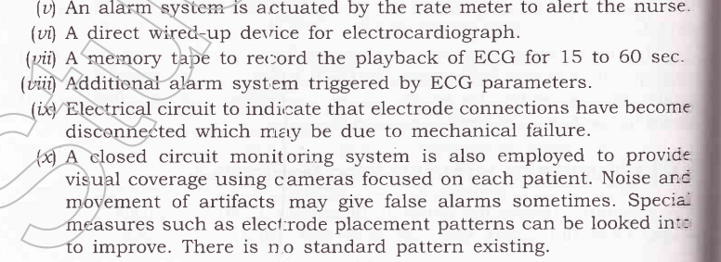
Elements of ICU

Slide 11
Elements of ICU

Slide 12
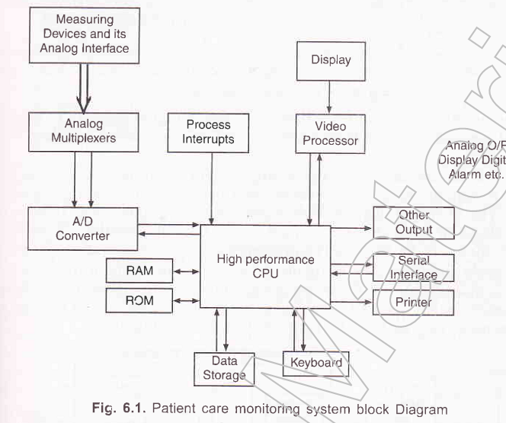
Elements of ICU

Slide 13
Elements of ICU

Slide 14
Patient Monitoring Display
An important features of any patient monitoring system is its ability to display the physiological waveforms being monitored.
Clear , faithful reproduction of the ECG, arterial blood pressure, and other variables enable the medical staff to periodically check the patient’s progress and make the vital decision at time of crisis.

Slide 15
Patient Monitoring Display
Although paper chart recording are often used to provide a permanent record of the data, the principal display device for patient monitoring is the cathode ray tube (CRT).
Ranging from a small single- or dual-channel display at the patient’s bedside to a large mutichannel unit at the nurse station, the CRT provides a continuous, current presentation of one or more waveform from a given patient or simultaneous waveform from several patients.

Slide 16
Patient Monitoring Display
In addition, computerized patient monitoring system may permit display of calculated parameters and graphic information, including trend plots and comparison of current measurement result with past data.
Two type of CRT display are found in patient monitoring sytems:
Conventional or ‘bouncing ball’ display.
Nonfade display

Slide 17
Patient Monitoring Display
The conventional or bouncing ball display is nothing more than an oscilloscope with the horizontal sweep driven by a slow speed sweep generator that causes the electron beam to move from left to right at a predetermined rate,selectable from the front panel control.
Sweep rate of 25 and 50 mm/sec are often included to corresponds to standard ECG chart speeds.

Slide 18
Patient Monitoring Display
Multiple traces are obtained by an electronic chopper that causes the electron beam to sequentially jump from trace to trace, sharing time among the various channels of data.
Eight or more channels can be presented simultaneously in this manner, all of which are presented in time relationship with each other.

Slide 19
Patient Monitoring Display
As the electron beam moves across and writes a pattern on the face of the CRT, the earlier portion of the trace begin to fade away and finally disappears.
The ability of the trace to remain visible on the face of the CRT is known as persistence.
The duration of this persistence is determined by the phosphor(coating) inside the CRT. The longest persistence tubes that are available allow the trace to be visible for approximately 1 second.

Slide 20
Patient Monitoring Display
In case of pattern like the ECG or blood pressure waveform, for example, which may occur at the rate of 60 events per minute, the persistence of the tube allow the viewer to see only one cycle of the waveform.
In addition, this displayed waveform will not be uniformly bright. The early portion of the display will always be dimmer than the more current portion

Slide 21
Patient Monitoring Display
Such a ‘temporary Display’ has great limitation for the observer, who may need to evaluate the waveform for diagnostic purposes. Doing so become an almost impossible task.
When it is necessary to perform any analysis on such waveform , the waveform must be permanently recorded on paper.
Any event that might have occurred unseen may be lost within a second and cannot be documented on paper even with a time lag or delay between the CRT and writeout device.

Slide 22
Patient Monitoring Display
Nowadays non fade system are used with LCD and LED displays, whose persistence is much greater than the previous one.
In addition to non fade display makes possible the presentation of digital numerical readout on the face of the monitor screen.
Thus, the ongoing heart rate, systolic and diastolic blood pressure, and the patient’s temperature may be displayed along with the ECG and blood pressure waveform.

Slide 23
Diagnosis,Calibration and Repairability of Patient Monitoring Equipment
Just as the physician must diagnose the patient monitoring equipment in the hospital.
In connection with the typical Intensive-Care Unit, there is often an associated maintenance and design group composed of engineers and technicians who usually have access to wide variety of diagnostic device for electronic equipment.

Slide 24
Diagnosis,Calibration and Repairability of Patient Monitoring Equipment
Not only is it necessary to keep medical instrumentation in good repair, but it is equally important to keep all equipment calibrated accurately.
Many piece of medical electronics have built in calibation devices.

Slide 25
Diagnosis,Calibration and Repairability of Patient Monitoring Equipment

Slide 26
Diagnosis,Calibration and Repairability of Patient Monitoring Equipment

Slide 27
Diagnosis,Calibration and Repairability of Patient Monitoring Equipment

Slide 28
Diagnosis,Calibration and Repairability of Patient Monitoring Equipment

Slide 29
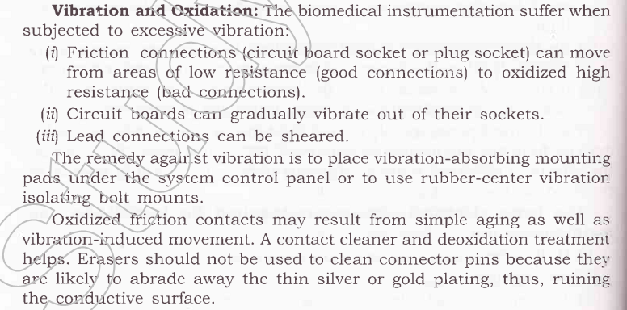
Diagnosis,Calibration and Repairability of Patient Monitoring Equipment

Slide 30
Diagnosis,Calibration and Repairability of Patient Monitoring Equipment

Slide 31
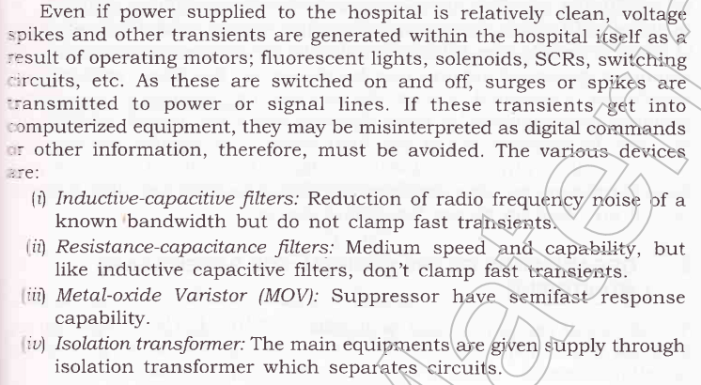
Diagnosis,Calibration and Repairability of Patient Monitoring Equipment

