Slide 1
Content
Proteomics
Types of proteomic
Application of proteomic
Genomics
Application of Genomics
Metabolomics
Type of metabolomics
Application of Metabolomics
Nutrigenomics

Slide 2
Proteomics
The study of structure and function of protein including the way they work and interact with each other inside the cells.
Proteome is derived from genome by gene expression.
Proteomics refers to large scale study of total protein of an individual.
In other word, proteomic also refers to identification and analysis of entire protein content.

Slide 3
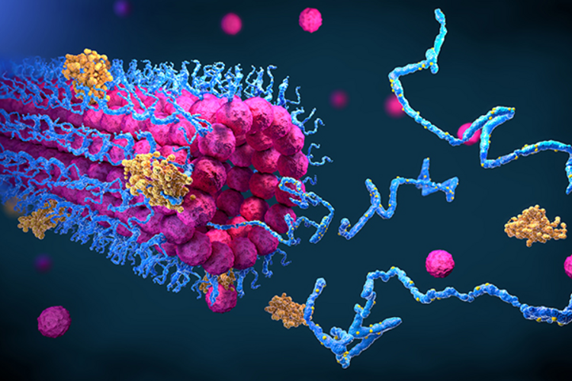
Type of proteomics
Functional Proteomics - The major goal of functional proteomic is to elucidate the biological function of protein.
It include identifying protein function characterization of enzyme activities.
This type of proteomics is performed by large-scale measurement of enzymatic activites of kinase or protein modifying enzymes.

Slide 4
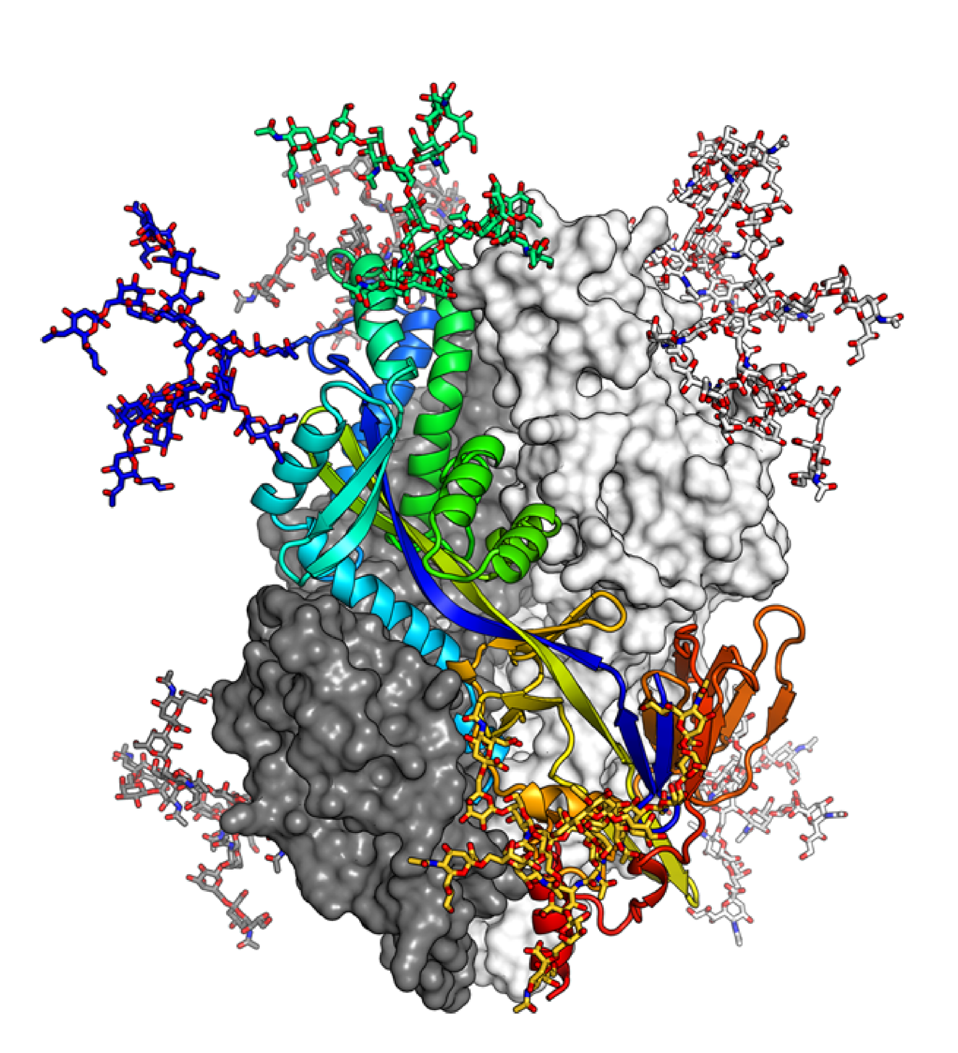
Structural Proteomics
The major goal of structural proteomics is to characterize the three-dimensional structure of protein.
It help to understanding the target sites of protein, where drugs bind.
This type of proteomic is generally done using X-ray crystallography and NMR spectroscopy.

Slide 5
Expression Proteomics
It is also termed as differential proteomic and its objective to identify or analyze protein expression in an organism.
Expression proteomic is genereally done using 2D-gel electrophoresis and mass spectrometry.

Slide 6
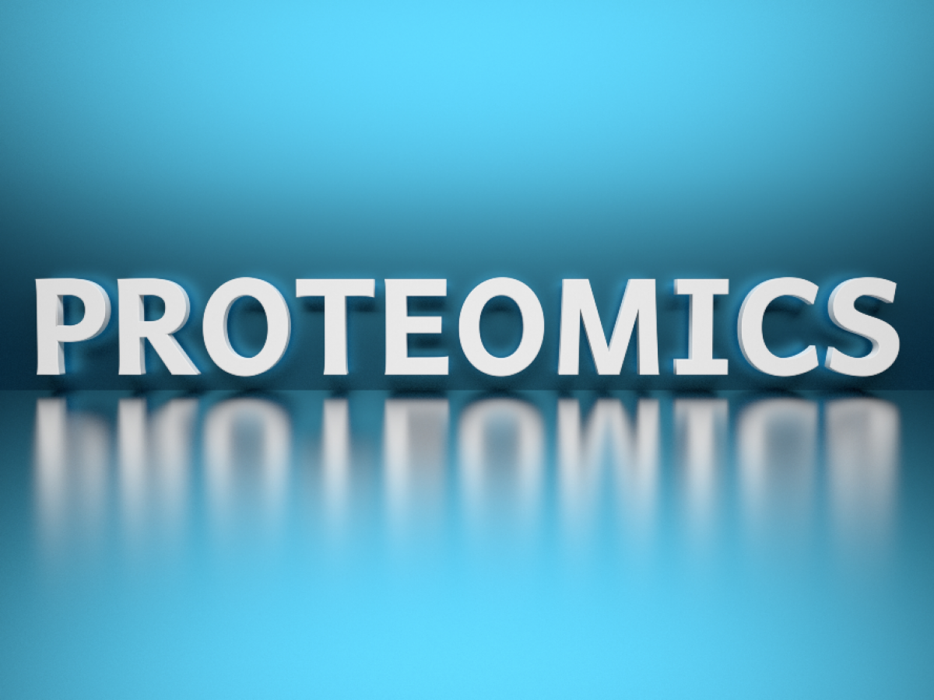
Application of Proteomic
Biomedical Research
Clinical Medicine
Agriculture
Environmental Science
Food Science
Pharmaceutical and Biotechnology
Neuroscience
Forensics
Microbiology
Proteogenomics

Slide 7
Biomedical Research
Disease Biomarker Discovery-
Proteomics helps identify protein biomarkers for diseases like cancer,Alzheimer and diabetes.
Drug Development-
It assists in drug target identification and validation, as well as drug efficacy and saftey testing.
Agriculture-
Crop Improvement-
Proteomics can identify proteins related to stress resistance,yield,and nutritional content in crops.

Slide 8
Pharmaceutical and Biotechnology
Biopharmaceutical Production- Proteomic is used to optimize the production of therapeutics protein like monoclonal antibodies.
Quality Control- Ensure the conistency and quality of biopharmaceutical products.
Forensics-
Proteomics can be used to identify individuals bashed on unique protein profiles,especially in cases where DNA analysis is not possible.

Slide 9
Genomics
Genomics is the field of genetics that attempts to understand the content,organization,function,and evaluation of genetic information contained in whole genome.
Frederick Sanger is the father of genomics.
A genome refers to complete set of genes in an organism.
The entire genome of human was decoded in 2003 as “Human Genome Project”.
As per report, about 22,300 protein-coding genes have been identified in human being.

Slide 10
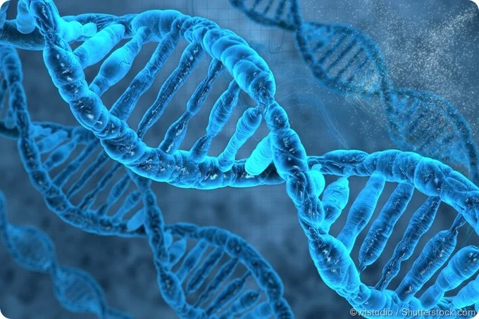
Application of Genomics
Medicine
Agriculture
Biotechnology
Evolutionary Biology
Environmental Science
Forensic
Bioinformatics
Nutrition and Health
Genetic Counselling

Slide 11
Medicine
Disease Diagnosis-
Identifying genetic markers for diseases allows for early detection.
Pharmacogenomics-
Customizing drug prescriptions bashed on genetic profiles to enhance efficacy and reduce side effect.
Biotecnology-
Biopharmaceutics-
Genomic information is used to develop biologic drugs and therapies.

Slide 12
Forensics
DNA Profiling- Genomic techniques are crucial in criminal investigations for identifying individuals.
Anthropology-
Human Evoluation- Genomics provides insights in to human evolutionary history and migration patterns.
Nutrition and Health-
Nutrigenomics- Studying how an individual genes affect their response to diet and nutrition.

Slide 13
Metabolomics
The term ‘metabolome’ refers to all metabolites in a cell,tissue,organ, or organism which are the end products of cellular and chemical processes.
The scientific study of metabolome is termed as ‘metabolomics’.
NMR spectroscopy also helped in identifying and measuring different metabolites in the body fluids.

Slide 14
Types of Metabolites
Endogenous metabolites- These are formed inside the body and these include glucose,hormones etc.
Exogenous metabolite- These are foreign in nature and enter in the body from outside e.g. drugs
These are also termed as xenometabolites. The study of such extracellular(foreign) metabolites is termed as exometabolomics.

Slide 15
Application of Metabolomics
Biomedical Research
Nutrition and Food Science
Pharmaceuticals
Enviromental science
Agriculture
Toxicology
Cancer research
Neurosicence
Veterinary Medicine
Forsenic science

Slide 16
Biomedical Research
Metabolomics helps in understanding disease mechanism identifying biomarkers for the early detection and monitoring treatment responses.
Nutrition and Food Science-
its used to study metabolic effect of different diets asses food quality and detect aduleration or contamination in food products.

Slide 17
Toxicology
it used to identify the metabolic pathways of toxins and assess their effects on organism.
Nuroscience-
it used to study brain metabolism neurotransmitter pathways and the effect of neurodegenerative diseases.
Forsenic science-
it can be applied in forsenic toxicology to analyze bodily fluids for drugs or toxins.

Slide 18

Nutrigenomics
it is the branch of genomic which studies the influence variation on nutrition and influence of nutrients on genes.
In this branch, a correlation is made between gene expression and metabolism of nutrients.
In simple term is the study of how the food we eat interacts with our genes to influence our health.

Slide 19
Common Example Of Nutrigenomics
Lactose intolearance-
some persons are not able to tolerate lactose because these lack genes responsible for production of enzyme lactase in small intestine. therefore it is recommended to avoid milk in person with lactose intolerance.
Phenylketonuria-
Phenylketonuria an inborn error of metabolism is another example of nutrigenomics. due to genetic variation some person lack phenylalanine hydroxylase which leads to decrease in phenylalanine metabolism and its accumulation may produce neurological damage.

Slide 20
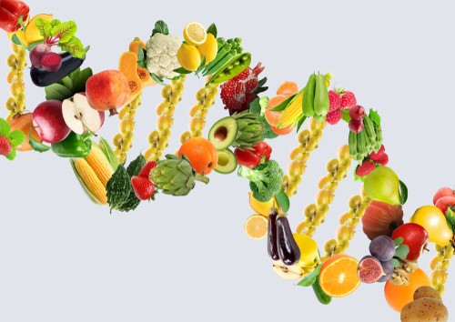
Application of Nutrigenomics
Clinical Medicine
Disease Prevention
Nutritional Therapy
Pregnancy Nutrition
Pharmaceuticals
Nutritional Genomics Research
Pediatrics
Gerontology
Food Allergies and Sensitivities

Slide 21
Clinical Medicine
Managing chronic diseases like cancer,cardiovascular disease and diabetes by customizing dietary interventions.
Disease Preventaion-
Identifying genetic risk factor for diet-related diseases like obesity,diabetes,and cardiovascular disease to develop targeted prevention strategies.
Nutritional Therapy-
Designing diets and supplements bashed on genetic markers to manage and treat certain medical condition.

Slide 22
Pregnancy Nutrition
Providing expectant mother with personalized dietary recommendations to support a healthy pregnancy and fetal development.
Pediatrics
Offering customized dietary guidence for infants and childern to promote healthy growth and development.
Gerontology
Tailoring dietary plans for older adults to address age-realted nutritional needs and promote healthy aging.

Slide 23
Nutritional Genomics Research
Investigating the interaction between genes and diet to uncover new insights into human biology and disease prevention.
Sport and Fitness
Designing personalized training and nutrition plans for atheletes bashed on their genetic predispositions for muscle development,endurance,and recovery.

