Slide 1
Techniques of Environmental Scanning
Any business which is part of the society cannot function in isolation , and it indispensable to move along with the changes taking place in the surrounding , i.e it’s ‘BUSINESS ENVIRONMENT’.
A business which does not adapt to these changes cannot survive in the market for a long duration of time.
To understand such changes and act accordingly , it is very important to firstly study and analyse this everchanging environment , with skills and diligence.
This whole process of analysing the environment is known as ‘ ENVIRONMENTAL SCANNING’.
There are several techniques which are used for studying the environment which can be business specific and depends on choice of the firm itself.
In the next slide we will focus on various possible techniques of environment monitoring.

Slide 2
SWOT Analysis
It is one of the most popular technique for environmental scanning.
Which stands for S- strengths
W- weaknesses
O- opportunities
T- threats
The first 2 variables ( ie. Strengths & Weaknesses) are highly internal to the firm.
The other 2 variables ( i.e Opportunities & Threats) are quite external to the firm.
This technique helps to understand on what key areas a firm can work , and which all areas it can utilise to get an advantage.
Also it is useful to take adequate steps to combat possible challenges and make best use of them.

Slide 3
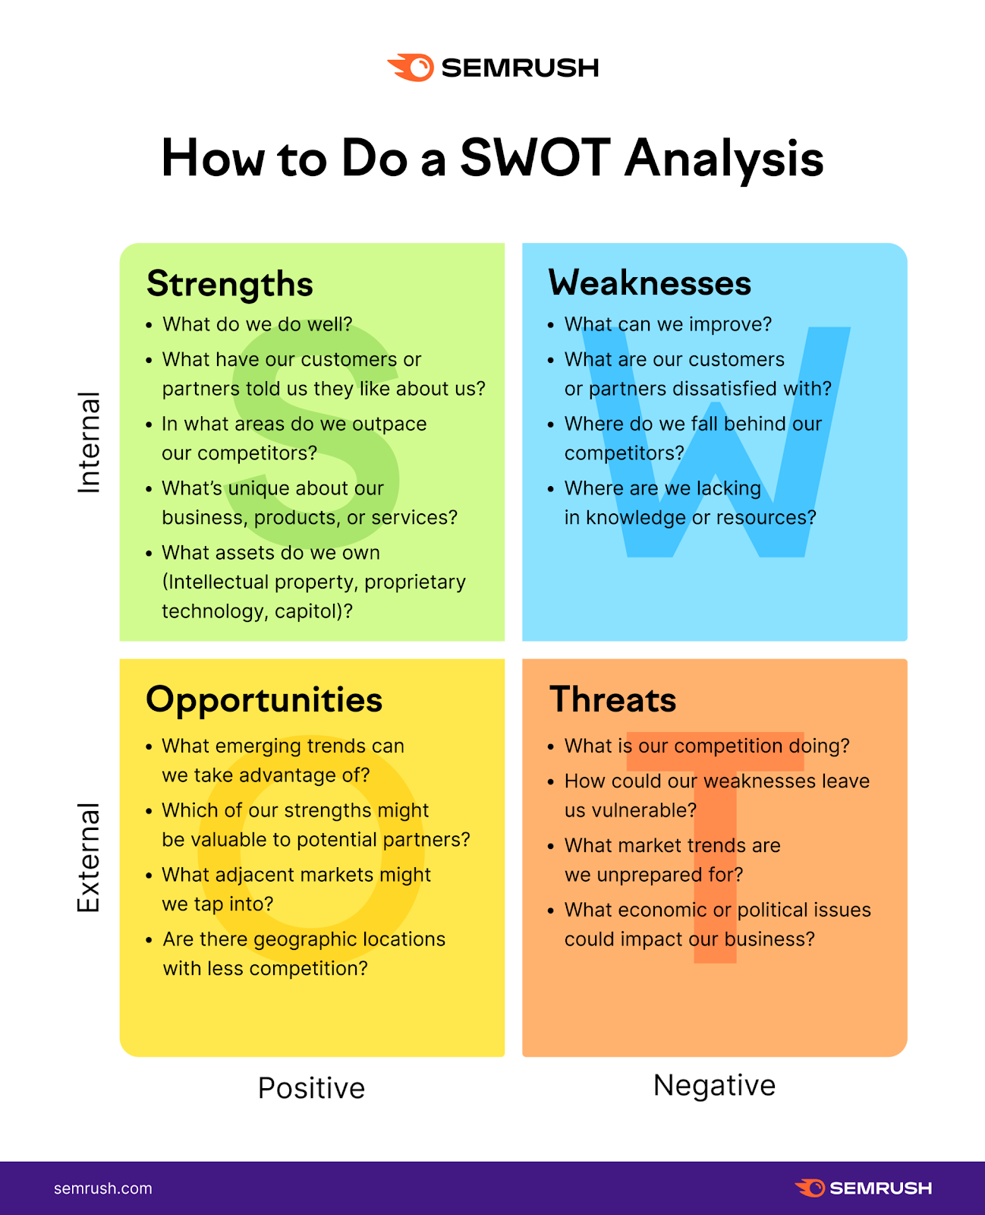

Slide 4
PESTLE Analysis
It stands for , P-Political
E- Economic
S- Social
T- Technological
L- Legal
E- Ecological
This is a detailed environmental analysis technique which keeps the external –MACRO environment of business in mind.
The technique studies impact of politically-economically-socially-technologically-legally & ecologically driven variables on a business.
Any business studies such variables and then decides about it’s own strategy for the same.

Slide 5
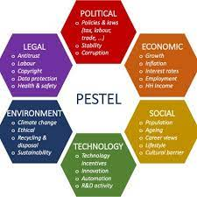

Slide 6
PEST Analysis
This analysis is a slight narrow version of PESTLE Analysis , as it includes only the following variables:
P- Political
E- Economic
S- Social
T- Technological
This technique again observes role of macro factors on a business setting.

Slide 7
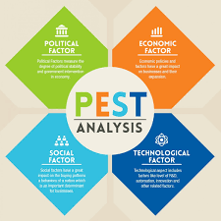

Slide 8
5 Force Model of Michael Porter
Porter’s 5 Force Model is that which identifies and analyses 5 competitive forces that shape every industry and helps industry to determine it’s weaknesses.
1. Threat of NEW ENTRANTS in the industry
2. Threat of existing SUBSTITUTE PRODUCTS
3. BARGAINING POWER of customers
4. BARGAINING POWER of SUPPLIERS
5. COMPETITION in the industry

Slide 9
