Slide 1
Source of Bioelectric Potentials
By:
Somesh Kumar Malhotra
Assistant Professor,
ECE Deptt.,UIET,CSJM University

Slide 2
Introduction
In carrying out their various function, certain system of the body generates their own monitoring signals, which convey useful information about the function they represent.
These signals are bioelectric potentials associated with nerve conduction , brain activity, heart beat, muscle activity and so on.
Bioelectric potentials are actually ionic voltages produced as a result of the electrochemical activity of certain special type of cells.

Slide 3
Introduction
Through the use of transducer capable of converting ionic potential into electrical voltages, these natural monitoring signals can be measured and results can be displayed in a meaningful way to aid the physician in his diagnosis and treatment of various diseases.

Slide 4
Resting and Action Potential
We know that some of the types of cells of the body are encased in a semipermeable membrane which allow some substances to pass-through the membrane whereas others are not allowed to pass through.
we also know that these cells of the body are surrounded by body fluids which are conductive solutions containing charge atoms, i.e., ions.
The prominent ions are sodium (Na+), potassium (K+), and chloride (Cl-)

Slide 5
Resting and Action Potential
The membrane of the cells allow entry of potassium and chloride ions whereas blocks the entry of sodium ions.
Various ions seek a balance between the inside of the cell and the outside.
The sodium is unable to penetrate the membrane. This results in unbalance of ions concentration and electric charge.

Slide 6
Resting and Action Potential
The concentration of sodium ions inside the cell becomes much lower than in the intercellular fluid outside.
The sodium ions are positive, therefore, this makes the outside of the cell more positive than the inside.
In an attempt to balance the electric charge, the additional potassium ions which are positive, enter the cell causing higher concentration of potassium on the inside than on the outside (see fig.

Slide 7
Resting and Action Potential

Slide 8
Resting and Action Potential
Thus charge balance cannot be achieved. Hence, equilibrium is achieved with a potential difference across the membranes. The inside of the cell is negative and outside is positive. This membrane potentials called the Resting Potential.

Slide 9
Resting and Action Potential
This potential is maintained until some kind of disturbance is caused to upset the equilibrium. The resting potentials range from - 60 mV to - 1OO mV.
The figure (b) illustrates the resting potential. A cell in the resting state is said to be polarized.

Slide 10
Resting and Action Potential

Slide 11
Resting and Action Potential
The excitation of a section of cell can be by using the flow of ionic current or any externally applied energy.
This excitation of a section of cell causes change in the characteristics of the membrane which allows some of the sodium ions to enter.
The movement of sodium ions into the cell further accelerates entry of sodium ions. This leads to rush of sodium ions inside the cell whereas potassium ions try to go outside but are unable to out that fast.
The net result is slightly higher potential inside the cell. This potential is known as the action potential which can be about + 20 mV.

Slide 12
Resting and Action Potential
When the rush of sodium ions through the cell membrane stops a new state of equilibrium is reached ,the membrane behaves in its normal condition i.e., sodium ions are not allowed to enter inside from outside. At this stage of the process, sodium ions are quickly transported from inside of cell to outside of cell and this active process is known as sodium pump. Once all sodium ions are pumped outside the cell, the cell reaches its Resting Potential.
The process of change from Action Potential to Resting Potential is known as Repolarization.

Slide 13
Typical waveform of action potential

Slide 14
Typical waveform of action potential
The waveform of the action potential is shown in fig.
The time scale depends on the type of cell producing the potential Nerve and muscle have 1 m sec duration, whereas heart muscle duration may be as high as 3OO m sec.
Please note that after repolarization completion, resting potential is named "after potentials", which reaches restinl' potential slowlY

Slide 15
Propagation of action potential
Once a cell is excited and generated action potential, ionic currents begin to flow. This process excites neighbouring cells or areas of the same cell. A nerve cell with a long fiber may have potential over a small segment of the fiber, but it is propagated in both directions from the origin point of excitation.

Slide 16
Propagation of action potential
The rate at which an action potential moves down a fiber is known propagation rate.
In nerve cells the 140 meters per second. The propogation of heart muscles cells slower in the range of 0.2 to 0.4 m per second.
Artria and venticles of the heart have special cells which have propagation rate of as low as 0.05 meter Per second.

Slide 21
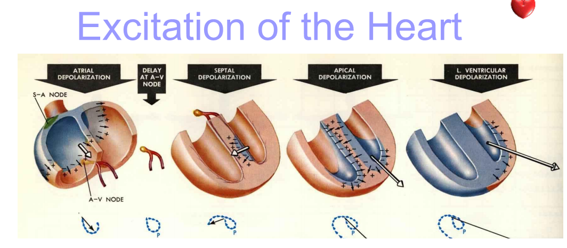

Slide 25
