Slide 1
Electrodes
By:
Somesh Kumar Malhotra
Assistant Professor,
ECE Deptt.,UIET,CSJM University

Slide 2
Introduction
In observing the measurement of ECG or the some other form of bioelectric potential, a conclusion could easily be reached that the measurement electrodes are simply electrical terminals or contact points from which the voltage can be obtained at the surface of the body.
Also the purpose of the electrolyte paste or jelly often used in such measurement might be assumed to be only the reduction of the skin impedance in order to lower the overall input impedance of the system.
These conclusions, however are incorrect and do not satisfy the theory that explains the origin of bioelectric potentials

Slide 3
Introduction
It must be realised that the biopotentials generated in the body are ionic potentials, produced by ionic current flow.
Efficient measurement of these ionic potentials requires that they be converted into electronic potentials before they can be measured by conventional methods

Slide 4
Introduction
It was the realization of this fact that led to the development of the modern noise free, stable measuring device now available.
Device that converts ionic potential into electronic potential are called ELECTRODES.

Slide 5
Electrode theory
The interface of metallic ions in solution with their associated metals gives an electrical potential which is called electrode potential.
The electrode potential is a consequence of difference in diffusion rates into and out of the metal.
The formation of a layer of charge at the interface is created due to equilibrium.It is a double layer charge.
The layer nearest to the metallic is one polarity and the layer next to the solution has opposite polarity.

Slide 6
Electrode – Electrolyte Interface
General Ionic Equations
a)
b)
a) If electrode has same material as cation, then this material gets oxidized and enters the electrolyte as a cation and electrons remain at the electrode and flow in the external circuit.
b) If anion can be oxidized at the electrode to form a neutral atom, one or two electrons are given to the electrode.
The dominating reaction can be inferred from the following :
Current flow from electrode to electrolyte : Oxidation (Loss of e⁻)
Current flow from electrolyte to electrode : Reduction (Gain of e⁻)

Slide 7
Half Cell Potential
A characteristic potential difference established by the electrode and its surrounding electrolyte which depends on the metal, concentration of ions in solution and temperature (and some second order factors) .
Half cell potential cannot be measured without a second electrode.
The half cell potential of the standard hydrogen electrode has been arbitrarily set to zero. Other half cell potentials are expressed as a potential difference with this electrode.

Slide 8
Measuring Half Cell Potential
Note: Electrode material is metal + salt or polymer selective membrane

Slide 9
Some half cell potentials
Standard Hydrogen electrode
Note: Ag-AgCl has low junction potential & it is also very stable -> hence used in ECG electrodes!

Slide 10
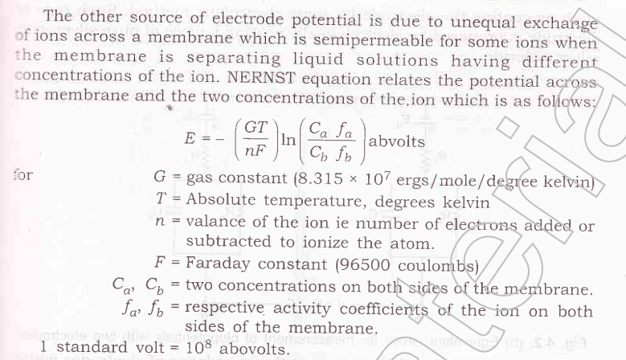
Electrode theory

Slide 11
Bio potential Electrodes

Slide 12
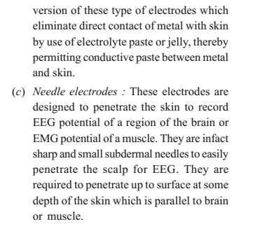
Bio potential Electrodes

Slide 13
Bio potential Electrodes
All three type of biopotential electrodes have the metal electrolyte interface.
In each case, an electrode potential is developed across the interface,proportional to the exchange of ions between the metal and the electrolyte.
The double layer of the charge at the interface act as a capacitor.

Slide 14
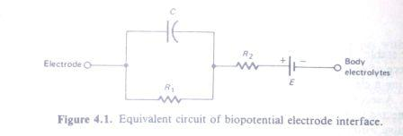
Bio potential Electrodes
Thus the equivalent circuit of biopotential electrode in contact with the body consist of a voltage in series with a resistance- capacitance network of the type shown in fig.

Slide 15
Bio potential Electrodes
Since measurement of bioelectric potentials require two electrodes, the voltage measured is really the difference between the instantaneous potentials of the two electrodes as shown in figure below.
If the two electrodes are of the same type , the difference is usually small and depends essentially on the actual difference of ionic potential between the two points of the body from which the measurement are being taken

Slide 16
Bio potential Electrodes

Slide 17
Bio potential Electrodes
If two electrodes are of different type, however they may produce a significant d.c. voltage that can cause current to flow through both electrodes as well as through the I/P circuit of the amplifier to which they are connected .
The d.c. voltage due to the difference in electrode potentials is called the electrode offset voltage .

Slide 18
Bio potential Electrodes
The resulting current is often mistaken for a true physiological event.
Even two electrodes of the same materials may produce a small electrode offset voltage.
In addition to the electrode offset voltage, experiments have shown that the chemical activity that take place with in a electrode can cause voltage fluctuation to appear without any physiological I/P.

Slide 19
Bio potential Electrodes
Such variations may appear as noise on a bioelectric signals.
This noise can be reduced by proper choice of the material or, in most cases, by special treatment, such as coating the electrodes by some electrolytic method to improve stability.
It has been found that electrochemically the silver-silver chloride electrode is very stable.

Slide 20
Bio potential Electrodes
Larger electrodes tend to have lower impedance. Surface electrodes generally have impedance of 2 to 10 Kohm, where as small needle electrodes and microlelectrodes have higher impedance.
For best results in readings and recording potentials measured by the electrodes , the I/P impedance of the amplifier must be several time that of electrode.

Slide 21
Microelectrodes
Microelectrodes are electrodes with tips sufficiently small to penetrate a single cell in order to obtain reading from with in a cell. The tip must be small enough to permit penetration without damaging the cell. This action is usually complicated by the difficulty of accurately positioning an electrode w.r.t. a cell.

Slide 22
Microelectrodes
Microelectrode are generally of two types:
Metal and
Micropipet
Metal microelectrode are formed by electrolytically etching the tip of a fine tungsten or stainless steel wire to desired size.then the wire is coated almost to the tip with an insulating material.
Some electrolytic processing can also be performed on the tip to lower the impedance.

Slide 23
Microelectrodes
The micro-pipet type of microelectrodes is a glass micro-pipet with tip drawn out to the desired size (usually about 1 micron in diameter).
The micro-pipet is filled with an electrolyte compatible with the cellular fluids.

Slide 24
Microelectrodes
This type of microelectrodes has a dual interface. One interface consist of a metal wire in contact with the electrolyte solution inside the micropipette, while the other is the interface between the electrolyte inside the pipette and the fluid inside or immediately outside the cell.

Slide 25
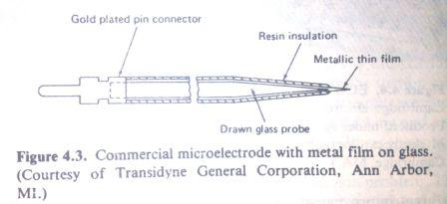
Microelectrodes
A commercial type of microelectrode is shown in Fig.In this electrode a thin film of precious metal is bonded to the outside of a drawn glass microelectrode.

Slide 26
Microelectrodes
Microelectrodes, because of their small surface areas, have impedance well up into the mega-ohm. For this reason, amplifier with extremely high impedance are required to avoid loading the current and to minimize the effects of small changes in interface impedance.

Slide 27
Body Surface Electrodes
The earliest bioelectric potential measurements used immersed electrodes, which was simply bucket of saline solution into which the subject placed his hand and feet, one bucket for each extremity. As might be expected, this type of electrode presented many difficulties, such as restricted position of the subject and danger of electrolytic spillage.

Slide 28
Body Surface Electrodes

Slide 29
Body Surface Electrodes
A great improvement over the immersion electrodes were the plates electrodes, first introduced about 1917.
Originally, these electrodes were seperated from the subject’s skin by cotton or felt soaked in a strong saline solution.
Later a conductive jelly or electrolyte paste replaced the soaked pads and metal was allowed to contact the skin through a thin coat of jelly

Slide 30
Body Surface Electrodes
Metal plate electrodes
Large surface: Ancient, therefore still used, ECG
Metal disk with stainless steel; platinum or gold coated
EMG, EEG
smaller diameters
motion artifacts
Disposable foam-pad: Cheap!
(a) Metal-plate electrode used for application to limbs. (b) Metal-disk electrode applied with surgical tape. (c)Disposable foam-pad electrodes, often used with ECG

Slide 31
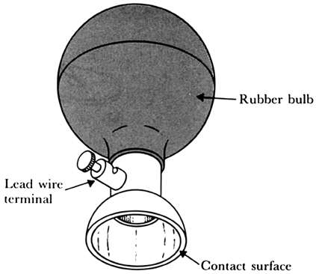
Body Surface Electrodes
Another fairly old type of electrode still in use is the suction-cup electrode shown in fig.
In this type, only the rim actually contacts the skin.
Suction electrodes
No straps or adhesives required
precordial (chest) ECG
can only be used for short periods

Slide 32
Body Surface Electrodes
One of the difficulties in using plates electrodes is the possibility of electrode slippage or movement.
This also occur with the suction cup electrode after sufficient length of time
A number of attempts were made to overcome this problems, including the use of adhesive backing and a surface resembling a nutmeg grater that penetrate the skin to lower the contact impedance and reduce the likelihood of slippage.

Slide 33
Body Surface Electrodes
All the preceding electrodes suffer from common problem. They are all sensitive to movement , some to greater degree than others. Even the slightest movement change the thickness of thin film of electrolyte between metal and skin and thus cause changes in electrode potential and impedances .

Slide 34
Body Surface Electrodes
Later, a new type of electrode, the floating electrode, was introduced in varying form by several manufacturers.
The principle of this electrode is to practically eliminate movement artifact by avoiding any direct contact of the metal with the skin .
The only conductive path between the metal and skin is the electrolyte paste or jelly, which form an electrolyte bridge.

Slide 35
Body Surface Electrodes
Metal disk
Insulating
package
Double-sided
Adhesive-tape
ring
Electrolyte gel
in recess
(a)
(b)
Reusable
Snap coated with Ag-AgCl
External snap
Gel-coated sponge
Disposable
Plastic cup
Plastic disk
Foam pad
Tack
Dead cellular material
Capillary loops
Germinating layer
(c)
Floating Electrodes

Slide 36
Body Surface Electrodes
Floating electrodes are generally attached to the skin by means of two sided adhesive collar (or rings), which adhere to both the plastic surface of the electrode and the skin.
Floating electrodes
metal disk is recessed
swimming in the electrolyte gel
not in contact with the skin
reduces motion artifact

Slide 37
Body Surface Electrodes
Various type disposable electrodes have been introduced in recent year to eliminate the requirement for cleaning and care after each use.
In general, disposable electrodes are of floating type with simple snap connectors by which the leads , which are reusable, are attached

Slide 38
Body Surface Electrodes
Special type of surface electrode have been developed for other application. for example a special ear-clip electrode was developed for use of reference electrode for EEG measurements

Slide 39
Body Surface Electrodes
Scalp surface electrode for EEG are usually small disk about 7mm in diameter or small solder pellets that are placed on the cleaned scalp, using an electrolyte paste.

Slide 40
Needle Electrodes
To reduce interface impedance and, consequently, movement artifacts, some electroencephalographer use small sub dermal needle to penetrate the scalp for EEG measurement.
These needle electrodes, shown in Figure, are not inserted into the brain, they merely peneterate the skin.
Generally, they are simply inserted through a small section of the skin just beneath the surface and parallel to it.

Slide 41
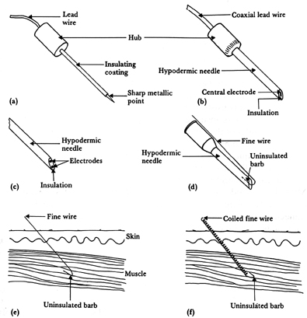
Internal Electrodes
Needle and wire electrodes for percutaneous measurement of biopotentials
(a) Insulated needle electrode. (b) Coaxial needle electrode. (c) Bipolar coaxial electrode. (d) Fine-wire electrode connected to hypodermic needle, before being inserted. (e) Cross-sectional view of skin and muscle, showing coiled fine-wire electrode in place.
The latest: BION – implanted electrode for muscle recording/stimulation
Alfred E. Mann Foundation

Slide 42
Needle Electrodes
In some research applications, simultaneous measurement from various depths in the brain along a certain axis is required.Special multiple depth electrodes have been developed for this purpose.
This type of electrodes usually consist of a bundle of fine wires, each terminating at different depth or each having an exposed conductive surface at a specific, but different depth.

Slide 43
Needle Electrodes
These wires are generally brought out to a connector at the surface of the scalp and are often cemented to the skull.

Slide 44
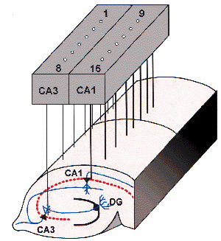
Needle Electrodes

Slide 45
Needle Electrodes
Needle electrodes for EMG consist merely of fine insulated wires, placed so that their tips, which are bare are in contact with nerve, muscles , or other tissue from which the measurement is made.
The remainder of the wire is covered with some form of insulation to prevent shorting.
Wire electrode of copper or platinum are often used for EMG pickup from specific muscles.

Slide 46
Needle Electrodes
The wires are either surgically implanted or introduced by means of a hypodermic needle that is later withdrawn, leaving the wire electrode in place.
With this type of electrode, the metal electrolyte interface take place between the uninsulated tip of the wire and the electrolyte of the body,although the wire is dipped into an electrolyte paste.

Slide 47
Needle Electrodes
The hypodermic needle is sometime a part of the electrode configuration and is not withdrawn .
Instead the wire forming the electrode are carried inside the needle, which creates the hole necessary for insertion, protect the wire and act as a grounded shield.
A single wire inside the needle serves as a unipolar electrodes, which measures the potentials at the point of contact with respect to some indifferent reference.

Slide 48
Needle Electrodes
If two wires are placed inside the needle , the measurement is called bipolar and provides a very localized measurement between the two wire tips.
Needle electrodes and other type of electrodes that creates an interface beneath the surface of the skin seem to be less susceptible to movement artifacts than surface electrodes, particulalry those of the older types

Slide 49
Needle Electrodes
By making direct contact with the subdermal tissue or the intercellular fluids, these electrodes also seems to have lower impedance than surface electrodes of comparable interface area.

