Slide 1
contents
INTRODUCTION
TYPES OF MICROARRAY
PRINCIPLE AND PROCEDURE
APPLICATION
ADVANTAGES AND DISADVANTAGES

Slide 2
INTRODUCTION
A Microarray, also known as a DNA chip or gene chip, is a powerful tool used in molecular biology and genomics to measure the expression levels of thousands of genes simultaneously.
It allows researchers to study gene expression patterns under different conditions, such as comparing gene expression in normal and diseased tissues.
Microarray technology can be used for a variety of purposes in research and clinical studies, such as measuring gene expression and detecting specific DNA sequences (e.g., single-nucleotide polymorphisms, or SNPs ).

Slide 3
Types of microarray
DNA Microarrays
cDNA Microarrays (Expression Microarrays):
These are the most common type of DNA microarray and are used to measure gene expression levels.
cDNA (complementary DNA) representing genes of interest is spotted on the array, and the labeled cDNA from a sample is hybridized to the array for gene expression analysis.
Oligonucleotide Microarrays
Instead of full-length cDNA, short oligonucleotides (typically 25-60 nucleotides) are used as probes.
Oligonucleotide microarrays are known for their specificity and are widely used for gene expression profiling.
SNP Microarrays (Single Nucleotide Polymorphism):
These microarrays are used to detect single nucleotide variations in the genome.
They are crucial for genotyping studies, identifying genetic variations associated with diseases, and population genetics.

Slide 4
Cont….
Protein Microarrays:
Antibody Microarrays:
An antibody microarrays use immobilized antibodies to capture and detect specific proteins in a sample.
They are valuable for studying protein-protein interactions, protein expression levels, and detecting specific antigens.
Reverse Phase Protein Arrays (RPPAs):
RPPAs are used to profile the expression of specific proteins or post-translational modifications in a sample.
They are particularly useful in cancer research and drug development.
Ligand-Binding Microarrays:
These microarrays are used to identify ligands (molecules that bind to a target) for specific receptors or proteins.
They have applications in drug discovery and characterizing biomolecular interactions.

Slide 5
Conti…
Tissue Microarrays (TMAs):
TMAs are used for high-throughput analysis of tissue samples.
They contain small tissue cores from numerous patient samples, allowing researchers to analyze multiple specimens simultaneously, often used in cancer research and diagnostic studies.
Peptide Microarrays:
Peptide microarrays consist of immobilized peptides and are used to study protein-protein interactions, epitope mapping, and protein function.

Slide 6
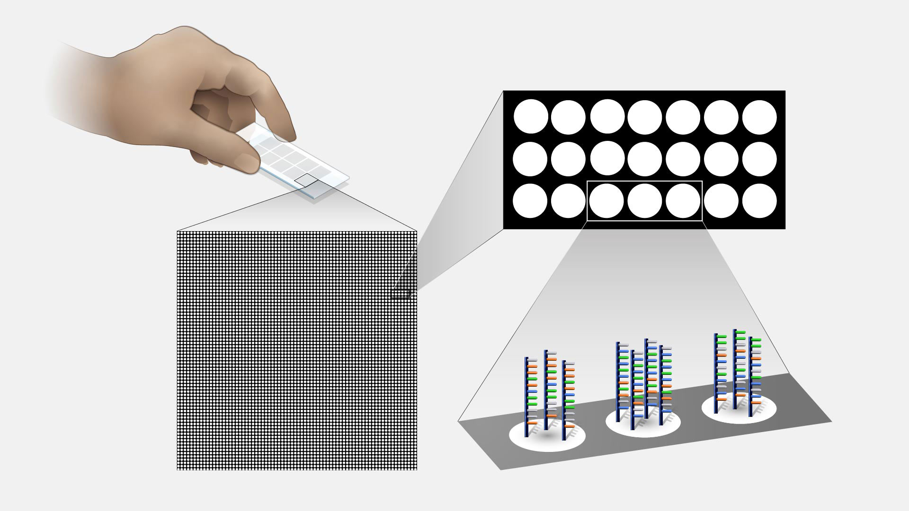
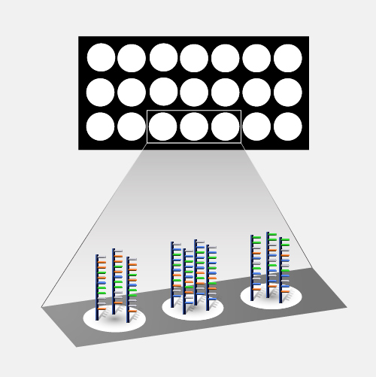
Dna microarray technique
A microarray is a laboratory tool used to detect the expression of thousands of genes at the same time.
DNA microarray are microscopic slides that are printed with thousands of tiny spots in defined positions, with each spot containing a known DNA sequence.
These slides are referred as DNA chip or Biochips.
DNA molecules attached to each slide act as probes to detect gene expression.
It evolved from Southern- blotting.

Slide 7
principle & PROCEDURE
The DNA microarray technique is based on the principle of hybridization between complementary DNA molecules.
It allows for the simultaneous detection and quantification of the expression levels of numerous genes in a single experiment.
A single stranded molecule recognized and specifically binds to a cDNA strand called as hybridization.

Slide 8
principle & PROCEDURE

Slide 9
procedure
SAMPLE PREPARATION.
DNA or RNA is extracted from the biological samples (cells, tissues,or organism) to be studied.
The RNA is usually converted into complementary DNA (cDNA) through reverse transcription.
LABELING
The cDNA from the sample is fluorescently labeled. This labeling can be done using fluorescent dyes to distinguish between different samples.
This label is used to detect and quantify the gene expression levels.
Each sample is often labeled with a different color dye.

Slide 10
Contin…..
HYBRIDIZATION.
The labeled cDNA from the samples is applied to the microarray slide, and it undergoes hybridization.
The cDNA binds to the complementary DNA probes on the microarray.
WASHING.
After hybridization, the slide is washed to remove any unbound or non-specific bound cDNA.
SCANNING.
The microarray slide is scanned with a specialized scanner that detects the fluorescence of the labeled cDNA.
The intesity of fluorescence at each spot is measured, providing information about the abundance of the corresponding gene in the sample.
DATA ANALYSIS & INTERPRETATION.

Slide 11
application
Gene Expression Profiling
Cancer Research
Pharmacogenomics
Infectious Disease Research
Functional Genomics
Toxico genomics
Stem Cell Research
Neuroscience
Environmental Genomics
Agriculture and Crop Improvement

Slide 12
ADAVANTAGES & DISADVANTAGES
ADVANTAGES.
Provides data foe thousands of genes in real time.
Single experiment generates many results easily.
Fast and easy to obtain results.
Different parts of DNA can be used to study gene expression.
DISADVANTAGES.
Expensive to create.
The DNA chips do not have very long shelf life.

