Slide 1
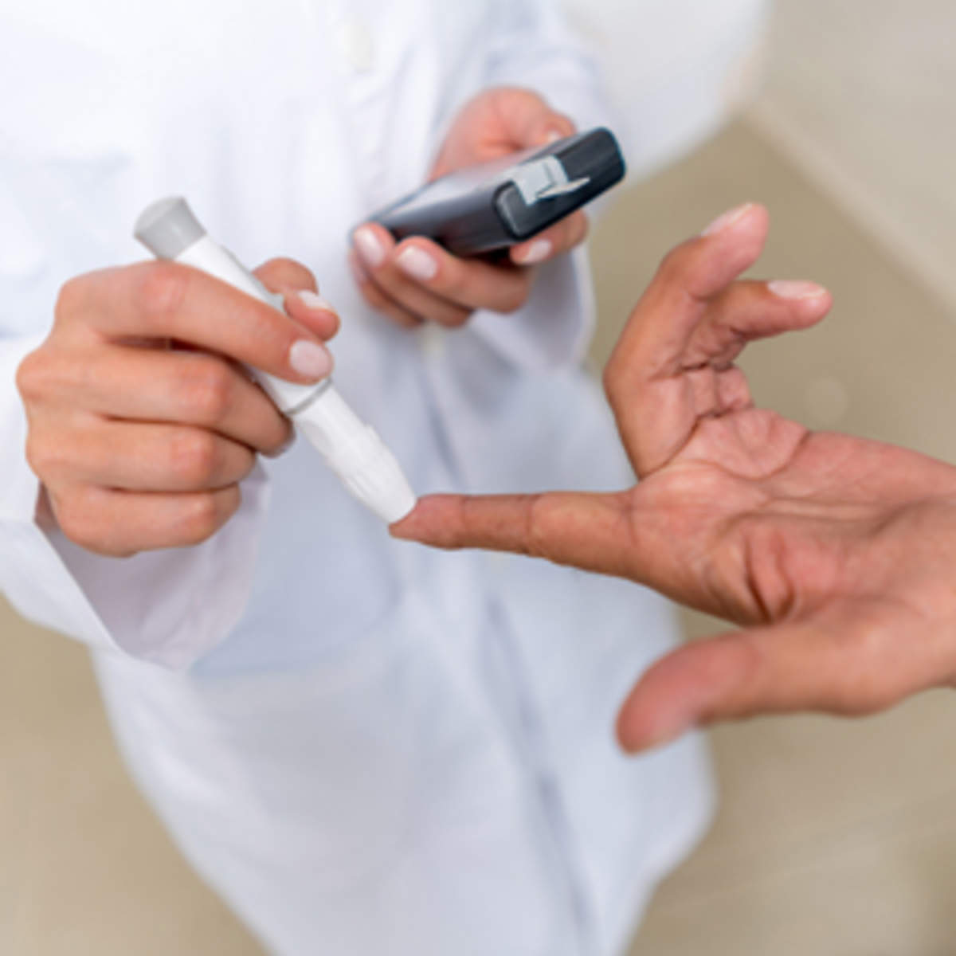
DIABETES MELLITUS By-Dr Aamena Zaidi Assistant Professor School of Health Sciences CSJMU

Slide 2
INTRODUCTION
Diabetes is a group of metabolic disorders characterized by abnormal metabolism, which results most notably in hyperglycemia , due to defects in insulin secretion, insulin action, or both.
Diabetes is a serious chronic disease without a cure, and it is associated with significant morbidity and mortality.
Diabetes is a serious disease associated with acute (due to hyperglycemia) and chronic (due to vascular damage) complications.

Slide 3
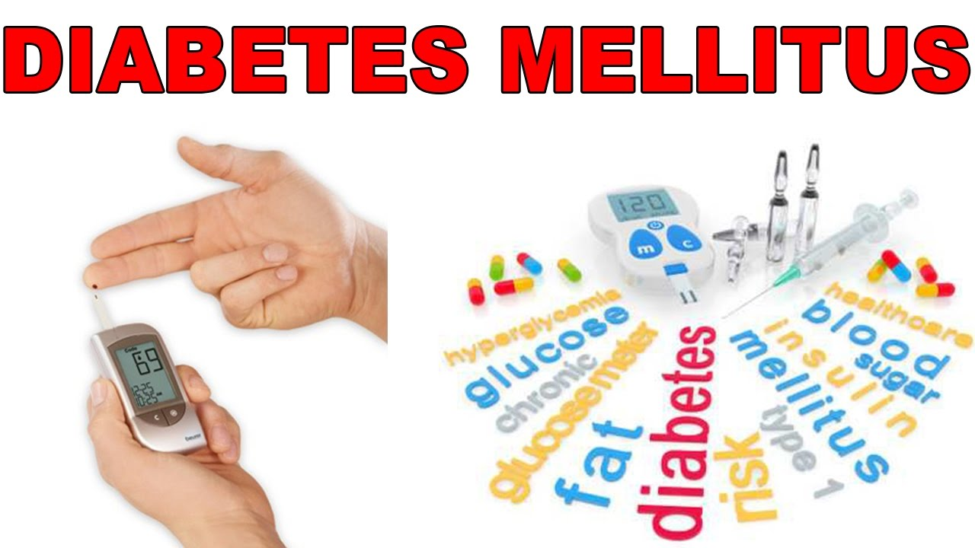
DIABETES MELLITUS
"Diabetes" comes from the Greek word for "siphon", and implies that a lot of urine is made.
The second term,"mellitus" comes from the Latin word, "mel" which means "honey", and was used because the urine was sweet.

Slide 4
Diabetes in india
According to the Indian Council of Medical Research- Indian Diabetes study (ICMR-INDIAB), a national diabetes study, India currently has 63 million people with diabetes.
India represents the world’s second largest diabetes population after China.
This is set to increase to over 100 million by 2030.
The majority of people with diabetes (>90%) have Type 2 diabetes (T2DM).

Slide 5
Learning Objective
At the end of this talk you should understand: What diabetes mellitus means ?
The difference between types-1 and -2 diabetes
How the different types are treated ?The reasons for the current epidemic of diabetes and how it can be prevented
What the complications of diabetes are and how they can be prevented

Slide 6
Types of Diabetes
TYPE -- 1 Diabetes Mellitus
❖ TYPE --2 Diabetes Mellitus
❖ Gestational Diabetes Mellitus
❖ Other uncommon types like
1. Genetic defects of beta cell function
2. Genetic defects in insulin action
3. Exocrine pancreatic defects
4. Infections
5. Drugs
6. Genetic syndromes like Down syndrome
7. PATHOPHYSIOLOGY

Slide 7
Etiology of Diabetes
Both type 1 and type 2 diabetes share one central feature: elevated blood sugar (glucose) levels due to absolute or relative insufficiencies of insulin, a hormone produced by the pancreas.
➢ Type 1-Beta cell destruction completely leading to absolute insulin deficiency
➢ Type 2 –combination of insulin resistance and Beta cell dysfunction

Slide 8
BASIC UNDERSTANDING OF GLUCOSE METABOLISM AND INSULIN ACTION

Slide 9
Action of Insulin
It works in the following way:
During and immediately after a meal, digestion breaks carbohydrates down into sugar molecules (of which glucose is one) and proteins into amino acids.
Right after the meal, glucose and amino acids are absorbed directly into the bloodstream, and blood glucose levels rise sharply. (Glucose levels after a meal are called postprandial levels.)

Slide 10
The rise in blood glucose levels signals important cells in the pancreas, called beta cells, to secrete insulin, which pours into the bloodstream. Within 20 minutes after a meal insulin rises to its peak level.
Insulin enables glucose to enter cells in the body, particularly muscle and liver cells. Here, insulin and other hormones direct whether glucose will be burned for energy or stored for future use.
When insulin levels are high, the liver stops producing glucose and stores it in other forms until the body needs it again.

Slide 11
Pathophysiology of Type-1

Slide 12
Pathophysiology of Type-1
Type 1 diabetes is characterized by destruction of the pancreatic beta cells. Most likely cause of these conditions is combined genetic, immunologic and possibly environmental (e.g. viral) factors contribute to cell destruction.
This is abnormal response of the body in which the antibodies are direct against the normal tissues as if they were foreign and eventually can damage Islet of Langerhans , specific area of the pancreas that produce insulin, reducing the production of insulin or totally no production of insulin.

Slide 13
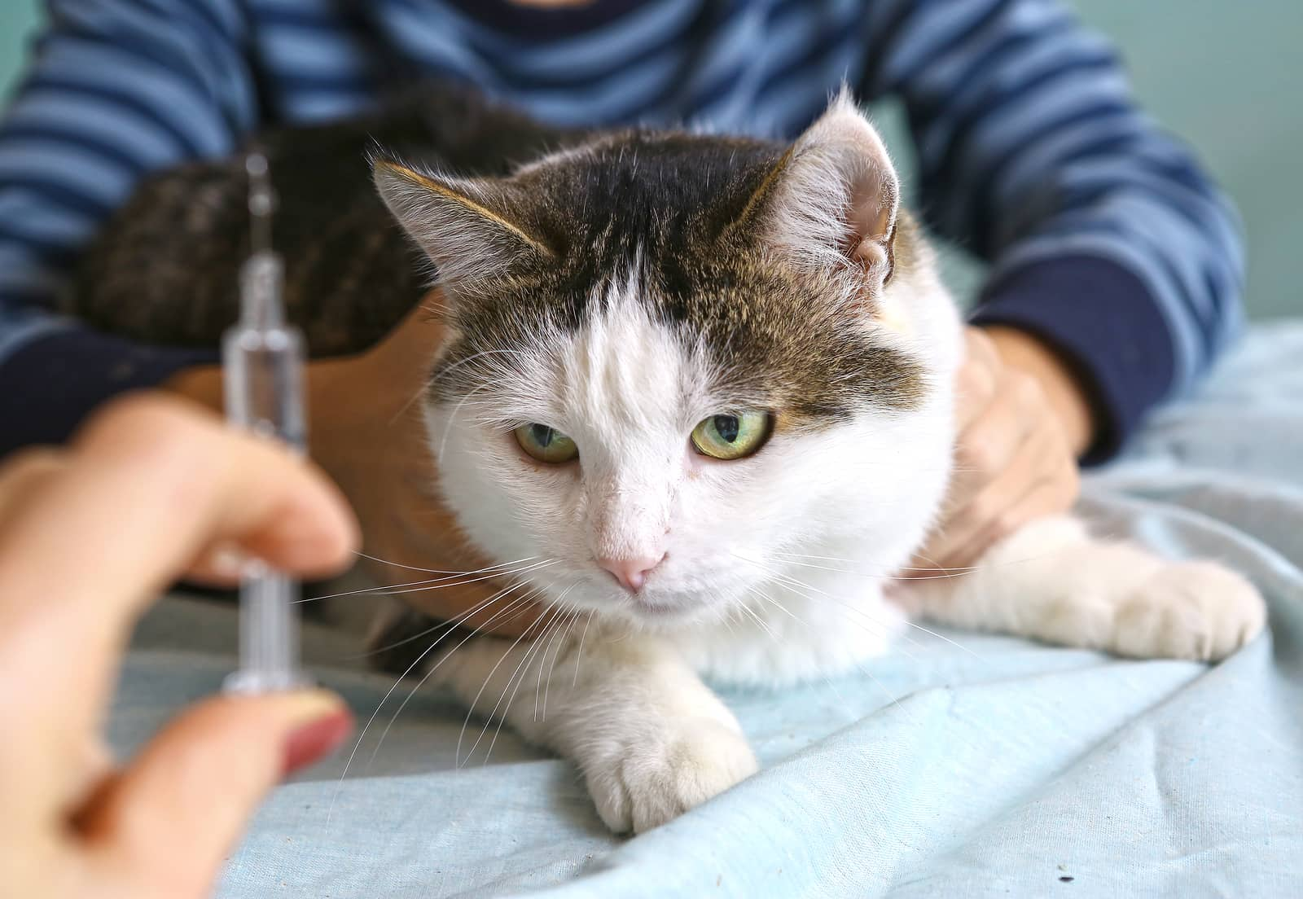
PATHOPHYSIOLOGY OF TYPE-2

Slide 14
Pathophysiology of Type-2
Type 2 Diabetes Mellitus is a adult onset, and non-insulin dependent. There are 2 main problems related to insulin in type 2 diabetes, first one is “insulin resistance “ (insulin do not bind with the special receptor on cell surface) and impaired insulin secretion (insulin secreting glands release irregular amount of insulin).

Slide 15
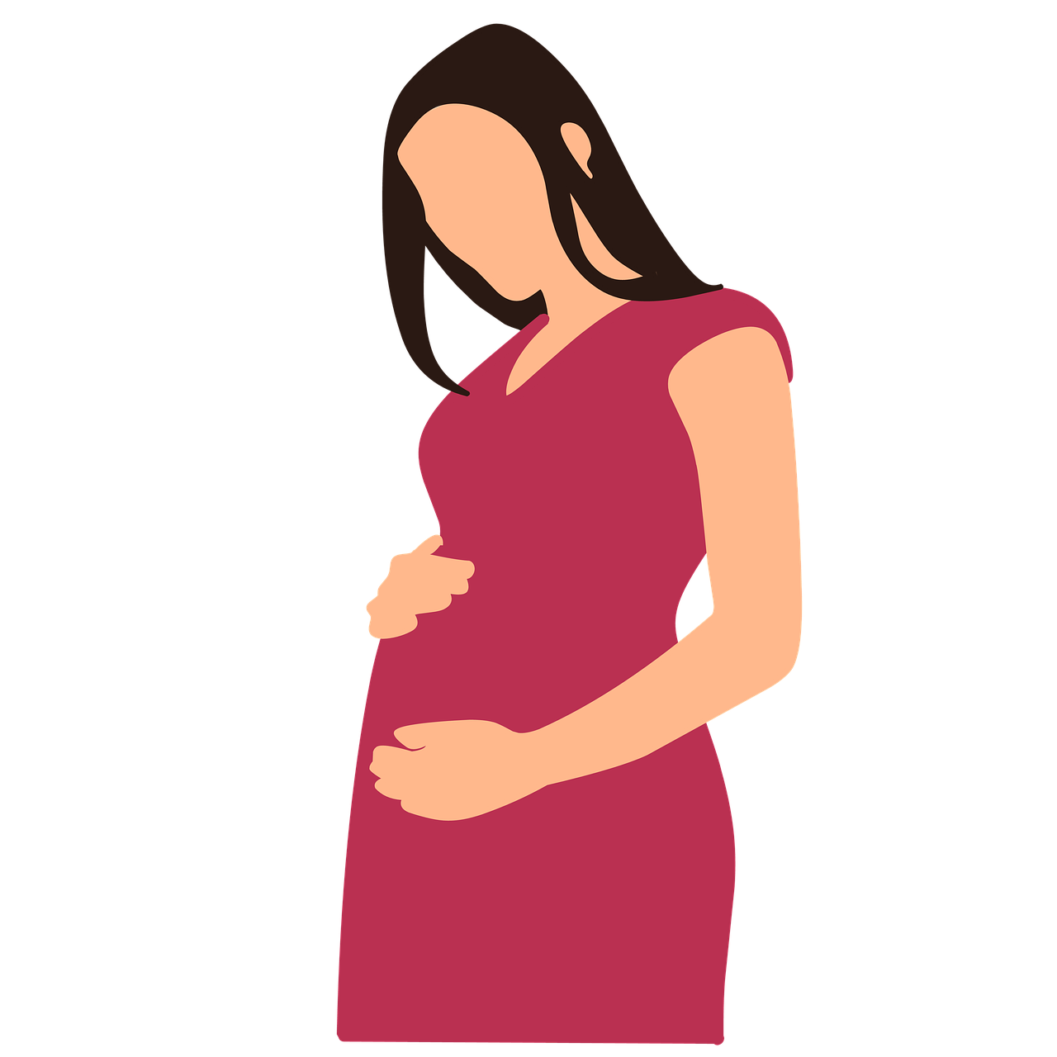
Gestational Diabetes
Diabetes diagnosed during pregnancy
Gestational diabetes is caused when the insulin receptors do not function properly.
This is likely due to pregnancy related factors such as the presence of human placental lactogen that interferes with susceptible insulin receptors.
Increased health risk to mother and baby •Big baby,jaundice,still birth can occur for untreated cases
Goes away after birth, but increased risk of developing Type 2 DM for mother and child

Slide 16
Differences between type-1 and type- DIABETES MELLITUS
Type 1
Young age
Normal BMI, not obese
No immediate family history
Short duration of symptoms (weeks)
Can present with diabetic coma (diabetic ketoacidosis)
Insulin required
Type 2
Middle aged, elderly
Usually overweight/obese
Family history usual
Symptoms may be present for months/years  Do not present with diabetic coma
Insulin not necessarily required
Previous diabetes in pregnancy These differences are not absolute

Slide 17
RISK FACTORS & SYMPTOMS

Slide 18
SYMPTOMS OF NEW ONSET
Polyurea
Polydipsia
Polyphagia
Weight Less
Fatigue

Slide 19
Symptoms
Tremor
Headache
Pallor
Dizziness
Paresthesia
Loss of coordination
Anxiety
Mood confusion
Seizure
Polyurea
Polydipsia
Dry mouth
Ketoacidosis (shortness of breath)
Hyperosmolar hyperglycemic non ketotic syndrome(fever,confusion, weakness)

Slide 20
INVESTIGATION
Fasting blood sugar
Post prandial blood sugar
HbA1C
Lipid Profile – To diagnose dyslipidaemia
RBS can be done only if the patient follows up for the diagnostic tests after a meal

Slide 21
Fasting Blood Sugar
Person to be tested should be on a normal diet for at least 3 days prior to testing.
The test should be done after an overnight fast of 8 – 10 hours (no beverages including tea or coffee should be consumed),
Draw a sample of blood after confirming fasting state of the patient.

Slide 22
Post prandial blood sugar
Following the collection of the fasting blood sample for analysis of fasting serum glucose (FSG). Patient is advised to have a normal meal and return to the clinic after 2 hours following the meal.
Draw a sample of blood after confirming the time of meal.

Slide 23
Hb1AC
Person to be tested should be on a normal diet for at least 3 days prior to testing.
The test should be done after an overnight fast of 8 – 10 hours
Draw a sample of blood after confirming fasting state of the patient.

Slide 24
TREATMENT GUIDLINES
Cigarette smoking  Hypertension (BP >140/90 mmHg or on antihypertensive medication)
Low HDL cholesterol (<40 mg/dL)
Family history of premature CHD
Age (men >45 years; women >55 years)

Slide 25
THANK YOU

