Slide 1
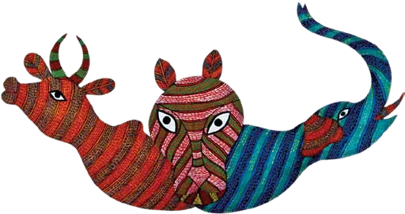
Gond Painting
Gond paintings are a form of painting from folk and tribal art that is practiced by one of the largest tribes in India with whom it shares its name. Gond comes from the Dravidian expression, Kond which means 'the green mountain'.

Slide 2
Origin
The Gonds, the largest aadivasi community in India are of Dravidian origin and can be traced to the pre-Aryan era. The word ‘Gond’ comes from Kond, which means green mountains in the Dravidian idiom. The Gond called themselves Koi or Koiture, but others called them Gond since they lived in the green mountains.
The Gond tribe is spread across Madhya Pradesh, Jharkhand, Chhattisgarh, Bihar, Odisha and Andhra Pradesh. In Madhya Pradesh, for centuries they inhabited the dense forests of the Vindhyas, Satpura and Mandla in the Narmada region of the Amarkantak range.
The Gonds narrate stories about their dogmas, gods, festivals, demons and everything else related to their way of life through paintings. It is an art form in which the painting in itself conveys folklore or a story. This art is practiced chiefly by the Gond and Pardhan tribes of Mandla. On the occasion of festivals the walls and floors of houses are covered with beautiful colourful paintings. The forms take shape spontaneously in space. Interestingly, Gond paintings bear very strong resemblance to the art of the aborigines of Australia.

Slide 3
Theme
The Gond paintings depict Lord Krishna, village deities like Marahi Devi, Phulvari Devi, Sanphadki snake, Phulchukki chiriya (bird), Sarpoti tree, etc. They reflect the artists’ creativity and unique view of things around them. Bold pictures of horses, tigers, birds, stags, spirits and humans are painted in many bright colours. The variety and diversity of Gond paintings is unlimited. Some of them also depict the symbiotic relationship between man and the animals, the web cycle, interdependence of plants and animals etc. The central theme of most of the paintings is flora and fauna. The Gond paintings reflect the realm of tribal life, their fears and aspirations rather than an icon demanding worship. The main motive of these paintings was to ensure fertility, safeguard the people from wild animals, avert disease and evil and propitiate the dead. They were drawn to celebrate festivals and also to please the spirits for aphrodisiacal purposes.

