Slide 1
UNIT- 1
HISTORICAL BACKGROUND AND DEVELOPMENT OF PROFESSION OF PHARMACY
SCHOOL OF PHARMACEUTICAL SCIENCES, CSJMU, KANPUR

Slide 2
CONTENTS
HISTORY OF PROFESSION OF PHARMACY IN RELATION TO:
PHARMACY EDUCATION
INDUSTRY AND ORGANISATION
PHARMACY AS CARRIER

Slide 5
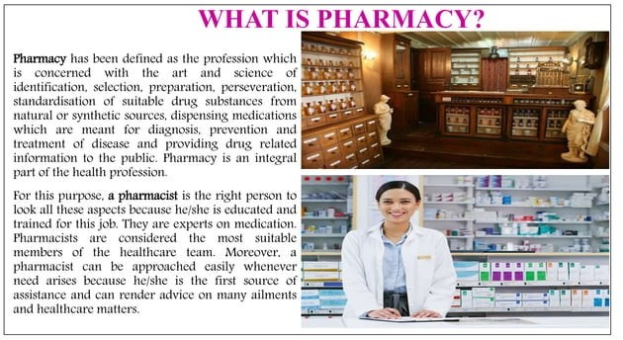

Slide 7
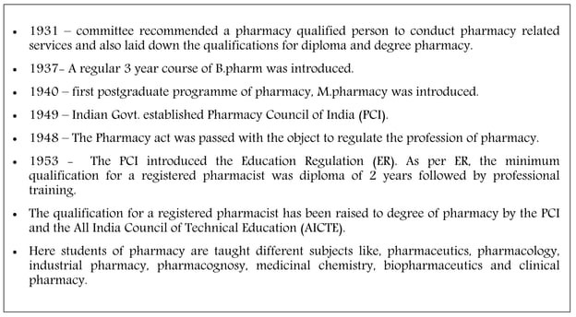

Slide 10
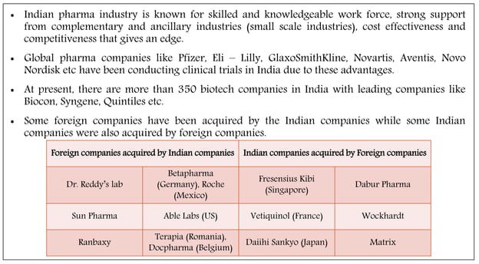

Slide 12
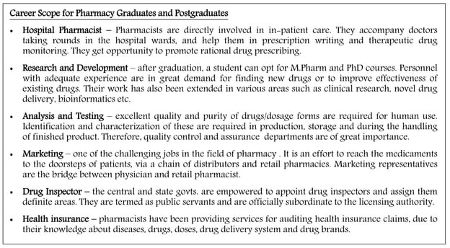

Slide 13
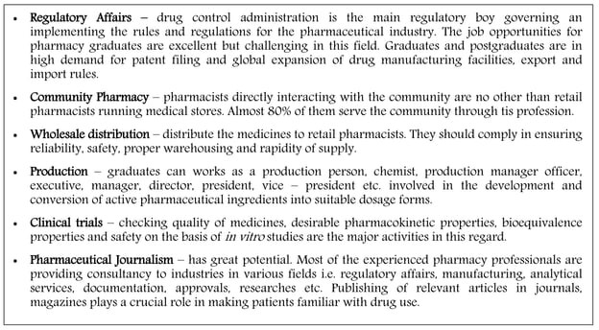

Slide 14
THANKYOU

