Slide 1
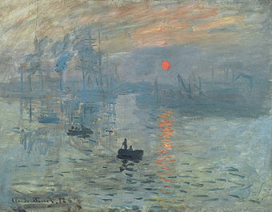
Impressionism (Art movement)
Claude Monet, (Impression, Sunrise), 1872, oil on canvas, Musée Marmottan Monet, Paris.
This painting became the source of the movement's name, after Louis Leroy’s article The Exhibition of the Impressionists satirically implied that the painting was at most, a sketch.

Slide 2
INTRODUCTION
Impressionism originated with a group of Paris-based artists whose independent exhibitions brought them to prominence during the 1870s and 1880s.
Impressionism is a 19th-century art movement characterized by relatively small, thin, yet visible brush strokes, open composition, emphasis on accurate depiction of light in its changing qualities (often accentuating the effects of the passage of time), ordinary subject matter, inclusion of movement as a crucial element of human perception and experience, and unusual visual angles.

Slide 3
Time Period of Impressionism
Impressionism was developed by Claude Monet and other Paris-based artists from the early 1860s. (Though the process of painting on the spot can be said to have been pioneered in Britain by John Constable in around 1813–17 through his desire to paint nature in a realistic way).

