Slide 1
Introduction to Research
By
Swarnakshi Upadhyay
Assistant Professor
School of Pharmaceutical Sciences
CSJM University

Slide 2
Introduction
The term RESEARCH consist of two words:
RESEARCH=RE+SEARCH
‘RE’ means again and again
‘SEARCH’ means to find out something

Slide 3
Difference between Search and Research
Search: Non scientific means and random process of looking for something- information Google Search, Literature Search, PubMed
Research: Systematic foundation through which
new knowledge is attained,
existing knowledge is improved,
new techniques and processes are developed.
Research is important for the advancement of any field

Slide 4
What is Research ?
“Research is seeing what everybody else has seen and thinking what nobody else has thought.” - Albert Szent-Györgyi
“Research is something that everyone can do, and everyone ought to do. It is simply collecting information and thinking systematically about it.” - Raewyn Connell

Slide 5
WHO Research Methodology 1992
Research is a quest for knowledge through diligent observation, comparison, investigation or experimentation aimed at discovery and interpretation of new knowledge
Existing knowledge is improved, new / novel techniques and processes are developed.
Research is art of scientific investigation
Scientific and systematic search for pertinent information on a specific topic is Research and the methods adopted as known as RESEARCH METHODOLOGY

Slide 6
Scientific Research
Research conducted for the purpose of contributing towards science by the systematic collection, interpretation and evaluation of data in a planned manner is called scientific research.
Scientific and systematic search for pertinent information on a specific topic
A researcher is the one who conducts this research

Slide 7
Characteristics of Research
A systematic approach must be followed for accurate data. Rules and procedures are an integral part of the process that set the objective. Researchers need to practice ethics and a code of conduct while making observations or drawing conclusions.
Research is based on logical reasoning and involves both inductive and deductive methods.
The data or knowledge that is derived is in real time from actual observations in natural settings.
There is an in-depth analysis of all data collected so that there are no anomalies associated with it.
Research creates a path for generating new questions. Existing data helps create more opportunities for research.
It makes use of all the available data so that there is no ambiguity in inference.
Accuracy is one of the most important aspects of research. The information that is obtained should be accurate and true to its nature. For example, laboratories provide a controlled environment to collect data. Accuracy is measured in the instruments used, the calibrations of instruments or tools, and the final result of the experiment.

Slide 8
Motivations in Research
The factors that motivate people to undertake research are
Desire to get a research degree along with its consequential benefits
Desire to face the challenge in solving the unsolved problems
Desire to get intellectual joy of doing some creative work
Desire to be of service to society
Desire to earn respect
Desire to get better employment
Curiosity about new things

Slide 9
OBJECTIVES OF RESEARCH
The purpose of research is to discover answers to questions through the application of scientific procedures. The main aim of research is to find out the truth which is hidden and which has not been discovered as yet. Though each research study has its own specific purpose, research objectives may fall into a number of following broad groupings:
To gain familiarity with a phenomenon or to achieve new insights into it (studies with this object in view are termed as exploratory or formulative research studies);
To portray accurately the characteristics of a particular individual, situation or a group (studies with this object in view are known as descriptive research studies);
To determine the frequency with which something occurs or with which it is associated with something else (studies with this object in view are known as diagnostic research studies);
To test a hypothesis of a causal relationship between variables (such studies are known as hypothesis-testing research studies).

Slide 10
Need for Research
The adequate knowledge of research is important in support of solving problem. Some of the ways it can be used on to:
To Categorise: This involves forming a typology of object, events or concepts i.e. a set of names or boxes into which these can be sorted. This can be useful in explaining which thing belongs together and how.
To Describe: Descriptive research relies on observation as a means of collecting data.
To Evaluate: This involves making judgements about the quality of objects or events.
To Compare: Two or more contrasting cases can be examined to highlight differences and similarities between them, leading to a better understanding of phenomenon.

Slide 11
To Correlate: The relationships between two phenomena are investigated to see whether and how they influence each other.
To Predict: Predictions of possible future behaviour or events are made on the basis that if there has been a strong relationship between two or more characteristics or events in the past, then these should exist in similar circumstances in future leading to predictable outcome.
To Control: Once we understand an event or situation, we may be able to find the ways to control it.

Slide 12
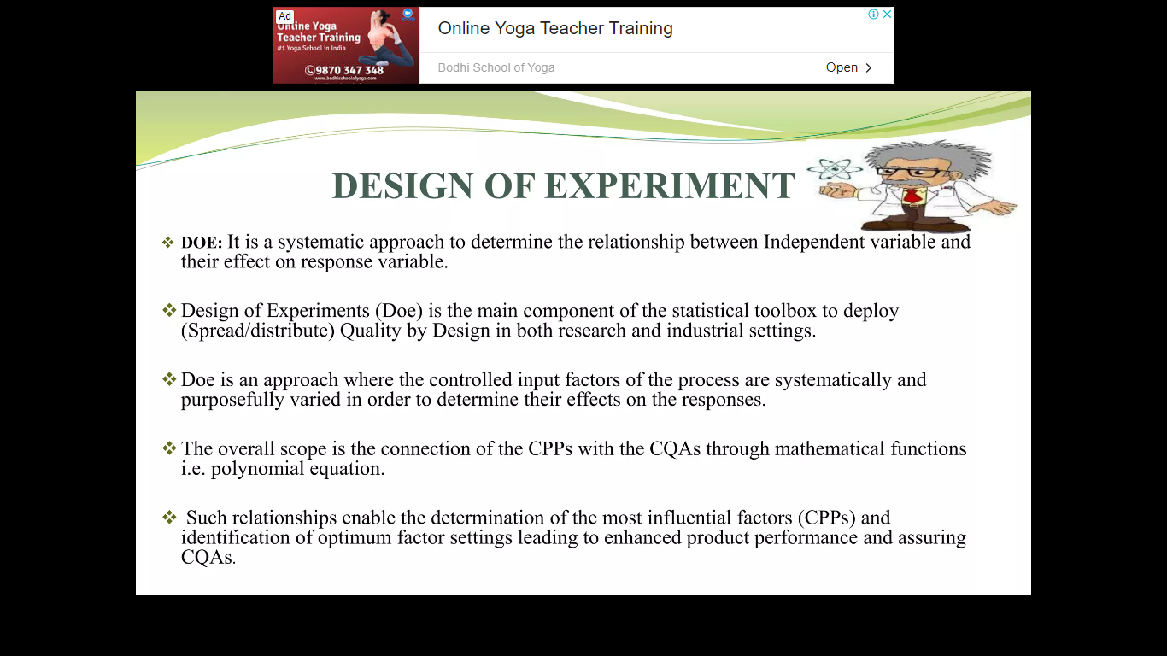

Slide 13
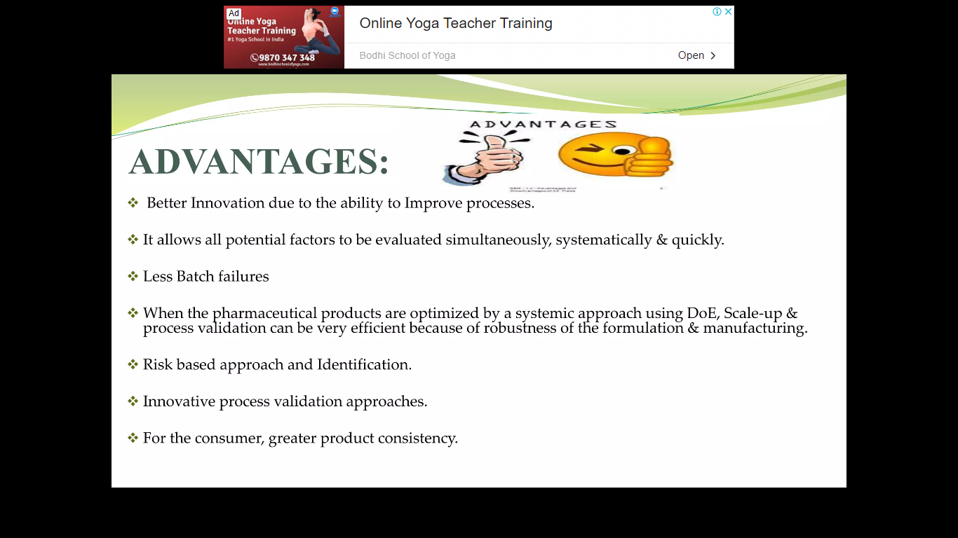

Slide 14
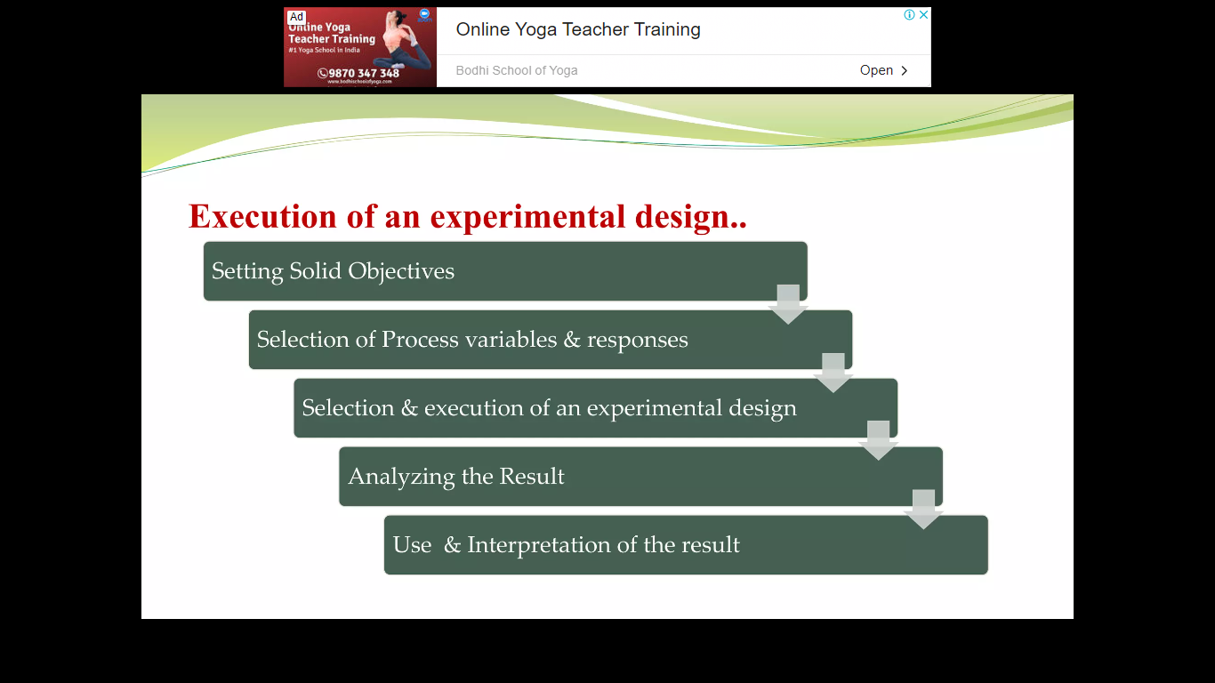

Slide 15
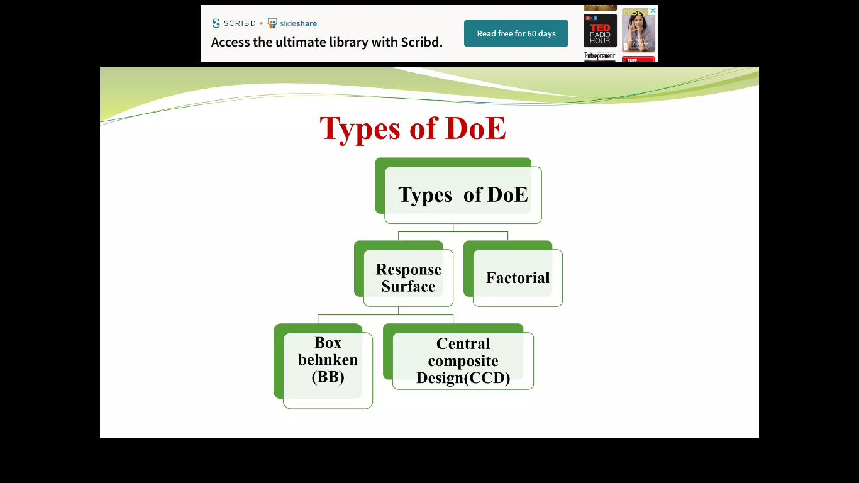

Slide 16
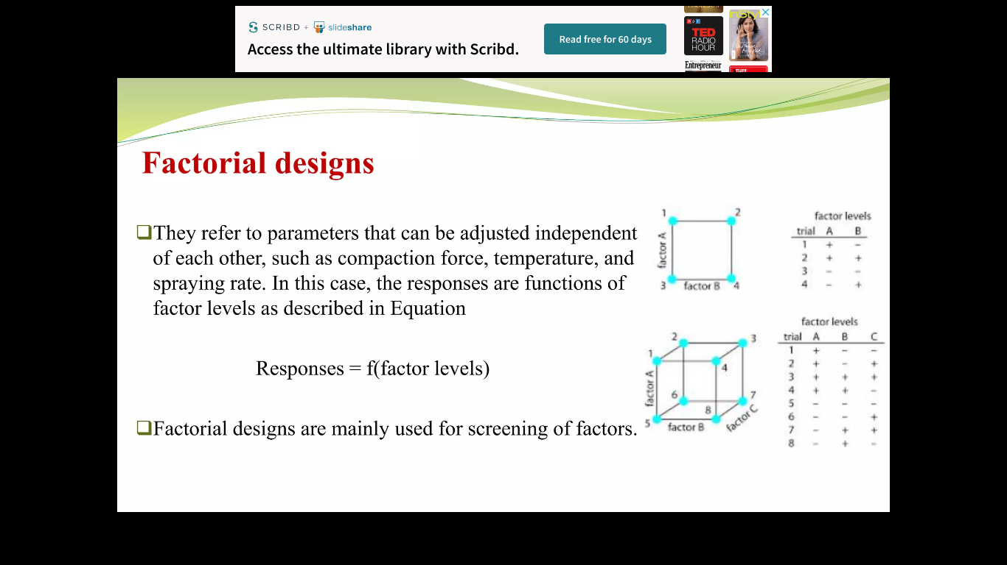

Slide 17
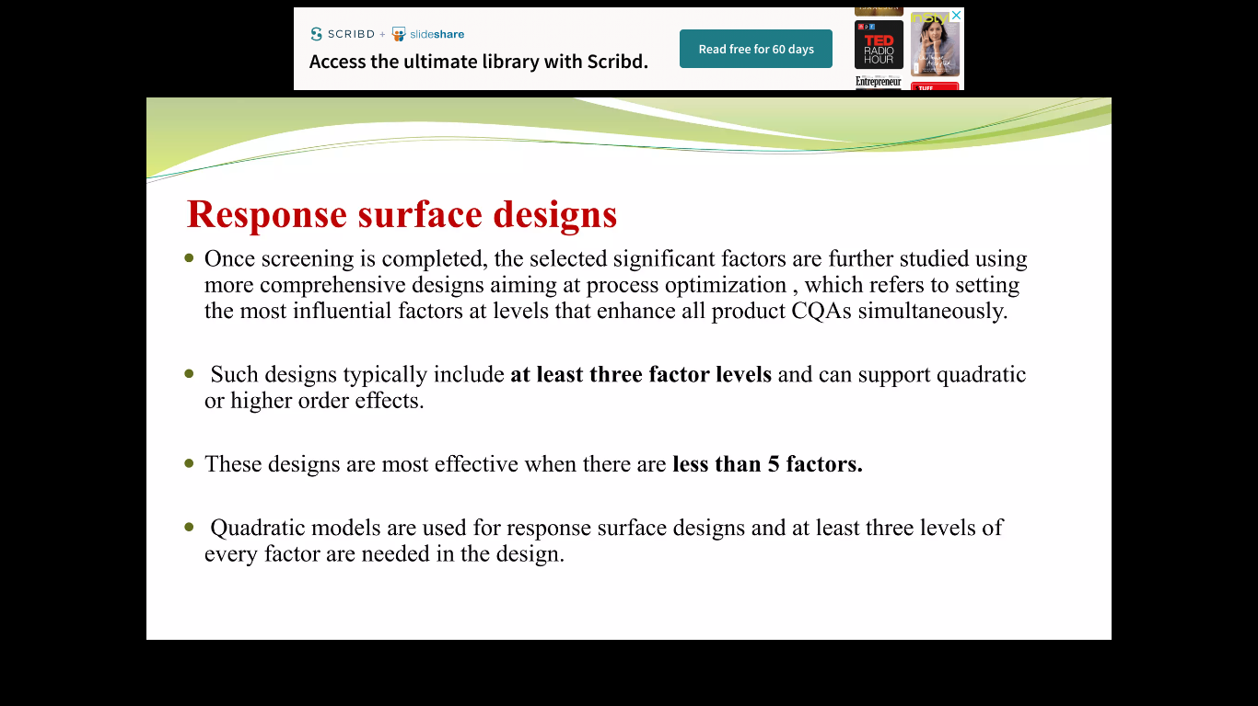

Slide 18
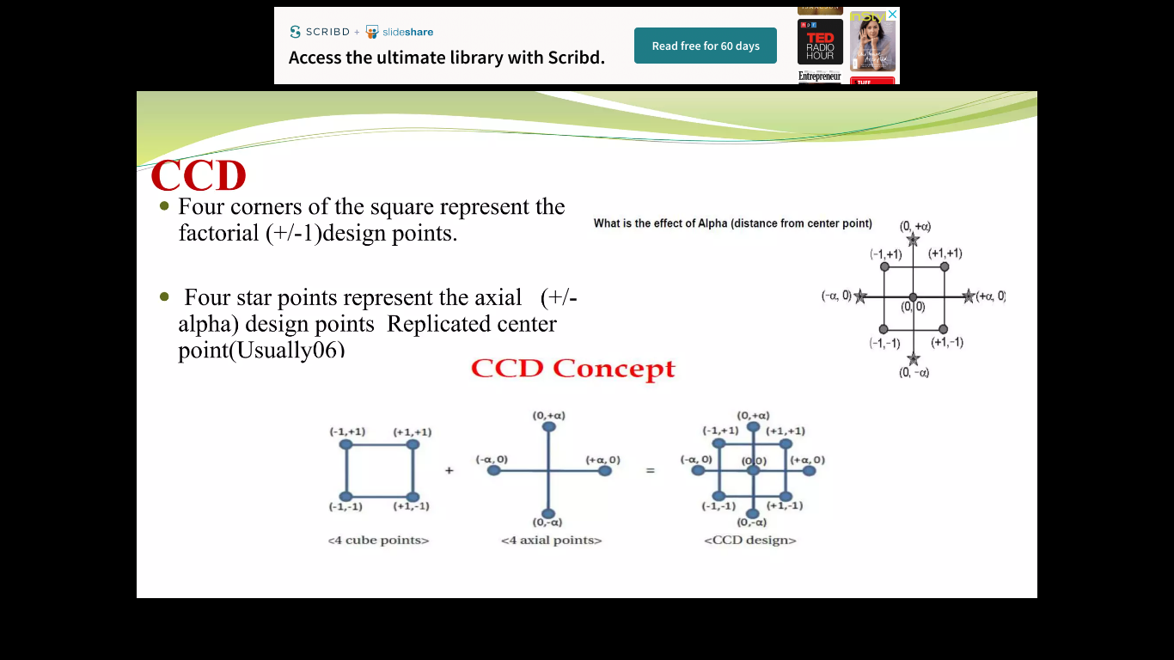

Slide 19
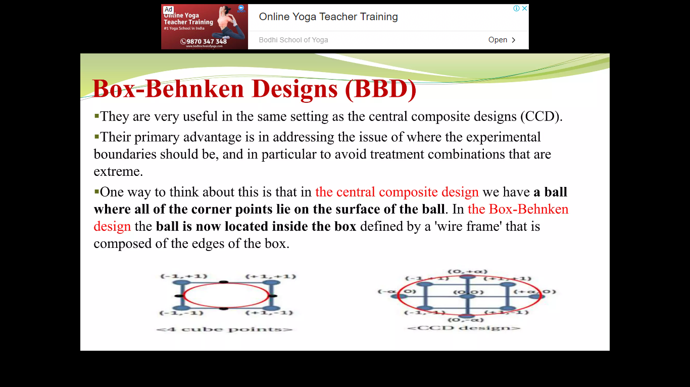

Slide 20
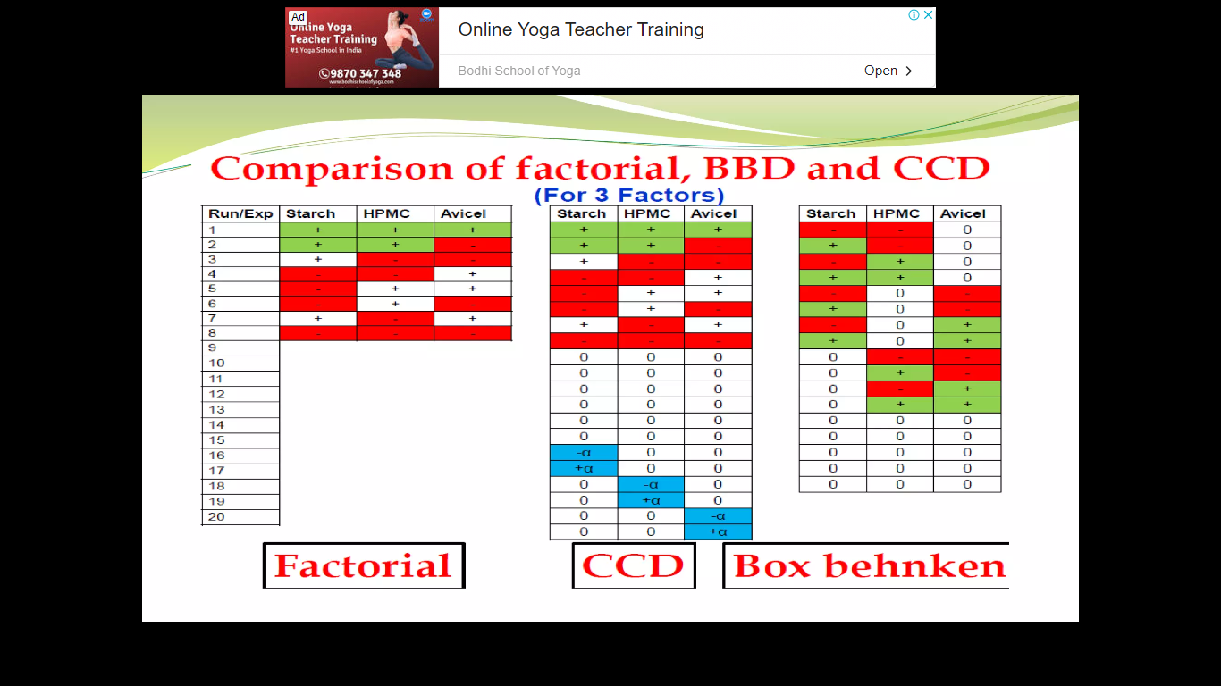

Slide 21
