Slide 2
CONCEPT OF TQM
Total Quality Management (TQM) is customer oriented management philosophy and strategy. It is centered on quality so as to result in customer delight. The word “Total’’ implies that all members of the organization make consistent efforts to achieve the objective of customer delight through systematic efforts for improvement of the organization

Slide 3
DEFINITION OF QUALITY
Juran , one of the quality gurus, defined quality as fitness for use. A very concise definition indeed, for a term that has so many dimensions! Quality of a product or service in simple terms is its suitability for use by the customer. Quality has to be perceived by the customer. Perception of the supplier is also important, but the customer experience of quality of a product or service is more important

Slide 4
DEFINITION OF QUALITY
International Organization for Standardization (ISO), the world body for standards formulation was founded in the year 1946 and has its headquarters in Geneva, Switzerland. Most countries in the world are members of ISO.
The definition of quality as per the ISO 9000 standard is: “The totality of features and characteristics of a product or service, that bear on its ability to satisfy a given or implied need”

Slide 5
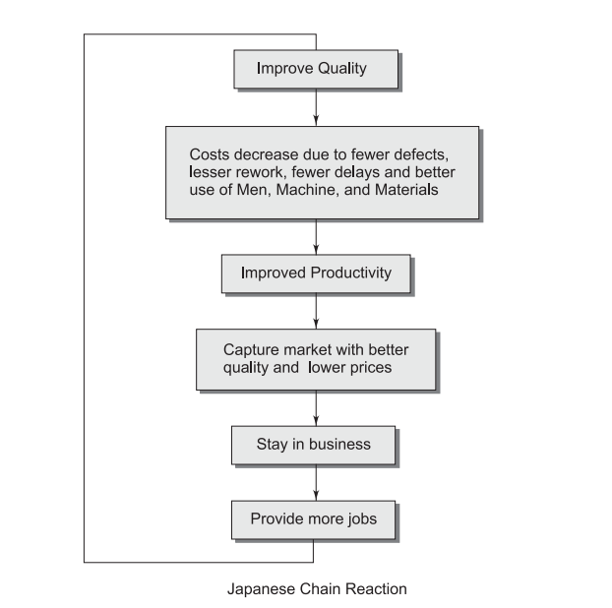
THE CONCEPT OF CHAIN REACTION

Slide 6
DIMENSIONS OF QUALITY
Product Quality:
Functionality: It refers to the core features and characteristics of a product. The definition of functionality as per ISO / IEC 9126: 1991: “A set of attributes that bear on the existence of a set of functions and their specified properties. The functions are those that satisfy stated or implied needs”.
Reliability: Reliability is measured by mean (average) time between failures (MTBF)

Slide 7
DIMENSIONS OF QUALITY
Usability A product should be easily usable. The customer should be able to use the product easily without the help of experts.
Maintainability Maintainability refers to the ease with which a product can be maintained in the original condition. It should be repairable so as to retain the original quality of the product at the lowest cost at the earliest possible time

Slide 8
DIMENSIONS OF QUALITY
Efficiency This is applicable to most products. Efficiency is the ratio of output to input.
Portability This is more important in the context of software. Portability is defined as a set of attributes that bear on the ability of software to be transferred from one environment to another. The environment may be organizational, hardware or software environment

Slide 9
DIMENSIONS OF QUALITY
Service Quality
Quality of Customer Service: Customer service is important in every business. In a service industry, meeting customers and finding out their implied requirements is more challenging.
This includes but is not limited to:
How well the customer is received?
How well the implied requirements are elucidated?
How well the customer is treated/handled/satisfied?

Slide 10
DIMENSIONS OF QUALITY
Quality of Service Design:
Since services are usually made to order, it is important that the service is designed as per the requirements of the specific customer. For instance, a software product developed for a specific bank takes into account the unique requirements of the bank. Quality of service design in turn depends on the quality of customer service.

Slide 11
DIMENSIONS OF QUALITY
Quality of Delivery
Quality of delivery is important in any sector, but more crucial in case of services. Defects on delivery should be zero to satisfy the customers.

Slide 12
EVOLUTION OF QUALITY
Dr Walter A Shewhart (1891–1967) worked in Western Electric Company and AT&T, USA.
He advocated Statistical Quality Control (SQC) and Acceptable Quality Level (AQL).
AQL is the foundation of today’s Six Sigma.
He is considered to be the father figure of SQC, who developed control charts for quality assessment and improvement.
Dr Shewhart also developed the Plan, Do, Check, Act (PDCA) cycle for continuous improvement, which is in use even today.

Slide 13
EVOLUTION OF QUALITY
Deming W. Edwards (1900–1993):
An associate of Shewhart, worked in Western Electric Company as a statistician.
He was invited to Japan to lead the quality movement.
He modified PDCA cycle of Shewhart to the Plan, Do, Study and Act (PDSA) cycle.
He also advocated extensive use of statistics and control charts and focused on product improvement and service conformance by reducing variations in the process.
He joined the US Census Bureau in the year 1939 and proved that quality control methods could lower costs even in an exclusive service organization.

Slide 14
EVOLUTION OF QUALITY
Joseph M. Juran (1904) Juran also joined Western Electric Company and developed Western Electric Statistical Quality Control Handbook.

Slide 15
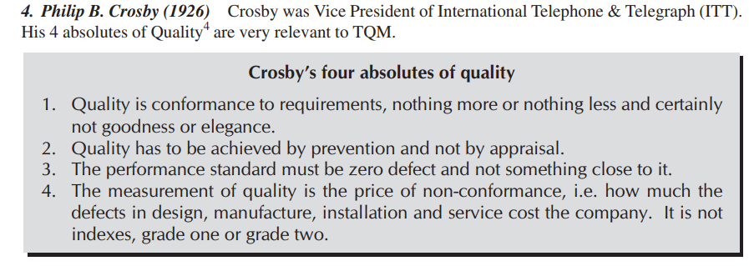
EVOLUTION OF QUALITY

Slide 16
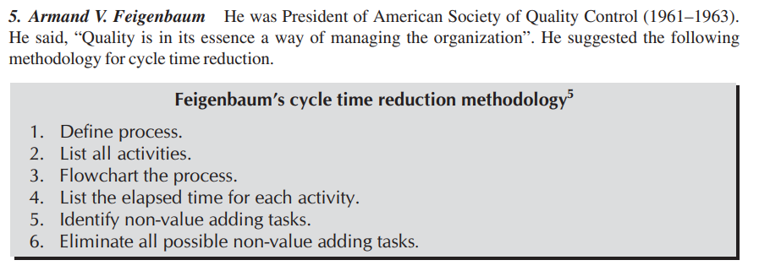
EVOLUTION OF QUALITY

Slide 17
EVOLUTION OF QUALITY

Slide 18
EVOLUTION OF QUALITY

Slide 19
QUALITY CONTROL (QC)
Quality Control or QC may be defined as: The operational techniques and activities that are used to fulfill the requirements for quality.
Juran1 gives 3 steps of QC:
1. Evaluate actual operating performance
2. Compare actual performance to goals
3. Act on the difference

Slide 20
QUALITY ASSURANCE (QA)
The definition of quality assurance is: All the planned and systematic activities implemented within the quality system, and demonstrated as needed, to provide adequate confidence that an entity will fulfill the requirements for quality.
Building quality into the products requires the following:
∑ Quality of Design
∑ Quality of Conformance
∑ Quality of Performance
∑ Quality of Service

Slide 21
QUALITY ASSURANCE (QA)
The definition of quality assurance is: All the planned and systematic activities implemented within the quality system, and demonstrated as needed, to provide adequate confidence that an entity will fulfill the requirements for quality.
Building quality into the products requires the following:
∑ Quality of Design
∑ Quality of Conformance
∑ Quality of Performance
∑ Quality of Service

Slide 22
QUALITY ASSURANCE (QA)
Quality of Design
It refers to how well the product or service has been designed to meet the current and future requirements of customers and add value to all the stakeholders.
The stakeholders for any organization are:
∑ Customers
∑ Employees
∑ Suppliers
∑ Owners
∑ Society

Slide 23
QUALITY ASSURANCE (QA)
Quality of Design
It refers to how well the product or service has been designed to meet the current and future requirements of customers and add value to all the stakeholders.
The stakeholders for any organization are:
∑ Customers
∑ Employees
∑ Suppliers
∑ Owners
∑ Society

Slide 24
QUALITY ASSURANCE (QA)
Quality of Conformance This indicates the consistency in delivering the designed product. Product quality in turn depends on the quality of all processes in the organization. Therefore, it involves all activities that will ensure the conformance of the products to its requirements consistently.
Quality of Performance Indicate the performance of the end product. This in turn depends on the quality of design (including the reliability of the product) and quality of conformance.

Slide 25
QUALITY ASSURANCE (QA)
Quality of Service
Selling a product is not the end of the business. It is the quality of associated services rendered that adds value to the product. Quality of services involves all activities that will enable the customer to procure and use the product without any hassles.

Slide 26
QUALITY IMPROVEMENT
This process aims at attaining unprecedented1 levels of performance, which are significantly better than the past level.

Slide 27
QUALITY PLANNING (QP)
In order to consistently meet customer requirements, the quality of 4 Ms namely — Man, Machine, Material and Methods need to be ensured. The requirements of the 4 Ms are to be identified in the form of quality objectives.
Quality planning refers to the activities that establish the objectives and requirements for quality. QP involves planning for the following with regard to a product or service or project or a contract: ∑ Quality objectives to be met ∑ Specific of QA/QC practices ∑ Resources needed ∑ Sequence of QA/QC activities.

Slide 28
STRATEGIC PLANNING
Strategic planning is important for any business. It involves making plans for the following, in particular:
∑ Business value
∑ Investment in machinery and equipment
∑ Manpower to be hired
∑ Budget
∑Product diversification
∑Markets to be served
∑Strategies for improving profits, etc.

Slide 29
QUALITY MANAGEMENT (QM)
According to ISO 9000 standards, Quality management comprises “All activities of the overall management function that determine the quality policy, objectives and responsibilities and implement them by means such as quality planning, quality control, quality assurance and quality improvement within the quality system.”

Slide 30
QUALITY MANAGEMENT (QM)
The quality system consists of the organizational structure, procedures, processes and resources needed to implement quality management. The above brings out the following:
∑ The company must have an objective and policy for quality of the products and services.
∑The organization should plan for meeting the objective.
∑ The plan should include QA, QC and methodology for improvement.
∑ There must be a clear organizational structure for building quality into the products and services with necessary resources.

