Slide 1
Madhubani Painting

Slide 2
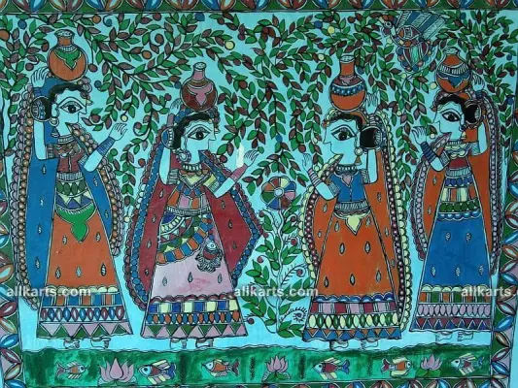
Introduction of Madhubani Painting:
Madhubani or Mithila painting is a folk art of the Mithila region. The Mithila region includes the north of Bihar and the eastern Terai of Nepal.
Madhubani paintings are traditionally done by women painters from the Mithila region. They live in a small society, and every mother teaches her daughter the art of making Madhubani paintings.
Since ancient times, women of the Mithila region have painted the walls and floors of their homes with Madhubani paintings to celebrate occasions such as religious festivals, births, and marriages.
Traditional Madhubani Painting on the Wall
The paintings on the walls are known as Bhitti Chitra and the paintings on the floor are known as Aripana. The colors used in Madhubani art are made from tree bark, flowers, leaves, and other natural sources.
Now for commercial purposes, Madhubani paintings are also done by women on handmade paper, cloth, and canvas, and men are also involved to meet the growing demand.

