Slide 1
Business Economics UNIT III Production and Cost Analysis
Course Code: F010101T

Slide 2
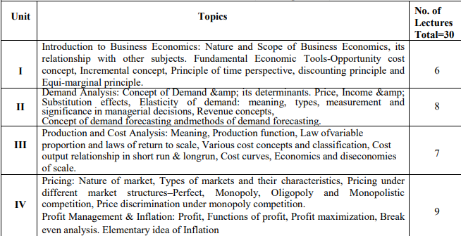

Slide 3
Production Function
A production function is a fundamental concept in economics that represents the relationship between inputs (factors of production) and outputs (goods and services) in the process of producing goods and services. It provides a mathematical or graphical representation of how different combinations of inputs lead to different levels of output.

Slide 4
Production Function
Q = f(L, K, M, ...)
Where:
Q represents the quantity of output produced.
L stands for labor input.
K represents capital input (physical capital such as machinery, equipment, etc.).
M could represent other inputs such as materials, technology, or land.
... indicates that there can be more inputs.

Slide 5
Production Function
The production function shows how varying the quantities of inputs affects the resulting output. It helps economists and businesses analyze how factors like labor, capital, and technology contribute to production and how changes in these factors influence overall output levels.

Slide 6
Production Function
There are several key concepts related to production functions:
Total Product (TP): This refers to the total quantity of output that is produced from a given combination of inputs.
Marginal Product (MP): The marginal product of a specific input is the additional output produced by adding one more unit of that input while keeping other inputs constant.
Average Product (AP): The average product of a specific input is the total output divided by the quantity of that input.

Slide 7
Production Function
Production functions are used in various economic analyses, such as determining the optimal combination of inputs to maximize output or analyzing the effects of technological advancements on production processes.

Slide 8
Law of variable proportion
known as the Law of Diminishing Return
That describes the relationship between the variable inputs (such as labor or raw materials) and the output of a production process.
It explains how changes in the proportion of one input while keeping other inputs constant can affect the overall production.

Slide 9
Law of variable proportion
The Law of variable proportion states that when only one production element is allowed to increase keeping all other elements constant, the production firstly increases, then the output will decrease and finally there will be a negative production.

Slide 10
Law of variable proportion
The law states that as more units of a variable input are added to a fixed quantity of other inputs (like capital and land), there comes a point where the marginal product of the variable input starts to decrease. In simpler terms, initially, increasing the variable input leads to a more than proportional increase in output, but eventually, the additional input leads to smaller and smaller increases in output or even negative effects on output.

Slide 11
Assumptions
Constant state of Technology: It is assumed that the state of technology will be constant and with improvements in the technology, the production will improve.
Variable Factor Proportions: This assumes that factors of production are variable. The law is not valid, if factors of production are fixed.
Homogeneous factor units: This assumes that all the units produced are identical in quality, quantity and price. In other words, the units are homogeneous in nature.
Short Run: This assumes that this law is applicable for those systems that are operating for a short term, where it is not possible to alter all factor inputs.

Slide 12
Example
Imagine a fixed plot of land (the fixed input) and labor as the variable input. Initially, adding more laborers to work on the land could lead to increased productivity. However, as the number of laborers increases further, they might start getting in each other's way, causing inefficiencies, and the additional output gained from each new laborer might decrease. Eventually, adding even more laborers could lead to a situation where the land becomes overcrowded, resulting in a decline in overall output.

Slide 13
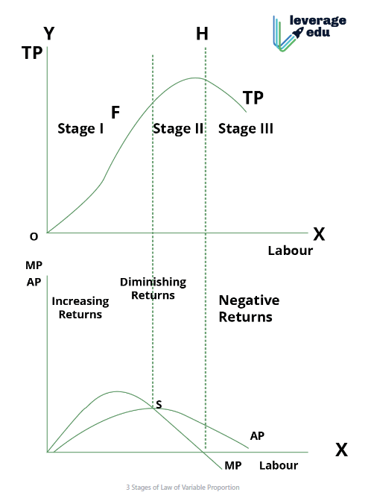
Notes:
Law of Variable Proportion: Meaning, Assumptions, Phases and Reasons for Variable Proportions - GeeksforGeeks

Slide 14
COST OF PRODUCTION
The total cost incurred by a business to produce a specific quantity of a product or offer a service.
The expenditures incurred to obtain the factors of production such as labor, land, and capital, that are needed in the production process of a product.

Slide 15
Explicit Cost
Explicit Costs refer to the actual expenditures of the firm to hire, rent or purchase the input it requires in production.
These include the wages to hire labour, the rental price of capital, equipment and buildings and the purchase prices of raw materials etc.
These are the recorded expenditure during the process of production.

Slide 16
Implicit costs
The costs of self-owned and self-employed resources.
These include the rewards for the entrepreneur’s self-owned land, labour and capital.
These costs do not appear in the accounting records of the firm.
The sum of explicit costs and implicit costs constitutes the total cost of production of a commodity.

Slide 17
Implicit Cost
Implicit costs include the highest salary that the entrepreneur can earn for him, if working for other firms and the highest return the firm could receive from investing its capital in alternatives uses or renting its land and buildings to the highest bidder rather than using them itself.

Slide 18
Economic Cost
Economic Cost = Accounting cost (Explicit Costs) + Implicit Cost (including normal profit)

Slide 19
Normal Profit
The minimum payment which a producer must get in order to induce him to undertake the risk Involved in production.
Reward or remuneration for the services of the entrepreneurs.
It is part of the cost of production because unless the entrepreneur expects to get it in the long-run, he is not likely to undertake production.
From an economic perspective, normal profit is also a type of cost. It represents the cost needed to keep the firm in business.

Slide 20
Economic cost
Is the sum total of both explicit cost and implicit cost, including normal profit, Economic cost is wider than the accounting cost.
It includes both explicit cost and implicit cost (including normal profit), whereas accounting cost includes only explicit or money cost.
In the theory of price, cost is taken in the sense of economic cost.

Slide 21
Real Cost and Nominal Cost
A nominal cost, also known as a nominal price, is the current price or cost of a good or service without adjusting for inflation or changes in purchasing power. In other words, it's the price that is expressed in the currency of the given time period without considering the impact of changes in the value of money over time.

Slide 22
Nominal Cost
if the price of a product increases from RS. 100 to Rs. 120 over the course of a few years, you might think the nominal cost has gone up by Rs. 20. However, if inflation during that time was 10%, the real increase in cost (adjusted for inflation) would only be Rs. 10 in terms of purchasing power.

Slide 23
Real Cost
if the price of a product increases from Rs.100 to Rs.120 over the course of a few years, you might think the nominal cost has gone up by Rs.20. However, if inflation during that time was 10%, the real increase in cost (adjusted for inflation) would only be Rs.10 in terms of purchasing power.
Notes:
At the same time, you should understand that real cost creates a special dimension of opportunity cost and highlights the importance of concept of scarcity as it reasserts the need for optimum utilisation of resources.

Slide 24
Real Cost
For example, if a product's nominal cost increased from Rs.100 to Rs.120 over a certain period, and the inflation rate during that time was 10%, the real cost of the product would be:
Real Cost = Nominal Cost / (1 + Inflation Rate) Real Cost = Rs.120 / (1 + 0.10) Real Cost ≈ Rs.109.09

Slide 25
Replacement Cost
Replacement cost is a financial concept that refers to the expense required to replace an asset, such as a piece of equipment, a building, or an entire business, with a new one of the same kind and quality. It represents the amount of money needed to reproduce or replace an asset at its current market value, without factoring in depreciation.

Slide 26
Historic Cost
Historic costs are incurred at the time of purchase of assets. They are also regarded as sunk costs, as they cannot be retrieved from the business without loss.
Sunk cost is an economic term for a sum paid in the past, which should no longer be relevant; hence these costs are irrelevant in decision-making with the perspective of time.

Slide 27
Controllable and Uncontrollable Costs
Controllable costs are those which are subject to regulation by the management of a firm, example, fringe benefits to employees, costs of quality control, etc.
On the other hand, uncontrollable costs are beyond regulation of the management example, minimum wages to be paid are determined by government, price of raw material by supplier.

Slide 28
Production and Selling Costs
Production costs (or simply costs) are estimated as a function of the level of output, whereas selling costs are incurred on making the output available to the consumer.
A commission paid to the salesman is calculated on the value of sales and is a selling cost whereas cost of raw material is a production cost.

Slide 29
Social Cost
The cost that the society has to hear on account of the production of a commodity.

Slide 30
Social Cost
For instance, oil refinery may discharge its wastes in the river causing water pollution; mills and factories located in the city cause air pollution by emitting smoke; buses and trucks and other vehicles cause both air and noise pollution. Such water, air and noise pollution cause health hazards and thereby involve cost to the entire society.

Slide 31
Opportunity Cost
Opportunity cost of a decision may be defined as the cost of next best alternative sacrificed in order to take this decision. In short, the opportunity cost of using resources to produce a good is the value of the best alternative or opportunity forgone. Opportunity costs include both explicit and implicit costs. For example, if with a sum of Rs. 2000, a producer can produce a bicycle or a radio set and decides to produce a radio set. In this case, opportunity cost of a radio set is equal to the cost of a bicycle that he has sacrificed.

Slide 32
Short Run Costs and Long Run Costs
Short run is a period of time within which the firm can change its output by changing only the amount of variable factors, such as labour and raw materials etc.
In short period, fixed factors such as land, machinery etc, cannot be changed.
Costs of production incurred in the short run i.e., on variable factors are called short run costs.
The long run costs are the costs over a period in which all factors are changeable.

Slide 33
Fixed and Variable Cost
Fixed cost includes expenses that remain constant for a period of time irrespective of the level of outputs, like rent, salaries, and loan payments, while variable costs are expenses that change directly and proportionally to the changes in business activity level or volume, like direct labor, taxes, and operational expenses.

Slide 34
Fixed Costs
The expenses incurred on fixed factors are called fixed costs, whereas those incurred on the variable factors may be called variable costs.
The fixed costs include the costs of:
(a) The salaries and other expenses of administrative staff;
(b) The salaries of staff involved directly in the production, but on a fixed term basis;
(c) The wear and tear of machinery (standard depreciation allowances);
(d) The expenses for maintenance of buildings;
(e) The expenses for the maintenance of the land on which the plant is installed and operates and
(f) Normal profit, which is a lump sum including a percentage return on fixed capital and allowance for risk.

Slide 35
Variable cost
The variable costs include the cost of:
(a) Direct labour, which varies with output.
(b) Raw materials; and
The sum of fixed and variable costs constitutes the total cost of production. Symbolically,
TC = TFC + TVC

Slide 36
Semi Variable Cost
This type of cost lies in between fixed and variable cost. It is neither perfectly variable nor perfectly fixed in relation to changes in output.
This type of costs include a portion of fixed cost and a portion of variable cost, this is known as semi variable cost.
For example- electricity bill generally include both a fixed charge (meter rent) and a variable charge(charge based on units consumed) and the total payment made is semi variable cost.

Slide 37
Total variable costs (TVC)
On the other hand, are the total obligations of the firm per time period for all the variable inputs that the firm use. Variable inputs are those that the firm can change easily and on short notice. Payment for raw materials the labour costs, excise duties are included invariable costs.

Slide 38
Total Costs
Total costs (TC) equal total fixed costs (TFC) plus total variable costs (TVC).
That is TC = TFC + TVC.

Slide 39
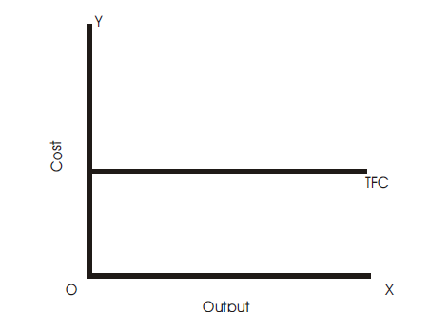
Total Fixed Cost (TFC)
Total fixed cost is the sum of expenses incurred on those inputs that remain same at different levels of output. Total fixed cost is graphically shown. It is a straight line parallel to output or x-axis. TFC is the total fixed cost curve parallel to x-axis indicating that it remains constant at all levels of output.

Slide 40
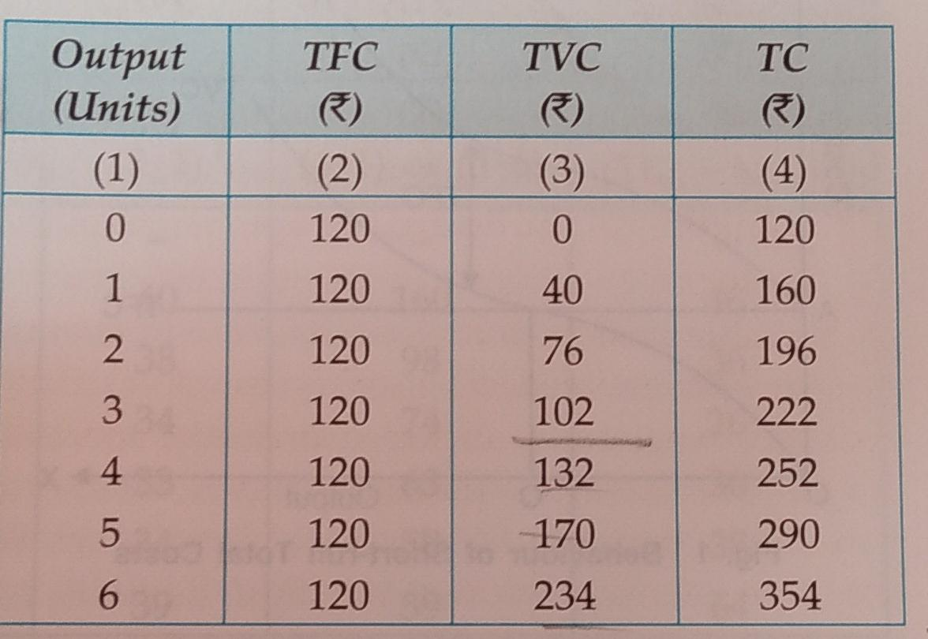
Table 1: Total Fixed, Total Variable and Total Cost

Slide 41
Total Fixed Cost (TFC)
Total cost incurred by the firm on the use of all fixed factors.
This cost is independent of output, it does not change with change in the quantity of output.
It remains constant regardless of the quantity of output produced.
Fixed cost includes interest on the capital invested, rent, insurance premium, property tax, etc.
That is why fixed cost is often known as 'unavoidable cost.

Slide 42
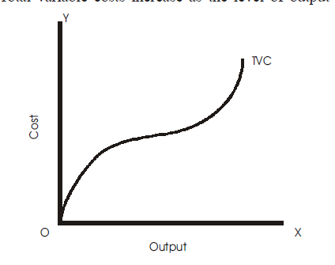
Total Variable Cost (TVC)
Total variable cost is the sum of expenses incurred on those factor inputs whose quantity varies with a change in the level of output. Total variable cost curve TVC is shown in the Fig. It has inverse-S shape. Total variable costs increase as the level of output increases.

Slide 43
Total Variable Cost (TVC)
This cost includes payments for raw materials, wages paid to temporary and casual workers, payment for fuel and power used in production, etc.
Since the use of variable factors varies in accordance with the level of output, variable costs also vary with the level of output.
These costs vary directly with change in the volume of output; rising as more is produced and falling as less is produced.

Slide 44
TVC Curve
Total variable cost increases with output. But the rate of increase in the total variable cost is different at different levels of output. As can be seen from the column (3) of Table 1, total variable cost initially increases at a decreasing rate as total output increases (up to 3 units) and subsequently it increases at an increasing rate with increase in output (from 4th unit onwards).
The TVC curve is a positively sloping curve, showing that as output increases total variable cost also increases. But the rate of increase of TVC is not same thoughout; it increases at a decreasing rate first and then at an increasing rate.
Hence, TVC curve looks like 'inverted S-shape. Also, note that TVC curve starts from the origin which shows that when output is zero, total variable cost is also zero.

Slide 45
Total variable cost increases at a diminishing rate due to increasing returns to the variable inputs arising from the fuller utilisation of fixed factors and specialisation.
It increases at an increasing rate due to diminishing returns to the variable inputs arising from difficulty of management and over utilisation of fixed factor etc.
TVC Curve

Slide 46
Total Cost (TC)
Total cost to a producer for the various levels of output is the sum of total fixed costs and total variable costs, i.e.,
TC = TFC+TVC
Total cost of production which is the sum of total variable cost and total fixed cost.

Slide 47
Total Cost
Since total cost has total variable cost as one of its components which varies with change in output, the total cost will also change directly with the change in output.
Also, since total fixed cost by definition remains constant, the changes in total cost are entirely due to changes in total variable cost.

Slide 48
TC Curve
Total cost is the sum of total fixed cost and total variable cost. Since a constant fixed cost is added to the total variable cost, the shape of TC curve is the same as that of the TVC curve.
This means that slopes of the total cost curves and the total variable cost curves are identical.
In other words, TC curve and TVC curve are always parallel to each other.
Note that TC curve originates not from O, but from point A because at zero level of output total cost equals total fixed cost since TVC is zero when output is zero.
Thus, total variable cost curve starts from the origin while the total cost curve starts at the point where the total fixed cost curve intersects the vertical axis (starting point of TFC). Vertical distance between the TVC and TC curves equals the amount of total fixed cost, and since the total fixed cost is constant, the vertical distance between the TVC curve and TC curve is same at all levels of output.
Like TVC, TC increases at a decreasing rate first and then at an increasing rate. Hence, the TC curve is initially concave downward, subsequently it is concave upward. This behaviour of the TC curve follows directly from the law variable proportions.

Slide 49
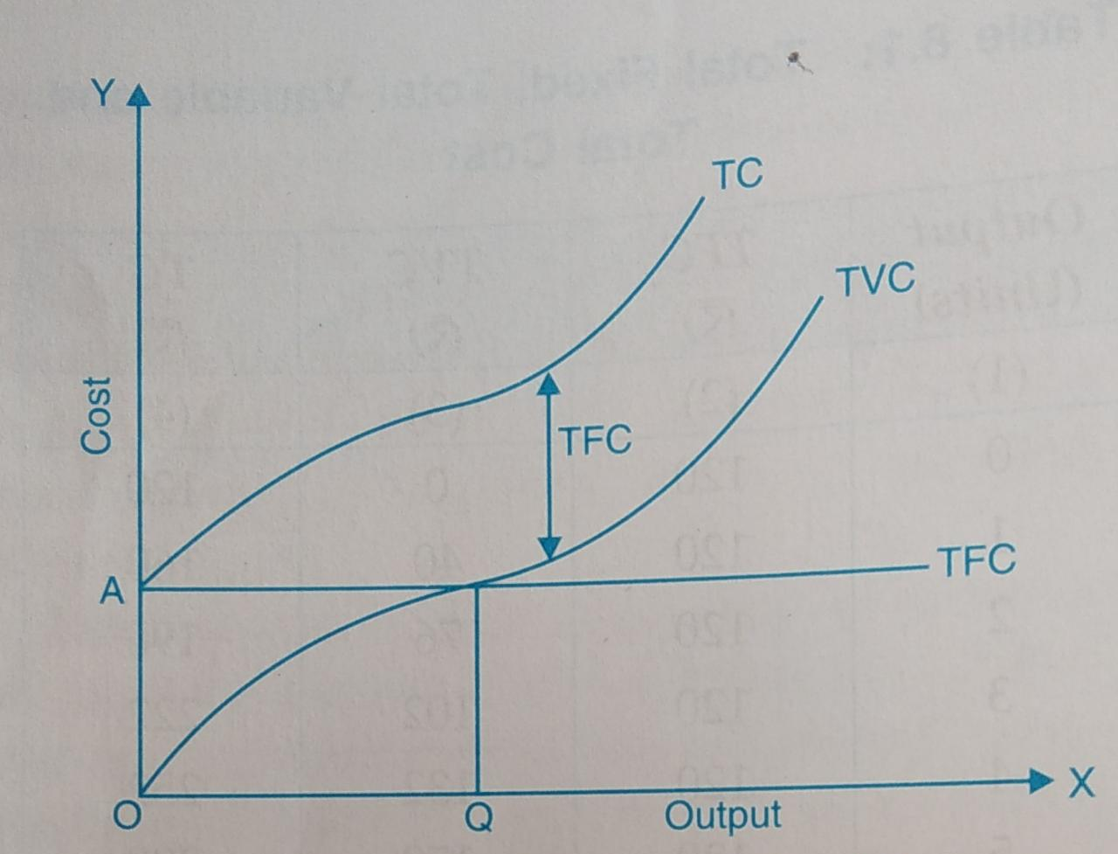
Fig 1: Behaviour of Short-run Total Costs

Slide 50
Average Cost Curves
Average cost is the cost per unit of output. Average cost is simply the total cost divided by the number of units produced Corresponding to three types of total costs in the short-run, there are three types of average cost namely (1) average fixed cost, (2) average variable cost, and (3) average total cost.

Slide 51
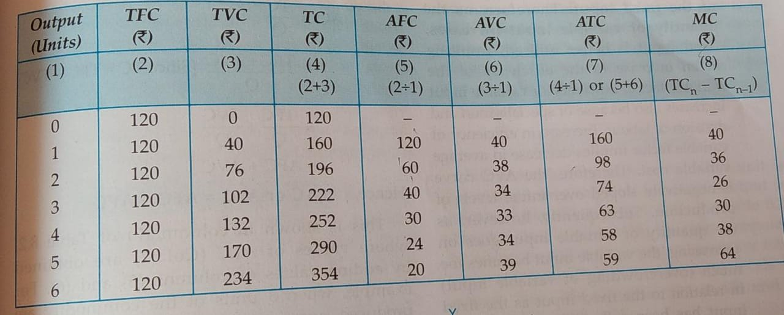
Table 8.2:Behaviour of Average Costs

Slide 52
Average Fixed Cost (AFC)
Average fixed cost is total fixed cost divided by total output. It is per unit cost on fixed factors
AFC = TFC/TQ
TQ is the total output.
AFC curve is a rectangular hyperbola

Slide 53
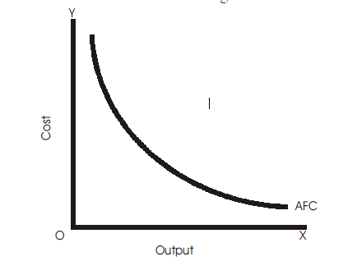

Slide 54
Average Fixed Cost (AFC)
Average fixed cost falls throughout with an increase in output because the total fixed cost is spread over larger and larger units as output increases.
AFC falls as output increases because the TFC numerator of the ratio is constant Q while the denominator increases. Yet as long as there is some fixed cost, the average fixed cost cannot be zero.
It slopes downward throughout its length from left to right showing continuous fall in average fixed cost with an increase in output.

Slide 55
Average Fixed Cost (AFC)
For very small outputs, average fixed cost is high, and for large outputs it is low.
AFC curve is asymptotic to the axes, i.e., the curve approaches the X-axis and the Y-axis at each end.
The curve approaches X-axis but never touches it because average fixed cost cannot be zero since the total fixed cost is positive.
Similarly, AFC curve never touches Y-axis because the total fixed cost has a positive value at very low levels of output.

Slide 56
Average Variable Cost (AVC)
The average variable cost is found by dividing the total variable costs by the total units of output, i.e., it is per unit cost of the variable inputs.
AVC =TVC/TQ
Average variable cost falls initially, reaches a minimum when the plant is operated optimally and rises after the point of normal capacity has been reached.

Slide 57
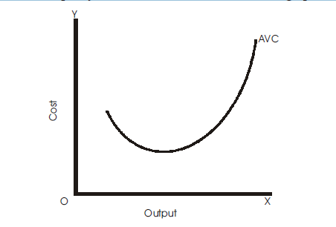

Slide 58
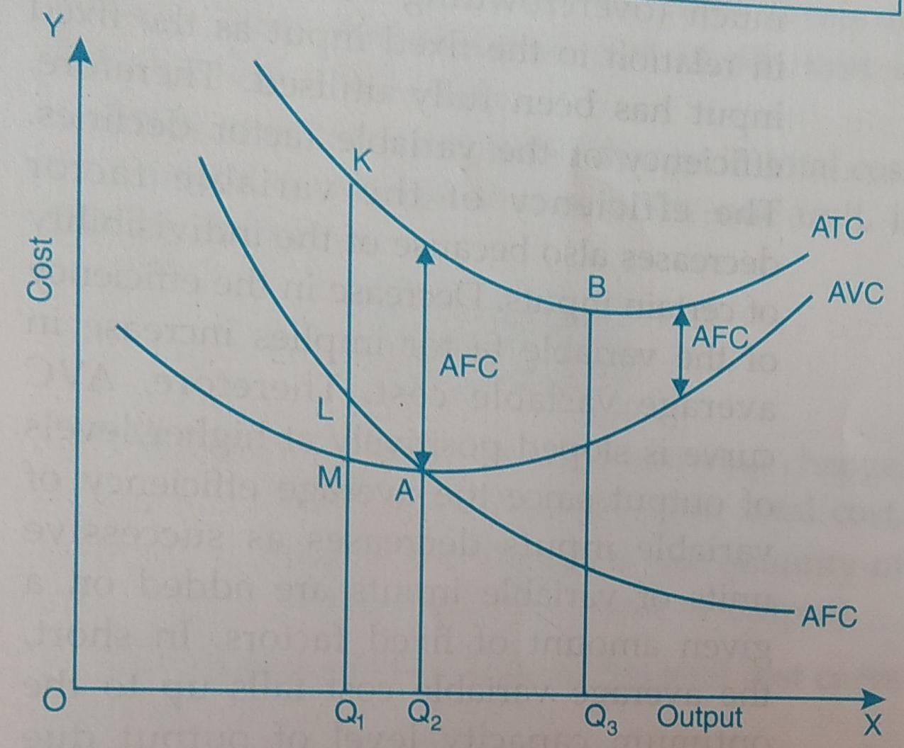
Fig 2: Behaviour of Short-run Average Costs

Slide 59
Average Variable Cost (AVC)
The average variable cost first falls (up to 4th unit of output) and then starts rising (from 5th unit onwards).
Graphically, the behaviour of the average variable cost is shown by AVC curve in Fig. 2. The AVC curve slopes downward up to OQ, level of output (the optimum capacity level of output), showing decrease in the average variable cost, and it slopes upward beyond output level OQ, indicating an increase in the average variable cost. In other words, AVC curve is U-shaped.
It is negatively sloped over early levels of production (from zero to OQ, level of output) and is positively sloped at higher levels of output (beyond OQ, level of output). It is minimum at A corresponding to the optimum capacity level of output OQ.

Slide 60
Why is AVC Curve U-shaped?
U-shape of AVC follows directly from the law of variable proportions. Initially, there is too little of variable input in comparison to the fixed input, resulting in underutilization of the fixed input.
Therefore, as the quantity of variable input increases, fixed input is better utilised, resulting in an increase in the efficiency of the variable factor. Efficiency of variable input increases also because of specialization and division of labour. Increase in efficiency of variable factor implies decrease in average variable cost.

Slide 61
Why is AVC Curve U-shaped?
Therefore, the AVC curve is negatively sloped over initial levels of production. Subsequently, however, as the quantity of variable input goes on increasing, the variable input becomes too much (overcrowding of variable input) in relation to the fixed input as the fixed input has been fully utilised. Therefore, efficiency of the variable factor declines.
The efficiency of the variable factor decreases also because of the indivisibility of certain inputs. Decrease in the efficiency of the variable factor implies increase in average variable cost. Therefore, AVC curve is sloped positively at higher levels of output since the average efficiency of variable inputs decreases as successive units of variable inputs are added on a given amount of fixed factors. In short, the average variable cost falls up to the optimum capacity level of output due to increasing returns to the variable factor and it increases thereafter due to diminishing returns to the variable factor.

Slide 62
Table 8.2:Behaviour of Average Costs

Slide 63
Fig 2: Behaviour of Short-run Average Costs

Slide 64
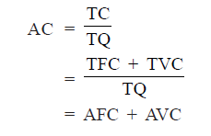
Average Total Cost (ATC/AC)
ATC is the per unit cost of both fixed and variable inputs. Average total cost of production can be obtained by dividing total cost by the units of output, i.e.,
Average total cost or ATC curve has the similar shape as that of AVC, that is, U-shaped.

Slide 65
Average Total Cost (ATC/AC)
Geometrically, ATC curve (or AC curve) can be obtained by adding the AFC and AVC curves. ATC curve is vertical summation of AFC and AVC curves. Therefore, at each level of output ATC curve lies above AVC curve equal to the value (height) of AFC curve. For example, in Fig. 2, for OQ1, level of output the average cost is KQ1, which is the sum of LQ1(AFC) and MQ1, (AVC).

Slide 66
Average Total Cost (ATC/AC)
A number of important observations must be noted about the ATC curve:
The distance between the average total cost curve and the average variable cost curve gets smaller as production increases. ATC curve is far above the AVC curve at initial levels of output because the average fixed cost is a high percentage of the average total cost. But ATC curve tends to come closer to AVC at higher levels of output because the average fixed cost accounts for a relatively small percentage of the average total cost.
ATC curve never touches AVC curve because the average fixed cost is always positive. Thus, the distance between the ATC curve and the AVC curve gets smaller as the level of output.

Slide 67
Average Total Cost (ATC/AC)
2. ATC curve is U-shaped indicating that the average total cost falls initially, reaches the minimum point and then starts rising. Remember that the level of output at which average cost is minimum is known as the optimum point of production. ATC curve is U-shaped for the same reasons for which AVC curve is U-shaped, i.e., ATC curve is U-shaped because of the law of variable proportions.

Slide 68
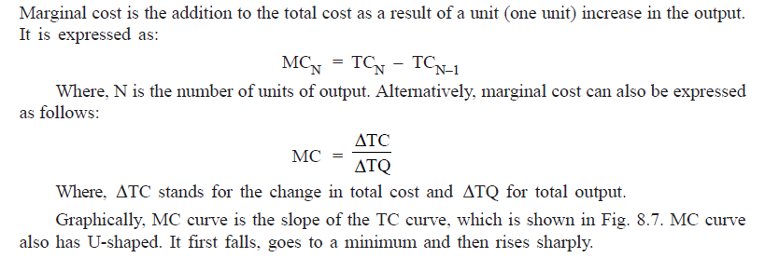
Marginal Cost

Slide 69
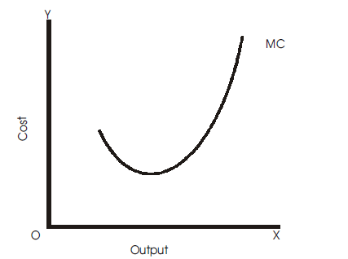
A
Q

Slide 70
Marginal Cost
Marginal cost has nothing to do with the fixed cost.
Marginal cost is an addition to the total cost when one additional unit of output is produced.
But there is no addition or change in the total fixed cost (as TFC is constant) with an increase in output.
It is thus clear that the marginal cost is independent of the fixed cost. Marginal cost is associated with the variable cost and thereby with the total cost.

Slide 71
Marginal Cost
Total cost exceeds the total variable cost by a constant amount (ie, the amount of total fixed cost), the addition in total cost for one additional unit of output would be the same as addition in the total variable cost.
MC curve derived from TVC curve is the same as derived from TC curve. Therefore, MC curve is common both to AVC curve and ATC curve. Notice that the MC curve cuts ATC and AVC curves at their minimum points.

Slide 72
Marginal Cost
MC curve is U-shaped. As output increases, MC curve slopes downward (up to OQ units), reaches the minimum (at point A) and then starts sloping upward beyond OQ level of output.
The U-shape of MC curve is because of the law of variable proportions. It is negatively sloped in the initial stage of production due to increasing returns to the variable factor and is positively sloped thereafter due to decreasing returns to the variable factor.

Slide 73
Marginal Cost
It is important to note that the TVC can be computed as the sum total of MC of various units of output, i.e. TVCn = MC1 + MC2+.....+ MCn, For example, it is seen in when 4 units of output are produced, ie, n= 4, then TVC = 40+36+26+30 =Rs.132

Slide 74
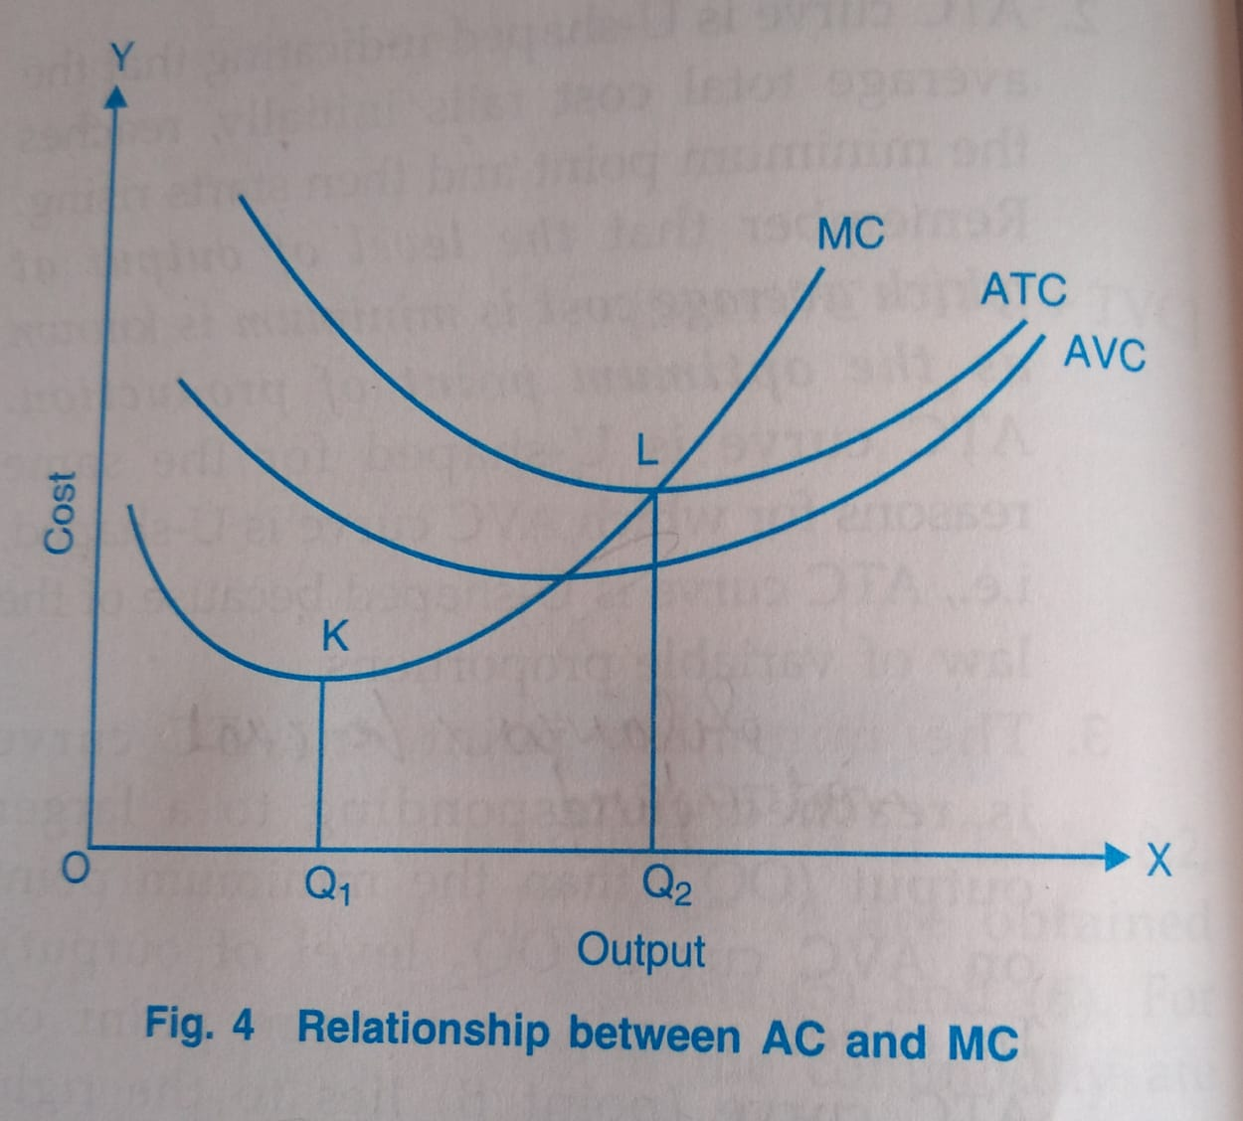

Slide 75
RELATIONSHIP BETWEEN AVERAGE COST AND MARGINAL COST
Average cost is obtained by dividing total costs by the units of output. Marginal cost is the change in total costs resulting from a unit increase in output. The relationships between the two are as follows:
1. When average cost falls with an increase in output, marginal cost is less than the average cost (before point L).
2. When average cost rises, marginal cost is greater than the average cost (after point L).
3. Marginal cost curve cuts the average cost curve at its minimum point (minimum point on the average cost curve is also the point of optimum capacity) i.e., at the point of optimum capacity, MC = AC (at point L).
With increase in average cost, marginal cost rises at a faster rate.

Slide 76
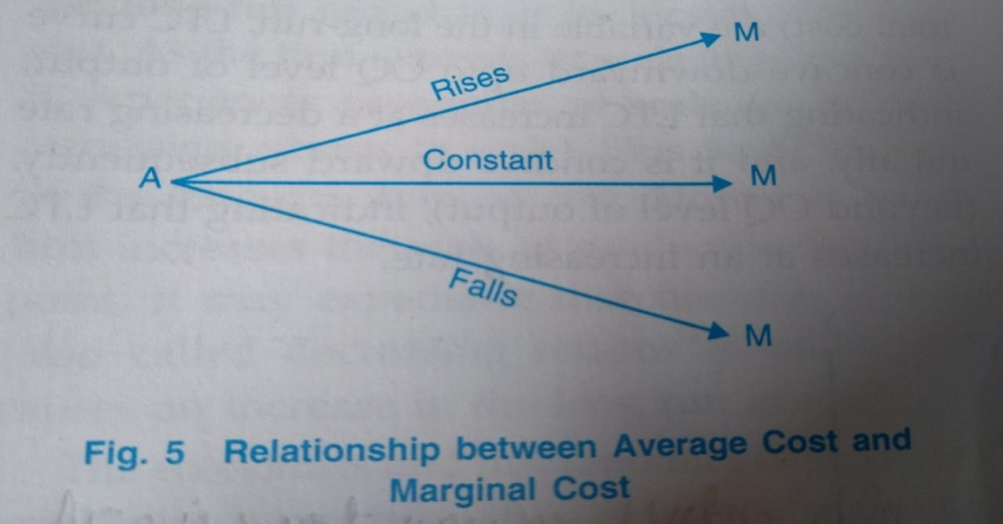
RELATIONSHIP BETWEEN AVERAGE COST AND MARGINAL COST
An easy way to remember the relationship between the average cost and marginal cost is that when M (marginal cost) is more than A (average cost), A rises; when M is less than A, A falls and when M is equal to A, then A is constant.

Slide 77
Long Run Cost Curves
A firm may be able to increase output in the short-run only by adding workers and raw materials etc. to the given plant and some fixed factors such as capital equipments, machinery, land, etc.
But in the long-run, the firm can build a new plant like a bigger factory more suitable to the larger output level.
The long-run cost of a product is the least cost of producing each level of output when all factors of production, including the plant, are variable.
In the long-run, a firm can produce a given level of output at the minimum cost since it has sufficient time to select the optimum plant size for that level of output.
Since there are no fixed costs in the long-run, the cost in the long-run is entirely made up of the variable cost. Therefore, out of the seven cost curves that we examined in our discussion of the short-run cost curves (TFC, TVC, TC, AFC, AVC, ATC and MC curves) only three are relevant in the long-run.

Slide 78
Long Run Cost Curves
the long-run total cost curve,
the long-run average cost curve and
the long-run marginal cost curve.

Slide 79
Long Run Cost Curves
Long-run total cost (LTC) curve is derived from short-run total cost (STC) curve as the envelope of STC curves.
The shape of long-run cost curve as that of an inverse 'S' shape, as shown in Fig. 6.
It is a positively sloping curve indicating that LTC increases with increase in output.
It begins from the point of origin, showing that LTC is zero when the quantity of output is zero because all the factors (and hence total cost) are variable in the long-run, LTC curve is concave downward upto OQ level of output, indicating that LTC increases at a decreasing rate initially, and it is concave upward subsequently, (beyond OQ level of output), indicating that LTC increases at an increasing rate.

Slide 80
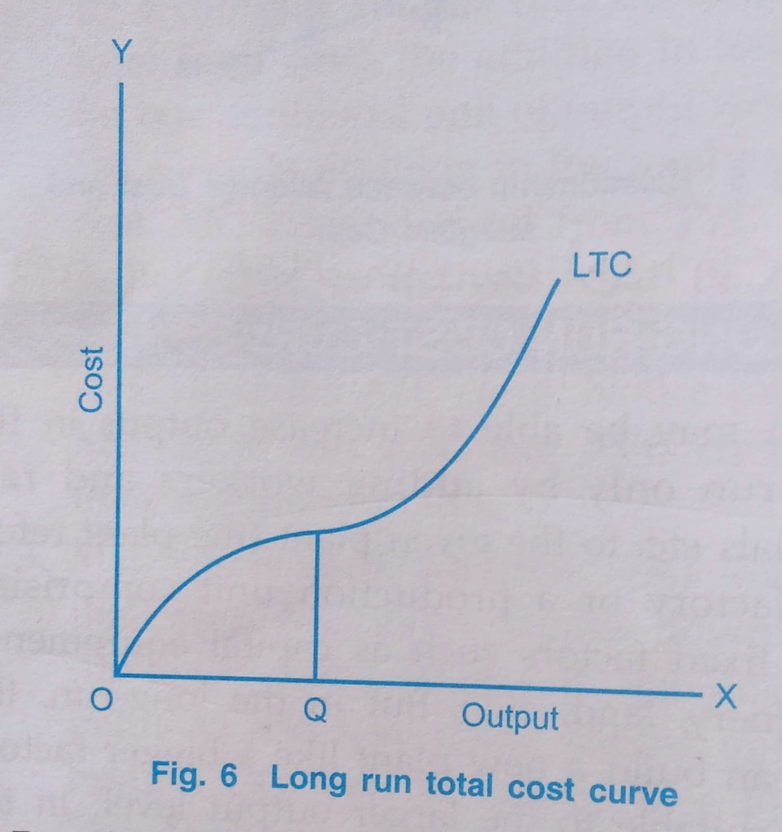

Slide 81
Long Run Cost Curves
But this shape of long-run total cost curve is because of economies and diseconomies of scale. However, we shall be concerned here only with the long-run average cost (LAC) and long- run marginal cost (LMC) because total cost and per unit cost are different ways of looking at the same thing, and they are interrelated.

Slide 82
Long-run Average Cost (LAC) Curve
Long-run average cost is the per unit cost of factors of production used in the long-run. It is obtained by dividing the long-run total cost with the level of output. It shows the lowest per unit cost of producing each level of output when all inputs have been adjusted that is, when any place size can be built.
A rational producer in the long run will produce each level of output with the help of such a plant which minimises the average cost. SAC curve corresponds to a particular plant, and the firm in the short-run can use this plane more or less intensively by applying more or less of the variable factors on it. For every plant there is a particular SAC curve and since in the long run the firm can change the size of plant, it can move from one SAC curve to another.

Slide 83
Long-run Average Cost (LAC) Curve
LAC curve is generally U-shaped, but U-shape of the long-run average cost curve is flatter than that of the short-run average cost curve. U-shape of the LAC curve implies that the long-run average cost falls first, reaches the minimum, and then rises. Thus, in Fig. 7, long-run average cost falls up to A (up to OQ level of output), rises beyond A (beyond OQ output), and is minimum at A (at OQ level of output). Long-run average cost curve is of U-shape because of economies and diseconomies of scale.

Slide 84
Long-run Marginal Cost (LMC) Curve
Long-run marginal cost (LMC) is the addition to the long-term total cost as one additional unit of output is produced when all inputs are optionally adjusted. When LAC curve is U-shaped, LMC curve is also U-shaped.
U-shape of the LMC curve will be flatter than the short-run marginal cost curve. This is illustrated in Fig. 7. It should be noted that the relationship between LAC and LMC curves is the same as between the short-run average cost curve and the short run marginal cost curve. When the LAC curve is U-shaped, the corresponding LMC curve will also be U-shaped and it will cut the LAC curve at its minimum point from below.

Slide 85
The relationship between LAC and LMC
When LMC is less than the LAC, average cost falls with increase in output. In other words, when LAC falls LMC is less than it It will be seen from Fig. 7 that so long as LMC curve lies below the LAC curve (up to OQ amount of output), LAC curve is negatively sloped. It does not matter whether LMC curve itself is sloping downwards or upwards. In other words, when LAC is falling, LMC is less than LAC

Slide 86
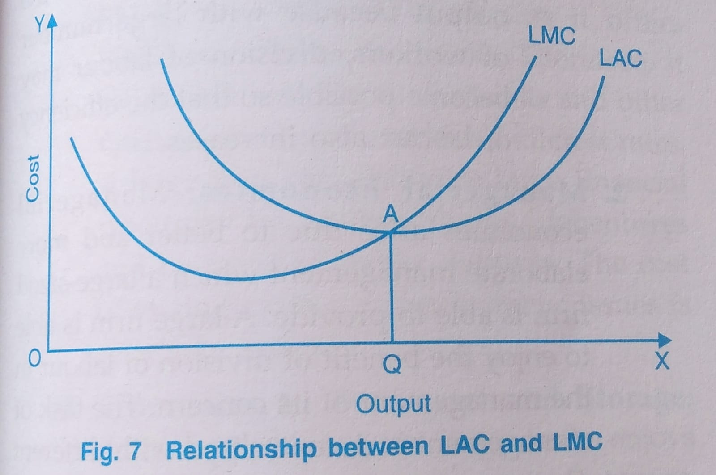

Slide 87
The relationship between LAC and LMC
2. When LMC is equal to LAC, average cost is constant. In Fig. 7, LAC is minimum and constant for a while at point A on LAC curve, and LMC curve cuts the LAC curve at this minimum point, showing that LMC = LAC

Slide 88
The relationship between LAC and LMC
3. When LMC is greater than LAC, average cost increases with increase in output. In other words, when LAC is rising LMC is also rising. In Fig. 7, LMC curve lies above LAC curve beyond OQ level of output and LAC curve is positively sloping. In other words, when LAC is rising, LMC is more than LAC.

Slide 89
The relationship between LAC and LMC
In the U-shaped cost curve, LAC falls first, reaches the minimum and then rises. Therefore, up to the minimum point of the LAC curve, LMC curve will be below the LAC curve. Beyond the minimum point of the LAC curve, LMC curve has to be above the LAC curve. This would imply that LMC curve has to cut the LAC curve at its minimum point from below.

Slide 90
Why is LAC Curve U-Shaped- Economies and Diseconomies of Scale
The U-shape of the long-run average cost curve is explained by the economies and diseconomies of scale. When the firms expand their size of production, ie, increase their scale of production, they get some advantages or economies of production. But if the scale of production becomes excessively large, certain disadvantages or diseconomies accrue to the firms. Economy means saving in per unit cost as output increases. Diseconomy means increase in per unit cost as output increases.

Slide 91
Why is LAC Curve U-Shaped- Economies and Diseconomies of Scale
Changing the firm's scale of production in the long-run can change its long-run average cost. As the firm expands its scale of production, it experiences economies of scale. This leads to a fall in the long-run average cost. However, as the firm increases the scale of production beyond a point, it may experience diseconomies of scale.
This causes an increase in the long run average cost. The economics and diseconomies of large-scale production are of two kinds: (i) Internal economies and diseconomies, (ii) External economies and diseconomies. It is important to remember that U-shape of LAC curve is explained by internal economies and diseconomies of scale. The long-run average cost of production falls initially due to internal economies of scale and it increases subsequently due to internal diseconomies of scale.

Slide 92
Internal Economies
Internal economies are those economies which arise from the expansion of the plant size or increase in the scale of production of the firm.
They are internal in the sense that they accrue to the firm when its scale of production increases and are available to that firm only i.e. they are firm specific.
They depend solely upon the size of the firm and will be different for different firms. They are specific to each firm, and are enjoyed by only those firms which expand their scale of production.

Slide 93
1. Technical Economies
Technical economies arise from the use of better techniques of production, increase in the labour efficiency, etc. A large firm achieves technical economies in the following forms:
(1) Use of advanced techniques: A large-sized firm is able to make use of advanced, sophisticated and specialised mechanics and equipments. Such machinery is costly and meant for the large-scale production. A large firm, therefore, can afford to employ such costly machinery since the high cost of machines can be easily spread over a large output. Use of advanced technique increases the efficiency in production and reduces the per unit cost of production.

Slide 94
1. Technical Economies…
(ii) Greater specialisation: A large firm permits greater division of labour and specialisation. It employs a large number of workers.
Therefore, it becomes possible to divide the whole production process into small jobs which can be assigned to specific workers according to their skill and qualifications.
It is also possible for a large firm to employ qualified specialists. This will increase the efficiency of labour and reduce per unit cost of production.

Slide 95
1. Technical Economies…
(iii) Use of by-products: A large firm is able to make economical use of its waste material. It can utilise its waste material to produce other products, i.e., by-products. Sugar Industry

Slide 96
2. Managerial Economies
A large firm is able to enjoy the benefit of division of labour in the management of its concern. The task of management is decentralised with different departments.
The management can be divided and sub-divided into different departments such as production, sales transport and personnel departments.
The firm can engage qualified persons to look after different departments. This functional specialisation in management increases efficiency at all levels.

Slide 97
3. Marketing Economies
Marketing economies arise from the large-scale purchase of raw materials
and other inputs and the large-scale sale of firm's own products. A large firm is able to buy raw materials and other inputs more cheaply than a small firm because a large firm buys regularly and in bulk and so is able to get discounts.
It is also able to get special concessional rates from transport companies. A large firm enjoys marketing economies in selling its products as well.

Slide 98
3. Marketing Economies
It can set up its own sales agency such as exclusive shops and showrooms, to promote the sale of its products. It can reduce the distribution cost by selling through wholesale dealers.
It can afford to incur large expenditure on sale promotion in the form of advertisement, door-to-door sale campaigns, exhibitions, etc. to push its sale The cost incurred on advertisement could be more than recovered by increase in sale.

Slide 99
4. Financial Economies
A large firm is in a favourable position while raising its finances. In other words, it enjoys financial economies. It will be able to raise the necessary finances easily and cheaply. It has better creditworthiness as it offers better security to the banks. Therefore, it can secure loans from the banks and other financial institutions at lower interest rates. A large firm can also raise large financial resources by issuing shares and debentures.

Slide 100
5. Economies in Transport and Storage
A firm producing on large scale enjoys the economies of transport and storage. A large-sized firm may possess its own fleet of transport to carry raw materials and finished products and thereby it can reduce the transport cost and can prevent delays in transportation. Similarly, a large-sized firm may have its own godowns and can save on the cost of storage.

Slide 101
6. Research and Development
A large-sized firm is able to take advantage of research and development (R&D). A large firm can have its own R&D wing. It can set up its own laboratories and employ a large number of scientists and research workers. This helps the large firm to discover new techniques, new product designs and improve the operational functioning.

Slide 102
7. Risk and Survival Economies
A large-sized firm is able to face the risks and uncertainties of business. This is known as risk and survival economies. It is, therefore, able to absorb various business shocks and can bear the risks and survive. Thus, a large firm or a firm which expands its is able to secure many internal economies of production. As a result of these economies, the firm is able to reduce the per unit cost.

Slide 103
Internal Diseconomies
An increase in the scale of production results in decrease in per unit cost due to economies of scale. At a certain scale the per unit cost of the firm will be at a minimum. The level of output at which the cost is minimum is known as the optimum point of production.
An increase in the scale of production beyond the optimum level may give rise to internal diseconomies. Internal diseconomies are those diseconomies which are experienced by a particular from when it expands its scale of production beyond a point. Diseconomies of scale may lead to increase in per unit cost. Following are the main types of internal diseconomies:

Slide 104
Diseconomies of Scale
The extensive use of machinery, division of labor, increased specialization and larger plant size etc., no doubt entail lower cost per unit of output but the fall in cost per unit is up to a certain limit.
As the firm goes beyond the optimum size, the efficiency of the firm begins to decline. The average cost of production begins to rise.

Slide 105
Factors of Diseconomies
1. Lack of co-ordination. As a firm becomes large scale producer, it faces difficulty in coordinating the various departments of production. The lack of coordination in the production, planning, marketing personnel, account, etc., lowers efficiency of the factors of production. The average cost of production begins to rise.
2. Loose control. As the size of plant increases, the management loses control over the productive activities. The misuse of delegation of authority, the redtapisim bring diseconomies and lead to higher average cost of production.

Slide 106
Factors of Diseconomies
3. Lack of proper communication. The lack of proper communication between top management and the supervisory staff and little feed back from subordinate staff causes diseconomies of scale and results in the average cost to go up.
4. Lack of identification. In a large organizational structure, there is no close liaison between the top management and the thousands of workers employed in the firm. The lack of identification of interest with the firm results in the per unit cost to go up.

Slide 107
5. Labour Inefficiency
An increase in the scale of production gives rise to the overcrowding of labour. There is loss of personal contact between owners and workers with the consequent loss of morale of workers and increase in labour trouble. Moreover, increase in the number of workers gives rise to trade union activities. All these lead to fall in efficiency and increase in the cost of production.

Slide 108
External Economies
External economies are those economies which are shared by all the firms in the industry. and they arise as a result of expansion of the industry as a whole and not because of increase in the output of an individual firm.
They are external in the sense that they accrue to a firm because of the factors that are entirely outside the firm.
These economies are general and common to all the firms in an industry because the firm is a part of the industry.
For example, when an industry is localised, it is able to get better transport and banking facilities, etc. These advantages will emerge for the industry as a whole and all the firms will enjoy these benefits. Some of the important types of external economies are:

Slide 109
1. Cheaper Inputs
When an industry expands, it demands various types of input like raw materials, capital equipments, etc. Industries which are engaged in the production of these inputs increase their scale of production in order to produce more of these inputs.
They may experience economies of scale as a result of which they are able to provide these inputs at lower prices. Therefore, the industries using more inputs will benefit because they will get these inputs at cheaper prices.

Slide 110
2. Technological Economies
When an industry expands, it may provide motivation for the discovery of improved and better techniques of production.
New methods of production and better machines are discovered. Production function improves. Productivity increases and per unit cost decreases.

Slide 111
3. Supply of Skilled Labour
When an industry expands in an area, a reservoir of skilled labour force in that area develops. At the same time, various specialised institutions, ie, engineering, management institutions, etc. develop which provide a constant stream of skilled labour.
This has a favourable effect on the level of productivity and cost of the firms in the industry.

Slide 112
4. Growth of Ancillary Industry
When an industry expands, a number a subsidiary industries develop to cater the requirements of the major industry. A number of specialised firms emerge to supply goods and material at low prices to the main industry.
For example growth of automobile industry promote the development of tyre and spare par industries.
Likewise, some specialised firm will develop to make use of the by-product and wastes of the main industry.

Slide 113
5. Constant Flow of Information
An expansion of industry may lead to the development of various types of information services. Firms may form an association and publish trade and technical journals for the exchange of technical information among its members about new markets, new source of raw materials, latest techniques, etc.
The firm may jointly set up research institutions to discover new and better techniques for the benefit of all the firms. All this would help in increasing the efficiency and lowering the cost of production of all the firms constituting the industry.

Slide 114
6. Economies of Concentration
When a number of firms are localised in a particular area, a wide variety of facilities and services are provided which benefit all of them.
Better transportation and communication facilities, better and adequate source of power, adequate banking facilities, etc. are provided when firms are located in a particular region.
Provision of such services increases the efficiency of all the firms and reduces the cost of production.

Slide 115
External Diseconomies
External diseconomies are those diseconomies which are experienced by all the firms of an industry when the scale of production of the industry as a whole expands beyond manageable limits.
Beyond a certain stage, expansion of industries will create diseconomies which are general and, therefore, are common to all the firms. They are not confined to any particular firm.
Most of the external diseconomies arise when many firms are localised at particular place. Increase in input prices, higher wages and costlier transport are some of the external diseconomies.

