Slide 1
SPRAINED FINGER
DR. PRABHKAR PANDEY

Slide 2
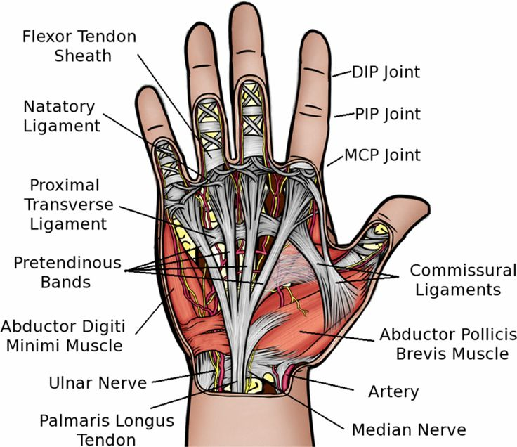
FINGER LIGAMENTS

Slide 3
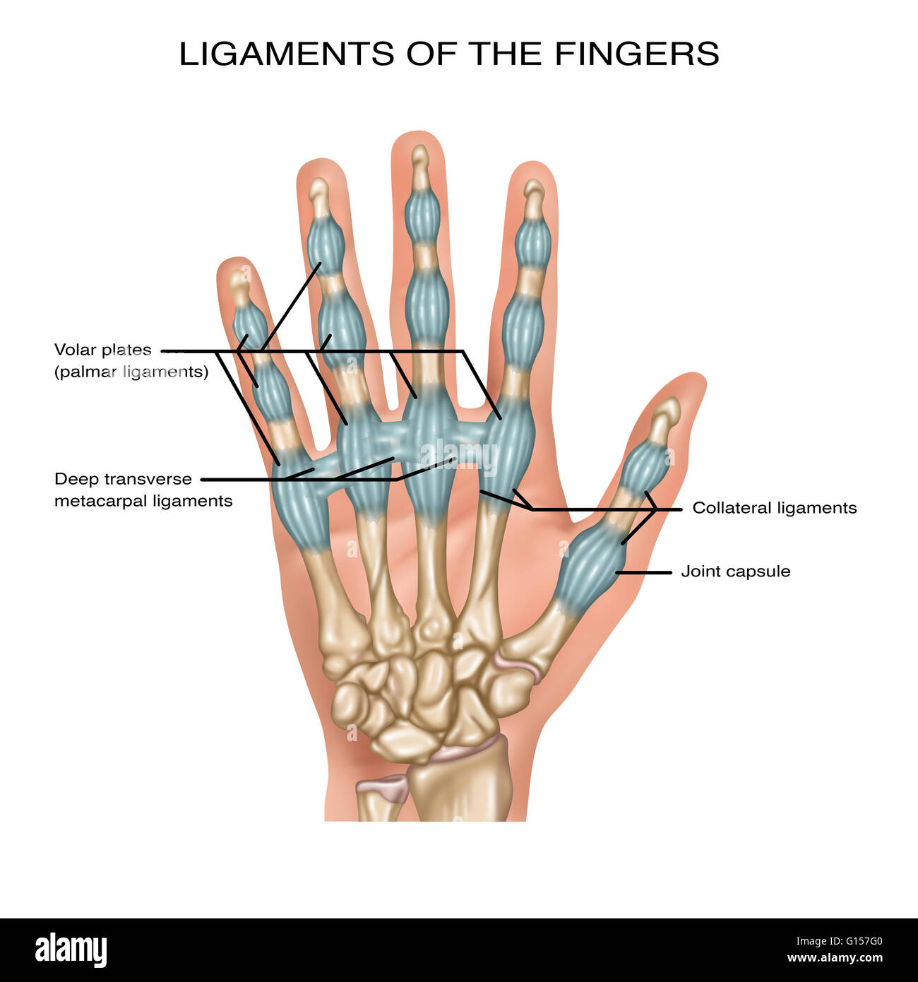

Slide 4
What is a sprain?
A sprain is an injury that occurs when ligaments are torn or stretched. Ligaments are the bands of tissue that connect joints together.
Sprains are extremely common injuries. While they are especially common in athletes that participate in sports involving catching or throwing balls, anyone can sprain a finger relatively easily.

Slide 5
What are the symptoms of a sprain?
General symptoms of sprains are pain, swelling, limited mobility, and bruising. There are three different grades of sprains. Each grade has its own specific version of these symptoms.
First-degree sprain
A first-degree sprain is the mildest. It involves ligaments that are stretched but not torn. Symptoms include:
some localized pain and swelling around the joint
a restriction in the ability to flex or extend the finger
The strength and stability of the finger and joint are not affected.

Slide 6
Second-degree sprain
A second-degree sprain is considered a moderate sprain, where more damage is done to the ligament. Damage may be done to the joint capsule, too. This may include a partial tear of the tissue. Symptoms include:
more intense pain
more significant swelling, which may extend to the full finger
limited range of motion that may affect the entire finger, not just one joint
mild instability of a joint
Third-degree sprain
A third-degree sprain is the most severe type of sprain. It indicates a severe tearing or rupture of the ligament. Symptoms may include:
full or partial dislocation of the finger
severe pain and swelling
instability of the full finger
discoloration of the finger

Slide 7
What are the causes of a sprained finger?
Sprained fingers are caused by physical impact to the finger. In most cases, sprains are caused by a blow to the end of a finger, which reverberates up to the joint and causes it to become hyperextended. This stretches or tears the ligaments.
Sports injuries are extremely common causes of sprained fingers. This is especially true for sports like basketball. If the player just barely misses the ball with the tips of their fingers, they could sprain them. That being said, anyone could sprain a finger just by hitting it the wrong way on the counter or breaking a fall.

Slide 8
How is a sprained finger diagnosed?
If you think that you have a mild sprain, there’s no need to see a doctor at first. If home treatment hasn’t helped and you have no improved mobility after three or four days, though, make an appointment just to double check.
Second- and third-degree sprains may require the attention of a doctor. They’ll inspect the joint and ask you to flex and extend your finger so they can evaluate its function and mobility. They may order an X-ray to check for fractures and evaluate the extent of the damage.

Slide 9
How are sprained fingers treated?
To treat a sprained finger at home, RICE is the first step you’ll take. RICE stands for rest, ice, compression, and elevation. You’ll need to rest the joint and apply ice packs on (and then off) for 20 minutes at a time. Never apply ice directly to the skin; wrap the ice pack in a towel. You can also submerge the joint in cool water. The cold can help reduce swelling and pain.
Compress the affected joint by wrapping it, and keep it elevated. Compression and elevation both help to reduce swelling. Elevation is especially important at night.
In addition to RICE, you can take over-the-counter pain relievers like ibuprofen (Advil) or acetaminophen (Tylenol) every eight hours.
If the sprain is severe enough, your doctor might immobilize the finger with a splint, which can help ensure that it heals correctly. In rarer cases that include severely torn ligaments, your doctor may need to operate on the ligament to repair it.

Slide 10
THANK YOU

