Slide 1
Business Economics UNIT II DEMAND ANALYSIS
Course Code: F010101T

Slide 2
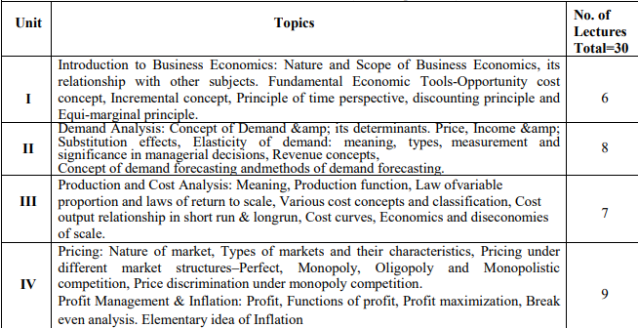

Slide 3
Suggested Readings
1. Varsney & Maheshwari, Managerial Economics
2. Mote Paul & Gupta, Managerial Economics: Concepts & cases
3. D.N.Dwivedi, Managerial Economics
4. D.C.Huge, Managerial Economics 5.
5. Peterson & Lewis, Managerial Economics

Slide 4
Demand
“If you can’t pay for a thing, don’t buy it. If you can’t get paid for it, don’t sell it.”
Benjamin Franklin
want, need or desire which is backed by willingness and ability to buy a particular commodity, at a given point of time.
A want with three attributes - desire to buy, willingness to pay and ability to pay

Slide 5
Demand
Demand means a desire. Desire means an urge to have something. In Economics, demand means a desire which is backed by willingness and ability to pay.
For example, if a person has the desire to purchase a CAR set but does not have the adequate purchasing power then it will be simply a desire and not a demand.
Thus, demand is an effective desire. All desires are not demand.
Demand = Desire + Willingness to Purchase + Ability to pay

Slide 6
Demand
Demand is the quantity of a commodity which consumers are willing to buy at a given price for a particular unit of time.

Slide 7
Individual Demand Schedule
Individual demand is the quantity of a commodity demanded by a consumer at a given price during a given period of time.
Individual demand schedule is a tabular representation showing different quantities of commodities that an individual consumer is prepared to buy at various prices over a given period of time.
This can be explained with the help of the following individual demand schedule.

Slide 8
Individual Demand Schedule Table 1
Price of commodity Rs. | Quantity demanded of commodity ‘x’ (in kgs)
10 | 1
8 | 2
6 | 3
4 | 4
2 | 5

Slide 9
Individual Demand Schedule
Table shows different quantities of commodity ‘x’ purchased by an individual consumer at various prices. It can be observed that less quantity of commodity is demanded at rising prices and more quantity of commodity is demanded at falling prices.
It indicates an inverse relationship between price and quantity demanded.

Slide 10
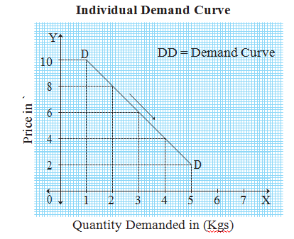
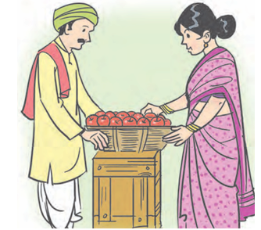
Individual Demand Curve
Individual demand curve is a graphical representation of the individual demand schedule. Inverse Relationship
It represents an individual demand curve which is based on table 1

Slide 11
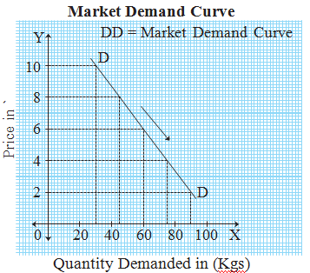
Market Demand Curve
Graphically, the market demand curve is a horizontal summation of individual demand curves. It is based on the market demand schedule.

Slide 12
Market Demand Curve
In figure , X axis represents market demand and Y axis represents the price of the commodity. The market demand curve ‘DD’ slopes downward from left to right, indicating an inverse relationship between price and market demand.

Slide 13
Types of Demand Direct and Derived Demand
When the goods and services are demanded by consumers to satisfy their wants directly, such demand is called direct demand.
All consumer goods such as furniture, garments, TV set, soaps, tea, etc, have direct demand.

Slide 14
Derived Demand
When a commodity is demanded to produce another product, such demand is called derived demand or indirect demand. Derived demand comes from producers to carry out production.
It depends on the demand for other goods and services. Factor services such land, labour, raw materials, machinery, etc. Have derived or indirect demand.

Slide 15
Income Demand
It is a demand for different quantities of a commodity or service that consumers intend to purchase at different levels of income assuming other factors remain the same.
Generally, the demand for a commodity or service increases with an increase in the level of income of individuals except for inferior goods.
Therefore, demand and income are directly proportional to normal goods whereas the demand and income are inversely proportional to inferior goods.

Slide 16
Cross Demand
It refers to the demand for different quantities of a commodity or service whose demand depends not only on its own price but also the price of other related goods and services.
For example, tea and coffee are considered to be the substitutes of each other. Thus, when the price tea increases, people switch to coffee. Consequently, the demand for coffee increases. Thus, it can be said that tea and coffee have cross demand.

Slide 17
Joint Demand
It is the quantity demanded for two or more commodities or services that are used jointly and are thus demanded together. For example, car and petrol, bread and butter, pen and refill etc, are commodities that are used jointly and are demanded together.
The demand for such commodities changes proportionately. For example, a rise in the demand for cars results in the proportionate rise in the demand for petrol. In the above example, an increase in the price of cars will cause a fall in the demand of not only cars but also of petrol.

Slide 18
Composite Demand
It is the demand for commodities or services that have multiple uses. For example, the demand for steel is a result of its uses for various purposes like making utensils, pipes, cans etc. In the case of a commodity or service having composite demand, a change in the price results in a large change in the demand.
This is because the demand for the commodity or service would change across its various usages. In the above example, if the price of steel increases, the price of other products made of steel also increases. In such a case, people may restrict their consumption of products made of steel.

Slide 19
Determinants of Demand
Price of the Product
Income of the Consumer
Consumer’s Expectation of Future Income and Price
Population
Growth of Economy
Consumer Credit

Slide 20
Price of the Product
The price of product is one of the most important determinants of its demand in the long run, and the only determinant in the short run.
The price and quantity demand are inversely related.
"All else being equal, as the price of a good or service increases, the quantity demanded for that good or service decreases, and conversely, as the price of a good or service decreases, the quantity demanded increases. (other factors remaining constant)
The assumption other factors remaining constant’ implies that income of the consumers, prices of the substitutes and complementary goods, consumer’s taste and preference, and number of consumers, remain unchanged.

Slide 21
Price of the Related Goods
The demand for a commodity is also affected by the changes in the price of its related goods. Related goods may be substitutes or complementary goods.

Slide 22
Substitutes
If a substitute good is available at a lower price then people will demand cheaper substitute good than costly good. For example, if the price of sugar rises then demand for jaggery will rise.
Tea and coffee, alcohol and drugs are some examples of substitutes in case of consumer goods.

Slide 23
Complementory
Change in the price of one commodity would also affect the demand for other commodity. For example, car and fuel. If the price of fuel rises, then demand for cars will fall.
For instance, an increase (or decrease) in the price of petrol causes a decrease (or an increase) in the demand for car and other petrol-run vehicles, other things remaining the same.

Slide 24
Nature of product
If a commodity is a necessity and its use is unavoidable, then its demand will continue to be the same irrespective of the corresponding price. For example, medicine to control blood pressure.

Slide 25
Size of population
Larger the size of population, greater will be the demand for a commodity and smaller the size of population smaller will be the demand for a commodity.

Slide 26
Expectations about future prices
If the consumer expects the price to fall in future, he will buy less in the present at the prevailing price. Similarly, if he expects the price to rise in future, he will buy more in the present at the prevailing price.

Slide 27
Advertisement
Advertisement, sales promotion scheme changes the preferences of the consumers and lead to demand for many products. For example, cosmetics, tooth brush etc.

Slide 28
Tastes, Habits and Fashions
Taste and habits of a consumer influence the demand for a commodity. If a consumer likes to eat chocolates or consume tea, he will demand more of them. Similarly, when a new fashion hits the market, the consumer demands that particular type of commodity. If a commodity goes out of fashion then suddenly the demand for that product tends to fall.

Slide 29
Consumer’s Income
Income is the basic determinant of quantity of a product demanded since it determines the purchasing power of the consumer.
That is why the people with higher current disposable income spend a larger amount on goods and services than those with lower income.
While other determinants of demand, e.g., product’s own price and the price of its substitutes are more significant in the short-run, income as a determinant of demand is equally important in both short run and long run.

Slide 30
Consumer-Credit Facility
Availability of credit to the consumers from the sellers, banks, relations and friends or from any other source encourages the consumers to buy more than what they would buy in the absence of credit availability.
That is why, the consumers who can borrow more can consume more than those who cannot borrow. Credit facility affects mostly the demand for durable goods, particularly those which require bulk payment at the time of purchase.

Slide 31
Level of Taxation
High rates of taxes on goods or services would increase the price of the goods or services. This, in turn would result in a decrease in demand for goods or services and vice-versa.

Slide 32
Other factors
Climatic conditions
Changes in technology
Government policy
Customs and traditions etc.

Slide 33
THE LAW OF DEMAND
The law of demand was introduced by Prof. Alfred Marshall
The law of demand states that the demand for a commodity increases when its price decreases and it falls when its price rises, other things remaining constant.
There is an inverse relationship between the price and quantity demanded. The law holds under the condition that “other things remain constant”.

Slide 34
THE LAW OF DEMAND
“Other things” include other determinants of demand, viz., consumers’ income, price of the substitutes and complements, taste and preferences of the consumer, etc. These factors remain constant only in the short run. In the long run they tend to change. The law of demand, therefore, hold only in the short run.

Slide 35
Assumptions
Constant level of income : If the law of demand is to find true operate then, consumers' income should remain constant. If there is a rise in income, people may demand more at a given price.
No change in size of population : It is assumed that the size of population remains unchanged. Any change in the size and composition of population of a country affects the total demand for the product.
Prices of substitute goods remain constant
It is assumed that the prices of substitutes remain unchanged. Any change in the price of the substitute will affect the demand for the commodity.

Slide 36
Assumptions
Prices of complementary goods remain constant : It is assumed that the prices of complementary goods remain unchanged because a change in the price of one good will affect the demand for the other.
No expectations about future changes in prices : It is assumed that consumers do not expect any further change in price in the near future. If consumers expect a rise in prices in future, they may demand more in the present even at existing high price.
No change in tastes, habits, preferences, fashions etc. : It is assumed that consumers' tastes, habits, preferences, fashions etc. should remain unchanged. Any change in these factors will lead to a change in demand.

Slide 37
Assumptions
No change in taxation policy : Taxation policy of the government has a great impact on demand for various goods and services.
Therefore, it is assumed that there is no change in the policy of taxation declared by Government.
The law of demand is explained with the help of the following demand schedule and diagram.

Slide 38
Demand schedule Table 3
Price of commodity | Quantity demanded of commodity (in kgs.)
50 | 1
40 | 2
30 | 3
20 | 4
10 | 5

Slide 39
Demand schedule
As shown in Table 3 when price of commodity ‘x’ is ` 50, quantity demanded is 1 kg. When price falls from ` 50 to ` 40, quantity demanded rises from 1 kg to 2 kgs. Similarly, at price ` 30, quantity demanded is 3 kgs and when price falls from ` 20 to ` 10, quantity demanded rises from 4 kg to 5 kgs. Thus, as the price of a commodity falls, quantity demanded rises and when price of commodity rises, quantity demanded falls. This shows an inverse relationship between price and quantity demanded.

Slide 40
Demand Curve
Y 50
40
30
20
10
D
D
0
¹ ² ³ ⁴ ⁵ X

Slide 41
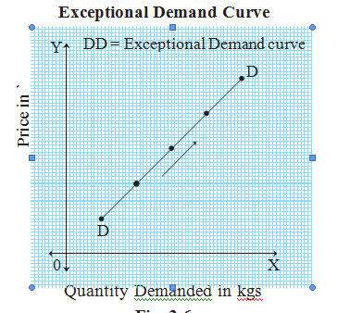
Exceptions to the Law of Demand
There are certain exceptions to the law of demand. It means that under exceptional circumstances, consumer buys more when the price of commodity rises and buys less when price of commodity falls. In such cases, demand curve slopes upwards from left to right. i.e. the demand curve has a positive slope as shown in

Slide 42
Following are the exceptions to the law of demand
Giffen's paradox : Inferior goods or low quality goods are those goods whose demand does not rise even if their price falls. Demand decreases when the price of such commodities fall.
Sir Robert Giffen observed this behaviour in England in relation to bread. He noted that, when the price of bread declined, people did not buy more because of an increase in their real income or purchasing power. They preferred to buy superior good like meat. This is known as Giffen's paradox.

Slide 43
Giffen's paradox
Prestige goods : Expensive goods like diamond, gold etc. are status symbol. So rich people buy more of it, even when their prices are high.
Speculation : The law of demand does not hold true when people expect prices to rise still further. In this case, although the prices have risen today, consumers will demand more in anticipation of further rise in price. For example, prices of oil, sugar etc. tend to rise before Diwali. So people go on purchasing more at a high price as they anticipate that prices may rise during Diwali.

Slide 44
Giffen's paradox
Price illusion : Consumers have an illusion that high priced goods are of a better quality. Therefore, the demand for such goods tend to increase with a rise in their prices. For example, branded products which are expensive are demanded even at a high price.
Habitual goods : Due to habit of consumption, certain goods like cigarrate / tobacco a is purchased in required quantities even at a higher price.

Slide 45
Elasticity of Demand
The term elasticity indicates responsiveness of one variable to a change in the other variable.
Elasticity of demand refers to the degree of responsiveness of quanitity demanded to a change in its price or any other factor.

Slide 46
Elasticity of Demand
According to Prof. Marshall, “Elasticity of demand is great or small according to the amount demanded which rises much or little for a given fall in price and quantity demanded falls much or little for a given rise in price.”
it is the ratio of percentage change in quantity demanded of a commodity to a percentage change in price.

Slide 47
Types of Elasticity of Demand
Income elasticity
Cross elasticity
Price elasticity

Slide 48
Income elasticity
It refers to the degree of responsiveness of a change in quantity demanded to a change in the income only, other factors including price remain unchanged. It is expressed as :
Percentage change in Qty. Demanded
Percentage change in Income
Ey =
% △Q
% △Y
=

Slide 49
Income elasticity
Where,
△ = Represents change
Q = Orignal demand
Y = Original income
△Q = Change in quantity demanded
△Y = Change in income of a consumer

Slide 50
Income elasticity
Positive income elasticity
Normal goods for which demand increases with increase in income.
Negative income elasticity
Inferior or goods for which demand decreases with increase in income of consumer.
Zero income elasticity
Necessary goods for which demand remains constant with increase in income of the consumer.

Slide 51
Cross elasticity
It refers to a change in quantity demanded of one commodity due to a change in the price of other commodity. (Complementary goods or substitutes)
Percentage change in Qty. demanded of A
Percentage change in Price of B
(A = Original commodity, B = Other commodity)
Ec=

Slide 52
Cross elasticity
Ec = % △Q_{A}
% △P_{B}
Q_{A} = Original quantity demanded of commodity A
△Q_{A} = Change in quantity demanded of commodity A
P_{B} = Original price of commodity B
△P_{B} = Change in price of commodity B

Slide 53
Remarks
Positive cross elasticity : Substitute goods. Example, tea and coffee.
Negative cross elasticity : Complementary goods. Example, tea and sugar.
Zero cross elasticity : Non-related goods. Example, tea and books.

Slide 54
Price elasticity
According to Prof. Alfred Marshall, price elasticity of demand is a ratio of proportionate change in the quantity demanded of a commodity to a given proportionate change in its price.
Percentage change in Quantity Demanded
Percentage change in Price
E_{d} =

Slide 55
Price elasticity
% △ Q
% △ P
Where,
Q = Original quantity demanded
△Q = Difference between the new quantity and original quantity demanded
P = Original price
△P = Difference between new price and original price
E_{d}=

Slide 57
Types of Price Elasticity of Demand
Perfectly Elastic Demand (Ed = infinite)
When a slight or zero change in the price brings about an infinite change in the quantity demanded of that commodity, it is called perfectly elastic demand. It is only a theoretical concept. For example, 10% fall in price may lead to an infinite rise in demand.
Percentage Change in Quantity Demanded
Percentage change in Price
E _{d} =

Slide 58
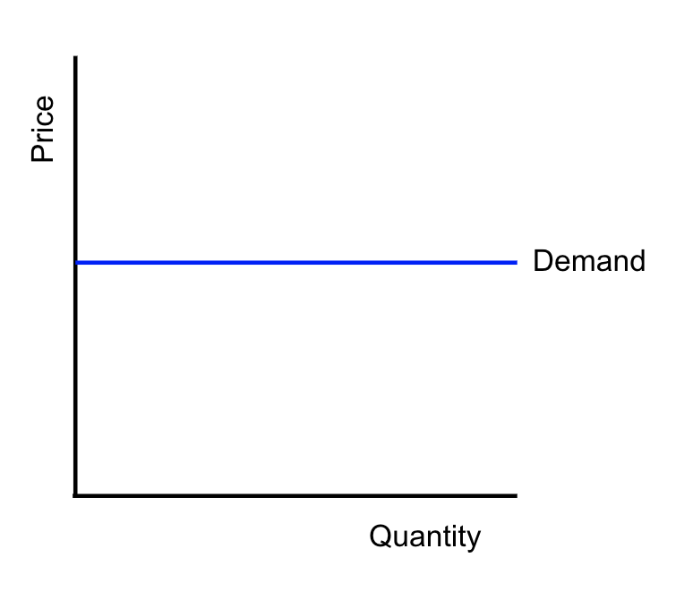
Perfectly Elastic Demand
In figure the demand curve is a horizontal line parallel to the X axis indicating
perfectly elastic demand.

Slide 59
Example: Bottled Water at a Music Festival
Imagine you are a vendor selling bottled water at a music festival. The weather is scorching hot, and people are thirsty. You have a cooler full of bottled water with a sign that says: "Bottled Water - $1 each."
In this scenario, the demand for bottled water may be perfectly elastic under the following conditions:
Numerous Competitors: There are several other vendors selling bottled water at the same price of $1 each.
Identical Products: All vendors are offering the same brand and size of bottled water, so there is no differentiation.
Low Cost: The price of bottled water is relatively low, so consumers are not concerned about the price at all.

Slide 60
Bottled Water at a Music Festival....
If the demand for bottled water at the festival is perfectly elastic, it means that consumers are willing to buy an unlimited amount of bottled water at $1 each. However, if any vendor tries to raise the price slightly above $1, consumers will immediately switch to buying from other vendors, and no one will buy from the vendor charging a higher price.
Again, it's important to note that this is an extreme theoretical example, and in the real world, demand for most goods and services is not perfectly elastic. In practical scenarios, the demand curve typically slopes downward, indicating that higher prices lead to lower demand, and lower prices lead to higher demand.

Slide 61
Perfectly inelastic demand (Ed = 0)
When a percentage change in price has no effect on the quantity demanded of a commodity it is called perfectly inelastic demand. For example, 20% fall in price will have no effect on quantity demanded.
Ed = % △ Q
% △ P
0
20
Ed = 0
Eg: Remdesivir, Petrol

Slide 62
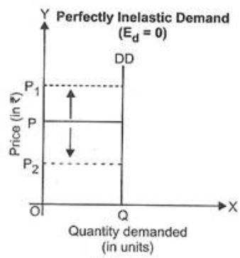
Perfectly inelastic demand (Ed = 0)
In practice, such a situation rarely occurs. For example, demand for salt, milk.

Slide 63
Example : Lifesaving drug
Imagine a life-saving medication that is vital for patients suffering from a severe medical condition. This medication is highly specialized and has no close substitutes in the market. Additionally, the patients who need this medication have no choice but to buy it, regardless of its price.
In this scenario, the demand for this life-saving medication may be perfectly inelastic under the following conditions:
No Substitutes: The medication has no alternative or substitute that can provide the same life-saving benefits.
Necessity: The medication is essential for patients' survival or well-being, leaving them with no option but to purchase it.
No Time to Adjust: In some cases, patients might not have enough time to explore other options due to the urgency of their medical condition.

Slide 64
Example : Lifesaving drug
If the demand for this life-saving medication is perfectly inelastic, it means that consumers will continue to buy the same quantity of the medication, even if its price increases significantly. The price increase will not affect the quantity demanded because patients are willing to pay any amount to obtain the medication they need to survive or improve their health.
Again, it's crucial to emphasize that perfectly inelastic demand is a theoretical concept and does not often occur in real-world markets. In practical scenarios, the demand for most goods and services is influenced to some extent by changes in price.

Slide 65
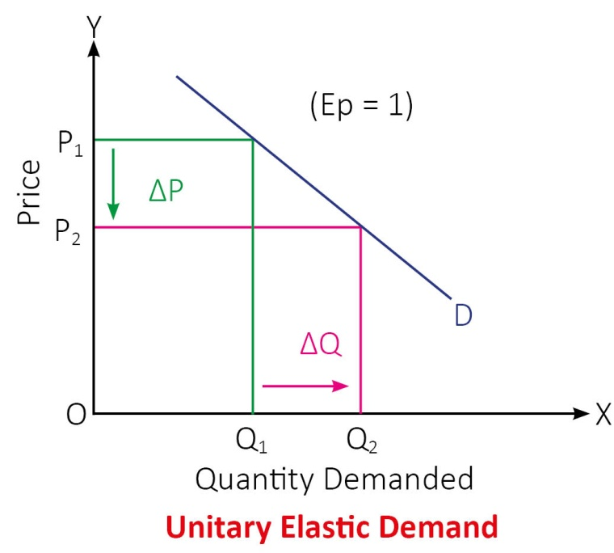
Unitary elastic demand (Ed = 1)
When a percentage change in price leads to a proportionate change in quantity demanded then demand is said to be unitary elastic. For example, 50% fall in price of a commodity leads to 50% rise in quantity demanded.
% △ Q
% △ P
_{Ed =}

Slide 66
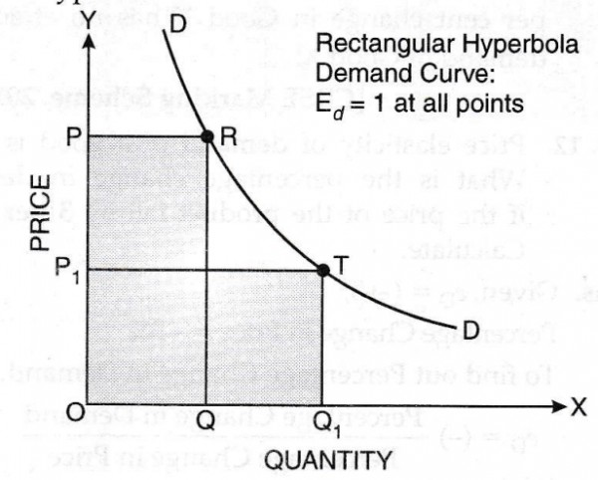

Slide 67
Unitary elastic demand
it's essential to keep in mind that finding a perfectly unitary elastic demand is rare in practice. Most products have different degrees of elasticity depending on various factors such as availability of substitutes, brand loyalty, and consumer behavior.

Slide 68
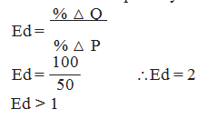
Relatively elastic demand (Ed >1)
When a percentage change in price leads to more than proportionate change in quantity demanded, the demand is said to be relatively elastic. For example, 50% fall in price leads to 100% rise in quantity demanded.
For example, if the price of a product increases by 20% and the demand of the product
decreases by 25%, then the demand would be relatively elastic

Slide 69
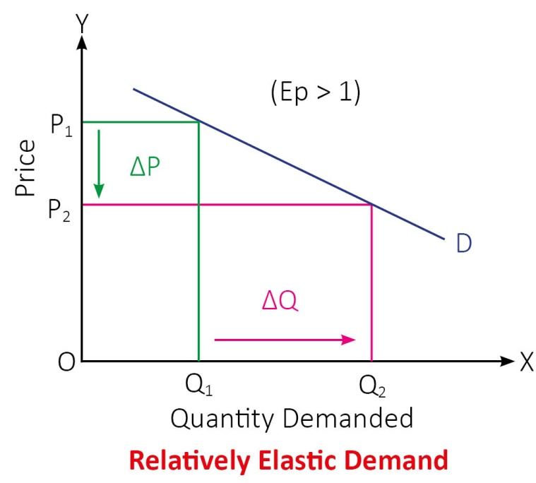
Relatively elastic demand (Ed >1)
In figure, when price falls from OP1 to OP2 (50%), demand rises from OQ to OQ₁ (100%).
Therefore, the demand curve has a flatter slope.

Slide 70
Example
For example, air-travel for vacationers is very sensitive to price. An increase in the air fare will lead the vacationer to choose another mode of transportation like car or lead him to postpone the vacation plan for the time being. Thus for a rise in airlines fare for the vacationers we would see a relatively more drastic reduction in demand towards air travel and hence its the situation of high price elasticity of demand.

Slide 71
Relatively elastic demand (Ed >1)
Coffee is a good example of a product with relatively elastic demand. Suppose the price of coffee increases by 10%, and as a result, the quantity demanded decreases by 20%. In this case, the price elasticity of demand would be greater than 1, indicating relatively elastic demand.
Elasticity of demand can vary based on market conditions, availability of substitutes, brand loyalty, and consumer preferences. The example provided above is for illustrative purposes

Slide 72
Relatively inelastic demand (Ed < 1) :
Where quantity demanded does not change much with respect to change in price of goods.

Slide 73
Relatively inelastic demand (Ed < 1) :
When a percentage change in price leads to less than proportionate change in the quantity demanded, demand is said to be relatively inelastic. For example, 50% fall in price leads to 25% rise in quantity demanded.

Slide 74
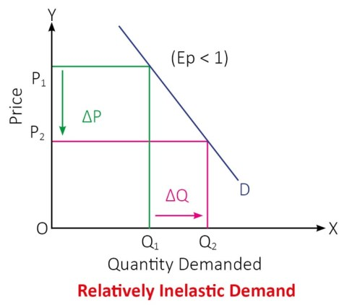
Relatively inelastic demand (Ed < 1) :
when price falls from OP 1to OP₂ (50%), demand rises from OQ1 to OQ₂ (25%).
Therefore, the demand curve has a steeper slope.

Slide 75
Example
Necessary goods like salt and sugar. It is difficult to give up consumption of such goods when their prices go high as they are necessities.
Low priced goods, consumption of which doesn’t affect the budget of individuals like pencils, combs, needles, matchboxes etc would also have a comparatively inelastic demand as people won’t care much about the price changes of such low ticket items.

Slide 76
Factors influencing the elasticity of demand
Availability of Substitutes: If there are many substitutes available for a product or service, consumers can easily switch to alternatives if the price changes. In such cases, demand tends to be more elastic because consumers are sensitive to price changes and can readily switch to other options.
Soft drinks. If the price of a particular brand of soda increases significantly, consumers can easily switch to other brands or non-carbonated beverages, making the demand for that brand relatively elastic

Slide 77
Factors influencing the elasticity of demand
Necessity vs. Luxury: Products or services that are considered necessities (Salt) tend to have inelastic demand because consumers must buy them regardless of price changes. On the other hand, luxury items, which are not essential for survival, often have more elastic demand as consumers can delay or avoid purchasing them if prices increase.

Slide 78
Factors influencing the elasticity of demand
Proportion of Income Spent: Products or services that consume a significant portion of consumers' income tend to have more elastic demand.
If the price of a high-end smartphone increases, consumers with lower incomes may switch to more affordable models or delay their purchase altogether.

Slide 79
Factors influencing the elasticity of demand
Time Horizon: In the short run, demand for certain goods may be inelastic because consumers need time to adjust their consumption patterns or find alternatives. However, in the long run, demand may become more elastic as consumers can make more substantial adjustments to their behavior.
In the short term, demand for petrol might be relatively inelastic as people need to fuel their cars. However, over time, consumers may start using more fuel-efficient vehicles or explore alternative transportation options.

Slide 80
Factors influencing the elasticity of demand
Brand Loyalty: Products or services with strong brand loyalty often exhibit inelastic demand. Consumers who are loyal to a specific brand may be less sensitive to price changes and continue purchasing the product regardless of its cost.
Apple iPhones. Some consumers are highly loyal to the Apple brand and may be willing to pay a premium for iPhones, even if there are cheaper alternatives with similar features.

Slide 81
Factors influencing the elasticity of demand
Perceived Necessity: If a product is perceived as indispensable or essential for a specific purpose, its demand tends to be less elastic. For instance, life-saving medications or critical medical treatments are perceived as necessary, leading to less price sensitivity.

Slide 82
Factors influencing the elasticity of demand
Durability: Durable goods, such as appliances or electronic devices, often have more elastic demand. Consumers may choose to delay their purchase or look for better deals when the price changes.Demand for perishable goods is inelastic. For example, milk,
Understanding the factors that influence the elasticity of demand is crucial for businesses and policymakers as it helps predict how changes in price will affect total revenue and consumer behavior. Elasticity also plays a significant role in pricing strategies, taxation policies, and market analysis.

Slide 83
Factors influencing the elasticity of demand
Income of the consumer : Demand for goods is usually inelastic, if the consumer has high income. The demand pattern of a very rich and an extremely poor person is rarely affected by significant changes in the price.

Slide 84
Methods of Measuring Price Elasticity of Demand
Percentage method
Total outlay method
Arc method

Slide 85
Percentage Method- Price Elasticity Demand
Price elasticity is calculated in terms of the rate of the percentage change in the quantity to the percentage change in price.
The price elasticity of demand can, according to this approach, be mathematically expressed as -

Slide 86
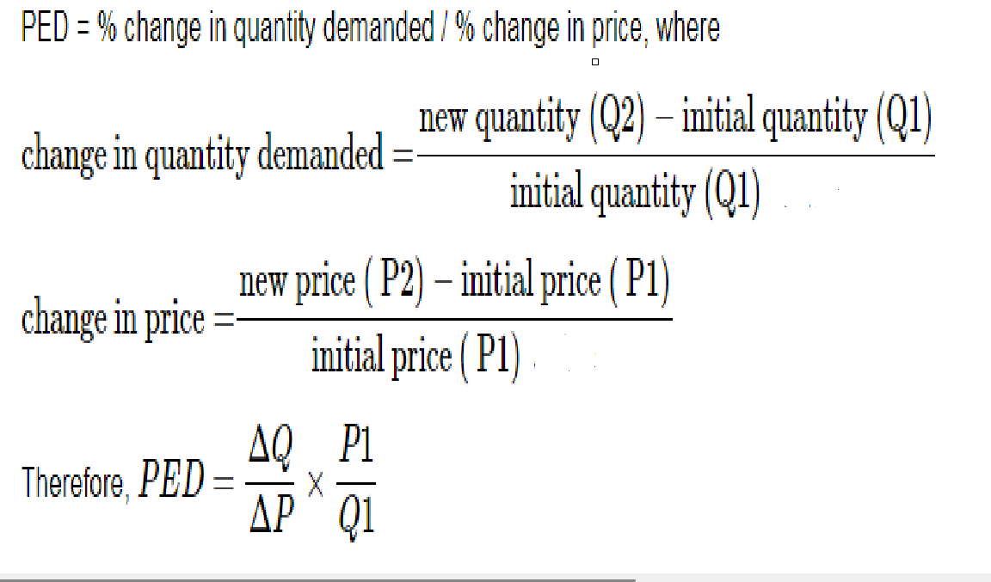
Percentage Method- Price Elasticity Demand

Slide 87
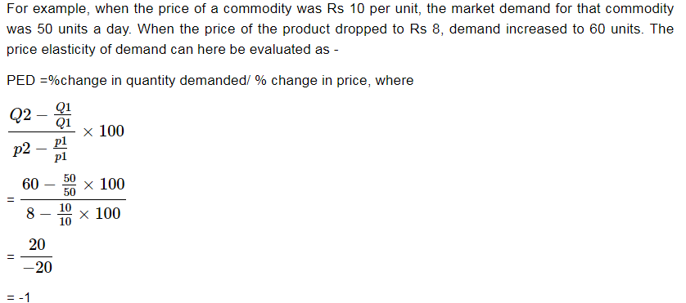
Percentage Method- Price Elasticity Demand

Slide 88
Percentage Method- Price Elasticity Demand
Demand price elasticity is often a negative number since the quantity requested and the price are inversely related. This implies that the higher the price, the lower the demand, and the lower the price, the greater the product demand.

Slide 89
Total Expenditure Method
Dr. Marshall has evolved the total expenditure method to measure the price elasticity of demand.
Elasticity of demand can be measured by considering the change in price and the subsequent change in the total quantity of goods purchased and the total amount of money spent on it

Slide 90
Total Expenditure Method
Total Outlay = Price X Quantity Demanded

Slide 91
Total Expenditure Method
Identify Initial Price and Quantity: Start with an initial price and corresponding quantity demanded.
Calculate Initial Total Expenditure: Multiply the initial price by the initial quantity to calculate the initial total expenditure (TE1 = Price × Quantity).
Change Price: Adjust the price by a certain percentage (increase or decrease).
Determine New Quantity Demanded: Determine the new quantity demanded at the adjusted price.

Slide 92
Total Expenditure Method
Calculate New Total Expenditure: Multiply the adjusted price by the new quantity to calculate the new total expenditure (TE2 = Adjusted Price × New Quantity).
Analyze the Change in Total Expenditure: Compare the initial total expenditure (TE1) with the new total expenditure (TE2). Depending on whether total expenditure increases, decreases, or remains unchanged, you can infer the elasticity of demand.
If TE2 > TE1: Total expenditure increased. Demand is elastic (price change leads to proportionally larger change in quantity demanded).
If TE2 < TE1: Total expenditure decreased. Demand is inelastic (price change leads to proportionally smaller change in quantity demanded).
If TE2 = TE1: Total expenditure remains unchanged. Demand is unit elastic (percentage change in price leads to an equal percentage change in quantity demanded).

Slide 93
Total Expenditure Method
Initial Price: $10 Initial Quantity: 100 units Initial Total Expenditure (TE1): $10 × 100 = $1000
Change Price: Increase by 10% Adjusted Price: $11 New Quantity Demanded: 90 units (due to price increase) New Total Expenditure (TE2): $11 × 90 = $990
Since TE2 < TE1, the demand is inelastic. The decrease in quantity demanded (10 units) due to the price increase was proportionally smaller than the increase in price (10%).

Slide 94
Revenue Method
Mrs. Joan Robinson has given this method and elasticity of demand is measured with the help of average revenue and marginal revenue.
When total revenue is divided by the number of units sold, we get average revenue.
when addition is made to the total revenue by the sale of one more unit of the commodity is called marginal revenue. Therefore, the formula to measure elasticity of demand can be written as
Ed = AR/(AR-MR)
Where Ed represents elasticity of demand, AR = average revenue and MR = marginal revenue.

Slide 95
Revenue Method
By selling 10 oranges a person gets Rs. 50 than Rs. 50 will be his total revenue and Rs. 50/ 10 will be his Average Revenue AR i.e. Rs. 5 per orange.
Suppose, if he sold one more orange and his total revenue increased to 54, than his extra revenue from one extra unit will be his marginal revenue (MR) i.e Rs. 4.
Ed = AR/(AR-MR)
Ed = 5/(5-4) = greater than 1)

Slide 96
Arc Elasticity Method
Arc elasticity of demand measures elasticity between two points on a curve.
“When elasticity is computed between two separate points on a demand curve, the concept is called Arc elasticity”
Leftwitch

Slide 97
Arc Elasticity Method
The point method of measurement of price elasticity of demand is not accurate as we cannot get the information on very small changes in price and quantity demanded in the market.
Thus, in the case of a large change in price and quantity the point method is not suitable to measure the price elasticity. To avoid these defects, the arc method of measurement of price elasticity of demand is taken as an alternative method to calculate price elasticity

Slide 98
Arc Elasticity Method
ARC refers to the section or portion of a demand curve between two points.
The arc method considers the average value of the initial and final values of price and quantities to measure the elasticity coefficient.
Thus, if is also known as the Average Elasticity Method or Mid-Point Method. To calculate price elasticity first we take the mid-point or average of prices and quantities as
Average or Mid point of Price = P = (P1+P2)/2
Average or Mid point of Quantity = Q = (Q1+Q2)/2

Slide 99
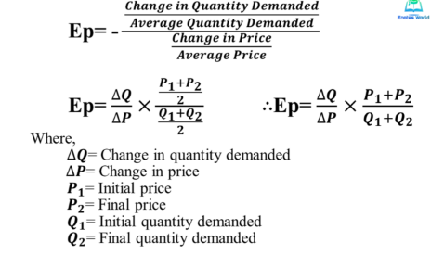

Slide 100
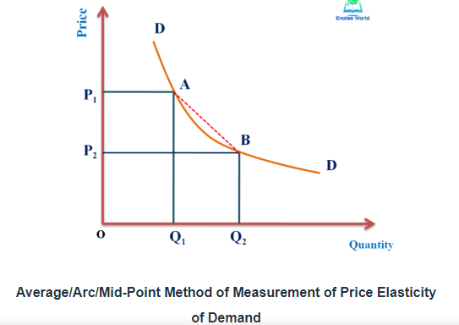

Slide 101
Arc Elasticity Method
In figure DD is the demand curve and based on the change in price and quantify, ep is calculated and which has the same value from A to B or from B to A because we take the average values while calculating the coefficient of elasticity. Thus, under such a method, the movement from A to B or movement from to A gives the same value of ep.
When the elasticity has to measure over some range or arc along a demand curve rather than at a particular point, the point elasticity does not provide the true and correct magnitude of price elasticity of demand.

Slide 102
Arc Elasticity Method
So, we have to use the arc method to measure the price elasticity of demand when the change in price and quantity is larger. Arc method is more suitable to use because of its technique.
In the case of the non-linear demand curve, the use of the arc method is more suitable. We have to keep in our mind that the arc elasticity measure takes into account the midpoint of the chord that connects the two points on the demand curve

Slide 103
Example
Suppose price of Chocolate is Rs. 4.00 per piece per Chocolate and its demand is of 1 Chocolate only. If the price falls to Rs. 2.00 per piece per Chocolate and its demand extend to 4 Chocolates, then,

Slide 104
Example
suppose the price of a smartphone decreases from Rs 500 to Rs. 400, and as a result, the quantity demanded increases from 1,000 units to 1,200 units. Calculate Arc Elasticity.

Slide 105
Example
Initial Price (P1): $500
Final Price (P2): $400
Initial Quantity Demanded (Q1): 1,000 units
Final Quantity Demanded (Q2): 1,200 units
Average Price (P): (P1 + P2) / 2 = ($500 + $400) / 2 = $450
Average Quantity Demanded (Q): (Q1 + Q2) / 2 = (1,000 + 1,200) / 2 = 1,100 units

Slide 106
Example
ΔQ = Q2 - Q1 = 1,200 - 1,000 = 200 units ΔP = P2 - P1 = $400 - $500 = -$100
Arc Elasticity = (ΔQ / Q) / (ΔP / P) Arc Elasticity = (200 / 1100) / (-100 / 450) Arc Elasticity ≈ -0.3636
In this example, the arc elasticity of demand is approximately -0.3636. The negative sign indicates that the product is elastic, meaning that a decrease in price led to a proportionally larger increase in quantity demanded

Slide 107
Application of Price Elasticity of Demand in Business Decision

Slide 108
Price Determination
A businessman has to consider the elasticity of demand of that product. He should consider whether a lowering of price will stimulate demand for his product, and if so to what extent and whether his profits will also increase a result thereof.
If the increase in his sales is more than proportionate, to the reduction in price, his total revenue will increase and his profits might be larger.
On the other hand, if increase in demand is less than proportionate to fall in price, his total revenue will fall and his profits would be certainly less.

Slide 109
Price Determination
Therefore, knowledge of elasticity of demand may help the businessman to make a decision whether to cut or increase the price of his product or to shift the burden of any additional cost of production on to the consumers by charging high price.
Note: In imperfect competition, for items having inelastic demand, the producer will fix a higher price and items whose demand is elastic the businessman will fix a lower price

Slide 110
Pricing of factors of production
The concept of elasticity of demand is useful in the determination of price of factors of production."If the demand for factors of production are more inelastic, the producers are prepare to pay more price for these factors.
Likewise, if the demand for the factors of production is more elastic, the producers are prepared to pay fewer prices for the factors.
For example, if the demand for labour in an industry is inelastic, the labour unions can easily increase wages. But if demand is elastic, the wages cannot be raised too much.

Slide 111
Pricing of joint products
Some goods are produced jointly due to some reasons such as sugar and ethanol production in a sugar industry. It is difficult to separate the cost of production of these two goods.
This makes it difficult to determine the price on the basis of cost. In such a situation, the price is determined on the basis of the elasticity of demand of these two products i.e high price is set up for the good having inelastic demand and low price for the good having elastic demand.

Slide 112
Price discrimination
Price discrimination refers to the act of selling the technically same products at different prices to different section of consumers or in different in sub-markets.
The policy of price discrimination is profitable to the monopolist when elasticity of demand for his product is different in different sub-markets.
Those consumers whose demand is inelastic can be charged a higher price than those with more elastic demand

Slide 113
Taxation and subsidy policy
The government can impose higher taxes and collect more revenue if the demand for the commodity on which a tax is to be levied is inelastic.
On the other hand, in ease of a commodity with elastic demand high tax rates may fail to bring in the required revenue for the government.
Government should provide subsidy on those goods whose demand is elastic and in the production of the commodity the law of increasing returns operates.

Slide 114
Designing of Marketing policies and strategies
Super Markets is a market where in a variety of goods are sold by a single organization. These items are generally of mass consumption.
Therefore, the organization is supposed to sell commodities at lower prices than charged by shopkeepers in the other bazars.
Thus, the policy adopted is to charge a slightly lower price for items whose demand is relatively elastic and the costs are covered by increased sales.

Slide 115
Designing of Marketing policies and strategies
Similarly the levels of price elasticity of demand can also be used as a basis of market segment and then devising marketing mix for each segment according separately. For example, most of the airlines find that business travellers have relatively price inelastic demand, while tourist have hire price elastic demand.

Slide 116
Designing of Marketing policies and strategies
Airlines take advantage of these differences by offering a stable and high price to business travellers with additional facilities like incentives for total business volume and better service. In contrast they offer low prices to tourists who are able to plan their holidays well in advance. Also there is a third segment comprising of customers ready to travel on holidays at very short notice provided they are offered very low prices. This third segment is used to fill up seats in air crafts which remain unsold to the other two segments till very close to the flight time. This enables airlines to get some revenue, against spare capacity, which would have otherwise been totally wasted.

Slide 117
Effect of use of machines on employment
Ordinarily it is thought that use of machines reduced the demand for labour. Therefore, trade unions often oppose the use of machines fearing unemployment. But this fear is not always true because use of machines may not reduce demand for labour. It depends on the price elasticity of demand for the products.

Slide 118
Effect of use of machines on employment
The use of machines may reduce the cost of production and price. If the demand of the product is elastic then the fall in price will increase demand significantly. As a result of increased demand the production will also increase and more workers will be employed. In such cases concept of elasticity of demand help the management to pacify the trade unions. However, if the demand of the product is inelastic then use of more machines will cause unemployment.

Slide 119
Public utilities
Demand for public utilities such as electricity, water supply, post and telegraph, public transportation etc. is generally inelastic in nature. If the operation of such utilities is left in the hand of private individuals, they may exploit the consumers by charging high prices.
Therefore, in the interest of general public, the government owns and runs such services. The public utility enterprises decide their price policy on the basis of elasticity of demand. A suitable price policy for public utility enterprises is to charge from consumers according to their elasticity of demand for public utility.

Slide 120
Output decisions
The elasticity of demand helps the businessman to decide about production. A businessman chooses the optimum product- mix on the basis of elasticity of demand for various products. The products having more elastic demand are preferred by the businessmen. The sale of such products can be increased with a little reduction in their prices.

Slide 121
Forecast:
A prediction, projection, or estimate of some future activity, event, or occurrence

Slide 122
Demand Forecasting
An estimation of future demand or sales of a commodity on the basis of an analysis of the past data about the demand or sales of the same.
It depicts both the price of the product as well as its expected amount of Demand or sales.
It is an estimation of future demand for a specific period based upon the statistical analysis of the past data.

Slide 123
Definition
“The company sales forecast is the expected level of
company sale based on a chosen marketing plan and
assumed environmental conditions.”
Philip Kotler

Slide 124
Characteristics of Demand Forecasting
1. Demand Forecasting is the foundation of planning
2. It is an estimate of future sales
3. It is made on the basis of past data and the present conditions prevailing the market
4. Demand Forecast can be in monetary terms or physical terms or in both.
5. Demand Forecast are for a define time or a period time
6. Demand Forecast is based upon two things (i) Marketing plan (ii) The economic and other factors (these factors are competition, tastes of the consumers, the substitutes and their prices etc.)

Slide 125
Essentials of Good Forecasting System:
Accuracy
Simplicity
Practicability
Availability
Economy
Stability
Flexibility

Slide 126
Demand Forecasting
Need of Demand Forecasting
Demand forecasting is predicting future demand for a product. The information regarding future demand is essential for planning and scheduling production, purchase of raw materials, acquisition of finance and advertising.
It is much more important where a large-scale production is being planned and production involves a long gestation period.
The information regarding future demand is essential also for the existing firms for avoiding under or over-production.

Slide 127
Types of Demand Forecasting
Short run Forecasting
The forecasts that are made for a period ranging between a week and an year are called as short-run forecasts. The objectives of such forecasts are as under:
1.Formulation of suitable Production Policy
2.Regular Supply of Raw material
3.Best utilization of Machine Capacity
4.Determination of Appropriate Price Policy
5.Regular Supply of Labour
6.Setting sales targets and establishing control and Incentives
7.Forecasting Short run financial needs

Slide 128
Long-term Forecasting
The prediction made for a period of more than one year for the purpose of long term planning of business activities of a firm are termed as long term forecasting. There objectives are as under:
1. Plant Capacity Planning
2. Man Power Planning
3. Long run Production Planning
4. Financial Planning

Slide 129
TYPES OF FORECASTING METHODS
Qualitative Methods: These types of forecasting methods are based on judgments, opinions, intuition, emotions, or personal experiences and are subjective in nature. They do not rely on any rigorous mathematical computations.
Quantitative Methods: These types of forecasting methods are based on mathematical (quantitative) models, and are objective in nature. They rely heavily on mathematical computations.

Slide 130
TECHNIQUES OF FORECASTING DEMAND

Slide 131
Survey Method
Survey method are generally used where purpose is to make short run forecast of demand. Under this method, surveys are conducted to collect information about consumer’s intentions and their future purchase-plans. This method includes :
survey of potential consumers to elicit information on their intentions and plan;
opinion polling of experts, i.e., opinion survey of market experts and sales representative, and through market studies and experiments.

Slide 132
Survey Method..
The following techniques are used to conduct the survey of consumers and experts.
Consumer Survey Methods :
The consumer survey method of demand forecasting involves direct interview of the potential consumers. It may be in the form of:
Complete enumeration, or
Sample survey.
These consumer survey methods are used under different conditions and for different purposes.

Slide 133
Direct Interview Method
The most direct and simple way of assessing future demand for a product is to interview the potential consumers or users and to ask them what quantity of the product they would be willing to buy at different prices over a given period say, one year.
This method is known as direct interview method.
This method may, cover almost all the potential consumers or only selected groups of consumers from different cities or parts of the area of consumer concentration. When all the consumers are interviewed, the method is known as complete enumeration survey method, and when only a few selected representative consumers are interviewed, it is known as sample survey method.

Slide 134
Expert-Opinion Method
In this method, the executive uses his own anticipation and what he hears from others. Outside experts are also consulted and the other executive heads are also required to give their opinion in the matter.
Salesmen are to provide information about customer’s attitude and preferences and the activities of competitors. Thus all possible information from the opinions of various persons is combined together to change the subjective opinions into quantitative forecasts.

Slide 135
Expert-Opinion Method
No doubt experts and experienced managers can be useful as guides and serve as reliable source of information, but one has to make his own decision from all the opinions.
Thus in this method broad guess is made by the executive in charge of a business. There are many advantages and disadvantages of opinion technique of forecasting :

Slide 136
Advantages
(i) Simple and easy to understand.
(ii) No specialised skill is required.
(iii) Low cost.
(iv) It is based on the information or opinion of the persons who are directly involved in the system.
(v) It can be used in case of new products where satisfactory data is not available

Slide 137
Disadvantages
(i) Opinions and intuitions are highly subjective.
(ii) Personal estimates are likely to be biased.
(iii) Time required to take the decision may be more.

Slide 138
Delphi Method
A group decision-making technique of forecasting demand. In this method, questions are individually asked from a group of experts to obtain their opinions on demand for products in future. These questions are repeatedly asked until a consensus is obtained.
In addition, in this method, each expert is provided information regarding the estimates made by other experts in the group, so that he/she can revise his/her estimates with respect to others’ estimates. In this way, the forecasts are cross checked among experts to reach more accurate decision making.

Slide 139
Delphi Method
Ever expert is allowed to react or provide suggestions on others’ estimates. However, the names of experts are kept anonymous while exchanging estimates among experts to facilitate fair judgment and reduce halo effect.

Slide 140
Delphi Method
The main advantage of this method is that it is time and cost effective as a number of experts are approached in a short time without spending on other resources. However, this method may lead to subjective decision making.

Slide 141
Market Studies and Experiments
Under this method, firms first select some areas of the representative markets - three or four cities having similar features, viz., population, income levels, cultural and social background, occupational distribution, choices and preferences of consumers.
Then, they carry out market experiments by changing prices, advertisement expenditure, and other controllable variables in the demand function under the assumption that other things remain the same.

Slide 142
Market Studies and Experiments
The controlled variables may be changed over time either simultaneously in all the markets or in the selected markets. After such changes are introduced in the market, the consequent changes in the demand over a period of time (a week, a fortnight, or month) are recorded.
On the basis of data collected, elasticity coefficients are computed. These coefficients are then used along, with the variables of demand function to assess the demand for the product.

Slide 143
Market Studies and Experiments
Alternatively, market experiments can be replaced by consumer clinic or controlled laboratory experiment. Under this method, consumers are given some money to buy in a stipulated store goods with varying prices, packages, displays, etc.
The experiment reveals the consumers responsiveness to the changes made in prices, packages and displays, etc. Thus, the laboratory experiments also yield the same information as the field market experiments. But the former has an advantage over the latter because of greater control over extraneous factors and its somewhat lower cost.

Slide 144
Statistical Methods
The statistical method is one of the important methods of demand forecasting. Statistical methods are scientific, reliable and free from biases. The major statistical methods used for demand forecasting are:
Regression
Trend Projection Method/Time Series
Moving Average

Slide 145
Trend Projection Method
This method is useful where the organization has a sufficient amount of accumulated past data of the sales. This date is arranged chronologically to obtain a time series. Thus, the time series depicts the past trend and on the basis of it, the future market trend can be predicted. It is assumed that the past trend will continue in the future. Thus, on the basis of the predicted future trend, the demand for a product or service is forecasted.

Slide 146
Regression Analysis
This method establishes a relationship between the dependent variable and the independent variables. In our case, the quantity demanded is the dependent variable and income, the price of goods, the price of related goods, the price of substitute goods, etc. are independent variables. The regression equation is derived assuming the relationship to be linear. Regression Equation: Y = a + bX. Where Y is the forecasted demand for a product or service.

