Slide 1
Business Economics UNIT III Production and Cost Analysis
Course Code: F010101T

Slide 2
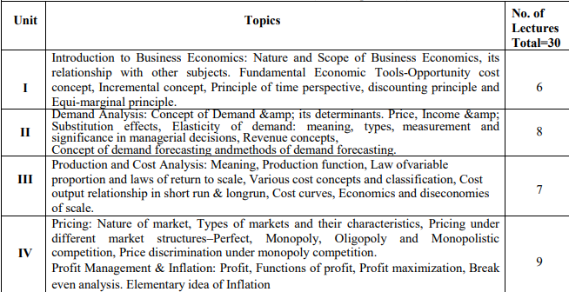

Slide 3
Production Function
A production function is a fundamental concept in economics that represents the relationship between inputs (factors of production) and outputs (goods and services) in the process of producing goods and services. It provides a mathematical or graphical representation of how different combinations of inputs lead to different levels of output.

Slide 4
Production Function
Q = f(L, K, M, ...)
Where:
Q represents the quantity of output produced.
L stands for labor input.
K represents capital input (physical capital such as machinery, equipment, etc.).
M could represent other inputs such as materials, technology, or land.
... indicates that there can be more inputs.

Slide 5
Production Function
The production function shows how varying the quantities of inputs affects the resulting output. It helps economists and businesses analyze how factors like labor, capital, and technology contribute to production and how changes in these factors influence overall output levels.

Slide 6
Production Function
There are several key concepts related to production functions:
Total Product (TP): This refers to the total quantity of output that is produced from a given combination of inputs.
Marginal Product (MP): The marginal product of a specific input is the additional output produced by adding one more unit of that input while keeping other inputs constant.
Average Product (AP): The average product of a specific input is the total output divided by the quantity of that input.

Slide 7
Production Function
Production functions are used in various economic analyses, such as determining the optimal combination of inputs to maximize output or analyzing the effects of technological advancements on production processes.

Slide 8
Law of variable proportion
known as the Law of Diminishing Return
That describes the relationship between the variable inputs (such as labor or raw materials) and the output of a production process.
It explains how changes in the proportion of one input while keeping other inputs constant can affect the overall production.

Slide 9
Law of variable proportion
The Law of variable proportion states that when only one production element is allowed to increase keeping all other elements constant, the production firstly increases, then the output will decrease and finally there will be a negative production.

Slide 10
Law of variable proportion
The law states that as more units of a variable input are added to a fixed quantity of other inputs (like capital and land), there comes a point where the marginal product of the variable input starts to decrease. In simpler terms, initially, increasing the variable input leads to a more than proportional increase in output, but eventually, the additional input leads to smaller and smaller increases in output or even negative effects on output.

Slide 11
Assumptions
Constant state of Technology: It is assumed that the state of technology will be constant and with improvements in the technology, the production will improve.
Variable Factor Proportions: This assumes that factors of production are variable. The law is not valid, if factors of production are fixed.
Homogeneous factor units: This assumes that all the units produced are identical in quality, quantity and price. In other words, the units are homogeneous in nature.
Short Run: This assumes that this law is applicable for those systems that are operating for a short term, where it is not possible to alter all factor inputs.

Slide 12
Example
Imagine a fixed plot of land (the fixed input) and labor as the variable input. Initially, adding more laborers to work on the land could lead to increased productivity. However, as the number of laborers increases further, they might start getting in each other's way, causing inefficiencies, and the additional output gained from each new laborer might decrease. Eventually, adding even more laborers could lead to a situation where the land becomes overcrowded, resulting in a decline in overall output.

Slide 13
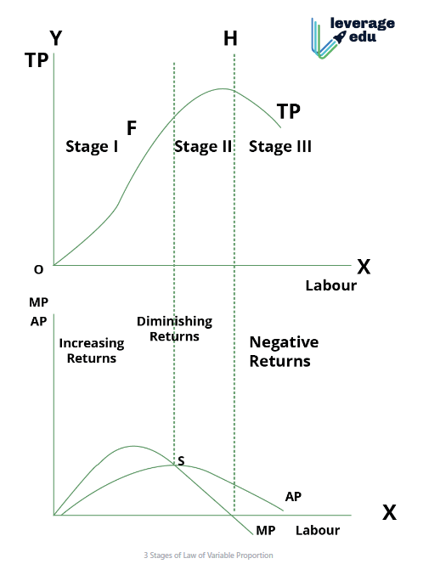
Notes:
Law of Variable Proportion: Meaning, Assumptions, Phases and Reasons for Variable Proportions - GeeksforGeeks

Slide 14
COST OF PRODUCTION
The total cost incurred by a business to produce a specific quantity of a product or offer a service.
The expenditures incurred to obtain the factors of production such as labor, land, and capital, that are needed in the production process of a product.

Slide 15
Type of Cost

Slide 16
Explicit Cost
Explicit Costs refer to the actual expenditures of the firm to hire, rent or purchase the input it requires in production.
These include the wages to hire labour, the rental price of capital, equipment and buildings and the purchase prices of raw materials etc.
These are the recorded expenditure during the process of production.

Slide 17
Implicit costs
The costs of self-owned and self-employed resources.
These include the rewards for the entrepreneur’s self-owned land, labour and capital.
These costs do not appear in the accounting records of the firm.
The sum of explicit costs and implicit costs constitutes the total cost of production of a commodity.

Slide 18
Implicit Cost
Implicit costs include the highest salary that the entrepreneur can earn for him, if working for other firms and the highest return the firm could receive from investing its capital in alternatives uses or renting its land and buildings to the highest bidder rather than using them itself.

Slide 19
Economic Cost
Economic Cost = Accounting cost (Explicit Costs) + Implicit Cost (including normal profit)

Slide 20
Economic cost
Is the sum total of both explicit cost and implicit cost, including normal profit, Economic cost is wider than the accounting cost.
It includes both explicit cost and implicit cost (including normal profit), whereas accounting cost includes only explicit or money cost.
In the theory of price, cost is taken in the sense of economic cost.

Slide 21
Normal Profit
The minimum payment which a producer must get in order to induce him to undertake the risk Involved in production.
Reward or remuneration for the services of the entrepreneurs.
It is part of the cost of production because unless the entrepreneur expects to get it in the long-run, he is not likely to undertake production.
From an economic perspective, normal profit is also a type of cost. It represents the cost needed to keep the firm in business.

Slide 22
Real Cost and Nominal Cost
A nominal cost, also known as a nominal price, is the current price or cost of a good or service without adjusting for inflation or changes in purchasing power.
In other words, it's the price that is expressed in the currency of the given time period without considering the impact of changes in the value of money over time.

Slide 23
Replacement Cost
Replacement cost is a financial concept that refers to the expense required to replace an asset, such as a piece of equipment, a building, or an entire business, with a new one of the same kind and quality. It represents the amount of money needed to reproduce or replace an asset at its current market value, without factoring in depreciation.

Slide 24
Historic Cost
Historic costs are incurred at the time of purchase of assets. They are also regarded as sunk costs, as they cannot be retrieved from the business without loss.
Sunk cost is an economic term for a sum paid in the past, which should no longer be relevant; hence these costs are irrelevant in decision-making with the perspective of time.

Slide 25
Controllable and Uncontrollable Costs
Controllable costs are those which are subject to regulation by the management of a firm, example, fringe benefits to employees, costs of quality control, etc.
On the other hand, uncontrollable costs are beyond regulation of the management example, minimum wages to be paid are determined by government, price of raw material by supplier.

Slide 26
Production and Selling Costs
Production costs (or simply costs) are estimated as a function of the level of output, whereas selling costs are incurred on making the output available to the consumer.
A commission paid to the salesman is calculated on the value of sales and is a selling cost whereas cost of raw material is a production cost.

Slide 27
Social Cost
The cost that the society has to bear on account of the production of a commodity.

Slide 28
Social Cost
For instance, oil refinery may discharge its wastes in the river causing water pollution; mills and factories located in the city cause air pollution by emitting smoke; buses and trucks and other vehicles cause both air and noise pollution. Such water, air and noise pollution cause health hazards and thereby involve cost to the entire society.

Slide 29
Opportunity Cost
Opportunity cost of a decision may be defined as the cost of next best alternative sacrificed in order to take this decision. In short, the opportunity cost of using resources to produce a good is the value of the best alternative or opportunity forgone. Opportunity costs include both explicit and implicit costs. For example, if with a sum of Rs. 2000, a producer can produce a bicycle or a radio set and decides to produce a radio set. In this case, opportunity cost of a radio set is equal to the cost of a bicycle that he has sacrificed.

Slide 30
Short Run Costs and Long Run Costs
Short run is a period of time within which the firm can change its output by changing only the amount of variable factors, such as labour and raw materials etc.
In short period, fixed factors such as land, machinery etc, cannot be changed.
Costs of production incurred in the short run i.e., on variable factors are called short run costs.
The long run costs are the costs over a period in which all factors are changeable.

Slide 31
Fixed and Variable Cost
Fixed cost includes expenses that remain constant for a period of time irrespective of the level of outputs, like rent, salaries, and loan payments, while variable costs are expenses that change directly and proportionally to the changes in business activity level or volume, like direct labor, taxes, and operational expenses.

Slide 32
Fixed Costs
The expenses incurred on fixed factors are called fixed costs, whereas those incurred on the variable factors may be called variable costs.
The fixed costs include the costs of:
(a) The salaries and other expenses of administrative staff;
(b) The salaries of staff involved directly in the production, but on a fixed term basis;
(c) The wear and tear of machinery (standard depreciation allowances);
(d) The expenses for maintenance of buildings;
(e) The expenses for the maintenance of the land on which the plant is installed and operates and
(f) Normal profit, which is a lump sum including a percentage return on fixed capital and allowance for risk.

Slide 33
Variable cost
The variable costs include the cost of:
(a) Direct labour, which varies with output.
(b) Raw materials; and
The sum of fixed and variable costs constitutes the total cost of production. Symbolically,
TC = TFC + TVC

Slide 34
Semi Variable Cost
This type of cost lies in between fixed and variable cost. It is neither perfectly variable nor perfectly fixed in relation to changes in output.
This type of costs include a portion of fixed cost and a portion of variable cost, this is known as semi variable cost.
For example- electricity bill generally include both a fixed charge (meter rent) and a variable charge(charge based on units consumed) and the total payment made is semi variable cost.

Slide 35
Total variable costs (TVC)
On the other hand, are the total obligations of the firm per time period for all the variable inputs that the firm use. Variable inputs are those that the firm can change easily and on short notice. Payment for raw materials the labour costs, excise duties are included invariable costs.

Slide 36
Total Costs
Total costs (TC) equal total fixed costs (TFC) plus total variable costs (TVC).
That is TC = TFC + TVC.

Slide 37
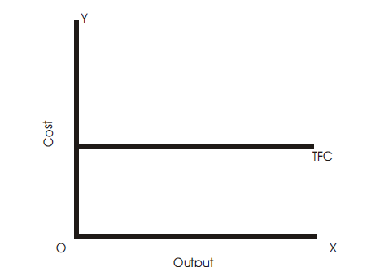
Total Fixed Cost (TFC)
Total fixed cost is the sum of expenses incurred on those inputs that remain same at different levels of output. Total fixed cost is graphically shown. It is a straight line parallel to output or x-axis. TFC is the total fixed cost curve parallel to x-axis indicating that it remains constant at all levels of output.

Slide 38
Total Fixed Cost (TFC)
Total cost incurred by the firm on the use of all fixed factors.
This cost is independent of output, it does not change with change in the quantity of output.
It remains constant regardless of the quantity of output produced.
Fixed cost includes interest on the capital invested, rent, insurance premium, property tax, etc.
That is why fixed cost is often known as 'unavoidable cost.

Slide 39
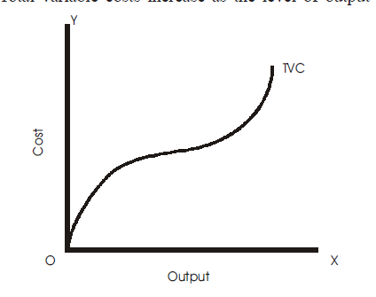
Total Variable Cost (TVC)
Total variable cost is the sum of expenses incurred on those factor inputs whose quantity varies with a change in the level of output. Total variable cost curve TVC is shown in the Fig. It has inverse-S shape. Total variable costs increase as the level of output increases.

Slide 40
Total Cost (TC)
Total cost to a producer for the various levels of output is the sum of total fixed costs and total variable costs, i.e.,
TC = TFC+TVC
Total cost of production which is the sum of total variable cost and total fixed cost.

Slide 41
Average Cost Curves
Average cost is the cost per unit of output. Average cost is simply the total cost divided by the number of units produced Corresponding to three types of total costs in the short-run, there are three types of average cost namely (1) average fixed cost, (2) average variable cost, and (3) average total cost.

Slide 42
Table 2:Behaviour of Average Costs
Output Units 1 | TFC 2 | TVC 3 | TC 4 | AFC 5 2/1 | AVC 6 3/1 | ATC 7 4/1 OR 5+6 | MC TCn-TCn-1
0 | 120 | 0 | 120 | - | - | - | -
1 | 120 | 40 | 160 | 120 | 40 | 160 | 40
2 | 120 | 76 | 196 | 60 | 38 | 98 | 36
3 | 120 | 102 | 222 | 40 | 34 | 74 | 26
4 | 120 | 132 | 252 | 30 | 33 | 63 | 30
5 | 120 | 170 | 290 | 24 | 34 | 58 | 38
6 | 120 | 234 | 354 | 20 | 39 | 59 | 64

Slide 43
Average Fixed Cost (AFC)
Average fixed cost is total fixed cost divided by total output. It is per unit cost on fixed factors
AFC = TFC/TQ
TQ is the total output.
AFC curve is a rectangular hyperbola

Slide 44
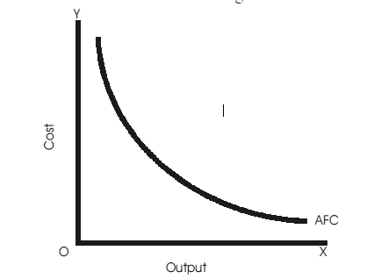

Slide 45
Average Fixed Cost (AFC)
Average fixed cost falls throughout with an increase in output because the total fixed cost is spread over larger and larger units as output increases.
AFC falls as output increases because the TFC numerator of the ratio is constant Q while the denominator increases. Yet as long as there is some fixed cost, the average fixed cost cannot be zero.
It slopes downward throughout its length from left to right showing continuous fall in average fixed cost with an increase in output.

Slide 46
Average Variable Cost (AVC)
The average variable cost is found by dividing the total variable costs by the total units of output, i.e., it is per unit cost of the variable inputs.
AVC =TVC/TQ
Average variable cost falls initially, reaches a minimum when the plant is operated optimally and rises after the point of normal capacity has been reached.

Slide 47
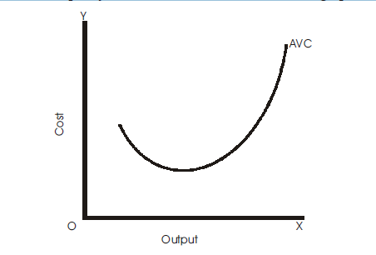

Slide 48
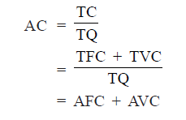
Average Total Cost (ATC/AC)
ATC is the per unit cost of both fixed and variable inputs. Average total cost of production can be obtained by dividing total cost by the units of output, i.e.,
Average total cost or ATC curve has the similar shape as that of AVC, that is, U-shaped.

Slide 49
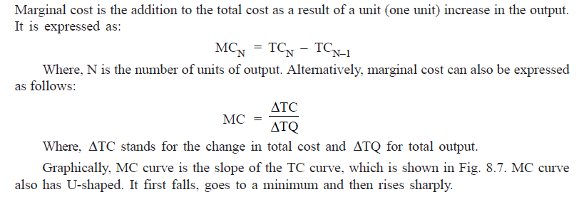
Marginal Cost

Slide 50
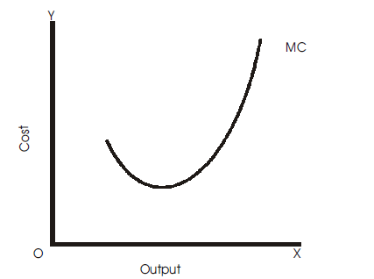
A
Q

Slide 51
Internal Economies
Internal economies are those economies which arise from the expansion of the plant size or increase in the scale of production of the firm.
They are internal in the sense that they accrue to the firm when its scale of production increases and are available to that firm only i.e. they are firm specific.
They depend solely upon the size of the firm and will be different for different firms. They are specific to each firm, and are enjoyed by only those firms which expand their scale of production.

Slide 52
1. Technical Economies
Technical economies arise from the use of better techniques of production, increase in the labour efficiency, etc. A large firm achieves technical economies in the following forms:
(i) Use of advanced techniques:
(ii) Greater specialization:
(iii) Use of by-products

Slide 53
2. Managerial Economies
A large firm is able to enjoy the benefit of division of labour in the management of its concern. The task of management is decentralised with different departments.
The management can be divided and sub-divided into different departments such as production, sales transport and personnel departments.
The firm can engage qualified persons to look after different departments. This functional specialisation in management increases efficiency at all levels.

Slide 54
3. Marketing Economies
Marketing economies arise from the large-scale purchase of raw materials
and other inputs and the large-scale sale of firm's own products. A large firm is able to buy raw materials and other inputs more cheaply than a small firm because a large firm buys regularly and in bulk and so is able to get discounts.
It is also able to get special concessional rates from transport companies. A large firm enjoys marketing economies in selling its products as well.

Slide 55
4. Financial Economies
A large firm is in a favourable position while raising its finances. In other words, it enjoys financial economies. It will be able to raise the necessary finances easily and cheaply. It has better creditworthiness as it offers better security to the banks. Therefore, it can secure loans from the banks and other financial institutions at lower interest rates. A large firm can also raise large financial resources by issuing shares and debentures.

Slide 56
5. Economies in Transport and Storage
A firm producing on large scale enjoys the economies of transport and storage. A large-sized firm may possess its own fleet of transport to carry raw materials and finished products and thereby it can reduce the transport cost and can prevent delays in transportation. Similarly, a large-sized firm may have its own godowns and can save on the cost of storage.

Slide 57
6. Research and Development
A large-sized firm is able to take advantage of research and development (R&D). A large firm can have its own R&D wing. It can set up its own laboratories and employ a large number of scientists and research workers. This helps the large firm to discover new techniques, new product designs and improve the operational functioning.

Slide 58
7. Risk and Survival Economies
A large-sized firm is able to face the risks and uncertainties of business. This is known as risk and survival economies. It is, therefore, able to absorb various business shocks and can bear the risks and survive. Thus, a large firm or a firm which expands its is able to secure many internal economies of production. As a result of these economies, the firm is able to reduce the per unit cost.

Slide 59
Internal Diseconomies
An increase in the scale of production results in decrease in per unit cost due to economies of scale. At a certain scale the per unit cost of the firm will be at a minimum. The level of output at which the cost is minimum is known as the optimum point of production.
An increase in the scale of production beyond the optimum level may give rise to internal diseconomies. Internal diseconomies are those diseconomies which are experienced by a particular from when it expands its scale of production beyond a point. Diseconomies of scale may lead to increase in per unit cost. Following are the main types of internal diseconomies:

Slide 60
Diseconomies of Scale
The extensive use of machinery, division of labor, increased specialization and larger plant size etc., no doubt entail lower cost per unit of output but the fall in cost per unit is up to a certain limit.
As the firm goes beyond the optimum size, the efficiency of the firm begins to decline. The average cost of production begins to rise.

Slide 61
Factors of Diseconomies
1. Lack of co-ordination. As a firm becomes large scale producer, it faces difficulty in coordinating the various departments of production. The lack of coordination in the production, planning, marketing personnel, account, etc., lowers efficiency of the factors of production. The average cost of production begins to rise.
2. Loose control. As the size of plant increases, the management loses control over the productive activities. The misuse of delegation of authority, the redtapisim bring diseconomies and lead to higher average cost of production.

Slide 62
Factors of Diseconomies
3. Lack of proper communication. The lack of proper communication between top management and the supervisory staff and little feed back from subordinate staff causes diseconomies of scale and results in the average cost to go up.
4. Lack of identification. In a large organizational structure, there is no close liaison between the top management and the thousands of workers employed in the firm. The lack of identification of interest with the firm results in the per unit cost to go up.

Slide 63
5. Labour Inefficiency
An increase in the scale of production gives rise to the overcrowding of labour. There is loss of personal contact between owners and workers with the consequent loss of morale of workers and increase in labour trouble. Moreover, increase in the number of workers gives rise to trade union activities. All these lead to fall in efficiency and increase in the cost of production.

Slide 64
External Economies
External economies are those economies which are shared by all the firms in the industry. and they arise as a result of expansion of the industry as a whole and not because of increase in the output of an individual firm.
They are external in the sense that they accrue to a firm because of the factors that are entirely outside the firm.
These economies are general and common to all the firms in an industry because the firm is a part of the industry.
For example, when an industry is localised, it is able to get better transport and banking facilities, etc. These advantages will emerge for the industry as a whole and all the firms will enjoy these benefits. Some of the important types of external economies are:

Slide 65
1. Cheaper Inputs
When an industry expands, it demands various types of input like raw materials, capital equipments, etc. Industries which are engaged in the production of these inputs increase their scale of production in order to produce more of these inputs.
They may experience economies of scale as a result of which they are able to provide these inputs at lower prices. Therefore, the industries using more inputs will benefit because they will get these inputs at cheaper prices.

Slide 66
2. Technological Economies
When an industry expands, it may provide motivation for the discovery of improved and better techniques of production.
New methods of production and better machines are discovered. Production function improves. Productivity increases and per unit cost decreases.

Slide 67
3. Supply of Skilled Labour
When an industry expands in an area, a reservoir of skilled labour force in that area develops. At the same time, various specialised institutions, ie, engineering, management institutions, etc. develop which provide a constant stream of skilled labour.
This has a favourable effect on the level of productivity and cost of the firms in the industry.

Slide 68
4. Growth of Ancillary Industry
When an industry expands, a number a subsidiary industries develop to cater the requirements of the major industry. A number of specialised firms emerge to supply goods and material at low prices to the main industry.
For example growth of automobile industry promote the development of tyre and spare par industries.
Likewise, some specialised firm will develop to make use of the by-product and wastes of the main industry.

Slide 69
5. Constant Flow of Information
An expansion of industry may lead to the development of various types of information services. Firms may form an association and publish trade and technical journals for the exchange of technical information among its members about new markets, new source of raw materials, latest techniques, etc.
The firm may jointly set up research institutions to discover new and better techniques for the benefit of all the firms. All this would help in increasing the efficiency and lowering the cost of production of all the firms constituting the industry.

Slide 70
6. Economies of Concentration
When a number of firms are localised in a particular area, a wide variety of facilities and services are provided which benefit all of them.
Better transportation and communication facilities, better and adequate source of power, adequate banking facilities, etc. are provided when firms are located in a particular region.
Provision of such services increases the efficiency of all the firms and reduces the cost of production.

Slide 71
External Diseconomies
External diseconomies are those diseconomies which are experienced by all the firms of an industry when the scale of production of the industry as a whole expands beyond manageable limits.
Beyond a certain stage, expansion of industries will create diseconomies which are general and, therefore, are common to all the firms. They are not confined to any particular firm.
Most of the external diseconomies arise when many firms are localised at particular place. Increase in input prices, higher wages and costlier transport are some of the external diseconomies.

