Slide 1
Immobilization of Enzymes: Methods and Applications
By
Swarnakshi Upadhyay
Assistant Professor
School of Pharmaceutical Sciences
CSJM University

Slide 2
Immobilization of Enzymes
Traditionally, enzymes in free solutions (i.e. in soluble or free form) react with substrates to result in products. Such use of enzymes is wasteful, particularly for industrial purposes, since enzymes are not stable, and they cannot be recovered for reuse.
Immobilization of enzymes (or cells) refers to the technique of confining/anchoring the enzymes (or cells) in or on an inert support for their stability and functional reuse. By employing this technique, enzymes are made more efficient and cost-effective for their industrial use. Some workers regard immobilization as a goose with a golden egg in enzyme technology. Immobilized enzymes retain their structural conformation necessary for catalysis.

Slide 3
Advantages of immobilized enzymes
Stable and more efficient in function.
Can be reused again and again.
Products are enzyme-free.
Ideal for multi-enzyme reaction systems.
Control of enzyme function is easy.
Suitable for industrial and medical use.
Minimize effluent disposal problems.
high enzyme substrate ratio.
Minimum reaction time.
Continuous use of enzyme.

Slide 4
Disadvantages associated with immobilization
The possibility of loss of biological activity of an enzyme during immobilization or while it is in use.
Immobilization is an expensive affair often requiring sophisticated equipment.
Some enzyme become unstable after immobilisation.
Sometimes enzymes become inactivated by the heat generated by the system.

Slide 5
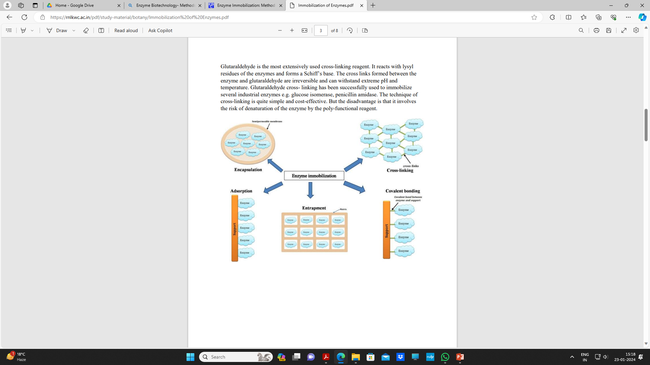
Methods of Immobilization

Slide 6
Adsorption
Adsorption involves the physical binding of enzymes (or cells) on the surface of an inert support.
The support materials may be inorganic (e.g. alumina, silica gel, calcium phosphate gel, glass) or organic (starch, carboxymethyl cellulose, DEAEcellulose, DEAE-sephadex).
Adsorption of enzyme molecules (on the inert support) involves weak forces such as van der Waals forces and hydrogen bonds. Therefore, the adsorbed enzymes can be easily removed by minor changes in pH, ionic strength or temperature. This is a disadvantage for industrial use of enzymes.

Slide 7
Entrapment
Enzymes can be immobilized by physical entrapment inside a polymer or a gel matrix.
The size of the matrix pores is such that the enzyme is retained while the substrate and product molecules pass through.
In this technique, commonly referred to as lattice entrapment, the enzyme (or cell) is not subjected to strong binding forces and structural distortions.
Some deactivation may however, occur during immobilization process due to changes in pH or temperature or addition of solvents.
he matrices used for entrapping of enzymes include polyacrylamide gel, collagen, gelatin, starch, cellulose, silicone and rubber.
Enzymes can be entrapped by several ways.

Slide 8
Microencapsulation
Microencapsulation is a type of entrapment.
It refers to the process of spherical particle formation wherein a liquid or suspension is enclosed in a semipermeable membrane.
The membrane may be polymeric, lipoidal, lipoprotein-based or non-ionic in nature.
There are three distinct ways of microencapsulation.
Building of special membrane reactors.
Formation of emulsions.
Stabilization of emulsions to form microcapsules.
Microencapsulation is recently being used for immobilization of enzymes and mammalian cells. For instance, pancreatic cells grown in cultures can be immobilized by microencapsulation. Hybridoma cells have also been immobilized successfully by this technique.

Slide 9
Covalent Binding
Immobilization of the enzymes can be achieved by creation of covalent bonds between the chemical groups of enzymes and the chemical groups of the support.
This technique is widely used.
However, covalent binding is often associated with loss of some enzyme activity.
The inert support usually requires pretreatment (to form pre-activated support) before it binds to enzyme.

Slide 10
Cross-Linking
The absence of a solid support is a characteristic feature of immobilization of enzymes by cross- linking.
The enzyme molecules are immobilized by creating cross-links between them, through the involvement of poly-functional reagents.
These reagents in fact react with the enzyme molecules and create bridges which form the backbone to hold enzyme molecules.
There are several reagents in use for cross-linking. These include glutaraldehyde, diazobenzidine, hexamethylene diisocyanate and toluene di- isothiocyanate.
Glutaraldehyde is the most extensively used cross-linking reagent. It reacts with lysyl residues of the enzymes and forms a Schiff’s base. The cross links formed between the enzyme and glutaraldehyde are irreversible and can withstand extreme pH and temperature. Glutaraldehyde cross- linking has been successfully used to immobilize several industrial enzymes e.g. glucose isomerase, penicillin amidase.
The technique of cross-linking is quite simple and cost-effective. But the disadvantage is that it involves the risk of denaturation of the enzyme by the poly-functional reagent.

Slide 11
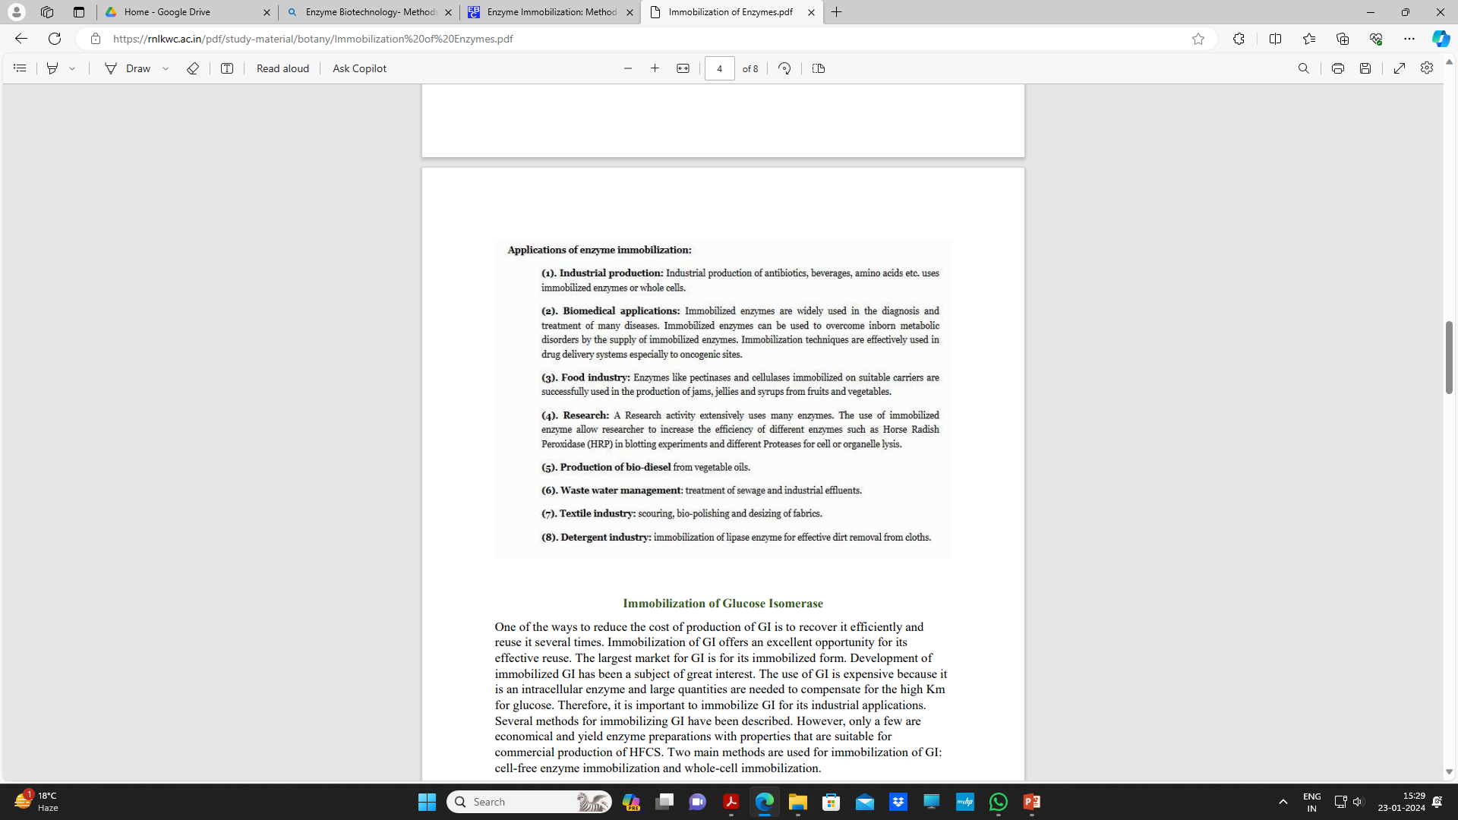
Application of Enzyme Immobilization

