Slide 1
INTRODUCTION TO AUTOMATION

Slide 2
INTRODUCTION
Production system: manufacturing support systems and facilities.
Mfg Support
System
Facilities
(Factory
Equipments)

Slide 3
INTRODUCTION… Cont.
Mfg. Support System:- Procedures used to manage production and to solve logistics & technical prob.
Facilities:-
The equipments in factory and the way the equipment is organized. It includes machines, tooling, material handling equipment, inspection equipment, comp. & plant layout.

Slide 4
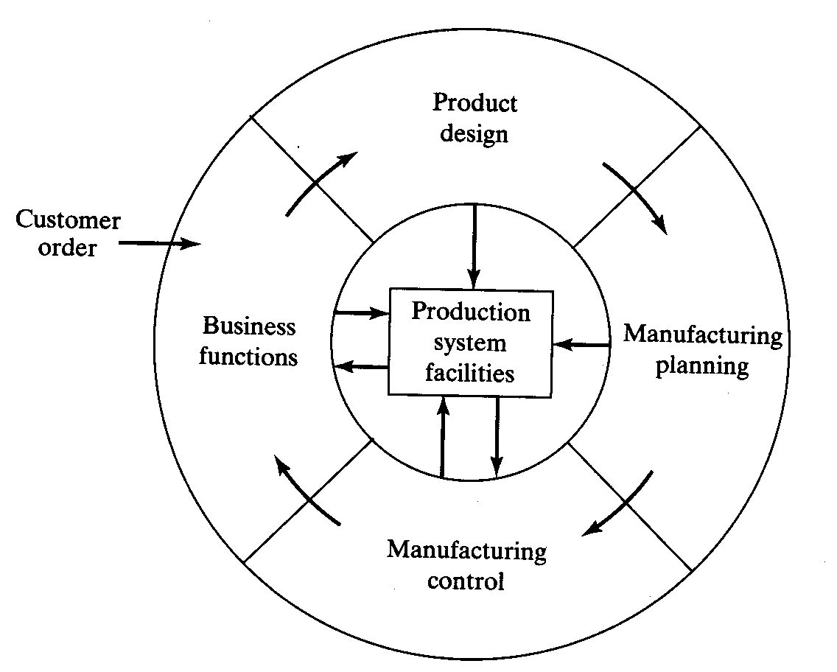
Sale,
Marketing
Forecasting
Order entry
Accounting
Customer billing etc.

Slide 5
Manufacturing
Manufacturing – the application of physical and chemical processes to alter the geometry, properties and /or appearance of a given starting material to make parts/product
- includes the joining of multiple parts to make assembled products
Economic viewpoint- the transformation of material into items of greater value…
Eg: iron converted into steel, sand transformed into glass, petroleum transforms into plastic etc.

Slide 6
Manufacturing Contd.
Machinery
Tools
Power
Labor
Starting Completed part
Material
Waste
As a technological process
Mfg. Process

Slide 7
Manufacturing Contd.
Value Added
Starting material Material in Processing Completed part
As an economic process
Mfg. Process

Slide 8
Manufacturing Contd.
Basic activities to convert raw material into finished products:
i. Processing and assembly operations
ii. Material handling
iii. Inspection and test
iv. Coordination and control

Slide 9
Processing and assembly operations
Processing operation transform a work material from one state of completion to a more advanced state that is closer to the final desired part/product. materials is fed into the process, energy is apply by the machinery and tooling to transform the material into finished products.
Assembly operations – two or more components combined to form a new entity
Eg: Welding, Soldering, Screws, Rivets etc.

Slide 10
Material handling & storage
Moving and storing materials between processing and/or assembly operations.
Inspection and test
Both are quality control activities to determine whether products meet the design std. and spec.

Slide 11
Coordination and control
Includes at process and plant levels
Process level – manipulating input and parameters of the process.
Plants level – labor, maintenance, costing, shipping, scheduling etc.

Slide 12
Product/Production Relationships
4 keys parameters:
i. Quality
ii. Variety
iii. Complexity of assembled products.
iv. Complexity of individual parts.

Slide 13
Production capacity
If n_{o} = Num. of distinct operation through which work units are routed.
To increase/decrease prod. Capacity:
i. Short term:
changes of S and H will increase prod. Capacity
ii. Long term
to increase capacity, change n, increase R_{p} and reduce n_{o}.
PC = n SH R_{p} / n_{o}

Slide 14
Manufacturing Operation Costs
Mfg costs – fixed and variable costs.
Fixed costs-remains constant for any level of prod.
Variable costs-varies in proportion to the level of prod.
Let TC = total annual costs (RM/yr), FC = fixed annual costs (RM/yr), VC= variable costs (RM/pc) and Q = annual quantity produced (pc/yr).

Slide 15
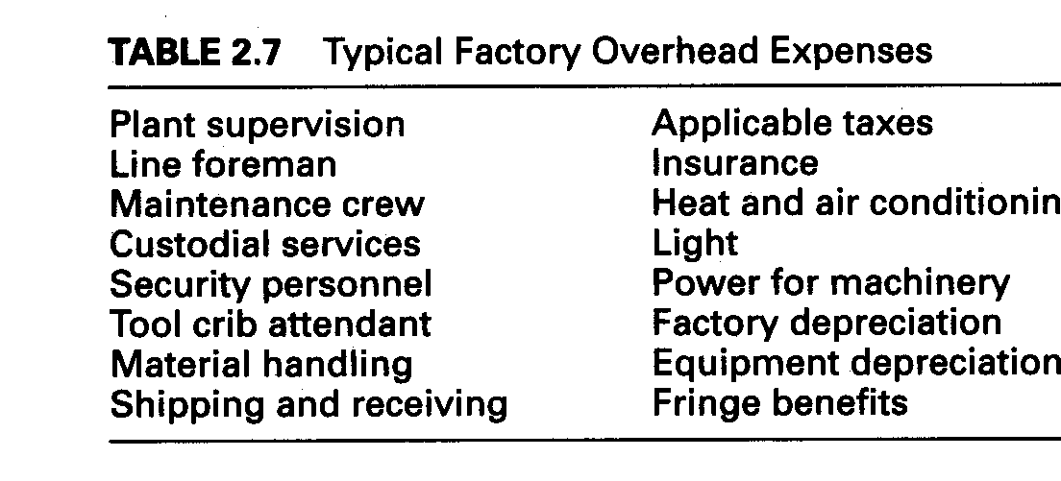
Manufacturing Operation Costs contd.
Typical Factory Overhead Expenses

Slide 16
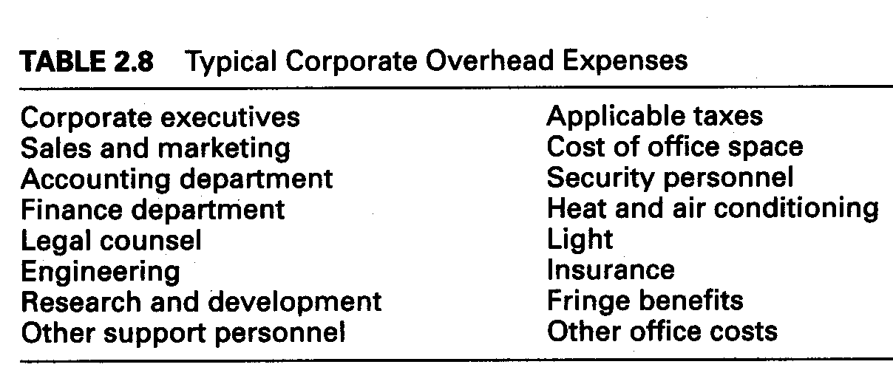
Manufacturing Operation Costs contd.

Slide 17
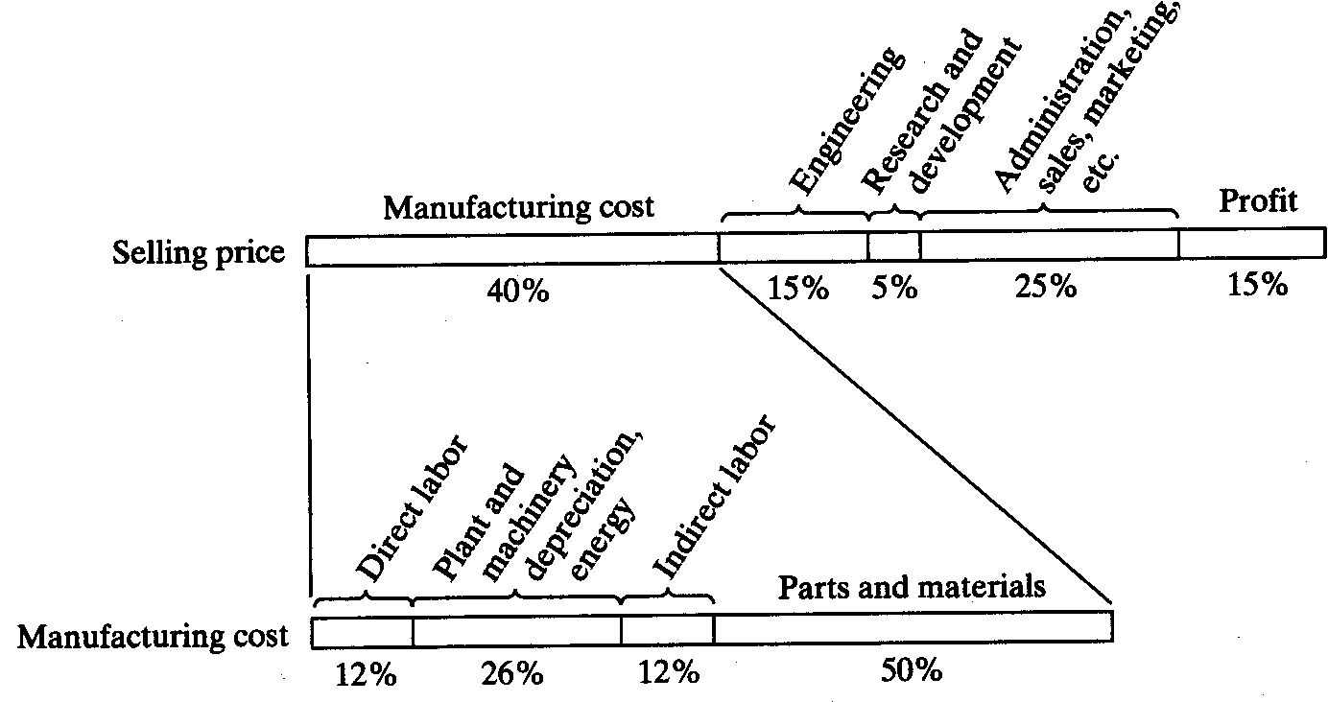
Manufacturing Operation Costs contd.
J.T Black.

Slide 18
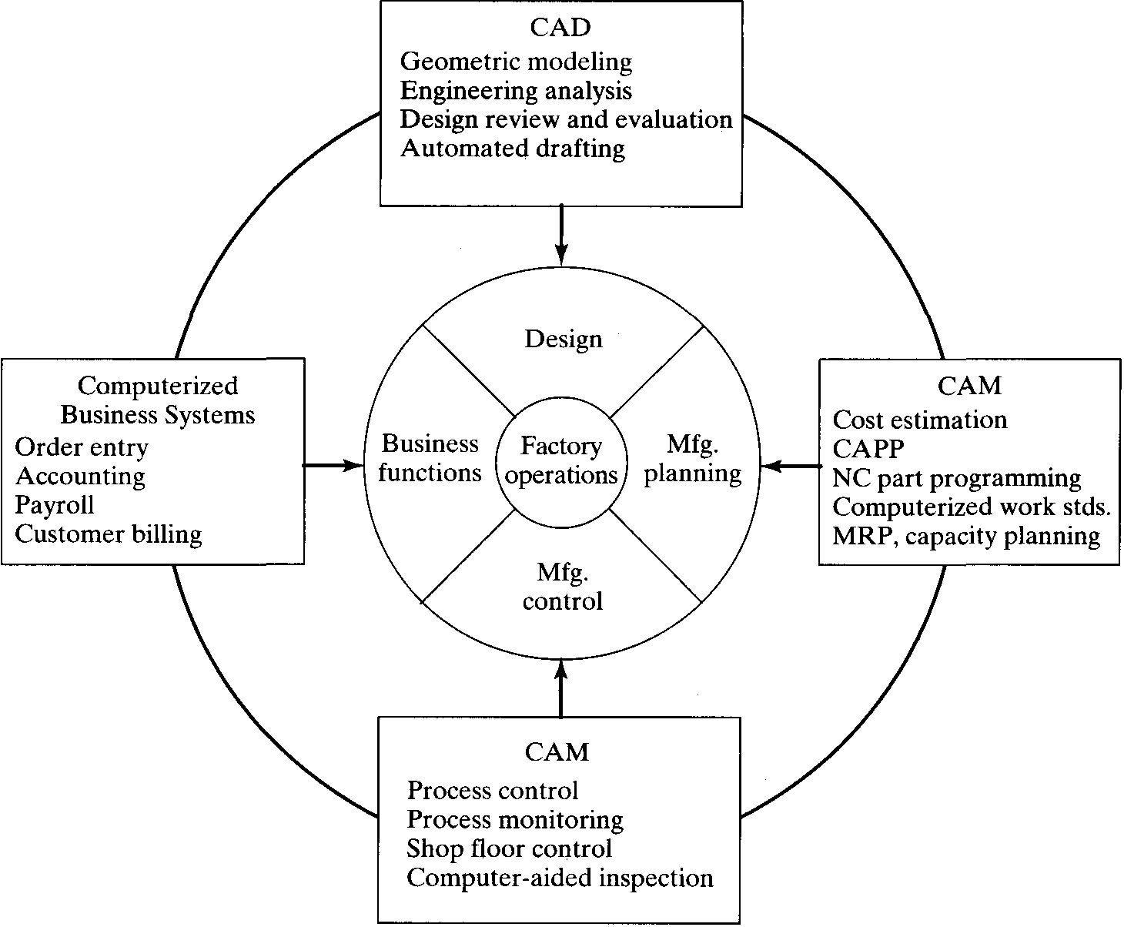

Slide 19
Industrial Automation
The technology by which a process or procedure is accomplished without human assistance.
A technique that can be used to reduce costs and/or to improve quality.
Can increase manufacturing speed, while reducing cost.
Can lead to products having consistent quality, perhaps even consistently good quality
It is implemented using a program of instructions combined with a control system that executes the instructions

Slide 20
Industrial Automation
To automate a process, power is required, both to drive the process itself and to operate the program and control system.
Automated processes can be controlled by human operators, by computers, or by a combination of the two.

Slide 21
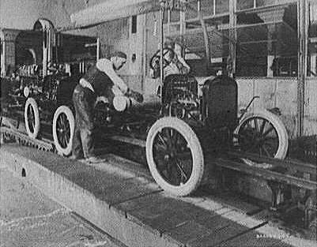

Slide 22
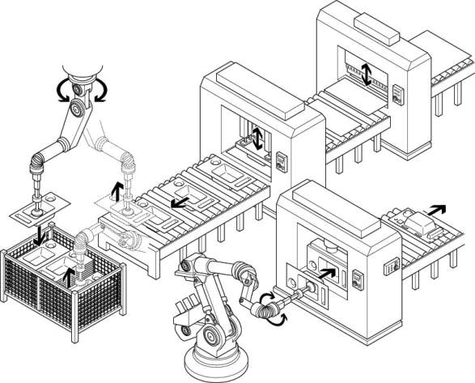
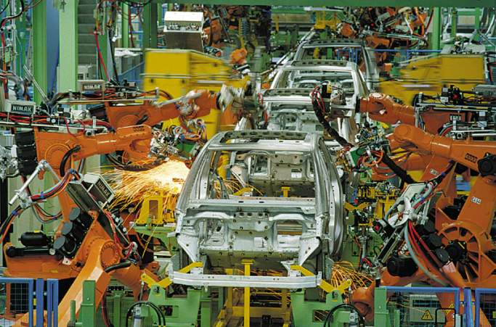
Automated Assembly lines

Slide 23
Automation defined.
Automation is a technique that can be used to reduce costs and/or to improve quality. Automation can increase manufacturing speed, while reducing cost. Automation can lead to products having consistent quality, perhaps even consistently good quality.
OR
Automation is a technology concerned with application of mechanical, electronic and computer-based system to operate and control system. This technology includes;

Slide 24
    Automatic assembly machines
    Automation machine tools to process parts
    Industrial robots
    Automatic materials handling and storage system
    Automatic inspection system and quality control
    Feedback control and computer process control
    Computer system for planning, data collection and decision making to support manufacturing activities

Slide 25
If a human operator is available to monitor and control a manufacturing process, open loop control may be acceptable.
If a manufacturing process is automated, then it requires closed loop control, also known as feedback control.
example of open loop control and closed loop control.

Slide 26
Arguments in favor of Automation
Automation is the key to shorter work week – working hours per week reduces and , allowing more leisure hours and a higher quality of life.
Automation brings safer working conditions for workers.
Automated production results in lower prices and better products

Slide 27
Arguments against Automation
It result in the subjugation of human being by a machine – reduces the need for skilled labor
There will be reduction in the labor force – resulting un employment.
Automation will reduce purchasing power- markets will become saturated with products that people cannot afford to purchase.

Slide 28
SOME CONSIDERATIONS
What automation and control technology is available?
Are employees ready and willing to use new technology?
What technology should be used?
Should the current manufacturing process be improve before automation?
Should the product be improved before spending millions of rupees acquiring equipment.

Slide 29
MANUAL LABOR IN PRODUCTION SYSTEMS
Task is too technologically difficult to automate.
Short product life cycle.
Customized product.
To cope with ups and downs in demand.
To reduce risk of product failure.

Slide 30
TYPE OF AUTOMATION
Hard Automation
  Controllers were built for specific purposes and could not be altered easily.
  Early analog process controllers had to be rewired to be reprogrammed.
  This controllers do what they are designed and built to do, quickly and precisely perhaps, but with little adaptability for change (beyond minor adjustments).
  Modification of hard automation is time-consuming and expensive, since modifications can only be performed while the equipment sits idle.

Slide 31
TYPE OF AUTOMATION
Soft Automation
  Modern digital computers are reprogrammable.
  It is even possible to reprogram them and test the changes while they work.
  Even if hardware changes are required to a soft automation system, the lost time during changeover is less than for hard automation

Slide 32
AUTOMATED MFG. SYSTEM
Automated Mfg. System can be classified into three basic types:
Fixed Automation
  A system which the sequence of processing (or assembly) operations is fixed by the equipment configurations.
  Each operations in the sequence is usually simple.

Slide 33
Fixed Automation
  The features of fixed automation;
    High initial investment for custom-engineered equipment
    High production rates
    Relatively inflexible in accommodating product variety.
    Examples, machining transfer lines and automated assembly machines.

Slide 34
Programmable Automation
Programmable Automation
  The production equipment is designed with the capability to change the sequence of operations to accommodate different product configurations.
  The operation sequence is controlled by a program, which is a set of instruction coded so that they can be read and interpreted by the system.

Slide 35
  New programs can be prepared and entered into the equipment to produce new products.
  The physical setup of the machine must be changed for each new products.
  This changeover procedures takes time.
  Eg: numerical control (NC) machine tools, industrial robots and PLC.

Slide 36
Programmable Automation Features
  The features of programmable automation;
    High investment in general purpose equipment.
    Lower production rates than fixed automation.
    Flexibility to deal with variations and changes in product configuration.
    Most suitable for batch production.

Slide 37
Flexible Automation
Flexible Automation
  An extension of programmable automation.
  Capable of producing a variety of parts/products with virtually no time lost for changeovers from one part style to the next.

Slide 38
Flexible Automation Features
  The features of flexible automation;
    High investment for custom-engineered system.
    Continuous production of variable mixtures of products.
    Medium production rates.
    Flexibility to deal with product design variations.

Slide 39
Relationship between product variety & quantity
  Examples, flexible manufacturing systems for performing machining operations.
  The relative positions of the three types of automation for different production volume and product varieties are shown below.
LOW
Product Variety
MEDIUM
HIGH
100
10000
1,000,000
Production Quantity

Slide 40
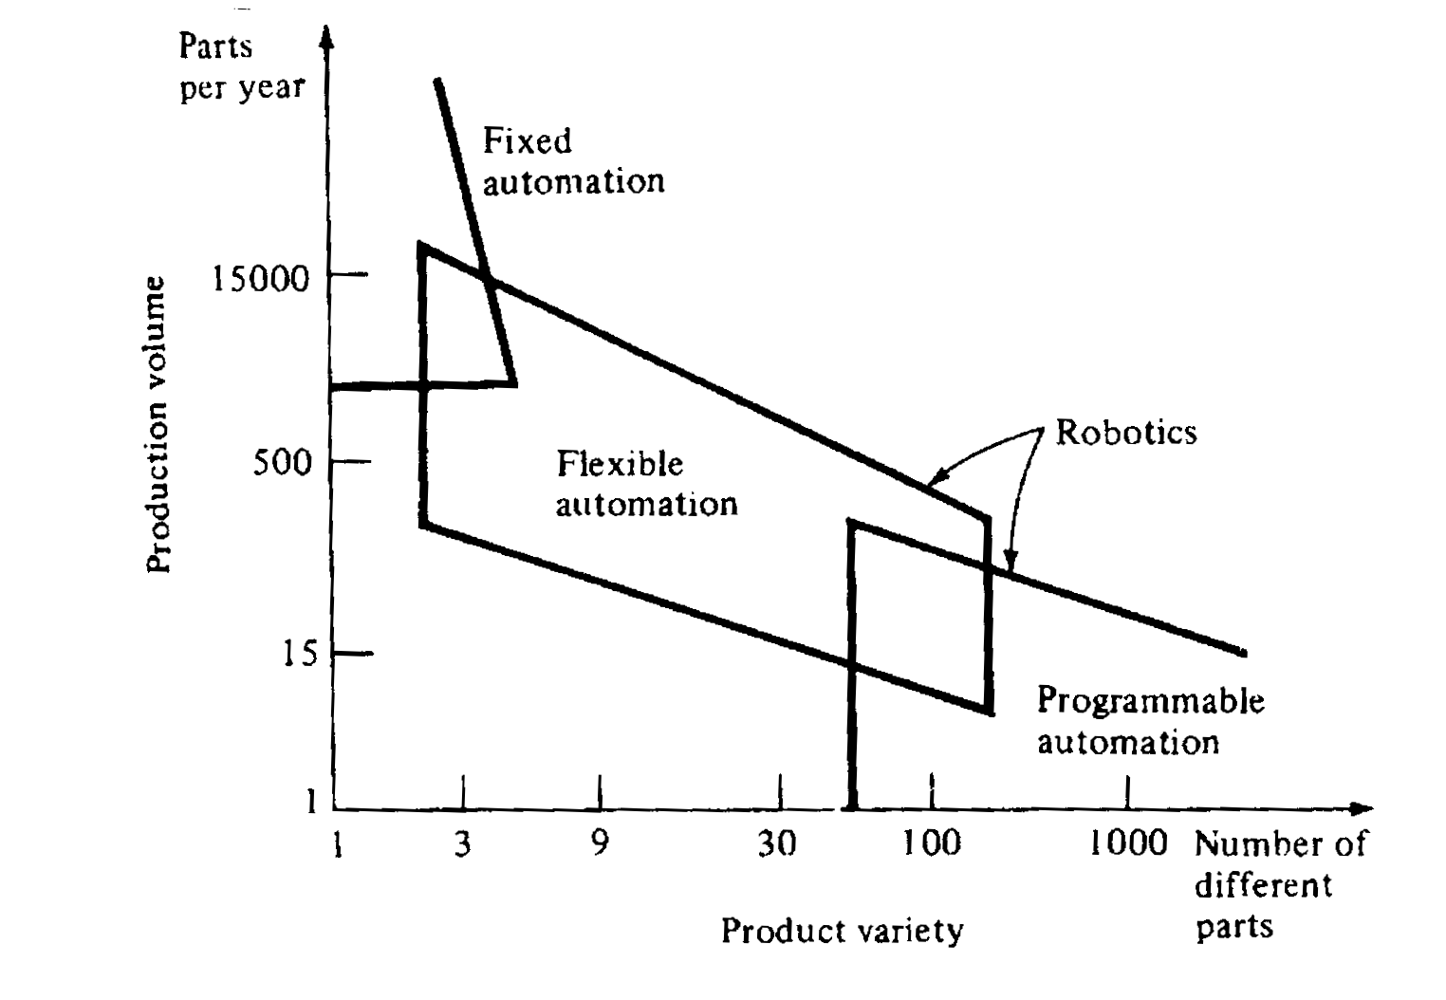
Relationship of fixed, programmable and flexible automation

Slide 41
Reason For Automating
To increase labor productivity
To reduce labor cost
To improve worker safety
To improve product quality
To mitigate the effects of labor shortages
To reduce/eliminate routine manual & clerical tasks.
To reduce mfg lead time
To accomplish processes that cannot be done manually
To avoid the high cost of not automating

Slide 42
Strategies For Auto./Prod System
Specialization of operation
Combined operations
Simultaneous operations
Integration operations
Increased flexibility
On-line inspection
Improved material handling and storage
Process control and optimization
Plant operations control
Computer-integrated manufacturing

Slide 43
Automation Control
Usually implies a sequence of mechanical steps.
A camshaft is an automation controller because it mechanically sequences the steps in the operation of an internal combustion engine.
Manufacturing processes are often sequenced by special digital computers, known as programmable logic controller (PLC).
PLC can detect and can switch electrical signals on and off.

