Slide 1
Process of Design Thinking (Design Thinking)
Dr Prabhat K. Dwivedi
Associate Professor
Deptt. of Business Management,
CSJM University, Kanpur, India

Slide 4
Design Thinking Process
P r o b l e m S p a c e
S o l u t i o n S p a c e
Design
Challenge
Design
Solution

Slide 6
Step 1: Empathize with Users

Slide 7
Step 1: Empathize with Users
This is a discovery phase to gain insights into users real needs.
A team of experts meet the users and try to find out their concerns.
Observe, monitor or empathize with users to understand expectations, feelings and pain points.

Slide 8
EMPATHY MAP

Slide 9
STEP 2- (Re)frame or Define the problem

Slide 10
STEP 2- (Re)frame or Define the problem
Put together all the gathered information, analyze, observe and synthasize it to define core problems.
Define the problem in a human centered way to solve human problems..
Eg. PROBLEM STATEMENT
“How might we improve the grocery shopping experience in a manner that positively impacts people and the environment?”

Slide 11
Step 3- Ideate New Solutions

Slide 12
Step 3- Ideate New Solutions
Generate ideas and new solutions to the problems.
Have as any as possible ideas to begin with.
Using ideation techniques, investigate or test the ideas to find the best possible solutions.

Slide 13
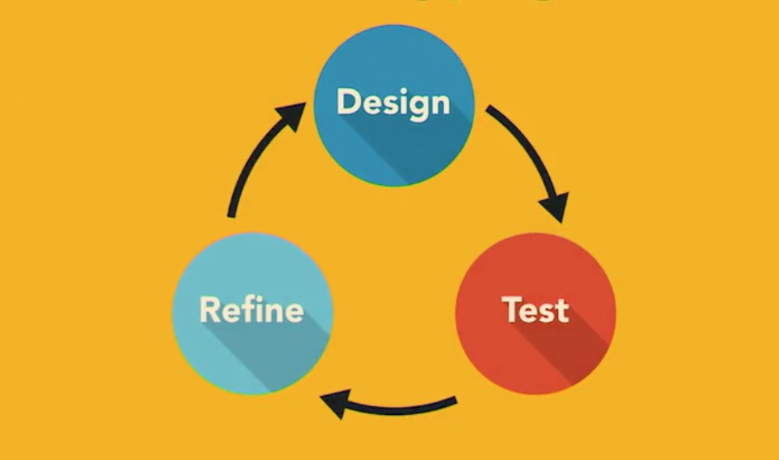
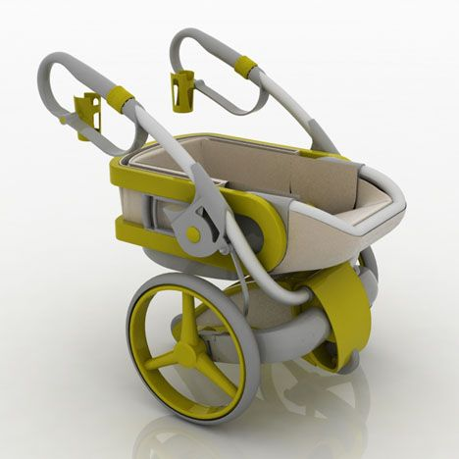
Step 4- Prototyping & Testing

Slide 14
Step 4- Prototyping & Testing
Create conceptual prototype of the product to investigate possible solutions.
Investigate different aspects of the problem and explore how each prototype would fix the problem.
Here you would have better idea of users behaviour’s, feelings and expectations.
Test the selected prototype with real users and internal stake holders.
Observe how well they handle the identified problems.
By the end of this step you would get an idea whether the solution is accepted, needs improvements, reexamined or completely rejected.

Slide 16
Sources
https://harappa.education/harappa-diaries/what-is-creative-thinking-and-its-importance
https://www.chasegroup.com.au/how-to-successfully-drive-innovation-in-organisations
https://www.mindmapping.com/

Slide 17
Thanks
Management Learners

