Slide 1
Innovation (Design Thinking)
Dr Prabhat K. Dwivedi
Associate Professor
Deptt. of Business Management,
CSJM University, Kanpur, India

Slide 2
“If I had asked the public what they wanted, they would have said a faster horse.“
Henry Ford (1863 - 1947)
Founder of Ford Motor Company

Slide 3
BCG’s Top 5 Most Innovative Companies 2020

Slide 5
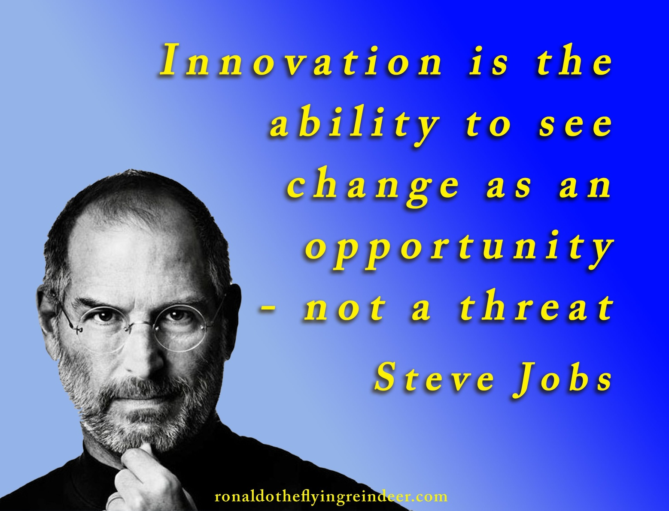

Slide 6
Innovation
Innovation is the specific tool of entrepreneurs, the means by which they exploit change as an opportunity for a different business or a different service.
"Innovation is the implementation or creation of something new that has realized value to others”.

Slide 7
Difference Between Research & Innovation
Research is a systematic process to generate understandings or knowledge, while innovation is a process of improvising the knowledge generated from research to meet real needs.

Slide 8
Innovation
Product Differentiation

Slide 9
Product Differentiation
Design
Attributes
Characteristics
Aesthetics

Slide 10
Innovation
Idea
Implementation
Impact

Slide 11
Myths of Innovation
Innovation begins with creativity.
Innovation is a smooth linear process.
Innovation is about risk-taking.

Slide 12
Reality of Innovation
Innovation begins with creativity.
Innovation begins with curiosity.
Innovation is a smooth linear process.
Innovation is iterative and the outcome of a series of experiments.
Innovation is about risk-taking.
Effective innovation involves risk-taking, assessment and mitigation.

Slide 13
Sources
https://harappa.education/harappa-diaries/what-is-creative-thinking-and-its-importance
https://www.chasegroup.com.au/how-to-successfully-drive-innovation-in-organisations
https://www.forbes.com/sites/louiscolumbus/2020/06/28/the-most-innovative-companies-of-2020-according-to-bcg/?sh=26e5ed862af3
https://www.forbes.com/sites/gregsatell/2013/03/07/how-to-manage-innovation-2/?sh=4fd53fc4785a

