Slide 1
Driving Innovation in Organisations (Design Thinking)
Dr Prabhat K. Dwivedi
Associate Professor
Deptt. of Business Management,
CSJM University, Kanpur, India

Slide 2
How to Successfully Drive Innovation in Organisations?

Slide 3
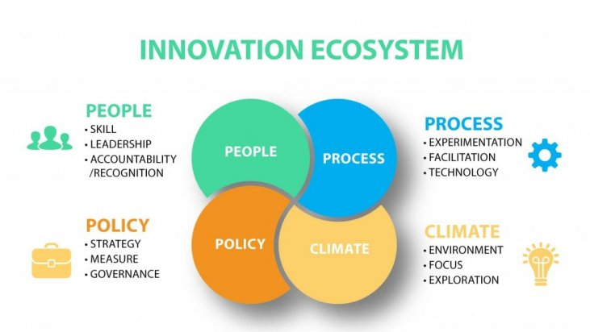

Slide 4
Innovation Capabilities
Strategy: a clearly defined innovation strategy which guides decisions, and an explicit innovation ambition from the Board and Top Management.
People: people are innovative, have a strong capability to innovate, and have innovation tools and innovation metrics.
Process: deep market and customer insights, constantly uncovering and understanding today's and tomorrow's customer needs, collaborate well with partners and leading-edge customers.
Culture: encouraged to think big, dream big and take calculated strategic risks. Great at making innovation investments, funding is easily available for new innovative projects, and have the time and freedom to innovate.

Slide 5
The Innovation Process Journey
Opportunity Identification
Opportunity Development
Scaling Up
Growth

Slide 6
The four Innovation Phases
Opportunity Identification: Ideation, finding great ideas, concept development;
Opportunity Development: Market research, strategy development, developing, testing and piloting those ideas into the new product, service, program or business;
Scaling Up: Launching the innovation, testing and validating that systems and processes are ready to scale;
Growth: Delivering the innovation at scale, driving growth so that the innovation is sustainable and merges successfully into the organisation.

Slide 7
“Innovation has become a core driver of growth and sustainability.” -A Chase Consulting Group Study

Slide 8
Recently conducted Innovation Studies found
8 out of 10 highly-innovative organizations had innovation as a strategy compared to only 4 out of 10 mainstream organizations.
Innovation is one of the top drivers of growth for their organizations in the next three to five years.

Slide 9
Why are some organisations able to continually innovate while other organisations often struggle to achieve their innovation outcomes??

Slide 10
An innovation research conducted by Chase Consulting Group identified the major innovation strategies organizations are employing to address future threats to their organizations or industry/sector.

Slide 12
Two of the top three innovation strategies are responding to customers changing demands; improving the customer experience and developing new products and services.

Slide 13
Sources
https://harappa.education/harappa-diaries/what-is-creative-thinking-and-its-importance
https://www.chasegroup.com.au/how-to-successfully-drive-innovation-in-organisations

Slide 14
Thanks
Management Learners

