Slide 1
Service Quality (Servqual) Model

Slide 2
Servqual
SERVQUAL is a multi-dimensional research instrument designed to capture consumer expectations and perceptions of a service along five dimensions that are believed to represent service quality.

Slide 3
The questionnaire consists of matched pairs of items - 22 expectation items and 22 perceptions items - organised into five dimensions which are believed to align with the consumer's mental map of service quality dimensions.

Slide 4
The Make-up of Servqual
GAPS
P-E SCORES
QUESTIONNAIRES
DIMENSIONS
WEIGHTINGS

Slide 5
The Five Key Service Dimensions
TANGIBLES - the appearance of physical facilities, equipment, personnel and information material
RELIABILITY - the ability to perform the service accurately and dependably
RESPONSIVENESS - the willingness to help customers and provide a prompt service

Slide 6
The Five Key Service Dimensions
ASSURANCE - a combination of the following
Competence - having the requisite skills and knowledge
Courtesy - politeness, respect, consideration and friendliness of contact staff
Credibility - trustworthiness, believability and honesty of staff
Security - freedom from danger, risk or doubt

Slide 7
The Five Key Service Dimensions
EMPATHY - a combination of the following:
Access (physical and social) - approachability and ease of contact
Communication - keeping customers informed in a language they understand and really listening to them
Understanding the customer - making the effort to get to know customers and their specific needs

Slide 8
Dimension | Sample expectations item | Sample perceptions item
Reliability | When excellent telephone companies promise to do something by a certain time, they do so | XYZ company provides its services at the promised time
Assurance | The behaviour of employees in excellent banks will instill confidence in customers | The behaviour of employees in the XYZ bank instils confidence in you.
Tangibles | Excellent telephone companies will have modern looking equipment | XYZ company has modern looking equipment
Empathy | Excellent banks will have operating hours convenient to customers | XYZ bank has convenient operating hours
Responsiveness | Employees of excellent telephone companies will never be too busy to help a customer | XYZ employees are never too busy to help you

Slide 9
The model of service quality
The model of service quality, popularly known as the gaps model was developed by a group of American authors, A. Parasuraman, Valarie A. Zeithaml and Len Berry, in a systematic research program carried out between 1983 and 1988.

Slide 10
Businesses use the SERVQUAL instrument (i.e. questionnaire) to measure potential service quality problems and the model of service quality to help diagnose possible causes of the problem.
The model of service quality is built on the expectancy-confirmation paradigm which suggests that consumers perceive quality in terms of their perceptions of how well a given service delivery meets their expectations of that delivery.^{[12]} Thus, service quality can be conceptualized as a simple equation:
SQ = P- E

Slide 11
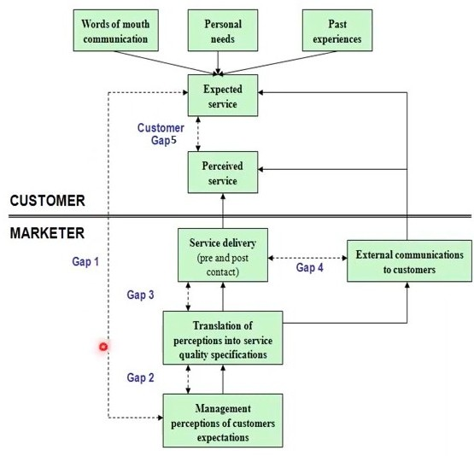
Conceptual Model of Service Quality

Slide 12
What are the Servqual Gaps?
Gap 1: The difference between management perceptions of what customers expect and what customers really do expect
Gap 2: The difference between management perceptions and service quality specifications - the standards gap

Slide 13
What are the Servqual Gaps?
Gap 3: The difference between service quality specifications and actual service delivery - are standards consistently met?
Gap 4: The difference between service delivery and what is communicated externally - are promises made consistently fulfilled?

Slide 14
What are the Servqual Gaps?
Gap 5: The difference between what customers expect of a service and what they actually receive
expectations are made up of past experience, word-of-mouth and needs/wants of customers
measurement is on the basis of two sets of statements in groups according to the five key service dimensions

Slide 15
Reasons for the Gaps
GAP 1 Not knowing what customers expect
GAP 2 The wrong service quality standards
GAP 3 The service performance gap
GAP 4 When promises do not match actual delivery
GAP 5 The difference between customer perception and expectation

Slide 16
Reasons for the Gaps
GAP 1 - not knowing what customers expect
lack of a marketing orientation
inadequate upward communication (from contact staff to management)
too many levels of management

Slide 17
Reasons for the Gaps
GAP 2 - the wrong service quality standards
inadequate commitment to service quality
lack of perception of feasibility - ‘it cannot be done’
inadequate task standardisation
the absence of goal setting

Slide 18
Reasons for the Gaps
GAP 2 - the wrong service quality standards
inadequate commitment to service quality
lack of perception of feasibility - ‘it cannot be done’
inadequate task standardisation
the absence of goal setting

Slide 19
Reasons for the Gaps
GAP 3 - the service performance gap
role ambiguity and role conflict - unsure of what your remit is and how it fits with others
poor employee or technology fit - the wrong person or system for the job
inappropriate supervisory control or lack of perceived control - too much or too little control
lack of teamwork

Slide 20
Reasons for the Gaps
GAP 4 - when promises made do not match actual delivery
inadequate horizontal communication - between departments or services
a propensity to overpromise

Slide 21
Servqual Data - How Useful is it?
We can assess service quality from the customer’s perspective
We can track customer expectations and perceptions over time and the discrepancies between them
We can compare a set of Servqual scores against those of competitors or best practice examples

Slide 22
Servqual Data - How Useful is it?
We can compare the expectations and perceptions of different customer groups - this is particularly useful in the public sector.
We can assess the expectations and perceptions of internal customers - eg other departments or services we deal with.

Slide 23
Servqual Data - What can we do with it?
We can use data on customer priorities to feed into the House of Quality (QFD)
Customer priorities and their ranked order of importance can become the WHATS
These WHATS can then be compared with the HOWS (key business processes) and relationships matched to check service design and provision according to key requirements

