Slide 1
Measures Of Variability
DR.VIPENDRA SINGH PARMAR
VSSD PG COLLEGE KANPUR

Slide 2
What is Variability?
Variability describes how far apart data points lie from each other & from the center of a distribution. Along with measures of central tendency, measures of variability give you descriptive statistics that summarize your data.

Slide 3
4 Main Measures Of Variability
Variability is also referred to as spread, scatter or dispersion. It is most commonly measured with the following:
Range: the difference between the highest and lowest values
Interquartile range: the range of the middle half of a distribution
Standard deviation: average distance from the mean
Variance: average of squared distances from the mean

Slide 4
Why Does Variability Matter?
While the central tendency, or average, tells you where most of your points lie, variability summarizes how far apart they are.
This is important because the amount of variability determines how well you can generalize results from the sample to your population.

Slide 5
Why Does Variability Matter?
While the central tendency, or average, tells you where most of your points lie, variability summarizes how far apart they are.
This is important because the amount of variability determines how well you can generalize results from the sample to your population.
Low variability is ideal because it means that you can better predict information about the population based on sample data. High variability means that the values are less consistent, so it’s harder to make predictions.

Slide 6
Why Does Variability Matter?
Data sets can have the same central tendency but different levels of variability or vice versa.
If you know only the central tendency or the variability, you can’t say anything about the other aspect. Both of them together give you a complete picture of your data.

Slide 7
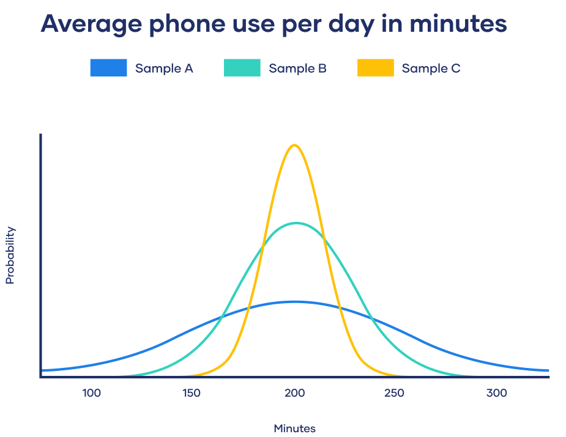
Example: Variability In Normal Distributions
You’re investigating the amounts of time spent on phones daily by different groups of people.
Using simple random samples, you collect data from 3 groups:
Sample A: High school students
Sample B: College students
Sample C: Adult full-time employees.
Third Skill
First Skill
Second Skill
Conclusion

Slide 8
Example: Variability In Normal Distributions
All three of your samples have the same average phone use, at 195 minutes or 3 hours and 15 minutes. This is the x-axis value where the peak of the curves are.
Although the data follows a normal distribution, each sample has different spreads. Sample A has the largest variability while Sample C has the smallest variability.

Slide 9
Range
The range tells you the spread of your data from the lowest to the highest value in the distribution. It’s the easiest measure of variability to calculate.
To find the range, simply subtract the lowest value from the highest value in the data set.
Because only 2 numbers are used, the range is influenced by outliers and doesn’t give you any information about the distribution of values. It’s best used in combination with other measures.
Range example : You have 8 data points from Sample A.
The highest value (H) is 324 and the lowest (L) is 72.
R = H – L
R = 324 – 72 = 252
The range of your data is 252 minutes.
Data (minutes) | 72 | 110 | 134 | 190 | 238 | 287 | 305 | 324

Slide 10
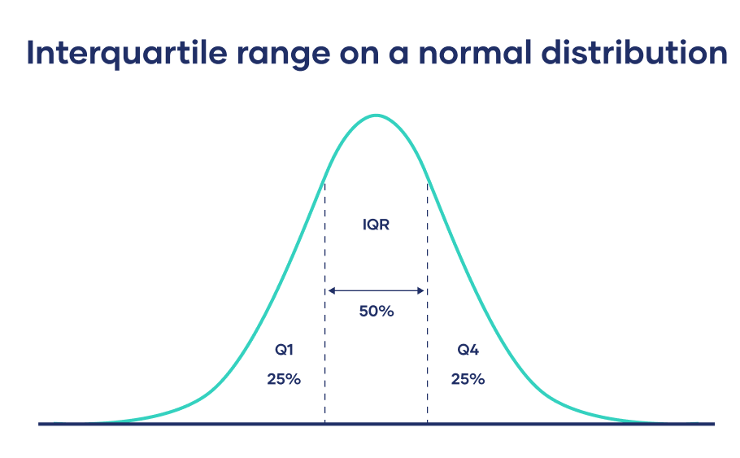
Interquartile Range
The interquartile range gives you the spread of the middle of your distribution.
For any distribution that’s ordered from low to high, the interquartile range contains half of the values.
While the first quartile (Q1) contains the first 25% of values, the fourth quartile (Q4) contains the last 25% of values.
The interquartile range is the third quartile (Q3) minus the first quartile (Q1). This gives us the range of the middle half of a data set.

Slide 11
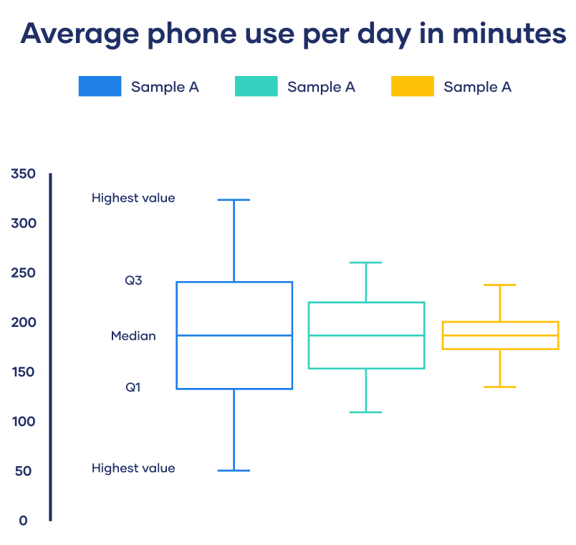
Five-number Summary
Every distribution can be organized using a five-number summary:
Lowest value
Q1: 25th percentile
Q2: the median
Q3: 75th percentile
Highest value (Q4)
These five-number summaries can be easily visualized using box and whisker plots.

Slide 12
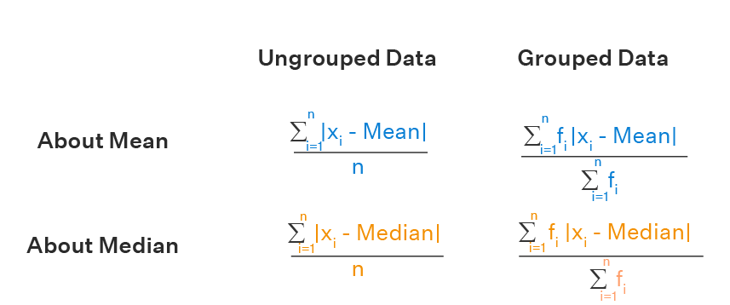
Mean Deviation
The difference between the observed value of a data point and the expected value is known as deviation in statistics.
Thus, mean deviation or mean absolute deviation is the average deviation of a data point from the mean, median, or mode of the data set.

Slide 13
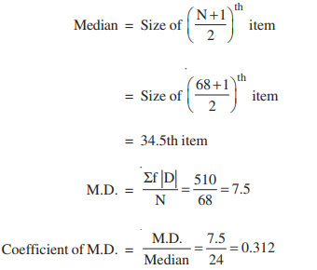
Example

Slide 14
Standard Deviation
The standard deviation is the average amount of variability in your dataset.
It tells you, on average, how far each score lies from the mean. The larger the standard deviation, the more variable the data set is.
There are six steps for finding the standard deviation by hand:
List each score and find their mean.
Subtract the mean from each score to get the deviation from the mean.
Square each of these deviations.
Add up all of the squared deviations.
Divide the sum of the squared deviations by n – 1 (for a sample) or N (for a population).
Find the square root of the number you found.

Slide 15
Standard Deviation Formula For Populations
If you have data from the entire population, use the population standard deviation formula:

Slide 16
Standard Deviation Formula For Samples
If you have data from a sample, use the sample standard deviation formula:

Slide 17
Standard Deviation Formula

Slide 18
Example of standard deviation

Slide 19
Example of standard deviation

Slide 20
Variance
The variance is the average of squared deviations from the mean. A deviation from the mean is how far a score lies from the mean.
Variance is the square of the standard deviation. This means that the units of variance are much larger than those of a typical value of a data set.
While it’s harder to interpret the variance number intuitively, it’s important to calculate variance for comparing different data sets in statistical tests like ANOVA.
Variance reflects the degree of spread in the data set. The more spread the data, the larger the variance is in relation to the mean.

Slide 21
Variance Formula
For Populations
For Samples

Slide 22
What’s The Best Measure Of Variability?
The best measure of variability depends on your level of measurement and distribution.
Level Of Measurement
For data measured at an ordinal level, the range and interquartile range are the only appropriate measures of variability.
For more complex interval and ratio levels, the standard deviation and variance are also applicable.
Distribution
For normal distributions, all measures can be used. The standard deviation and variance are preferred because they take your whole data set into account, but this also means that they are easily influenced by outliers.
For skewed distributions or data sets with outliers, the interquartile range is the best measure. It’s least affected by extreme values because it focuses on the spread in the middle of the data set.

Slide 23
THANK YOU

