Slide 1
BCA-3005 Elements of Statistics UNIT-I
DR.VIPENDRA SINGH PARMAR

Slide 2
Elements of Statistics
UNIT-I
Population, Sample and Data Condensation
Definition and scope of statistics, concept of population and simple with Illustration, Raw data, attributes and variables, classification, frequency distribution, Cumulative frequency distribution.
UNIT-II
Measures of Central Tendency
Concept of central Tendency, requirements of a good measures of central tendency, Arithmetic mean, Median, Mode, Harmonic Mean, Geometric mean for grouped and ungrouped data.
UNIT-III
Measures of Dispersion:
Concept of dispersion, Absolute and relative measure of dispersion, range variance, Standard deviation, Coefficient of variation.
UNIT-IV
Permutations and Combinations
Permutations of ‘n’ dissimilar objects taken ‘r’ at a time (with or without repetitions). nPr = n!/(n-r) !(without proof). Combinations of ‘r’ objects taken from ‘n’ objects. nCr = n!/(r!(n-r)!) (without proof) . Simple examples, Applications.
UNIT-V
Sample space, Events and Probability
Experiments and random experiments, Ideas of deterministic and non-deterministic experiments; Definition of sample space, discrete sample space, events; Types of events, Union and intersections of two or more events, mutually exclusive events, Complementary event, Exhaustive event; Simple examples. Classical definition of probability, Addition theorem of probability without Proof (upto three events are expected). Definition of conditional probability Definition of independence of two events, simple numerical problems.
UNIT-VI
Statistical Quality Control
Introduction, control limits, specification limits, tolerance limits, process and product control; Control charts for X and R; Control charts for number of defective {n-p chart} ,control charts for number of defects {c - chart}
Referential Books:
2. S.C. Gupta - Fundamentals of statistics - Sultan Chand & sons ,Delhi.
3. D.N. Elhance - Fundamentals of statistics - Kitab Mahal, Allahabad

Slide 3
UNIT-I Population, Sample and Data Condensation
Population
Definition: A population is the entire set of individuals, objects, or elements that are the focus of a research study.
It includes all units about which the researcher wants to draw conclusions.
Examples:
All students in a school → Population
All people living in India → Population
All employees in a company → Population
Sample
Definition: A sample is a smaller group selected from the population, which represents the population in a study.
When it is not possible to study the whole population (because of time, cost, or resources), researchers select a part of it

Slide 4
Population, Sample and Data Condensation
Examples:
100 students chosen from a school → Sample
5,000 people chosen from India’s population → Sample
50 employees selected from a company → Sample
Relationship Between Population and Sample
Population → Whole group
Sample → Part of the group (used to draw conclusions about the whole)
If the sample is chosen carefully (random and unbiased), the results obtained can be generalized to the entire population.
Data Condensation-
“Presenting a large amount (bulk) of data in a concise and organized form so that it can be easily understood, analyzed, and interpreted.”
Definition- Data condensation is the process of summarizing, classifying, and organizing raw data into a more concise and meaningful form for analysis and interpretation.

Slide 5
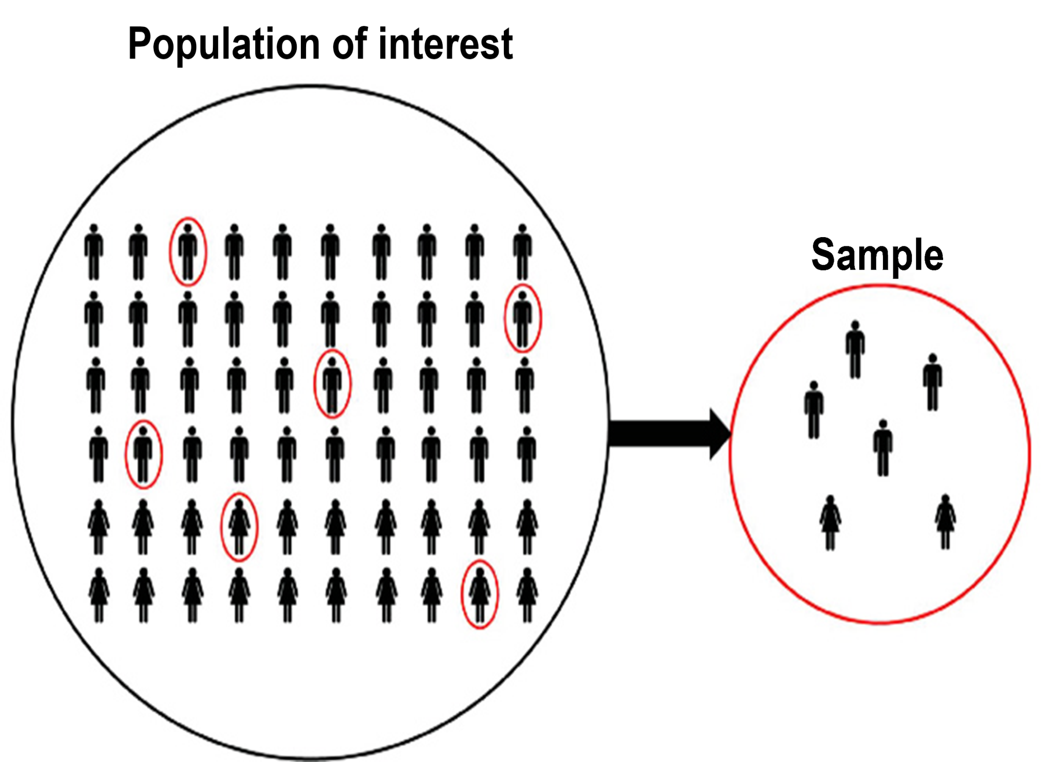

Slide 6
Definition and scope of statistics,
Statistics is a branch of mathematics concerned with
Collection of data
Organization & Presentation of data (tables, charts, graphs)
Analysis & Interpretation of data
Drawing valid conclusions for decision-making
Definitions:
Croxton & Cowden: Statistics may be defined as the collection, presentation, analysis and interpretation of numerical data.

Slide 7
Scope of Statistics
Statistics has a wide scope in various fields:
1.Nature of Data Handling
Descriptive Statistics → Summarizes and presents data (mean, median, mode, charts).
Inferential Statistics → Draws conclusions and predictions from sample data (hypothesis testing, estimation).
2. In Research
Helps in designing experiments, collecting data, and testing hypotheses.
3. In Business & Economics
Market research, forecasting demand, cost control, profit analysis.
4. In Social Sciences
Surveys (population, literacy, employment, health statistics).
5. In Government
Planning, policy-making, census, budget preparation.
6. In Sports & Physical Education
Performance analysis, biomechanical data, player selection, injury statistics.
7. In Everyday Life
Weather forecasting, medical reports, quality control, decision-making.

Slide 8
Raw data, attributes and variables
Raw data-
Raw data refers to unprocessed data that has been collected from various sources, such as surveys, experiments, or databases. Raw data is usually in its original form and hasn’t been manipulated or analyzed.
It is the “first-hand” information.
Features:
Unsorted and unclassified
Can be numerical or descriptive
Needs to be organized into tables, charts, or graphs for analysis
Example:
Marks of 10 students in a test:
45, 50, 62, 70, 55, 48, 60, 72, 66, 58

Slide 9
Raw data, attributes and variables
Attributes-
An attribute is a qualitative characteristic or feature of an object or individual that cannot be measured numerically but can be observed and classified.
Features:
Describe quality, property, or category
Usually classified as “present” or “absent” (binary), or in categories (nominal/ordinal)
Non-numeric in nature
Examples:
Gender (Male/Female/Other)
Blood group (A, B, AB, O)
Religion, Nationality, Eye color

Slide 10
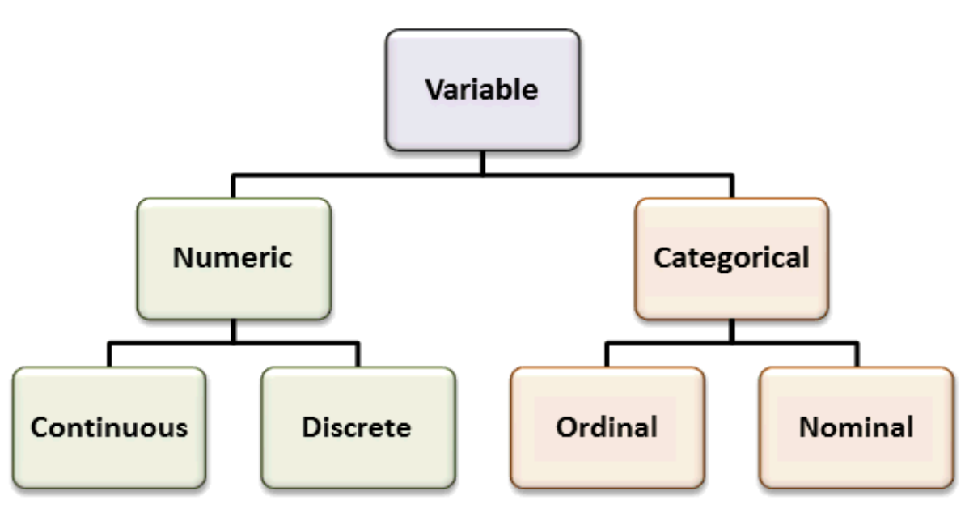
Raw data, attributes and variables
Definition: Variables
A variable is a characteristic, property, or quantity that can be measured numerically and whose value can vary from one individual to another.
Types of Variables:

Slide 11
Raw data, attributes and variables
Numeric variables (quantitative variables)-
Numeric variables have values that describe a measurable quantity as a number, like 'how many' or 'how much'. Therefore numeric variables are quantitative variables.
Numeric variables may be further described as either continuous or discrete:
Discrete (countable): e.g., number of children, number of players
Continuous (measurable): e.g., height, weight, speed, time
Categorical variables (qualitative variables)-
Categorical variables have values that describe a 'quality' or 'characteristic' of a data unit, like 'what type' or 'which category'.
A categorical variable is a type of variable that represents categories or groups rather than numbers with mathematical meaning.
These variables describe qualities or characteristics.
They cannot be measured numerically (like height or weight), but they can be classified into groups

Slide 12
Raw data, attributes and variables
Categorical variables are of two main types: Nominal and Ordinal.
1. Nominal Variables (Labels / Names)
"Nominal" means name only.
Categories have no order or ranking.
Each value is just a label to identify a group.
We cannot say one category is higher or lower than another.
✅ Examples:
Gender: Male, Female, Other
Blood Group: A, B, AB, O
Religion: Hindu, Muslim, Christian, Sikh
Nationality: Indian, American, French
Here "Male" is not greater than "Female," and "Blood group A" is not less than "Blood group O" — they are just different categories.

Slide 13
Raw data, attributes and variables
Ordinal Variables (Order / Ranking)
"Ordinal" means order matters.
Categories can be arranged in a meaningful rank order.
However, the difference between categories is not measurable or equal.
✅ Examples:
Education Level: Primary < Secondary < Graduate < Postgraduate
Socioeconomic Status: Low < Middle < High
Customer Satisfaction: Very Unsatisfied < Unsatisfied < Neutral < Satisfied < Very Satisfied
Class Position: 1st, 2nd, 3rd
👉 In ordinal data, "Graduate" is higher than "Secondary," but we cannot say it is "two times higher." The gap between categories is not numerically precise.

Slide 14
Frequency Distribution
A frequency distribution is a way of organizing raw data into a table (or graph) that shows how often each value (or group of values) occurs.
Among those numbers, few may be repeated twice and even more than twice. The repetition of number in a data set is termed as frequency of that particular number or the variable in which that number is assigned. The frequencies of variables in a data are to be listed in a table. This table is known as frequency distribution table and the list is referred as frequency distribution.

Slide 15
Key Terms
Raw Data → The original unorganized data (e.g., students’ marks: 12, 15, 20, 12, 18…).
Class Interval → A range of values into which data is grouped (e.g., 10–19, 20–29…).
Frequency (f) → The number of times a value/class occurs.
Tally Marks → A counting method used to record frequencies.
Total Frequency (Σf) → The sum of all frequencies, equal to total observations (N).
Steps in Creating Frequency Distribution
Collect raw data.
Decide the range (highest – lowest value).
Choose class intervals (equal width, e.g., 0–9, 10–19, etc.).
Count how many values fall into each class.
Record frequencies in a table.

Slide 16
Types of Frequency Distribution
Simple Frequency Distribution → shows how often each value/class occurs.
Relative Frequency Distribution → shows frequency as a proportion (%) of the total.
Cumulative Frequency Distribution (CFD) → adds frequencies step by step.
Less than type → cumulative total going upward.
More than type → cumulative total going downward.

Slide 17
1. Simple Frequency Distribution
👉 Shows how often each value or class interval occurs.
Example (Marks of 10 students): 12, 15, 20, 20, 25, 25, 25, 30, 30, 35
X | Frequency (f)
12 | 1
15 | 1
20 | 2
25 | 3
30 | 2
35 | 1
Total (N) | 10

Slide 18
2. Relative Frequency Distribution
👉 Shows frequency as a proportion or percentage of the total. Formula: Relative Frequency=f/N ​×100
Example (from above data):
Marks (Class) | Frequency (f) | Relative Frequency (%)
12 | 1 | 10%
15 | 1 | 10%
20 | 2 | 20%
25 | 3 | 30%
30 | 2 | 20%
35 | 1 | 10%
Total | 10 | 100%

Slide 19
3. Cumulative Frequency Distribution
Adds frequencies step by step.
the word Cumulative means "how much so far". In statistics, it is the running total of all frequencies. Cumulative frequency corresponding to a particular value is the sum of all the frequencies up to and including that value.
Years Frequency Cumulative Frequency
1991 - 92 10 10
1992 - 94 15 10 + 15 = 25
1994 - 96 9 25 + 9 = 34
1996 – 98 13 34 + 13 = 47
1998 - 2000 7 47 + 7 = 54
The Cumulative Frequency can be clearly understood when displayed in a table. A table displaying the cumulative frequencies is called as cumulative frequency distribution and this is one of important type of frequency distribution.

Slide 20
Types of cumulative frequency distribution
There are main two types of cumulative frequency distribution as follows:
Less than type → cumulative total going upward.
Marks (≤) | Cumulative Frequency
≤12 | 1
≤15 | 2
≤20 | 4
≤25 | 7
≤30 | 9
≤35 | 10

Slide 21
Types of cumulative frequency distribution
(b) More than type → cumulative total going downward.
Marks (≥) | Cumulative Frequency
≥12 | 10
≥15 | 9
≥20 | 8
≥25 | 6
≥30 | 3
≥35 | 1
Summary
Simple Frequency → actual count
Relative Frequency → percentage of total
Cumulative Frequency → running total (less than / more than)

